Slide 1
Digitalization and trade
Onno Hoffmeister

Slide 2
A more and more digitally connected world
Onno Hoffmeister, Digitalization and trade
Workshop on Integrated Use of International Trade Statistics and Economic Statistics, 23-25 Nov 2021

Slide 3
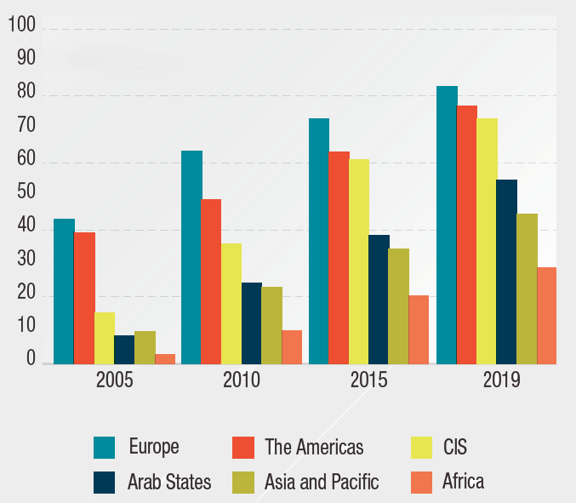
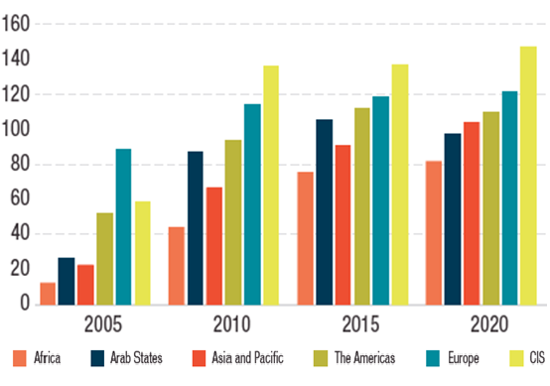
Mobile telephone subscriptions per 100 people
Onno Hoffmeister, Digitalization and trade
Spread of mobile telephony and internet
Internet use (%)
Source: UNCTAD, Digital Economy Report, 2021
Workshop on Integrated Use of International Trade Statistics and Economic Statistics, 23-25 Nov 2021

Slide 4
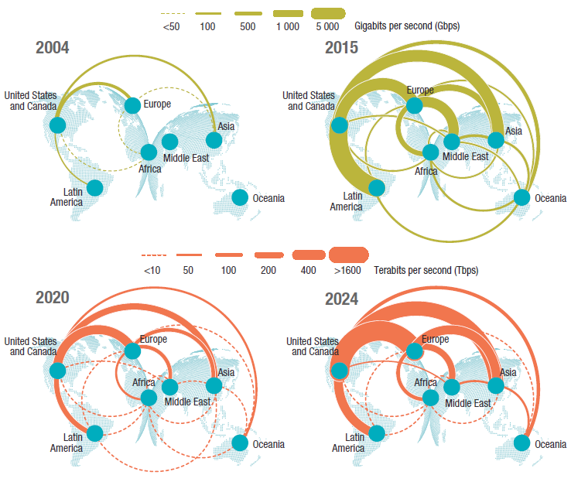
Interregional international bandwidth
Onno Hoffmeister, Digitalization and trade
Increasing cross-regional connectivity
Source: UNCTAD, Digital Economy Report, 2021
Workshop on Integrated Use of International Trade Statistics and Economic Statistics, 23-25 Nov 2021

Slide 5
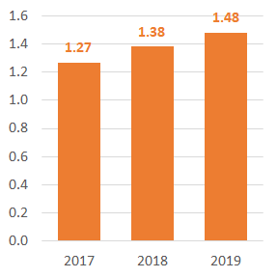
Global online shoppers (billions)
Onno Hoffmeister, Digitalization and trade
Growing use of e-commerce, by households
Source: UNCTAD calculations based on national data
Workshop on Integrated Use of International Trade Statistics and Economic Statistics, 23-25 Nov 2021

Slide 6
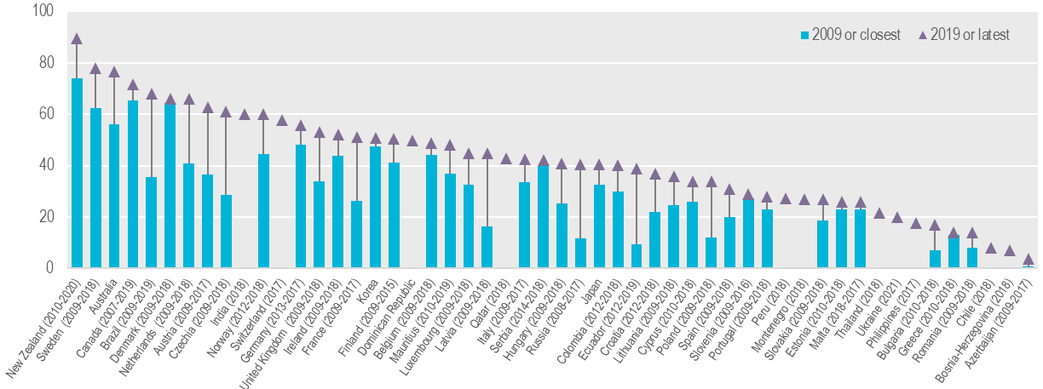
Percentage of enterprises making e-commerce purchases
Onno Hoffmeister, Digitalization and trade
… and enterprises
Source: UNCTAD
Workshop on Integrated Use of International Trade Statistics and Economic Statistics, 23-25 Nov 2021

Slide 7
International trade going digital
Onno Hoffmeister, Digitalization and trade
Workshop on Integrated Use of International Trade Statistics and Economic Statistics, 23-25 Nov 2021

Slide 8
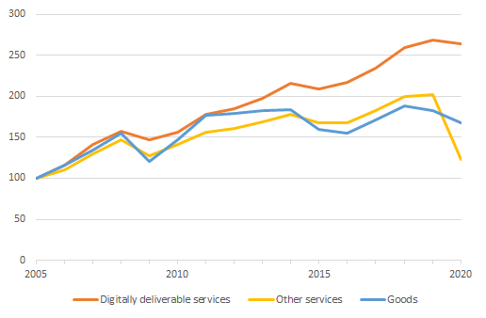
Global exports (2005=100)
Onno Hoffmeister, Digitalization and trade
Digitally deliverable services
Source: UNCTAD, UNCTADstat
Workshop on Integrated Use of International Trade Statistics and Economic Statistics, 23-25 Nov 2021

Slide 9
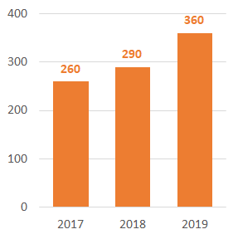
Cross-border online shoppers worldwide (millions)
Onno Hoffmeister, Digitalization and trade
Cross-border e-commerce
Cross-border B2C e-commerce sales in 2019:
US$440 billion (+8%)
Source: UNCTAD calculations based on national data
Workshop on Integrated Use of International Trade Statistics and Economic Statistics, 23-25 Nov 2021

Slide 10
Challenges for statistics compilers
Onno Hoffmeister, Digitalization and trade
Agreeing on common concepts
Adapting data collection instruments
Identifying the location of exporters
Growing involvement of private households in trade
Workshop on Integrated Use of International Trade Statistics and Economic Statistics, 23-25 Nov 2021

