Slide 1

International Workshop on the Integrated Use of International Trade Statistics and Economic Statistics
Travel services data sources and compilation challenges during the pandemic lockdown
DAY 1,
23 November 2021

Slide 2
OUTLINE OF PRESENTATION
TRAVEL ITEM
Definition
Main data sources
THE CHALLENGES DURING THE LOCKDOWN
Suggestions by International Organizations
Italian experience
Travel Workshop initiatives
Leassons learned

Slide 3
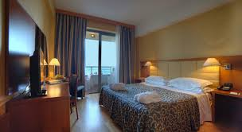
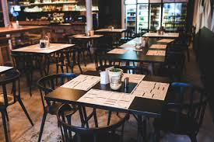


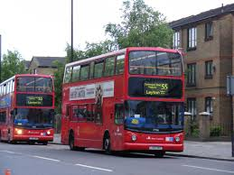
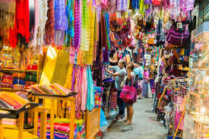
TRAVEL DEFINITION
Goods and services acquired by non-residents
in the economy that they visit
Economy A
Economy B
A traveler is someone who moves between different geographic locations for any purpose and any duration.

Slide 4

TRAVEL DEFINITION
Two tasks for compilers
Identify the travelers (resident concept)
Estimate their expenditure in the visited economy
Goods and services acquired by non-residents
in the economy that they visit

Slide 5

TRAVEL DEFINITION
RESIDENCE DEFINITION (BPM6 4.117)
A household is resident in the economic territory in which household members maintain or intend to maintain a dwelling or succession of dwellings treated and used by members of the household as their principal dwelling.
“ONE YEAR RULE”
Being present for one year or more in a territory or intending to do so is sufficient to qualify as having a principal dwelling there

Slide 6


TRAVEL DEFINITION
“ONE YEAR RULE” – EXCEPTIONS
Notable exceptions for remaining resident in the territory of origin:
Students: regardless how long they study abroad (except if intend to stay after)
Medical patients: in rare cases where treatment takes more than one year
Same rule for accompanying dependents

Slide 7
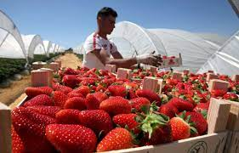
TRAVEL DEFINITION
TRAVEL VS TOURISM STATISTICS (Tourism is a subset of travel)
Number of international travellers is greater than the number of international tourists
Travelers
Tourists
border/seasonal and other short term workers
students
patients
crews on public modes of transport (private included, e.g. corporate jets, yatchs), nomads, refugees, etc.
+ visitors to other countries as part of regular life routine (i.e usual environment)
$$\# Travel=\# Tourism+K(border workers,students,patients)$$

Slide 8
TRAVEL DEFINITION
Expenditure
TRANSACTOR –BASED
cover goods and services for own use or give away acquired from an economy by non residents during visits to that economy.

Slide 9



TRAVEL DEFINITION
Expenditure (Travel vs Tourism)
Travel does not include:
- expenditure in international passenger transportation
purchases of valuables and consumer durables (even above the customs threshold)
goods for resale
Travel includes:
- imputed values, such as the provision of accommodation free of charge (relatives, friends)

Slide 10
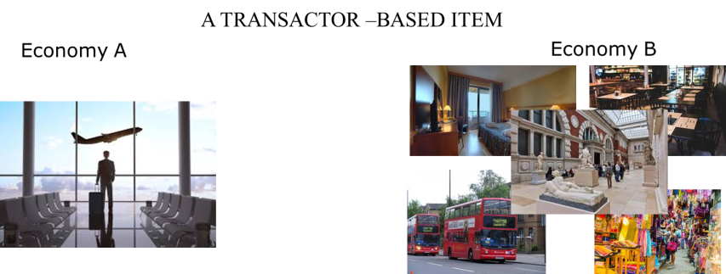
TRAVEL DEFINITION
The peculiar aspect is the movement abroad of a resident to purchase goods and services, so it is necessary a specific mode of supply for travel item: CONSUMPTION ABROAD
Mode 2: Consumption abroad
Definition: services supplied in the territory of one WTO Member to the service consumer of any other Member
Example: Nationals of country A have moved abroad as tourists, students, or patients to consume the respective services.

Slide 11
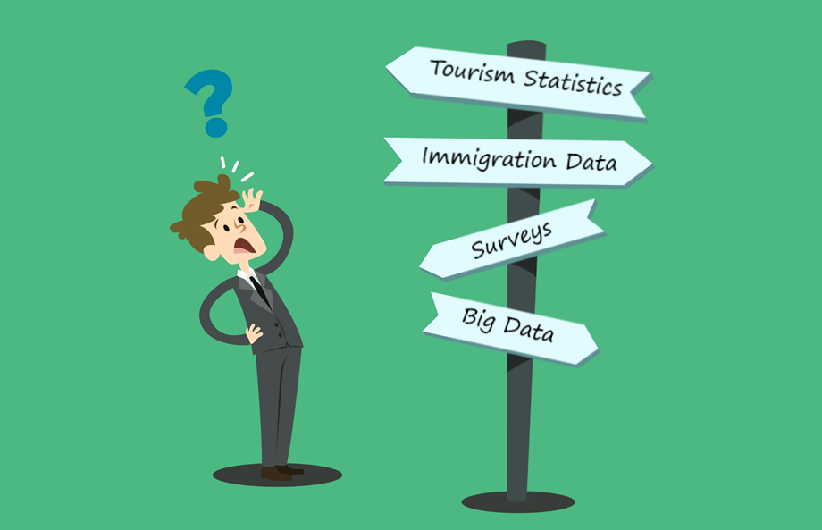
TRAVEL MAIN DATA SOURCES
MAIN DATA SOURCES FOR COMPILING TRAVEL ITEM

Slide 12
TRAVEL MAIN DATA SOURCES
FRONTIER SURVEY:
+ Allows the collection of additional information about the trip
- High costs and grossing up procedure
HOUSEHOLD SURVEY:
+ Easy implementation
- Covers only the inward (resident); memory bias.
CREDIT (DEBITS) CARDS – PAYMENT STATISTICS (and ITRS):
+ Timely (big data); Low costs (in general)
- Coverage (cash transactions; digital platform); personal vs business

Slide 13
TRAVEL MAIN DATA SOURCES
ENTERPRISE SURVEY (Tour Operators / Accommodations):
+ Implementation (with other surveys)
- Coverage (only resident operators) – need of other sources
ADMINISTRATIVE DATA (IMMIGRATION):
+ Precise information about the number of travelers
- No information about expenditure (average? Holiday vs border workers)
TOURISM STATISTICS (Accommodations – Tourism Satellite Account):
+ Coherence between tourism/travel
- Need additional data sources (seasonal/border workers, patients, students)
MOBILE DATA:
+ Timely data; journey information
- No information about expenditures; in general high costs

Slide 14
TRAVEL MAIN DATA SOURCES
In general compilers use a mix of sources for estimating bop travel item.
In many cases additional information are collected for users:
- number of international travels
- trip characteristics (length of stay, reason, places visit)
- expenditure characteristics (mean of payment, use of digital platforms, etc. )

Slide 15
THE CHALLENGES DURING THE LOCKDOWN
TRAVEL ITEM
Definition
Main data sources
THE CHALLENGES DURING THE LOCKDOWN
Suggestions by International Organizations
Italian experience
Travel Workshop initiatives
Lessons learned

Slide 16

SUGGESTIONS BY INTERNATIONAL ORGANIZATIONS
Ensuring Continuity in the Production of External Sector Statistics During the COVID-19 Lockdown (IMF – Statistics Department)
Cross-border trade in services will be largely impacted. With businesses stalled, several components will be direly affected, in particular transport and travel
The collection of data should focus on those types of services that are the most relevant for the economy
For assessing the impact of the pandemic on travel related services, and for adequately estimating the drop in their values, compilers may use alternative sources
https://www.imf.org/-/media/Files/Publications/covid19-special-notes/en-special-series-on-covid-19-ensuring-continuity-in-the-production-of-external-sector-statistics.ashx

Slide 17

SUGGESTIONS BY INTERNATIONAL ORGANIZATIONS
Guidance on the compilation of the balance of payments statistics in the context of the Covid-19 crisis (Eurostat – Integrated global Accounts and Balance of Payments)
Travel and transport were the most affected service categories, not only economically, but also in expected challenges to data compilation
…a number of possible alternative data sources and methods were identified:
Mobile positioning data received from mobile phone operators;
Credit card data;
Surveys conducted via telephone, instead of in-person…
For the compilation of travel services, a virtual workshop has been established where compilers … have set up an exchange of bilateral data
https://ec.europa.eu/eurostat/documents/10186/10693286/BOP_guidance.pdf

Slide 18

SUGGESTIONS BY INTERNATIONAL ORGANIZATIONS
Some considerations on the possible impact of the COVID-19 pandemic on balance of payments statistics (ECB)
Statisticians have been actively identifying the vulnerabilities of their statistical systems to the pandemic and looking for solutions to address these vulnerabilities since the first COVID-19 cases were identified in Europe in February.
https://www.ecb.europa.eu/stats/balance_of_payments_and_external/balance_of_payments/shared/pdf/Impact_of_Covid-19_in_BoP.en.pdf

Slide 19

THE ITALIAN EXPERIENCE
In March 2020 the Italian frontier survey was interrupted
Alternative data sources:
Mobile Data
Credit/Debit Cards
Mirror Data
Administrative Data (Airport Authorities)

Slide 20

THE ITALIAN EXPERIENCE
Methodological Approach (two steps):
1- Estimation of variation rates with the new data sources
2- Application of the variation rates to the historical expenditure levels (credits and debits)
The underlying hypothesis is that the decrease in percentage terms of the travel expenditures during the pandemic was well approximated by the variations in the correlated indicators (big data).

Slide 21
THE ITALIAN EXPERIENCE
1- Estimation of variation rates with the new data sources

Slide 22
THE ITALIAN EXPERIENCE
1- Estimation of variation rates with the new data sources

Slide 23
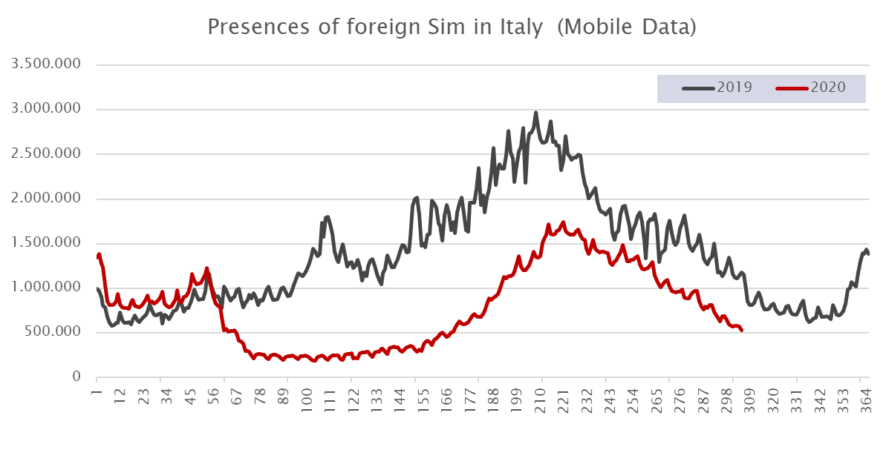
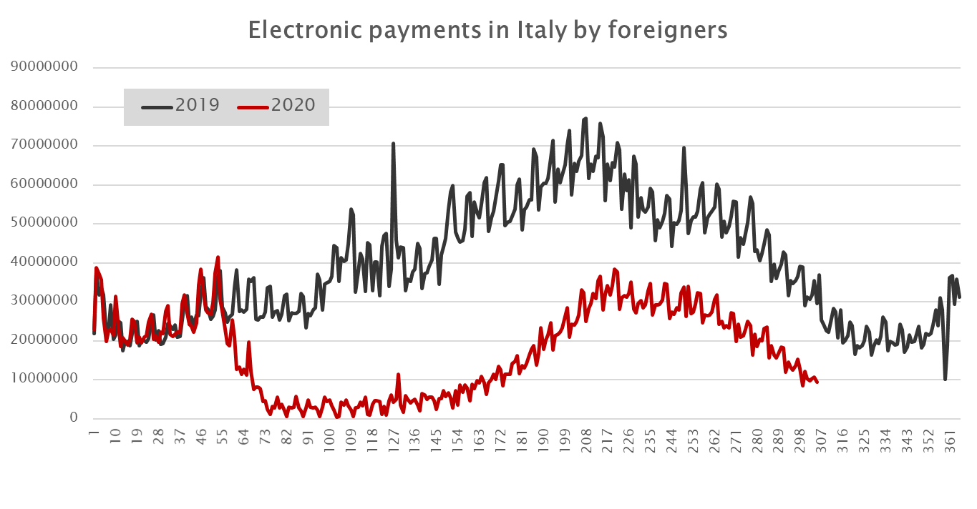

THE ITALIAN EXPERIENCE
2- Application of the variation rates to the historical levels of expenditures
${Variation Rate}_{Q2 2020;2019}$=$\frac{{Indicator}_{Q2 2020}}{{Indicator}_{Q2 2019}}$
${Expenditure}_{Q2 2020}$=${Expenditure}_{Q2 2019}∙{Variation Rate}_{Q2 2020;2019}$

Slide 24

THE ITALIAN EXPERIENCE
But it is not so easy…
let's have a look to a part of the issues (a small subset)
  Italian residents with foreign SIM
  SIM non human
  Some forms of tourism were not possible during the lockdown

Slide 25
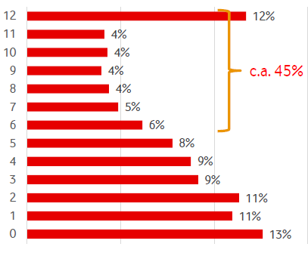
THE ITALIAN EXPERIENCE
  Italian residents with foreign SIM
Number of months in which a foreign sim was registered in Italy in the year before the pandemic (percentage distribution)
Around 45 percent of the foreign SIM cards present in Italy during the pandemic, were almost constantly in Italy in the previous year.
Consequently, we have corrected some figures about the largest foreign communities in Italy (Romania, Albania, North Africa).

Slide 26
THE ITALIAN EXPERIENCE
  SIM cards non human
The SIM non human are mainly produced in the Netherland.
Indeed in the row data, during the pandemic, the foreign SIM cards from Netherlands do not present a significant reduction in comparison to 2019.
Consequently, we have attributed to Netherland a reduction rate in line with the others European countries.

Slide 27
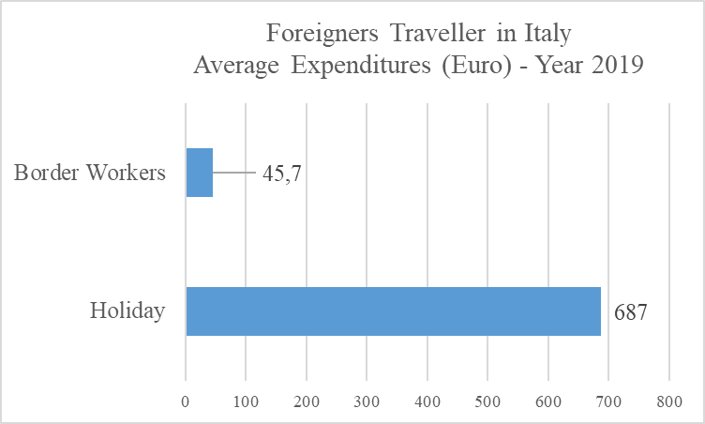

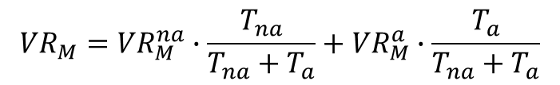
THE ITALIAN EXPERIENCE
  Some forms of travel were not possible during the lockdown
During the lockdown some forms of travel/tourism were not possible: like holidays, some business travels (conferences, exhibitions, trade fairs..)
In math terms, we apply a zero variation rate to the trips not allowed (na) during the pandemic
$${VR}_{M}={VR}_{M}^{na}∙\frac{T_{na}}{T_{na}+T_{a}}+{VR}_{M}^{a}∙\frac{T_{a}}{T_{na}+T_{a}}$$
$${VR}_{M}^{na}=0$$

Slide 28

THE TRAVEL WORKSHOP EXPERIENCE
MAIN ACTIONS DURING THE COVID PANDEMIC
Preliminary data exchange: variation rates for credits and debits
"The milestones file“ i.e. sharing of information about the pandemic: when it has began in the country, the first restriction measures, and the lockdown.
Analysis of the compilation issues during the lockdown

Slide 29
THE TRAVEL WORKSHOP EXPERIENCE
Preliminary data exchange: variations rates for credits and debits
An example
Large participations (in March 2020): GR-ES-FR-DE-NO-RO-AT-SL-PO-BE-NL-IT
No indication about template form, data to share and timing, because the compilers were in different situations, and with different details available.

Slide 30
The Italian Experience: Travel Item
"The milestones file": An example (Italy: from the first Covid case to the national lockdown)
Date | Country | Geografical Area | Event | Description
21/02/2020 | Italy |  | first positive in Italy | First official case of Covid 19 verified by an hospital
22/02/2020 | Italy |  | First small "Red Zone" | Limited to 11 small municipalities: school closed, no movements outside the municipalities ; no social events
23/02/2020 | Italy | Lombardia (Milan) - Veneto (Venice) | Restriction Measures | Schools museums, cinemas and theatres closed; no social events; limited activity of bar and restaurants
25/02/2020 | Italy | North Italy (exception Valle d'Aosta and Trentino) | Restriction Measures | Schools museums, cinemas and theatres closed; no social events; limited activity of bar and restaurants, not essential shops, and malls.
01/03/2020 | Italy | North Italy (exception Valle d'Aosta and Trentino) | Restriction Measures | Schools museums, cinemas and theatres closed; no social events; not essential commercial activity closed (limited activity of bar and restaurants)
04/03/2020 | Italy | Italy | Restriction Measures | Schools museums, cinemas and theatres closed; no social events; not essential commercial activity closed (limited activity of bar and restaurants)
08/03/2020 | Italy | Lombardia (Milan) - other selected municipalities (Venice) | Regional Lockdown | Restriction to the movements of people (stay at home) and social distancing; only essential commercial activity open
11/03/2020 | Italy | Italy | National lockdown | Restriction to the movements of people (stay at home) and social distancing; only essential commercial activity open

Slide 31
THE TRAVEL WORKSHOP EXPERIENCE
Analysis of the compilation issues during the lockdown
We have prepared a small document:
Compilation Issues of Travel Item during the lockdown due the Covid-19 pandemic
The Topics
Reimbursements on travel-related expenses due to the pandemic
Imputed values for stays in second house or at friends or relatives houses
Non-resident but nationals in their country of citizenship during lockdown phases
Difference between nationality of payment or sim cards and residency of the owner
Discrepancy between credits and debits using different data sources
The authors instituions:
DE (Deutsche Bundesbank)
FR (Banque de France)
AT(Oesterreichische Nationalbank and Statistiks Austria
PT (Banco de Portugal)
ES (Banco de España and Instituto Nacional de Estadística)
IT (Banca d’Italia)
HU(Magyar Nemzeti Bank)

Slide 32
LESSONS LEARNED
Lessons Learned – In the Bank of Italy
The experiences with big data (mobile data and credit cards) developed before the pandemic has allowed us using these sources during the lockdown («return of investment»).
The new challenge is to integrate big data and traditional sources (frontier survey).

Slide 33
LESSONS LEARNED
Lessons Learned – In the Travel Workshop
Partner country data (and soft information) are useful in extreme conditions (like the beginning of a shock); but a net for communication should have been already formed.
Working together to common issues is a way forward, that brings concrete results.
Indeed, we would like analyze (together) in 2022 the use of payment statistics for compiling travel.

Slide 34
International Workshop on the Integrated Use of International Trade Statistics and Economic Statistics
Travel services data sources and compilation challenges during the pandemic lockdown
Andrea.carboni@bancaditalia.it

