Slide 1
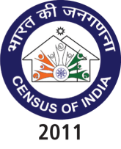
Census 2011
&
Data Dissemination
Dr. C. CHANDRAMOULI
REGISTRAR GENERAL &
CENSUS COMMISSIONER, INDIA
29th February 2012

Slide 2
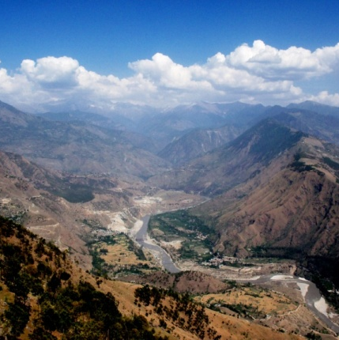

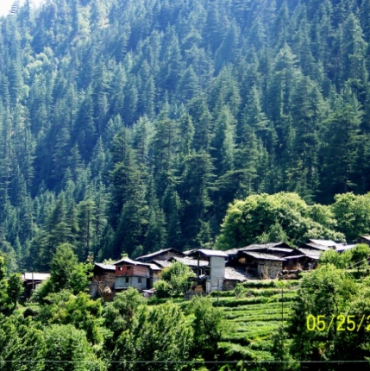
Census of India 2011

Slide 3
Features of Census 2011
Legal Backing – Census Act 1948
Paper Based - Extended de facto canvasser method
Extensive use of GIS/ICT in pre Census and Census activities
Highly manpower intensive- 2.7 million persons deployed
Complex Logistics
ICR Technology for data processing

Slide 4
Challenges – Diverse & Vast
Multi-level
0.6 million villages
7935 Towns
Multi-Ethnic
4,635 ethnic groups
80,000 Segments, Synonyms and Titles
2nd largest in the world
1.2 bn population
2.4% of worlds surface area
Large Population
Challenges…

Slide 5
Challenges – Diverse & Vast
Multi-cultural
655 religions and other persuasions
Difficult people
Nomads, Homeless, Forest/Island Dwellers
Difficult
Areas
Disturbed civil conditions
18 languages (training); 16 languages (canvassing); 6661 mother tongues
Infants, Elderly women, Disabled
Inaccessible terrain

Slide 6
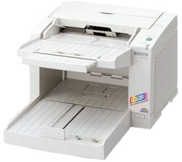




Census 2011 Process
House to house canvassing
(extended de facto)
Scanning
Image based
Recognition (ICR)
Data
Dissemination
Database/
Tabulation
Manual completion of unrecognized characters
Image validation

Slide 7
Census 2011
Data Highlights

Slide 8
Total Population (in Crore)
 | 2001 | 2011 | Difference
India | 102.9 | 121.0 | 18.1
Rural | 74.3 | 83.3 | 9.0
Urban | 28.6 | 37.7 | 9.1
For the first time since Independence, the absolute increase in population is more in urban areas that in rural areas
Rural – Urban distribution: 68.84% & 31.16%
Level of urbanization increased from 27.81% in 2001 Census to 31.16% in 2011 Census
The proportion of rural population declined from 72.19% to 68.84%

Slide 9
Trends in Rural Urban Distribution of Population
- India (in %) (1901, 1951, 2011)
India
Rural
Urban

Slide 10
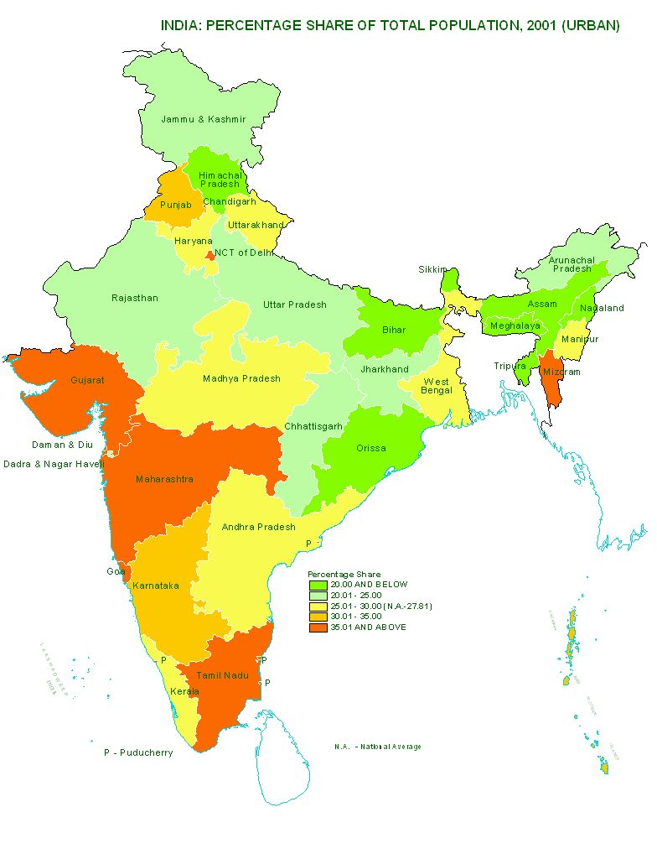
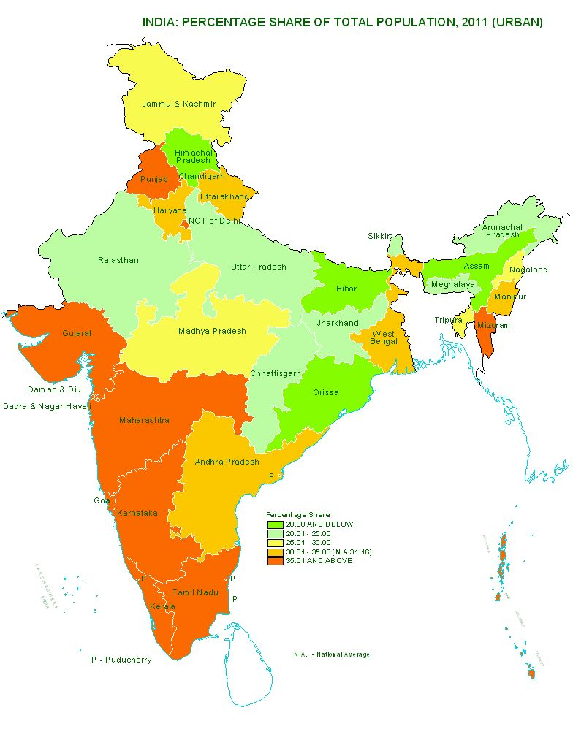
Percentage share of Urban Population in Total Population – India, 2001 & 2011
INDIA
2001
INDIA
2011

Slide 11
Data Highlights – Census 2011
Growth Rate of Population (in %)
 | 1991-2001 | 2001-2011 | Difference
India | 21.5 | 17.6 | -3.9
Rural | 18.1 | 12.2 | -5.9
Urban | 31.5 | 31.8 | +0.3
The slowing down of the overall growth rate of population is due to the sharp decline in the growth rate in rural areas, while the growth rate in urban areas remains almost the same.

Slide 12
Data Highlights – Census 2011
Growth Rate of Population (in %)
 | 1991-2001 | 2001-2011 | Difference
EAG | 25.0 | 20.9 | -4.1
Rural | 23.5 | 18.7 | -4.8
Urban | 31.6 | 29.9 | -1.7
Non EAG | 18.9 | 15.0 | -3.9
Rural | 13.2 | 5.7 | -7.5
Urban | 31.5 | 32.7 | +1.2
Though the growth rate of population in rural areas of EAG States is nearly 3 times that in rural areas in non EAG States, it is for the first time that significant fall of growth rate is seen in the rural areas of EAG States

Slide 13
Growth Rates (Rural)
India, EAG & Non-EAG States
General decline in Rural Growth Rate among all the three categories during the last decade 2001-11
Whereas Non-EAG States have shown decline in growth since 1971-81, the EAG States have declined only during the last decade.
The Growth in Rural Areas in Non-EAG States during 2001-11 has sharply declined to 5.71%.
EAG States are Rajasthan, Uttar Pradesh, Uttarakhand, Bihar, Jharkhand, Madhya Pradesh, Chhattisgarh and Orissa
Source: Census 2011 – Provisional Population Totals - India

Slide 14
Data Highlights – Census 2011
Sex Ratio
 | 2001 | 2011 | Difference
Overall
India | 933 | 940 | +7
Rural | 946 | 947 | +1
Urban | 900 | 926 | +26
0-6 years
India | 927 | 914 | -13
Rural | 934 | 919 | -15
Urban | 906 | 902 | -4
The improvement in overall sex ratio is largely in urban areas
Though the Urban Child sex ratio is far worse than in the rural areas, the fall in Child sex ratio in rural areas is around 4 times that in urban areas. In fact the decline is more gradual in urban areas.
  There is a decline of 8.9 million children in Rural areas, while in Urban areas has shown increase of 3.9 million.

Slide 15
Data Highlights – Census 2011
Literacy Rates (in %)
 | 2001 | 2011 | Difference
Overall
India | 64.8 | 74.0 | +9.2
Rural | 58.7 | 68.9 | +10.2
Urban | 79.9 | 85.0 | +5.1
The improvement in literacy rate in rural area is two times that in urban areas
The rural urban literacy gap which was 21.2 percentage points in 2001, has come down to 16.1 percentage points in 2011

Slide 16
Data Highlights – Census 2011
Literacy Rate - Male/Female (in %)
 | 2001 | 2011 | Difference
Males
India | 75.3 | 82.1 | +6.8
Rural | 70.7 | 78.6 | +7.9
Urban | 86.3 | 89.7 | +3.4
Females
India | 53.7 | 65.5 | +11.8
Rural | 46.1 | 58.8 | +12.7
Urban | 72.9 | 79.9 | +7.0
Improvement in female literacy is more than males in both rural and urban areas
The gender gap in literacy has come down from 24.6 in 2001 to 19.8 in 2011 in rural areas and from 13.4 in 2001 to 9.8 in 2011 in urban areas

Slide 17
Literacy Rate : Rural – Census 2011
Pace of increase in Female Literacy Rate is perceptibly higher in Rural areas.
It has increased from 46.13% in 2001 to 58.75% in 2011
Gender gap in Literacy Rate has narrowed down considerably over the Censuses but continue to be high (19.81).
This gap is largest in Rajasthan (31.2 points)
Source: Census 2011 – Provisional Population Totals - India

Slide 18
Literacy Rate: Urban – Census 2011
There has been a consistent increase in both Male & Female Literacy Rate in Urban areas
The steady increase in the Female Literacy Rate has reduced the gender gap significantly
Source: Census 2011 – Provisional Population Totals - India

Slide 19
Census 2011 -Data Dissemination
Development of CensusInfo Dashboard
Based on Dev Info platform 6.0
Provisional results from Census 2011 released using Census Dashboard

Slide 20
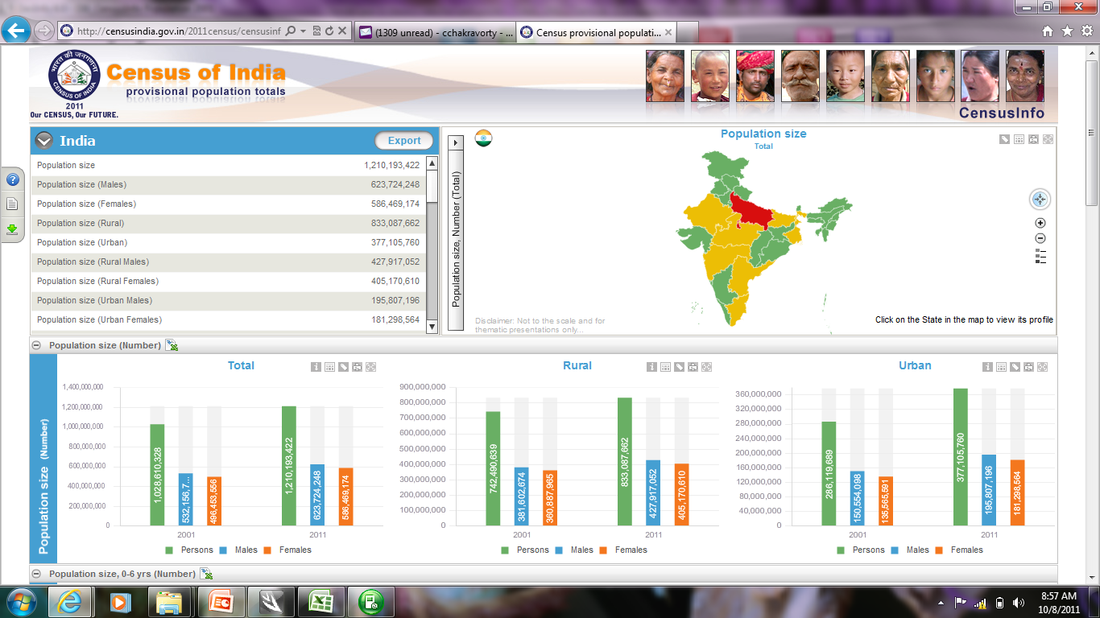
CensusInfo Dashboard on the Web

Slide 21
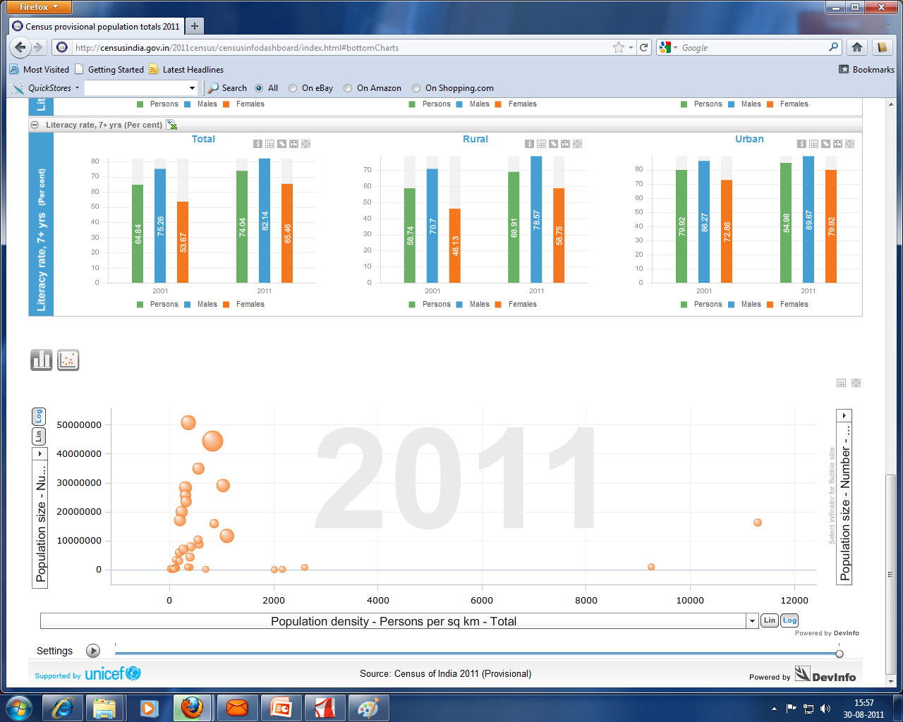
CensusInfo
State Comparisons

Slide 22
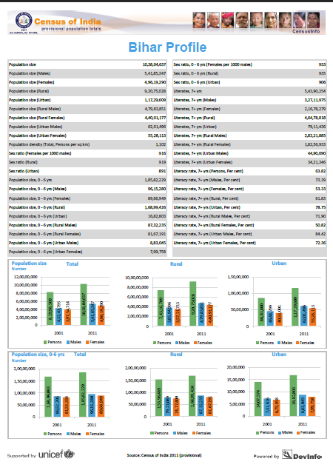
Area
Profile

Slide 23

Thank You
Registrar General and Census Commissioner, India,
2 A Mansingh Road, New Delhi 110011, India
Phone: +91-11-24105383
Fax: +91-11-23383145
E mail: rgi.rgi@nic.in
Website: http://www.censusindia.gov.in

