Slide 1
WDC200H
How to Foster
Innovation in
Data Communication
Hans Rosling
Karolinska Institutet
www.gapminder.org

Slide 2
Data
World

Slide 3
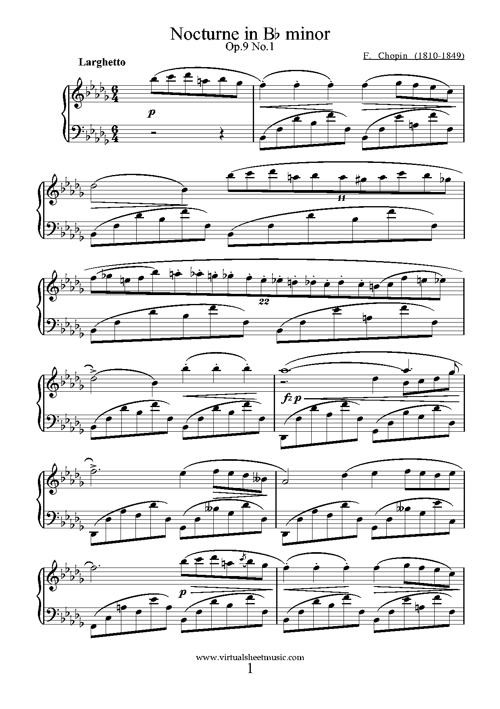
Instrument
makers
Composer
Musician
New technology

Slide 4
WDC200H
www.gapminder.org/desktop

Slide 5
Data
microdata
indicators
www
research
media
Gov
Com
World
Market
Civil
society

Slide 6
Unified format
Data
Access license
Data
Data
microdata
indicators
API
www
Bulk download
innovations
competition
research
media
Gov
design
Com
interactivity
wow
storytelling
World
Market
Civil
society
media integration

Slide 7
WDC200H
http://www.gapminder.org/downloads/gapminder-world-map/

Slide 8
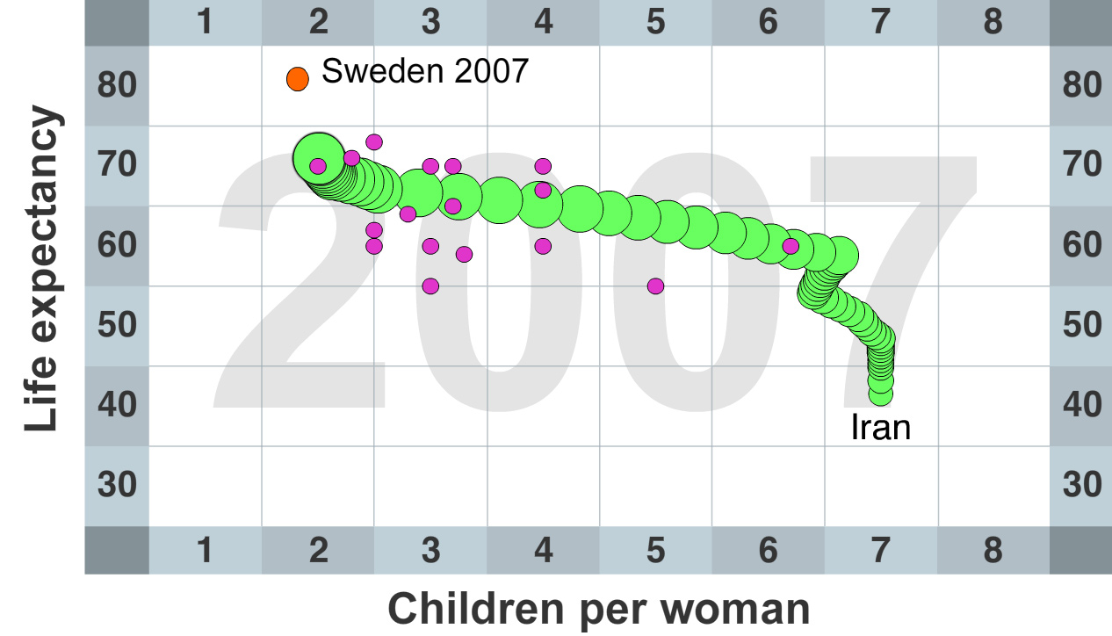
Investors
Stockholm

Slide 9
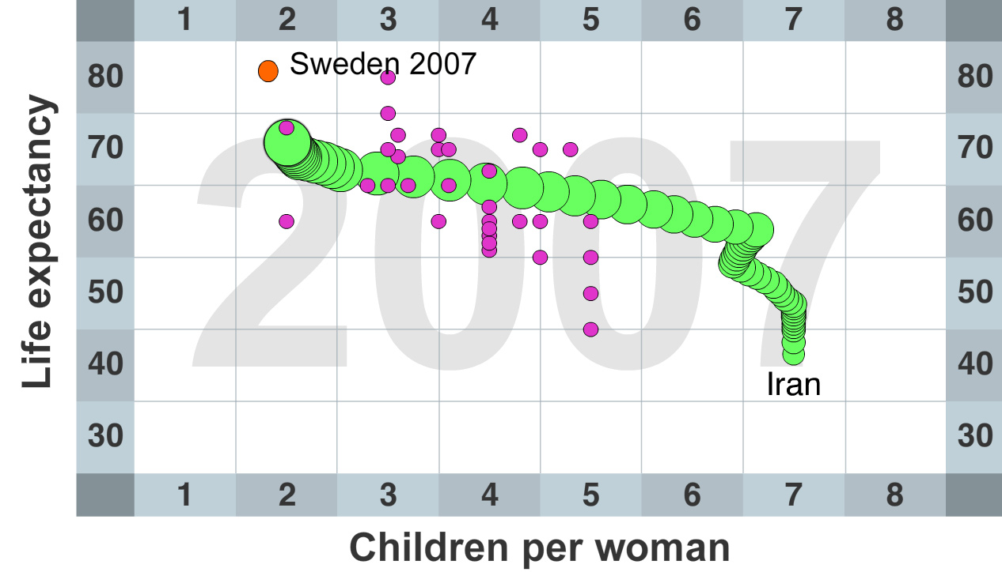
Media
Stockholm

Slide 10
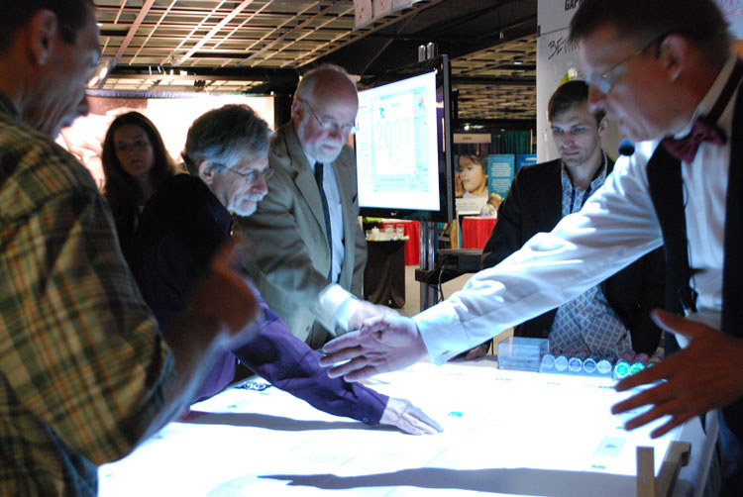

Slide 13
Dissemination
Communication
Access

Slide 14
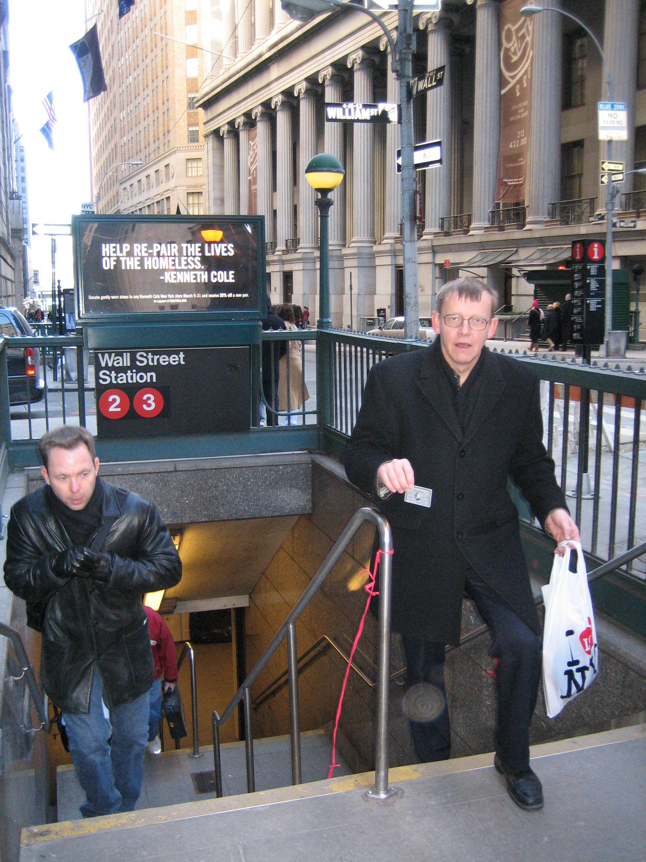
Sidewalks are free !
WDC2003WDC 2003
Statistics = intelectual sidewalks!

Slide 15
PUBLIC
INTERNET
DATA
UN
National
NGO

Slide 16
PUBLIC
EXPENSIVE
$ 100
$ 299
$ 30
INTERNET
DATA
UN
National
NGO

Slide 17
PUBLIC
DIFFICULT
User name
m6fg3
User name
lkk9sd
User name
ed4ghj
Password
****
Password
****
Password
****
EXPENSIVE
$ 100
$ 299
$ 30
INTERNET
DATA
UN
National
NGO

Slide 18
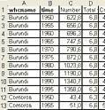
PUBLIC
BORING
DIFFICULT
User name
m6fg3
User name
lkk9sd
User name
ed4ghj
Password
****
Password
****
Password
****
EXPENSIVE
$ 299
$ 100
$ 299
$ 100
$ 30
$ 30
INTERNET
DATA
UN
National
NGO

Slide 19
What is needed ?
Flash
Illustrator
Freehand
After
Effects
PowerPoint
DESIGN TOOLS
DATABASES
Excel
ODBC
XML
WebService
Access
MySQL

Slide 20
The spark =
access to datasets !
Flash
Illustrator
Illustrator
Freehand
After
Effects
PowerPoint
DESIGN TOOLS
gapminder.org
DATABASES
Excel
ODBC
XML
WebService
Access
MySQL

Slide 21
PUBLIC
SEARCH
ANIMATE
LIBERATE
INTERNET
DATA

Slide 22
Public access to data!
PUBLIC
INTERNET
DATA

Slide 23
Children dying before age 5 per 1000 live births (log)
Low income countries
Middle income countries
High income countries
3
Singapore
Iceland
Japan
Sweden
Slovenia
Finland
4
Grandaughter 2004
Czech Republic
Cyprus
Spain
Italy
France
Norway
5
Portugal
Greece
Belgium
Denmark
Germany
Austria
Switzerland
6
Malta
New Z.
Ireland
Cuba
Croatia
Israel
Australia
UK
7
Estonia
South
Korea
Canada
Nether-
lands
Luxem-
burg
8
Chile
Lithuania
U. Arab
Emirates
USA
Poland
Hungary
Brunei
Slovakia
10
Belarus
Malaysia
Chile
Daughter 1974
Costa Rica
Barbados
Bahrain
Kuwait
Sri Lanka
Macedonia
Bulgaria
St Lucia
Latvia
Oman
Bahamas
Bosnia
Serbia
Mauritius
Syria
Ukraine
Albania
Uruguay
Argentina
Colombia
Romania
Venezuela
Trinidad
& Tobago
20
Jamaica
Libya
Palestine
China
Fiji
Russia
Qatar
Thailand
Grenada
Tonga
St Vincent & G
Paraguay
Tunisia
Mexico
Mexico
Vietnam
Jordan
Ecuador
Panama
Saudi Arabia
dor
El Salva
30
Armenia
El Salva
Peru
Brazil
Myself 1948
Philippines
Armenia
Vanuatu
Egypt
Vanuatu
Dominican R.
Lebanon
Cape Verde
Nicaragua
Cape Verde
Iran
Turkey
Samoa
40
Indonesia
Samoa
Suriname
Belize
Honduras
Algeria
50
Mongolia
Georgia
Morocco
Maldives
Guatemala
Solomon Islands
North
Korea
Egypt
60
Uzbekistan
India
Namibia
Guyana
Mother 1921
70
Nepal
Kyrgyzstan
Comoros
Bolivia
South Africa
Eritrea
Bangladesh
Comoros
Timor-L.
80
Laos
Sudan
Timor-L.
Lesotho
Kazakhstan
Health
Sudan
Azerbaijan
100
Papua N.G.
Bhutan
Gabon
Yemen
Bhutan
Myanmar
Tajikistan
Ghana
Kenya
Bhutan
Turkmenistan
Sao
Tome
Congo Rep
Ghana
Gambia
Haiti
Pakistan
Botswana
Burundi
Madagascar
Togo
Zimbabwe
Mauritania
Iraq
Djibouti
Grandma 1891
Ethiopia
Uganda
Cambodia
Benin
Senegal
Cameroon
Swaziland
Mozambique
Guinea
Zambia
Malawi
Mozambique
Greatgrandma 1863
200
Rwanda
Burkina Faso
Somalia
Guinea-
Bissau
Central
A.R.
Chad
Nigeria
Ivory
Coast
Equatorial
Guinea
Liberia
Niger
Mali
Angola
Sierra Leone
Afghanistan
300
100
200
300
500
1 000
2 000
3 000
5 000
10 000
20 000
50 000
Money
Gross National Income per capita, in US dollar, exchange rate (log)

Slide 24
DbHd
Data base Hugging disorder

Slide 25
Data
microdata
indicators
www
research
media
Gov
Com
World
Market
Civil
society

Slide 26
Data
microdata
indicators
www
research
media
Gov
Com
World
Market
Civil
society

Slide 27
Access license
Data
Data
Data
microdata
indicators
unified format
www
machine readable
research
media
Gov
design
innovations
Com
interactivity
storytelling
World
Market
Civil
society

Slide 28
Access license
Unified formate
Machine readable

