Slide 1
Quality reports for registers and administrative data
4 March 2020, NY
Lasse.SanDberg@ssb.no
Notes:
Intro
Will talk about our experience with quality reports for registers and administrative data
Building the register-based system in Norway has taken time.
As part of our regular quality assessments in Statistics Norway, the need for better cooperation with data owners where often emphasised.
Starting around 2011/2012, we introduced a new approach to professionalise our cooperation with data owners, which included MoUs and Quality reports.

Slide 2
Over 100
administrative registers
BRØNNØYSUND REGISTER
NORWEGIAN TAX ADMINISTRATION
Central Coordinating Register
for Legal Entities
National Registry
collects basic data on public
and private sector units with a duty
to report
NORWEGIAN MAPPING AUTHORITY
contains key data on everyone
who lives or has lived in Norway
New Cadastre
is Norway’s official property
register, includes buildings,
dwellings and addresses
Notes:
Today, Statistics Norway are using around 100 register for production of statistics, and although we still use surveys, our system can be described as a register-based system.
It has taken a lot of effort and time to build the system and it has been developing over several decades. (unique personal ID that was introduced in 1964, Legal Entity ID and CCRLE in 1995, 2011 first register-based population and housing census...)

Slide 3
Statistics Norway shall be informed when important new administrative data processing systems are to be established or when there are plans to establish or change such systems
Notes:
The statistics act gives Statistics Norway the right to access registers.
But just as important, it also gives SSB the right to influence registers. (standards, variable definitions, ..)
The legal framework gave us the tools to access and influence registers, but better cooperation with data owners was needed to improve the quality

Slide 4
Rather than repairing,
errors should be corrected
in the source
Notes:
In 2011, Statistics Norway carried out the its first register-based population and census. The experience and challenges encountered, inspired change in SSB’s approach to improve quality in registers. Until then, all errors were only corrected in the statistical versions of the registers. However, to improve quality, it would be necessary to correct errors in the source.

Slide 5
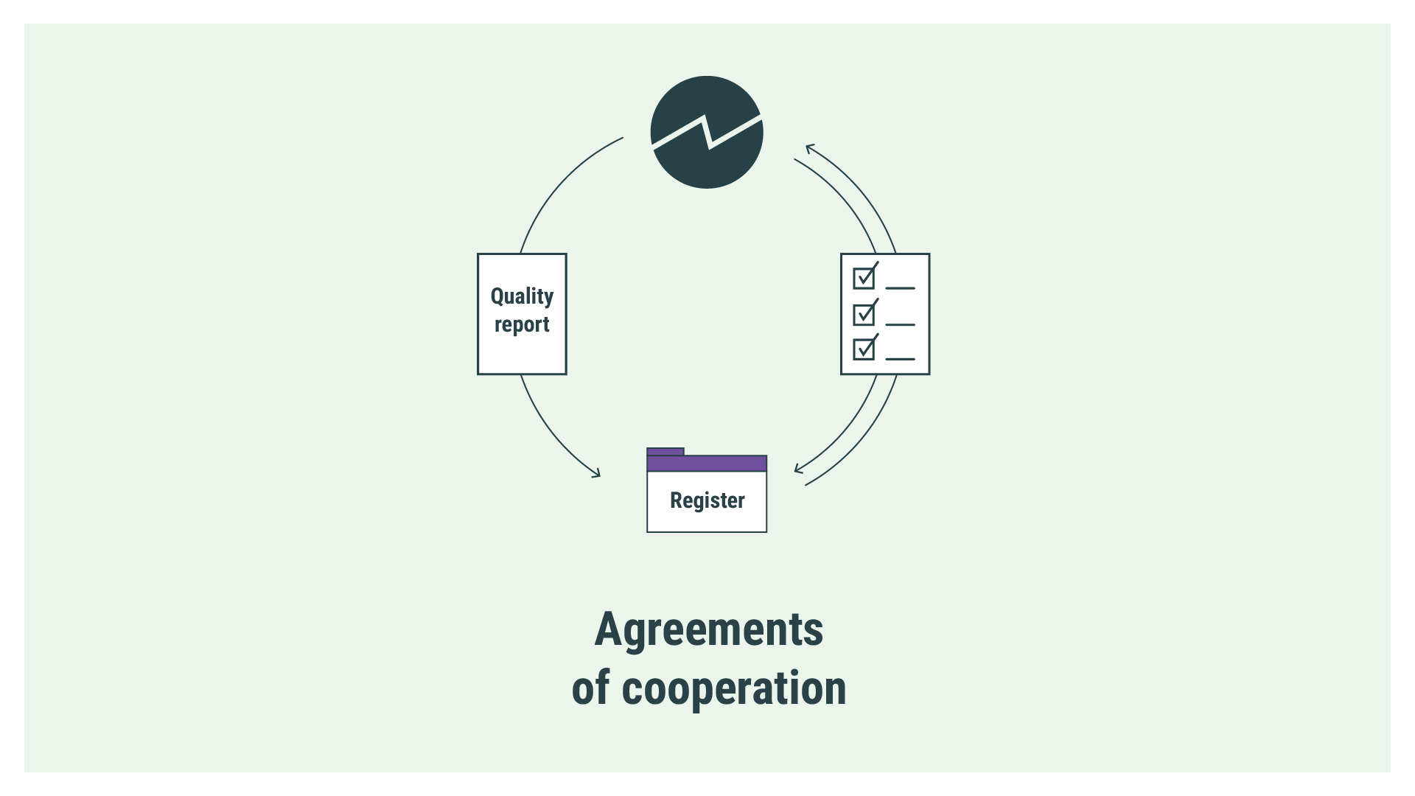
Notes:
To standardise and professionalise our cooperation with data owners, SSB established a template for “Agreements on cooperation”. These are supplemented by an annual quality report for each register, which included feedback on the micro-level for the first time.
Developing the new system involved the division for methodology and data collection, SSB’s legal adviser, experts on quality (CoP, methodology), statistical departments including the department for Business Surveys.

Slide 6
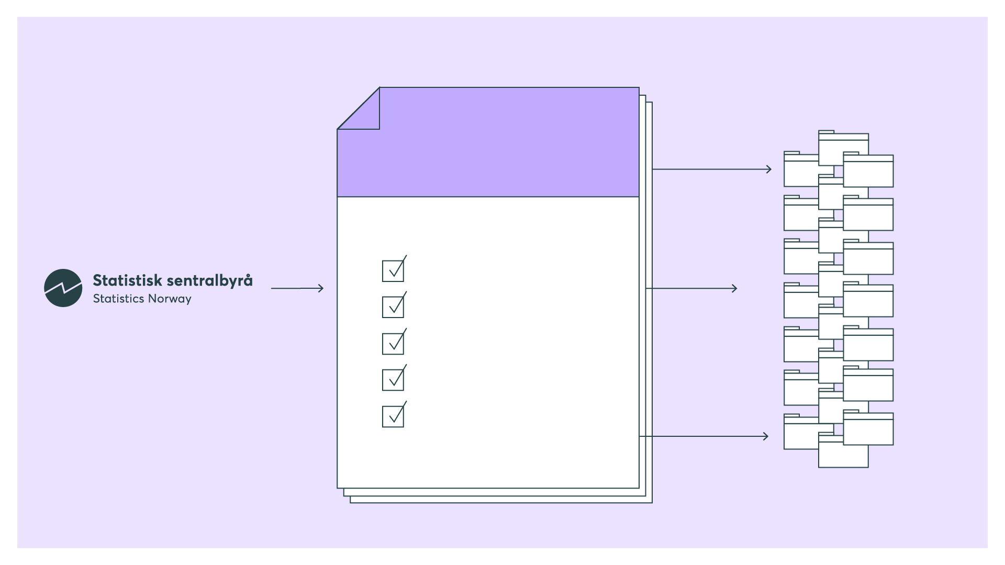
Registers
Annual Quality Report
Feedback on:
Technical checks
Accuracy
Completeness
Integrability
Time
Notes:
Much of the underlying principled for the quality reports, are from the ESS Code of Practice. The CoP provides the framework for SSBs quality assessment of statistical products and processes, and it was also the underlying framework when developing the new system for quality reporting for registers.
The indicators selected for the report can be grouped in the following five dimensions of quality: Technical checks, Accuracy, Completeness, Integrability, and Time.
In addition, the quality reports are used to give feedback on errors in the data at the micro-level. This was a major change to the previous approach and has been a very important element in improving the quality of admin data.

Slide 7
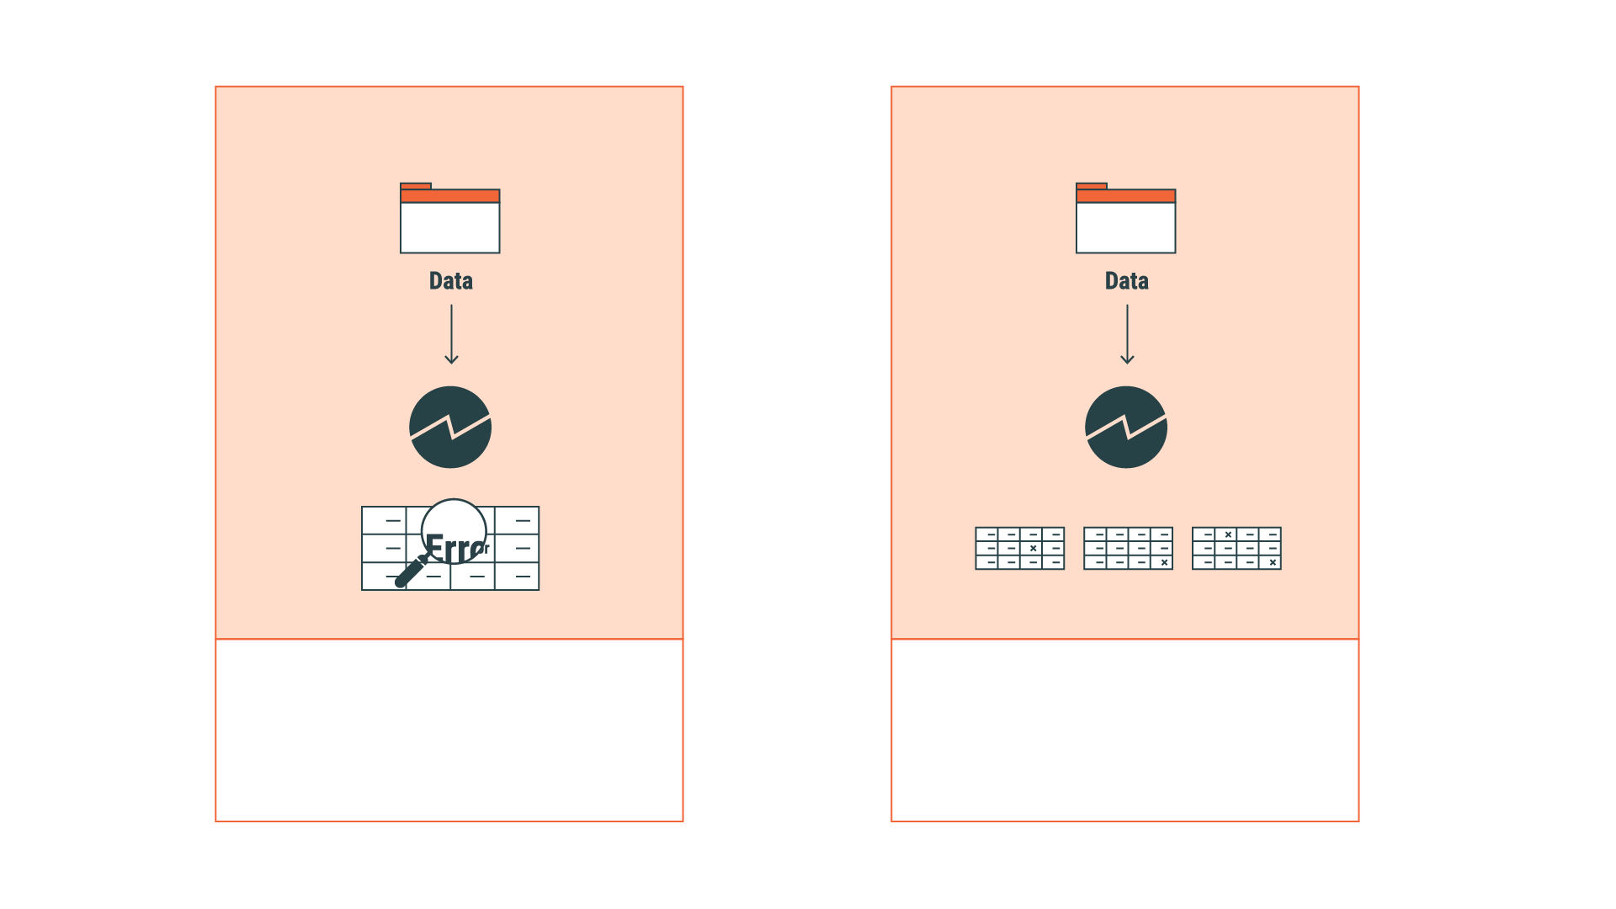
Single source approach
Multiple source approach
Feedback on micro-level
Aggregated reporting
Notes:
When an error is found, based on assessment of only one source, SSB gives feed-back at the micro level. This allows the data owners to correct the errors in the source. This has been a change to earlier practices, but the justification is that we are making a complaint on the quality directly to the data owners. This is in line with the Statistics act’s requirements to secrecy. The legal advisors were strongly involved in assessing the new approach, together with management and data owners. As with surveys, SSB can ask for clarifications from the respondent, in this case data owners, at the micro-level.
When errors are found after merging sources, the general response it to only provide aggregated reporting. This is also useful for the data owners to pinpoint the areas where there are quality issues.
In addition, when a data owner has several registers, SSB can carry out analysis on their behalf. An agreement on data processing allows reporting at micro level from SSB to the register owner, provided that the register owner can use both registers for administrative reasons.

Slide 8
Results so far
Extensive use of the data improves data quality
About 100 reports linked to agreements with 29 owners of registers
Win-win – all parties benefits
Notes:
Today, we prepare 100 quality reports for 29 owners.
It is clear that this approach has made a big difference in improving the quality in registers. The more data is used, the better quality we get.
And it is a Win-win – everyone benefits from this approach. We have had a very positive response from data owners, who are much more motivated to sharing data with SSB after they also could see a direct benefit trough improved quality in own registers.
Although the legal framework secures our access to administrative data, the focus on cooperation, coordination and communication has been key to making the administrative data suitable for statistics.

Slide 9
Thank you!

