Slide 1
High-Level panel Strengthening Migration Statistics
Improving migration statistics at the national level
Mr. Störtzbach
Head of division
International co-ordination and co-operation

Slide 2
1. Migration statistics in Germany
Migration visibly shapes German society
Germany is one of the major destination countries in Europe for refugees fleeing the civial war in Syria
Migration Statistics is an integral part of official population statistics

Slide 3
2. Large-scale inflow challenged German statistical systems
Statistics on refugees rely on administrative records of the Federal Agency of Migration and Refugees
Problems in administrative data due to large numbers of refugees entering Germany during 2015 and 2016
Lessons learnt in administrative procedures

Slide 4
3. Initiatives to improve migration statistics
Quantifying humanitarian immigration in administrative data

Slide 5
3. Quantifying humanitarian immigration
https://www.destatis.de/DE/ZahlenFakten/GesellschaftStaat/
Bevoelkerung/MigrationIntegration/MigrationIntegration.html

Slide 6
3. Initiatives to improve migration statistics
Quantifying humanitarian immigration in administrative data
Migration mainstreaming

Slide 7
3. Initiatives to improve migration statistics
Quantifying humanitarian immigration in administrative data
Migration mainstreaming
Data integration to fill data gaps on socioeconomic variables

Slide 8
3. Initiatives to improve migration statistics
Quantifying humanitarian immigration in administrative data
Migration mainstreaming
Data integration to fill data gaps on socioeconomic variables
Innovative ways for data visualization and dissemination

Slide 9
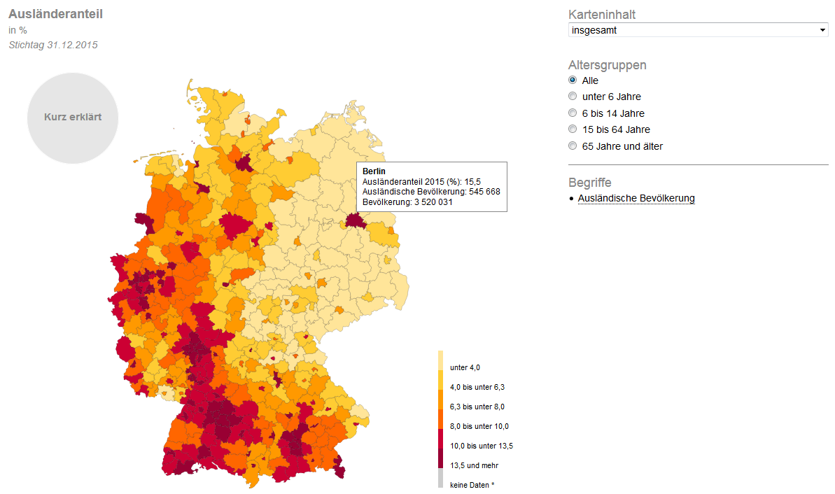
3. Data visualization: interactive maps
Maps on …
share of foreign population
Berlin
Share of foreign population (%): 15.5
Foreign population: 545 668
Total population: 3 520 031
share of people seeking protection
share of foreigners in employment
unemployment rate among foreigners
https://service.destatis.de/DE/karten/migration_integration_regionen.html

Slide 10
4. Outlook: Big-Data in migration statistics
Subject to ongoing research at the Federal Statistical Office
Potentially valuable data sources for migration statistics:
Geo-located data: mobile phones & social media content
Online search queries
Obstacles:
Legal Basis?
Challenge to objectivity, neutrality and independence?

