Slide 1
TRANSFORMATIVE AGENDA FOR OFFICIAL STATISTICS
SESSION 3: Innovation and modernization through standards-based statistical business architecture
7 - 9 September 2016
By Edwin St Catherine,
Director of Statistics, SAINT LUCIA

Slide 2
Innovation and Modernization:
Three Areas where most development and modernization is occurring
Increasing use of Administrative data
The signing of MOUs with critical data providers
National Insurance Corporation (Social Security Agency)
Inland Revenue Department (Tax Office)
National Registry of Businesses
Ministry of Commerce – Trade Licenses Department
Electoral/Health/Education/Registry
Strengthen Statistical Modernization by building strategic relationships with Big Data Providers
Dynamic Up-to-date Business Register with specific business rules for updating and maintaining the register from the Tax Office and Social Security Agencies in particular
Up-to-date frame for the Conduct of Economic Surveys, Balance of Payments Surveys, Job Openings and Labour Market Turnover Surveys
Leverage the use of GIS to be the agency which maintains the electoral boundaries in collaboration with the office of the Speaker of the house and our unique position of ownership of the Census database
Ensure rich data sources are available to populate the SUT (Supply and Use Tables) based on SNA 2008 standards
General improvement in quarterly business statistics on sales, quarterly GDP and other High Frequency Indicators
Other holders of Big Data – Telecoms, Global Technology Companies, Credit Card Companies
Define tools and data formats at the global level and invest in international agreements which will allow access and use of this data

Slide 3
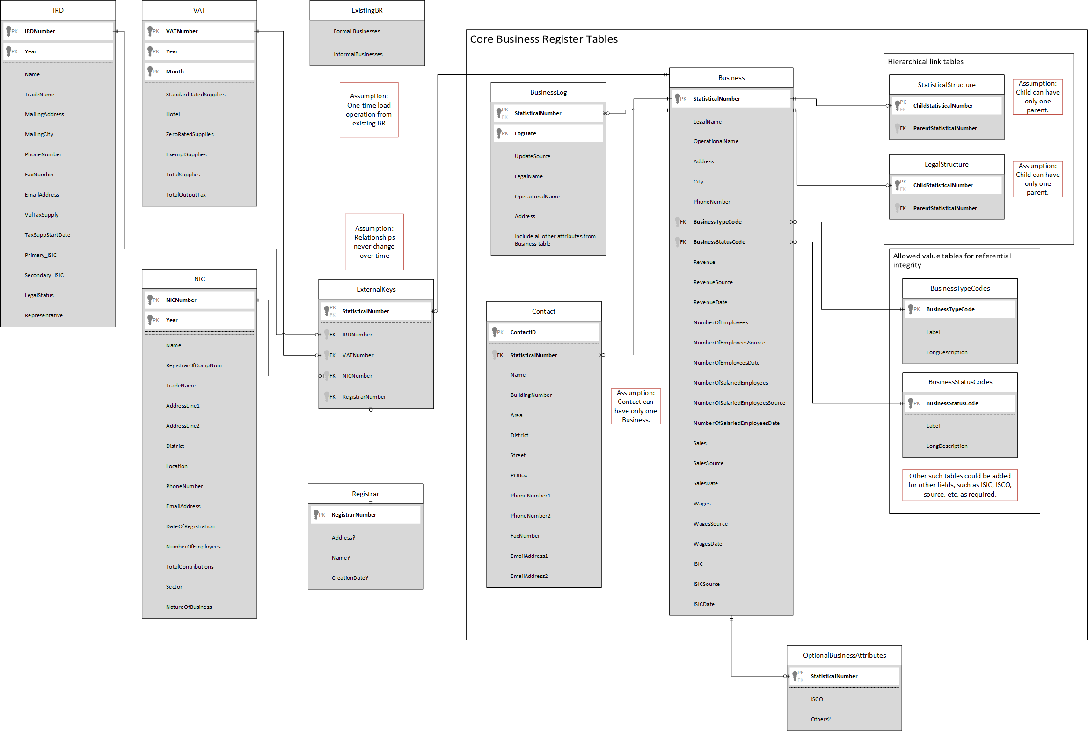
Proposed Business Register Data Model

Slide 4
Innovation and Modernization:
Sample Survey Data Collection, Processing and Dissemination
Use of electronic data capture methods
Use of World Bank Survey Solutions Tablet Computer CAPI (V5.11) software
Save printing cost, save data capture cost, reduce time to dissemination of sample survey results. Questionnaires sync’ed from tablets to internet are reviewed by the supervisor online and returned to the enumerators tablet for correction.
Tablet collection allows more effective management of teams of enumerators over the internet when tablets are sync’ed from any location to the internet based on the structure of the sample, collection of GPS coordinates of interviews, use of validation checks built and implemented at the time the interview is being done results in a very clean dataset at the outlet.
Time to delivery of results no more than a month for labour force statistics
Census 2020 ready – Allow Internet Data Submission, built in GPS based routing of enumerators
Strategy for Implementing LSMS (Living Standards Measurement Surveys) and HBS (Household Budget Surveys)
The difficult task of collecting consumption expenditure data overlap in these two surveys, therefore not only should the coding system be the same, that is, use of COICOP but also serious consideration needs to be given to using a strategy of doing one survey to cover the weighing updates required for the CPI and the Supply and Use Table for the national accounts on the one hand and the need to collect data on poverty/inequality and living conditions on the other hand at the same time especially in smaller SIDS
Use of Big data to validate consumption expenditure aggregates where possible

Slide 5
Innovation and Modernization:
Adapting current data sources to capture SDG Indictors recognizing the higher cost of collecting data in SIDS
LSMS – Compute money metric based poverty indicators and Multi-dimensional Poverty Indicators (MPI)
Poverty measures based on a national and international poverty line (FGT)
Multi-dimensional Poverty based on Alkire-Forster
Inequality Measures, Gini, theil, MPI based inequality measures
Inclusion of broader measures of progress, example money metric identification and tracking of the lower middle and upper classes in the society
Food Security Indicators
MICS – Multiple Indicator Cluster Survey – Consideration for a SIDS friendly version that focuses on collecting a few key indicators on women and children which reduces the cost and complexity of this survey.
Adapt continuous Labour Force Surveys/Surveys of population to cover new topics
Multi-Dimensional Poverty, perhaps after accumulating several quarters of data into an annual dataset
Decent Work Indicators
Informal Sector and Informal employment indicators

Slide 6
Innovation and Modernization:
Data Dissemination in SIDS
In All areas of Statistical Activity SIDS cannot invest a lot in software development and therefore need to rely on statistical software which has been developed by development partners, UNICEF, WorldBank, IMF, EuroStat, Statistics Canada, US Census Bureau etc and customized to meet their needs
IMF - PIPS (Price Index Processor) Output of Consumer Price Index Aggregates
Move to updated database platform/make more tablet friendly
EUROSTAT - EUROTRACE (Trade Data Processing)
Implementation of Webcomext for dissemination to the web using open standards
WorldBank/PARIS21 - MetaData Editor to document Sample Surveys - The metadata produced by the Editor is compliant with the Data Documentation Initiative (DDI) 2.n and the Dublin Core XML metadata standards allows for dissemination of survey documentation over internet is a very powerful method to promote the use of Census and Sample Survey Data
WorldBank – ADEPT – Modules to improve the dissemination the results of Surveys

Slide 7
Innovation and Modernization:
Data Dissemination in SIDS
WorldBank – R Package on CRAN - Statistical Disclosure Control (SDCMicro) requires continuous and more support for implementation in SIDS since accidental disclosure is especially important in SIDS where disclosue risk are relatively higher given the smaller numbers of records and higher sampling fraction associated with these datasets
Statistics Canada (PRASC Project) – National Accounts Compilation Tools based on open standards for Supply and Use Tables
UNECLAC – Redatam allows dynamic website dissemination of Census and Sample Survey Data – Open Data Compliant
UNICEF – DEVINFO – Compliance with DDI/SDMX
US Census Bureau – CSPRO - Compliance with DDI

Slide 8
Innovation and Modernization:
Development of Websites which are based on open standards, Joomla
We need our support agencies to recognize the importance of the implementation of standards in software intended to assist especially SIDS with their Statistical Infrastructure particularly in the area of data dissemination
Continuous efforts at training staff/Personnel who understand new data formats
Importance of Open Data Standards
Importance of standards specific to SDMX (Statistical Data and MetaData Exchange), DDI (Data Documentation Initiative)

