Slide 1

A closer look at tourism
Oliver Herrmann
World Tourism Orgnisation
Statistics and Tourism Satellite Account Programme

Slide 2

  Overview
UNWTO mandate
You manage what your measure! About measuring tourism
Measuring tourism:
“traditional” measures of tourism
the conceptual framework for measuring tourism: the International Recommendations for Tourism Statistics 2008 and the Tourism Satellite Account
the economic measurement of tourism: TSA
Enabling economic impact analysis: an added benefit of TSA
Conclusion

Slide 3

  UNWTO’s role in tourism statistics
UN mandate
Statistics is more than numbers:
it is a process
4. Direct support to countries : Capacity Building and technical assistance
3. Dissemination, encouraging analysis and use by tourism stakeholders
2. Securing international comparability through the implementation of standards, compilation of international data and indicators,
1. Striving for international comparability, through development of standards

Slide 4
  You manage what you measure!
If you can measure it, you can manage and improve it!
Measurement
Analysis
Policy/Strategy Formulation
Implementation and Monitoring
Evaluation
“Statistics permeate modern life.
They are the basis for many governmental, business and community decisions”
Ban Ki-Moon, UN Secretary-General, on World Statistics Day (2010)

Slide 5
I. International standards
- Multilateral coordination in advancing the conceptual framework for measuring tourism and expanding its analytical potential -
1. Employment & decent work (ILO)
2. Sub-national → domestic tourism in detail; tourism products/segments
3. UN System:
a. UNSC, CCSA
b. STSA Committee
c. Interagency Taskforce on Statistics of International Trade in Services (MSITS), (with Eurostat, UNSD, WTO, IMF, OECD)
II. Guidelines for implementation of standards
- Multilateral coordination in designing practical guidance for implementing the standards across countries -
1. IRTS 2008 Compilation Guide
2. ILO-UNWTO Technical Guide on Measuring Employment in Tourism
3. Input to Compilers Guide MSITS - UN Expert Group
IV. Dissemination
- To users for analysis, advocacy, policy design, results-based management, strategy -
1. Compilation - databases and publications:
a. Compendium (PBEL)
b. Yearbook,Outbound(PBEL)
c. TSA indicators
2. Macroeconomic indicators
3. Technical paper series
4. More user-friendly website (ELCM)
5. E-learning material (THMS)
6. Maps
III. Capacity building & instruments for technical assistance
- Designing methods and material to support countries in their implementation -
1. Regional Statistical CB Programme:
a. WSI Africa (RPAF)
b. WSIII+RS Asia-Pacific (RPAP)
c. WSIII Europe/CIS (RPEU)
2. Material: Documenting National Systems of Tourism Statistics ↔ Compilation Guide
3. E-learning material (THMS)
4. Training the trainers WS (TCSV)
  STSA key objectives and Programme of Work

Slide 6

  About why tourism has to be measured
Can managers disregard the (economic) importance of tourism?
Understanding tourism is not straightforward: need to go beyond physical flows of visitors or accommodation data
Reasons:
  Tourism expenditure and relations to economic growth and jobs
  Tourism as an economic sector: establishments produce goods and services supplied to visitors
  Significant contributor to environmental, economic, and social changes
Understanding the importance of having to measure tourism are:
  NSOs, Central Banks and international trade negotiators, NTAs

Slide 7
  The “traditional” measures
Physical flows
Approximations from the Balance of Payments

Slide 8

  Setting the scene
Tourism: a social, cultural and economic phenomenon which entails the movement of people to countries or places outside their usual environment
→ for personal or business/professional purposes
→ activity of visitors (both tourists and excursionists)
Until recently, the absence of standards led people to develop their own concepts, definitions, classifications: comparison not possible…
in order to be comparable between countries and over time, the measurement of tourism, like that of other (economic) activities required an international consensus (to be meaningful and realistically applicable across countries)
  This meant agreeing on concepts, definitions and classifications
In order to be credible as an economic phenomenon and comparable to other economic sectors and industries, tourism needed a link to standard economic measurement (i.e. System of National Accounts)
  This meant setting up a Satellite Account framework for tourism

Slide 9

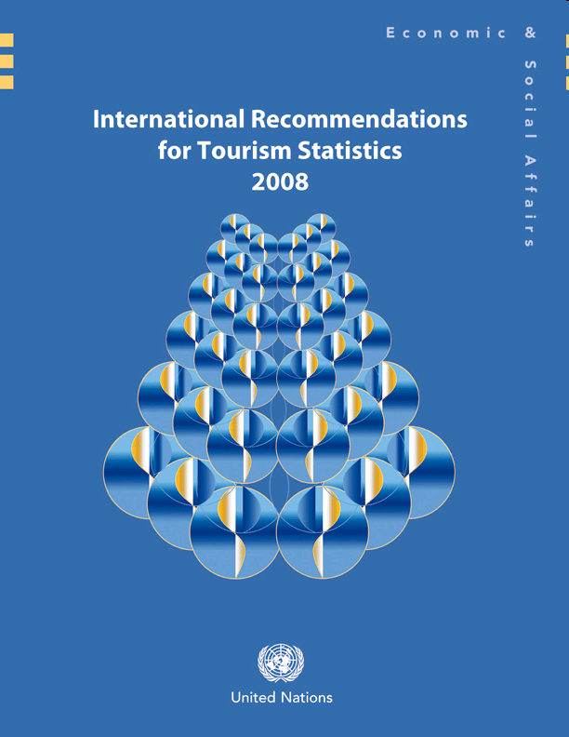
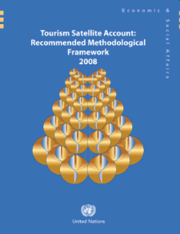
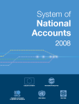
  The 2008 international consensus
supported by all UN countries and ILO, IMF, World Bank, WTO, European Commission
IRTS 2008: concepts, definitions, classifications for basic tourism statistics
TSA: RMF 2008: framework for the economic measurement of tourism consistent with SNA, BoP
System of Tourism Statistics
Credible, comparable statistics
Tourism as an economic sector (i.e. GDP, etc.)

Slide 10








Development over time
UN
Standards
RTS
(Recommendations on Tourism Statistics) (1993)
Adoption of TSA (Tourism Satellite Accounts) (2000)
International Recommendations
for Tourism Statistics (2008)
Update of TSA (Tourism Satellite Account: Recommended Methodological Framework) (2008)
SDG / SCP / 10 YFP
UNWTO International Conferences
Iguazú Conference
on “The Tourism Satellite Account (TSA): Understanding Tourism and Designing Strategies” (2005)
Nice Conference
on the Measurement of the Economic Impact of Tourism (1999)
Bali Conference
on Tourism: An Engine for Employment Creation (2009)
40 days
100%
Revised Guidebook on Indicators
of Sustainable Development for Tourism Destinations
30 days
UNWTO
Guidelines
50%
35 days
38%
SEEA/Tourism
“linked tourism and environmental economic accounts (SEEA-TSA)”
150 days
40%
What tourism managers need to know
A practical guide to the development and use of indicators of sustainable tourism (1996)
The Guidebook on Indicators
of Sustainable Development for Tourism Destinations (2004)
UNWTO/INRouTe
Sub-national Measurement and Analysis –
Towards a Set of UNWTO Guidelines (2013)
UNWTO/ ILO
Measuring Employment in the Tourism Industries – Guide with Best Practices (2014)
18 days
UNWTO/INRouTe
Handbook
on sub-national measurement and analysis of tourism
25 days
1999
2000
2004
2005
2008
2009
2013
2014
2015 2016 / 2017
1993 1996
Today

Slide 11
I. International standards
- Multilateral coordination in advancing the conceptual framework for measuring tourism and expanding its analytical potential -
1. Employment & decent work (ILO)
2. Sub-national → domestic tourism in detail; tourism products/segments
3. UN System:
a. UNSC, CCSA
b. STSA Committee
c. Interagency Taskforce on Statistics of International Trade in Services (MSITS), (with Eurostat, UNSD, WTO, IMF, OECD)
II. Guidelines for implementation of standards
- Multilateral coordination in designing practical guidance for implementing the standards across countries -
1. IRTS 2008 Compilation Guide
2. ILO-UNWTO Technical Guide on Measuring Employment in Tourism
3. Input to Compilers Guide MSITS - UN Expert Group
IV. Dissemination
- To users for analysis, advocacy, policy design, results-based management, strategy -
1. Compilation - databases and publications:
a. Compendium (PBEL)
b. Yearbook,Outbound(PBEL)
c. TSA indicators
2. Macroeconomic indicators
3. Technical paper series
4. More user-friendly website (ELCM)
5. E-learning material (THMS)
6. Maps
III. Capacity building & instruments for technical assistance
- Designing methods and material to support countries in their implementation -
1. Regional Statistical CB Programme:
a. WSI Africa (RPAF)
b. WSIII+RS Asia-Pacific (RPAP)
c. WSIII Europe/CIS (RPEU)
2. Material: Documenting National Systems of Tourism Statistics ↔ Compilation Guide
3. E-learning material (THMS)
4. Training the trainers WS (TCSV)
  STSA key objectives and Programme of Work

Slide 12

  Guidelines for implementation
IRTS 2008 Compilation Guide: Practical guidance and country examples to strengthen quality and international comparability
  National compilers, international experts, and international/regional organisations under UNWTO-UNSD coordination
Measuring employment in the tourism industries: Guide with best practices: enhance the production of reliable, consistent, comprehensive and internationally comparable statistics on employment
  ILO/UNWTO and 8 leading countries
For who? All involved in compilation: NSOs, NTAs, CBs
and any entity that can (potentially) produce relevant
information and also all users of tourism data
Notes:
8 countries: (Austria, Brazil, Canada, Ireland, New Zealand, Spain, Switzerland, United Kingdom)

Slide 13

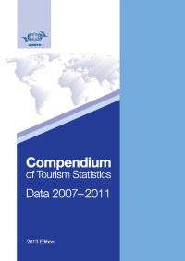
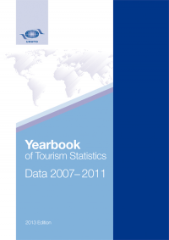
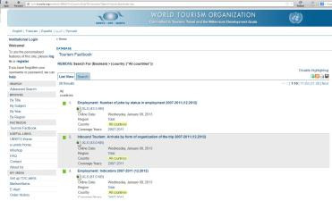
Tourism Statistics
Dissemination of data to users for
  Analysis,
  Advocacy,
  Policy design,
  Results-based management,
  Strategy.
Notes:
We at UNWTO believe that a proper measurement of tourism lies at the heart of a more effective management of the sector.
It is often said that «You manage what you measure», or «If you can measure it, you can manage and improve it».
Proper measurement is required for analysis, which is necessary for successful policy or strategy formulation, which in turn is monitored and evaluated on its effectiveness and efficiency.
The UNWTO statistics department is extremely helpful in this regard. The Compendium and Yearbook of tourism statistics are flagship publication and with the electronic version constitute the most comprehensive database on tourism world-wide!

Slide 14
The Compendium
Worldwide availability of comparable tourism data
205 Countries and territories
KEY
Countries with data published in the Compendium and Yearbook (2013 Edition)
Disclaimer: The maps elaborated by UNWTO are for reference only and do not imply any judgment on the legal status of any territory, or any endorsement or acceptance of such boundaries.

Slide 15
Coverage: Inbound Tourism
KEY
Number of available series
(44 series of total)
Disclaimer: The maps elaborated by UNWTO are for reference only and do not imply any judgment on the legal status of any territory, or any endorsement or acceptance of such boundaries.
Notes:
The Compendium of Tourism Statistics contains 145 series that cover 6 areas: inbound, domestic and outbound tourism, tourism industries, employment and complementary indicators. Each area is broken down in parts which are then broken down by series.
These maps represent the available statistical data by series compiled in the 2013 edition of the Compendium of Tourism Statistics.

Slide 16
Coverage: Domestic Tourism
KEY
Number of available series
(28 series of total)
Disclaimer: The maps elaborated by UNWTO are for reference only and do not imply any judgment on the legal status of any territory, or any endorsement or acceptance of such boundaries.

Slide 17
Coverage: Outbound Tourism
KEY
Number of available series
(11 series of total)
Disclaimer: The maps elaborated by UNWTO are for reference only and do not imply any judgment on the legal status of any territory, or any endorsement or acceptance of such boundaries.

Slide 18
Coverage: Tourism Industries
KEY
Number of available series
(30 series of total)
Disclaimer: The maps elaborated by UNWTO are for reference only and do not imply any judgment on the legal status of any territory, or any endorsement or acceptance of such boundaries.

Slide 19
Coverage: Employment
KEY
Number of available series
(17 series of total)
Disclaimer: The maps elaborated by UNWTO are for reference only and do not imply any judgment on the legal status of any territory, or any endorsement or acceptance of such boundaries.

Slide 20


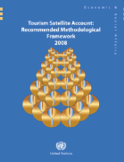
  Tourism Satellite Account: what is it?
Tourism: a TSA is about tourism and only tourism. It observes the definitions of “visitor”, “trip”, “tourism” in IRTS 2008.
Satellite: a TSA is satellite to a larger body, the System of National Accounts (SNA), that enables “zooming in” on tourism. It observes the concepts, definitions and relationships of SNA, so that its results are expressed in the same terms: Value Added, Gross Domestic Product, etc.
Account: a TSA consists of a set of tables that record observations and counts of certain economic activities, such as values of products supplied by tourism industries, employment in these industries, and inbound visitor expenditures.
TSA ≠ “model” (i.e. an approach to simulating visitor spending and deriving tourism receipts and employment over various industries)
TSA produces measurements of the direct economic contribution, models can use TSA data to derive indirect, induced effects
60 countries
Notes:
So what is a TSA really?
In order to answer this question, it is helpful to disect the term «Tourism Satellite Account».
… Tourism… (read remainder point slide)
… Satellite …. (read remainder point slide)
… Account… (read remainder point slide)
At UNWTO we are aware of some 60 countries who have or taking the necessary steps to develop some kind of TSA excercise based on the international recommended framework.

Slide 21
  Tourism Satellite Account: what is it? (ii)
a framework that enables measuring tourism in the same way as “traditional” economic activities (e.g. manufacturing, agriculture)
A statistical tool consisting of 10 tables, each representing a different aspect of tourism’s contribution to the economy :
Tables 1-3: Expenditure of Inbound, Domestic tourism and Outbound tourism
Table 4: Consumption
Table 5: Production (by tourism industries)
Table 6: Demand meets supply: Gross Value Added (GVA), Gross Domestic Product (GDP) attributable to tourism
Table 7: Employment
Table 8: Investment
Table 9: Government consumption
Table 10: Non-monetary indicators

Slide 22
TSA: determining factors
  Developing a TSA is a complex process: the elaboration of a TSA is not feasible if the tourism statistics are not well developed before. Both the system of tourism statistics (STS) and the country’s system of national accounts and related systems should be well described in statistical terms.
  Prerequisites of a TSA establishment: the country must measure inbound, outbound and domestic visitors and their expenditures and consumption (in accordance with the international standards: IRTS2008 and TSA:RMF2008), and must also set up an Inter-institutional Platform (pool of institutions involved in the production of Tourism Statistics: mainly NTA, NSO, Central Bank and Immigration Department that exchange their data and gather their knowledge).
  A TSA exercise demands the allocation of resources: principally in terms of Human Resources and finance.
Notes:
Developing a TSA is a long process (we are speaking about a medium or long term perspective). Developing a TSA is a complex process: the elaboration of a TSA is not feasible if the tourism statistics are not well developed before. The country must meet the following prerequisites: the country must measure inbound, outbound and domestic visitors and their expenditures and consumption (in accordance with the international standards: IRTS2008 and TSA:RMF2008), and must also set up an Inter-institutional Platform (roughly, it’s a pool of institutions involved in the production of Tourism Statistics that exchange their data and gather their knowledge: these institutions are mainly the National Tourism Administration, National Statistical Office, Central Bank and the Immigration Department). And finally, make clear that a TSA exercise is expensive, it demands the allocation of resources: principally in terms of finance and also in Human Resources.

Slide 23

  TSA: general benefits
  1st official, objective, credible measure of tourism’s economic contribution
  Helps raise profile of tourism and awareness of its economic importance by providing information not previously available
  Provides comparable measures between countries, over time, and to other economic sectors
  Provides government and private sector with powerful advocacy tool
  Its production requires good quality data, and usually leads to improvements in underlying or related statistics
  Requires close working relations between key stakeholders, thus can improve relationships and understanding
  Strong foundation for further research, e.g. calculating the indirect effects
Benefits of TSA depend on the users

Slide 24
  TSA: benefits to public sector
Accurate figures on which to base policy and decisions
  Better understanding and monitoring of the sector from an “industrial” perspective
  Suggesting new approaches to destination marketing
  Mainstreaming tourism policy within general evidence-based economic policies
  Opening new avenues of public-private sector cooperation and developing non-traditional partnerships
  Facilitating closer inter-departmental liaison and cooperation
  TSA is a powerful advocacy tool for National Tourism Administrations

Slide 25
  TSA: benefits to private sector
  Advocacy (for the first time a measure of tourism’s economic importance is objective and credible), especially vis-à-vis other sectors
  Identifying the composition of the sector (what industries provide goods and services to visitors and to what extent)
  Identifies component industries’ dependence on tourism
  Helps understand how the market is evolving (by providing consistent time series that reflect the composition of demand and supply)
  Assists in redirecting marketing activities, demonstrating how the market is evolving and changing
  Provides input to analysis of the strengths, weaknesses, opportunities and threats, supporting better planning of tourism development

Slide 26
  TSA: benefits to data producers, researchers
Data producers:
  TSA implementation can strengthen the overall national statistical system through:
    interagency cooperation
    the building of capacity
    identification of gaps or inconsistencies in underlying/related statistics and their improvement
    standardization of statistical methodology
    development of statistical infrastructures (periodic surveys, etc.)
    strengthening international comparability
  Increased public recognition of the importance of tourism statistics and justification for resources in this area
  Raising the interest of donor entities
Researchers:
  The quality of research produced can only be as good as the data it is based on

Slide 27
  TSA: How to distinguish it?
Observes UNWTO definitions (TSA:RMF 2008)
Limited to direct economic contributions
Measures ten Tourism Characteristic Products
Presents four main macroeconomic aggregates and one employment account:
  Internal tourism expenditure
  Internal tourism consumption
  Tourism direct gross value added
  Tourism gross domestic product
  Employment in the tourism industries
TSA is an exhaustively detailed accounting system incorporating standard definitions
Other economic impact estimation systems are models and simulations differing in definitions, coverage and outputs
Notes:
10 Tourism Characteristics Products: Accommodation services for visitors, food and beverage serving activities, passenger transport services (railway, road, water, air), transport equipment rental services, travel agencies, cultural services, sports and recreational services.

Slide 28
  Enabling economic impact analysis:
  an additional benefit of TSA
TSA, in itself, does not provide economic impacts but enables calculating them:
  Economic contribution of tourism: size and significance of the sector within the economy
    → direct effect; provided by TSA
  Economic impact: refers to changes in the economy resulting from specific events or activities that comprise a “shock” to tourism demand or supply
    → direct, indirect and induced effects; requires an economic model
Economic impact analysis:
Economic impact analysis:
Estimates changes to an economy from a shock (like an event, policy)
Traces flows of spending associated with tourism to identify the resulting changes in sales, output, government tax revenues, household income, employment…
Economic modelling
(like Input-Output, CGE)
TSA
+
=

Slide 29
  Conclusion
There are many reasons for adequately measuring and analyzing tourism
Though it is no panacea, the TSA is the most sophisticated expression of tourism measurement and has several benefits
TSA implementation is a continuous process striving for full integration into the System of National Accounts and, though its full results are often provided with a lag, it is possible to generate key TSA indicators on a more regular basis
Analysis of TSA data should be encouraged to:
  expand our understanding of tourism beyond its direct effects: indirect and induced
  understand the impacts of historical and future public (and private) sector actions

Slide 30
Thank you

Slide 31
Analysis: Comparing arrivals in a group of countries
Total tourist arrivals (‘000) in some African countries
Notes:
- Let’s proceed to some visual examples of how the data in these publications can be used to draw important information about countries, both Members and potential Members.
- We will provide an overview of about 20 different data and indicator series (20 out of the 145!), and show them in the order established in the Compendium and then proceeding to the Yearbook.
- This shows the arrivals of tourists in a group of African countries located more or less in the same geographic area.
- Please note that a tourist is a visitor whose trip includes an overnight stay. Those visitors who do not stay overnight are called excursionists (or same-day visitors).

Slide 32
Analysis: The length of foreign tourists’ stay across countries
Notes:
Continuing our examples of inbound tourism, this figure shows the average length of stay by inbound tourists in some Mediterranean countries.
Information of this kind could help us better understand the competitive landscape in the sub-region in terms of countries’ ability to retain tourists. For example, in the neighbouring countries of Spain and Portugal the average number of nights spent varies considerably—while tourists spend an average of more than 8 nights in Spain, tourists in Portugal spend less than 4.
Also, the duration of a trip is an important input in assessing and planning for the level of demand for tourism services, such as overnight accommodation services.

Slide 33
Analysis: Establishments in the tourism industries
Notes:
The Compendium also contains a section with information on the tourism industries composing the sector. It provides, amongst other things, the total number of establishments disaggregated by key tourism industries (like accommodation, food and beverage serving activities, passenger transportation, travel agencies, and others). An example is provided for South Africa. In principle, we could compare these figures to those of other countries, or look at how they change over time. We could also compare these figures with figures on establishments in other industries and sectors.

Slide 34
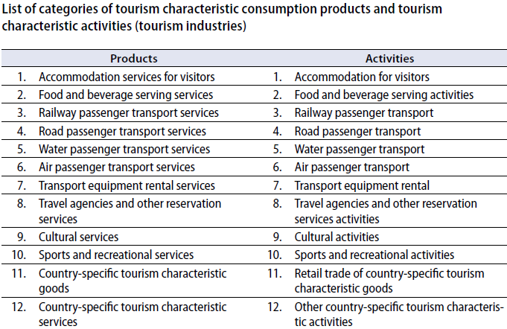
Air Passenger transport as a classified product and activity (industry)

