Slide 1
DIANA REY, Ph.D.
Cultural Area

Slide 2
Content
How did the manual come about and what was the process leading to this?
What measurement tools are used in the methodology of the Cultural Satellite Accounts?
A look at how the countries using CSAs have progressed.
What are the lessons learnt.
Recommendations for an international manual.

Slide 3
How did the idea of the manual come about and what was the process leading to this?

Slide 4
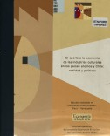
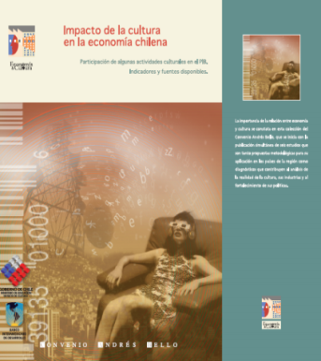
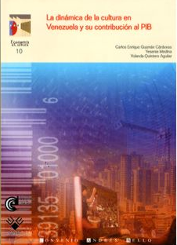
1999
Project - Economy and Culture.
Ecuador, Chile, Colombia, Peru and Venezuela.
Impact of Cultural Industries in Colombia and Chile
Impact of Cultural Industries in Venezuela and Bolivia
Manual “Cultural Satellite Account”
Initiation of the actualization process
Presentation of the Guide
2003
2005
2007-09
2013
2015

Slide 5
Declaration of the Ministry of Culture at the Conference on Iberoamerican Culture. Spain, 2012
Decision 782 of 2013 from the Andean Community regarding the Programme on "Harmonizing Statistics and Cultural Satellite Accounts" Peru, 2013.
Declaration of the XLI Official meeting of the Heads of State and governments of countries belonging to the Central American intergration system. Costa Rica, 2013
Declaration of the Meeting: “Withdrawal of ministers and high level authorities from Iberian-American Culture”, April,2014.
Declaration of the XVII Conference on Iberian-American Culture. Mexico 2014.

Slide 6
Phase I: 2013
Virtual work table for a technical needs diagnosis on the actualization of the CSC.
“Methological characterization for an economic valuation of Colombian Cultural Heritage", financed by the Colombian Minister of Culture.
Phase II: 2014
International meeting in Costa Rica with support from the Ministry of Culture and Youth. (11 countries and 7 cooperation bodies).
Conformation of the Actualization Committee (Dane – Colombia)
Phase III: 2015
Technical revision of the Guide delivered by Marion Pinot
Collectivisation and feedback provided by Colombia, Costa Rica, Mexico and ECLA.
Regional workshop on the application of the Implementation Guide on the Cultural Satellite Accounts.

Slide 7
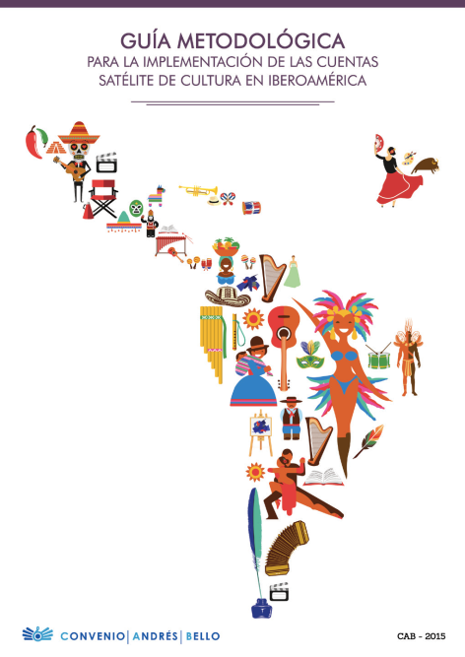
From the Methodological Manual to the Implementation Guide
All the countries belonging to the Iberian-American region, and SEGIB, OEI, ECLA, OEA, BID, AECID y CECC-SICA

Slide 8
Functional Definition of Cultural Field
“specific human activities and their products whose reason d´ être is the creation, production, diffusion, transmission, consumption and appropriation of symbolic content relating to the arts and heritage".

Slide 9
Sector | Subsector
Creation – copy right | literary, musical and audiovisual
Design | architectural, industrial or of products, graphic, textile, fashion, advertising, the web.
Games/toys | Traditional games and toys
Performing arts and artistic performances | theatre, dance, other forms of performing arts (circus, pantomime, narration, declamation etc.)
Visual arts | Fine arts (including representations of mixed origin), photography, graphic arts and illustration.
Music | Live music performances, music editing, phonographic production.
Audiovisual and radio | cinema and video (including animation), radio, television, online games, video games.
Books and publications | books, periodical publications, libraries, other editorial products, music scores, postcards, posters and calendars)
Cultural education - | informal cultural education (through the use of games and activities), formal cultural education (including basic primary and secondary education, higher education, education on fine arts, design and other, curation and cultural management)
Material heritage | historical cultural archives, other types of heritage relating to buildings (historical centres, historical monuments, archaeological heritage), other types heritage relating to property of furniture (antiquities, paintings etc..)
Non-material heritage | traditional festivals and customs, traditional food, handicrafts, language

Slide 10
The Guide uses an Internationally Recongnisable Industrial Classification System (IUIC) in its current version 4 and the Central Classification of Products (CCP), revision 2.
Frames of analysis
Production accounts of the designated activities
Equilibrium supply-demand of the specific products
Structure of the productive sector and use of the designated activities
National spending classified as per financier-beneficiary
Synthetic indicators
National cultural spending
Added cultural value

Slide 11
Objectives
Characterize the cultural field, establishing its frontiers, limitations and taxonomy.
Identify cultural products, the activities which they generate, determine their uses, production, exchange and consumption mechanisms.
Establish and analyse cultural expenditure and consumption according to its objective, nature and beneficiaries.
Present the information based on the supply and demand of cultural products, incorporating both monetary and non-monetary information.
Determine the economic trends of cultural products within foreign trade.

Slide 12
Objectives
Identify (complementary) monetary and non-monetary indicators which are relevant to explaining the economic variables established as part of the measurement techniques within the cultural field.
Determine the evolution and contribution of cultural economy within the national economy.
Promote the generation of basic statisitcs to strengthen measurement techniques within the cultural sector.
Foster the intergration of economic calculations around culture within the central framework of national accounts on cultural information.
Serve as a source of information for the development, monitoring and evaluation of public policies on cultural matters.

Slide 13
Tools set I: Conceptual and methodological aspects of the Cultural Satellite Accounts
The dynamic relation between culture and economics.
Concepts, scope and measurement framework of the CSAs.
Tool set II: Tools to characterize and calculate the Cultural Satellite Accounts
Delimitation and segmentation in the field of measurement.
Production accounts and accounts generating revenues of characteristic cultural activities.
Equilibrium of supply-utilisation of cultural products.
Analysis of cultural expenditure and its funding.
Analysis of the cultural job market.
Complementary indicators of the Cultural Satellite Accounts.
Source of information and preparation of data.
Tools set III: Instruments to implement Cultural Satellite Accounts
Minimal conditions and recommended actions to design the CSA.
Road map to implement the Cultural Satellite Accounts.
Glossary.

Slide 14
A look at how the countries using CSAs have progressed

Slide 15
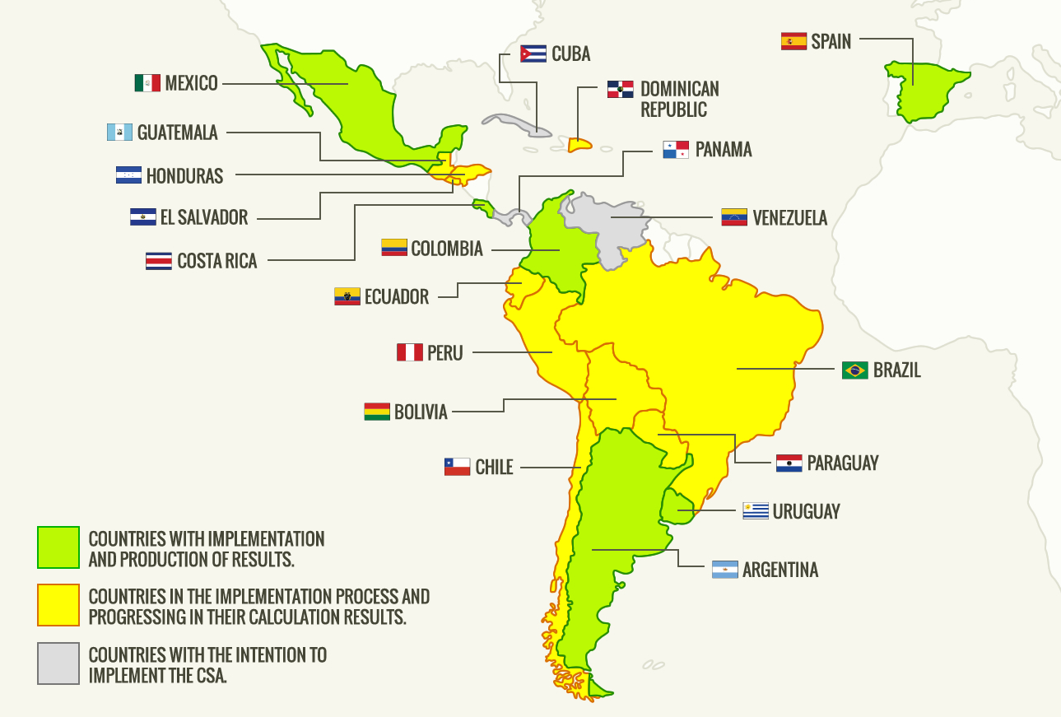

Slide 16
Country | Year Base | Year Results | Last Publication | GDP
Argentina | 1993 | 2004-2011 | 2012 | 3.4%
Colombia | 2005 | 2000-2010 | 2013 | 1.8%
Costa Rica | 2011 | 2010-2012 | 2013 | 1.4%
Mexico | 2012 | 2008-2012 | 2014 | 2.7%
Spain | 2000 | 2000-2009 | 2012 | 2.5%
Uruguay | 2005 | 2005-2008 | 2009 | 1.9%

Slide 17
COUNTRY | CALCULATED INDICATORS |  |  |  |  |  | YEARS RESULTS
 | PRODUCTION | GDP | OFFER | SPENDING | EMPLOYMENT | NON-MONETARY
Argentina | X | X |  |  | X | X | 2004-2011
Colombia | X | X | X | X | x |  | 2000-2010
Costa Rica | X | X | X | X | X | X | 2010-2012
España | X | X | X |  | X | X | 2000-2009
Uruguay | X | X |  |  | X | X | 2005-2008

Slide 18
COUNTRY | CALCULATED SECTORS |  |  |  |  |  |  |  |  | Heritage
 | Creation | Design | Games and Toy stores | Performing Arts | Visual Arts | Music | Audiovisual and radio | Books and publications | Cultural education
COLOMBIA |  |  | x | x |  | x | x | x | x
COSTA RICA |  |  |  |  |  |  | x | x
SPAIN |  |  |  | x | x | x | x | x | x | x
MEXICO |  | x | x | x | x | x | x | x |  | x
URUGUAY |  |  |  | x | x | x | x | x | x | x

Slide 19
The methodological trends and highlights
Years of economic base: 1993 (Argentina), with the longest record. 2011 (Costa Rica).
Not a single country listed has implemented all the methodology for the calculation of employment.
The longest results are from Spain (2000-2011) and Colombia (2000-2010) and the shortest, have them Mexico and Uruguay (2005-2008).
Costa Rica decided to measure advertising as an economic sector.
Chile carried out some methodological modifications, and now they renamed the exercise as an exploratory statistical operation.

Slide 20
Disadvantages relating to the measuring processes
Lack of information from what can be classified as “informal economy” or illegal activities which take place in the countries of that region.
The difficulty to identify what can be defined as those working in the cultural sector.
The lack of data representing activities taking place in rural areas.
The lack of sensitisation on behalf of cultural agencies on the importance of providing the information.
The difficulty to access information regarding cultural products, whose processes of creation and production go beyond the traditional national frontiers and their dissemination channels, are therefore often not captured in the more traditional distribution channels.

Slide 21
What are the lessons learnt and recommendations for a possible international manual?

Slide 22
Minimal conditions
Rely on a consolidated System of National Accounts (SNA) which is framed in the SNA of the year 2008.
Develop a socioeconomic characterization of cultural sectors to be used as a type of economic measurement within the sector.
Foster exchange of information between agents and cultural institutions.
Recommended actions
Intergrate the proposals given by the Cultural Satellite Accounts within the Statistical Plans of each participatory country.
Design a work plan to put in place the Cultural Satellite Account.
Generate feedback between the Cultural Satellite Account proposals on measurement techniques and other related accounts.

Slide 23
Recommendation for the road map
Create a map of the institutional and statistical framework.
Undertake interinstitutional actions.
Conformation of an interdisciplinary team to measure the CSA and start of activities.
Selection of the (statistical) universe and prioritisation of sectors.
Apply the CAB methodology and proposed calculations.
Analyse and validate results.
Divulge and make the results known socially.
Monitor and evaluate results.
Establish alliances and resources to guarantee the continuity of the Cultural Satellite Accounts.
Record experiences relating to measurement methods and techniques.

