Slide 1
UNESCO Institute for Statistics
Cultural Satellite Experts Meeting
Bonnie Nichols
Office of Research & Analysis
National Endowment for the Arts
November 2015

Slide 2
Arts and Cultural Production Satellite Account (ACPSA)
Produced by the U.S. Bureau of Economic Analysis in Partnership with the National Endowment for the Arts
Notes:
First step was to develop partnership with the Bureau of Economic Analysis. De-centralized statistics in U.S..

Slide 3
Guide
ACPSA production is defined as production intended chiefly as a function of creative or cultural engagement, or whose goods and services are intended primarily to facilitate public access to such output.

Slide 4
Concentric Circles Model of Cultural Industries
David Throsby, Macquarie University, Sydney Australia
Notes:
For examples, we looked to a number of frameworks for arts and cultural satellite accounts: Canadian, Australian, UNESCO, among others.

Slide 5
Related industries
Wider cultural industries
Core creative arts
Other core creative industries

Slide 6
Core creative arts—performing arts; independent artists; promoters and agents.
Other core creative—architectural and design services; photography services; arts educational services.
Wider cultural production—motion picture/TV; sound recording; publishing.
Related production—manufacturing (jewelry, musical instruments); construction (new theaters, libraries); and retail sales (art galleries, book stores).
Notes:
Examples

Slide 7
ACPSA Production is Estimated from the Ground Up Items/Commodities/Industries
Items
“Advertising agencies”; radio, TV, and cable advertising; newspaper advertising
Excludes public relations, media buying, and distribution
Commodity
“Creative” advertising
(Nearly $240 billion in 2013)

Slide 9
Notes:
4.32% of U.S. GDP

Slide 12
Obstacles
Large responsibility for the NEA
Creative economy
Misunderstandings about the ACPSA
Multiplier caveats ($1.69)
Self-employed workers (Schedule C)
State-Level Estimates
Data
Notes:
Arts and cultural production accounts for half of the creative economy. Adjustment for non-compliance

Slide 13
Lessons Learned

Slide 14
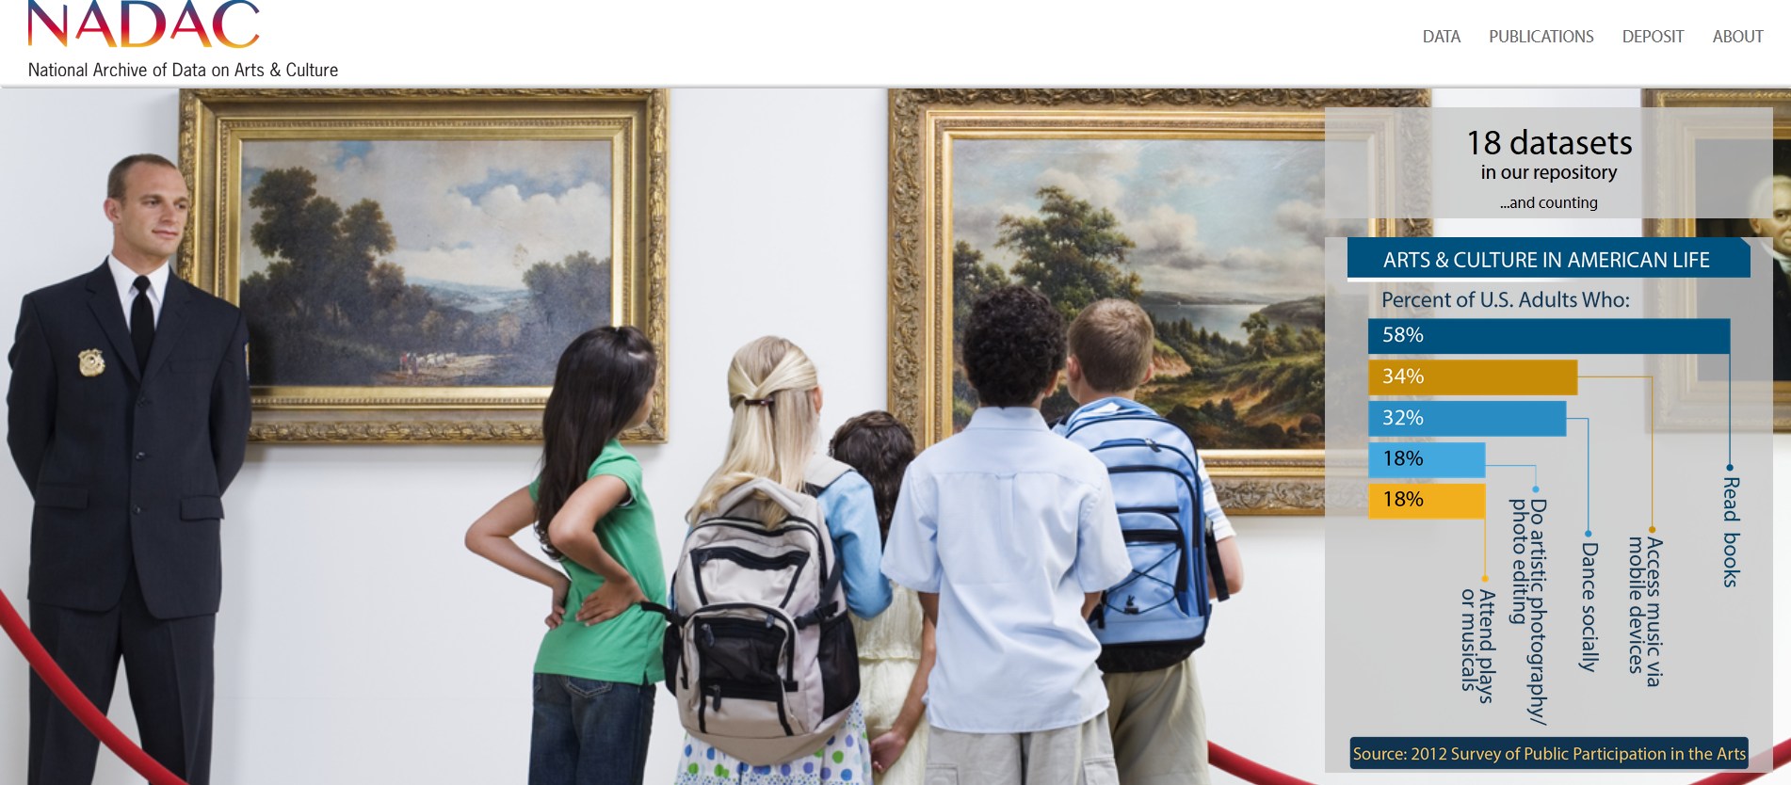
National Archive of Data on Arts & Culture

