Slide 1
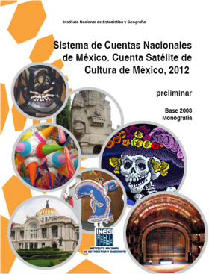

Culture satellite account of Mexico

Slide 2
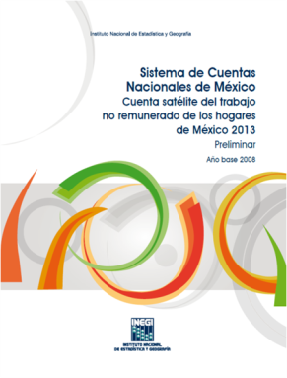

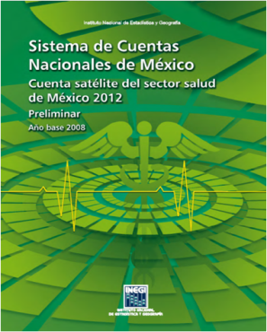
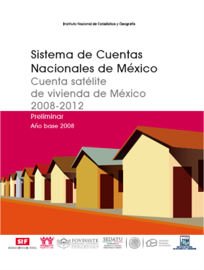
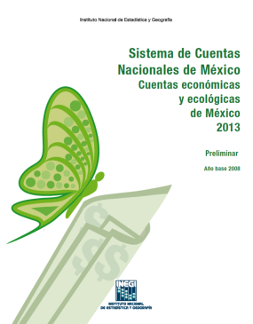
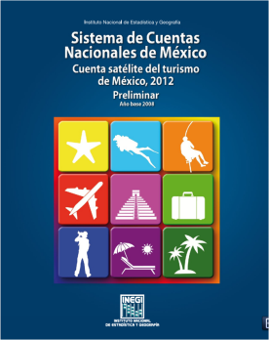
The satellite accounts in Mexico
Non-profit
institutions
Housing
Household
production
Health
Environment
Tourism
Culture
Developing:
Environmental - economic accounts of ecosystems
Green Growth Indicators
Impact of mining on the economy, society and environment

Slide 3
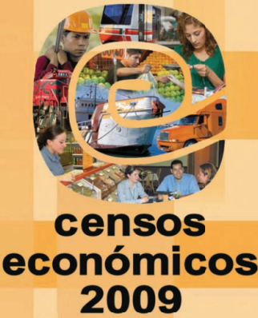
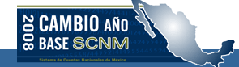
Information sources
Base year
Intercensal years
Goods and services Account
Price
index
Surveys
Economic Census

Slide 4










Technical Working Group
A consulting group was established to provide technical support to the CSA
Participants:
Cultural institutions
Handcrafts
Cinematography
Publishing
Universities

Slide 5

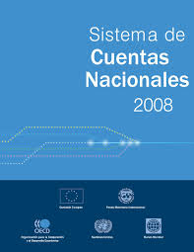
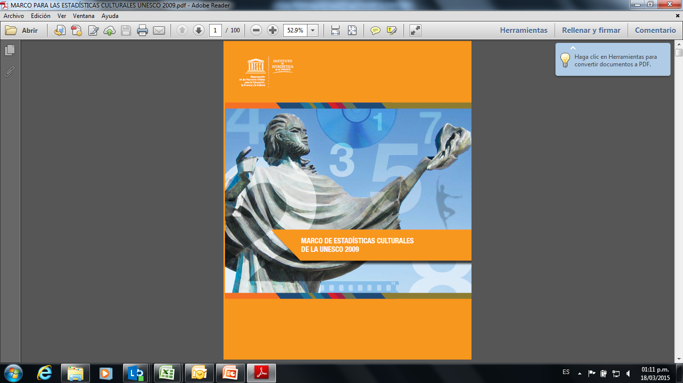




Culture Satellite Account
Objective
To identify and measure the economic flows generated by the activities and products conforming the cultural sector.
Conceptual
Framework

Slide 6
Culture Satellite Account - Definition
The economic sector of culture is defined as a set of products and social activities based on creative and symbolic aspects which are transformed, through a process of creation, production, transmission, consumption, conservation and formation, into goods and services.
Consists of quantifying the value of the economic activity, acknowledging that the reality of the cultural phenomenon has other dimensions and manifestations not considered in this satellite account.

Slide 7

Characteristic or related activities ¿?
Is culture the reason to be of this activity?
No
Is culture feasible without this activity?
Yes
No
Yes
Characteristic
Related
Not included

Slide 8
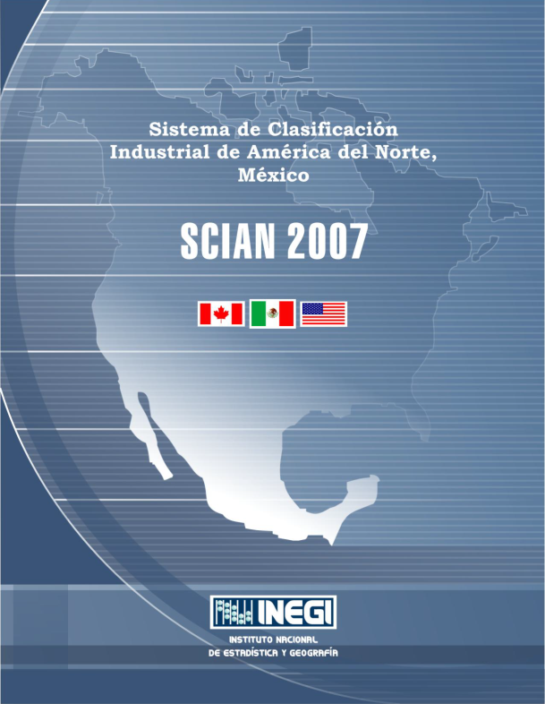
Culture Satellite Account
103 National industries
71 characteristic activities
32 related activities

Slide 9
Culture Satellite Account
NAICS 2007
ISIC 4
103 National industries
1,049 National industries
56 Classes
419 Classes
10%
13%

Slide 10


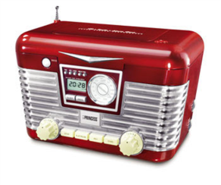



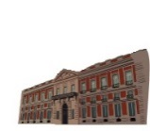

Culture Satellite Account
Market
production
Government
Household
production
Non-market activities

Slide 11
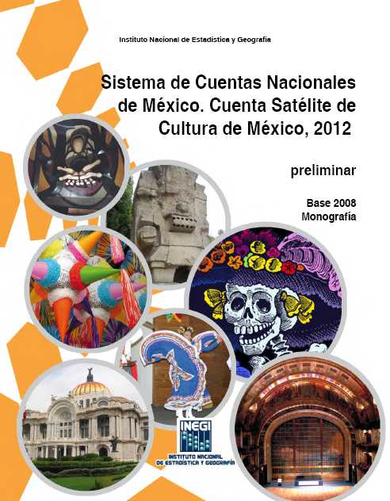
Contributions from other satellite accounts
Non-profit
institutions
Household
production
Health
Tourism
Government
Household
production
Market
Culture

Slide 12








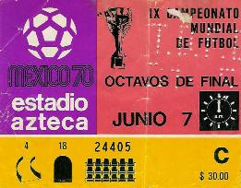

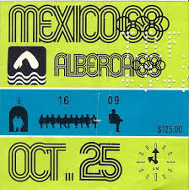

The mexican case
Festive events (household production)
Handcrafts (output for own final use)
Traditional toys
Sports events
Software design
Street commerce
Street performances

Slide 13
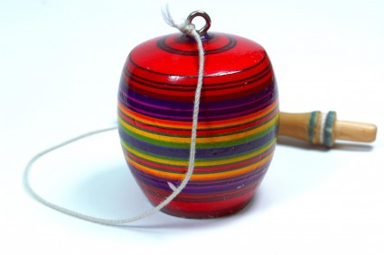


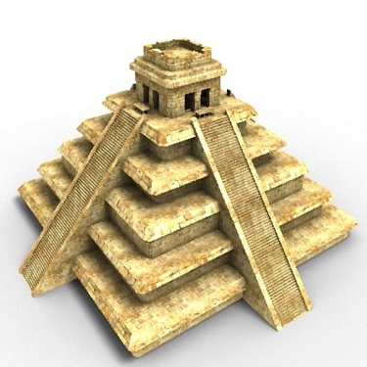
Functional classification (percentage distribution)
Culture GDP, general and specific areas, 2012^{P}
Handcrafts and traditinal toys
Design and creative services
Performing arts
Music and concerts
25.3%
12.2%
1.7%
1.4%
33.9%
12.5%
11.4%
1.6%
Audiovisual media
Visual arts and photography
Publishing
Heritage
^{P} Preliminary

Slide 14



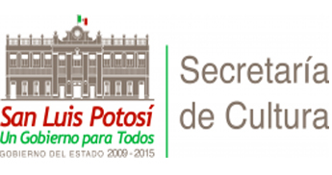








Non-market valuation: Government
147
Specialized units
31
103
Federal
States
13
Non-specialized federal units

Slide 15
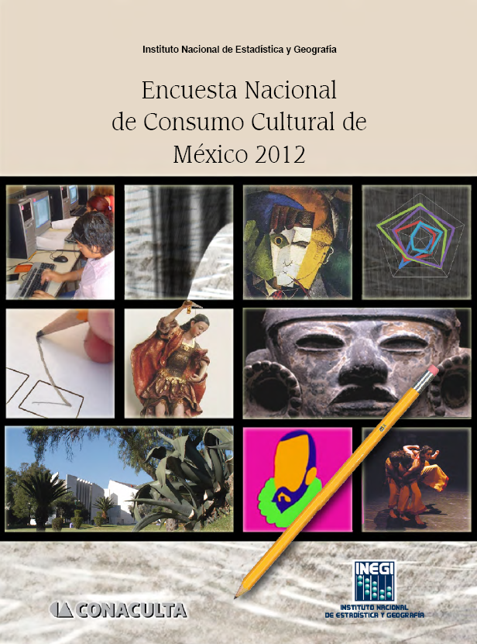



National Survey of Cultural Consumption
Objetive:
Gather information on the households’ expenditure in the cultural field, so as to quantify the economic aspects associated with Culture.
Total expenditure for the adquisition of cultural goods and services by households
Handcraft production
Volunteer participation

Slide 16



National Survey of Cultural Consumption
Main results:
Households’ expenditure for purchasing cultural goods
and services amounted to
122,269
million pesos, equivalent to 3.8% of their total expenditure* in the year 2012.
The attendance to cultural sites and events is equivalent to
389 times the capacity of the Azteca Stadium.
24.8%
is spent to access cultural sites and events
6.7%
is spent on cultural courses and workshops.
*Sources: National Survey of households’ Income and expenditure. National Survey of Cultural Consumption

Slide 17
Culture Satellite Account
Main results:

Slide 18
Main results for 2012
Culture
GDP:
405,997^{P}
million
pesos
Market
economic
valuation
2.0%
3.7%
of the GDP
Δ per year
Government economic
valuation
0.1%
0.9%
of the GDP
Δ per year
2.7% of the GDP
Household
production
(survey)
0.6%
5.0%
of the GDP
Δ per year
^{P} Preliminary

Slide 19
Main results for 2012: constant prices
Culture GDP: Annual growth rate, 2008 - 2012
(2008 prices)
Growth %
Culture
Total economy

Slide 20

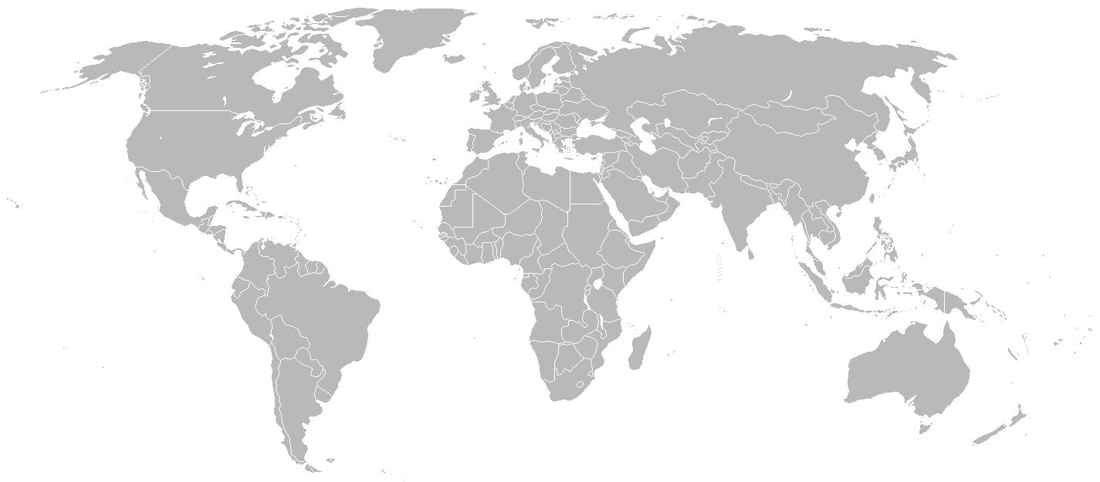









Culture Satellite Account: international comparative
Culture GDP. International comparative
FIN
(2012)
3.2%
3.1%
CAN
(2010)
CZR
(2010)
1.7%
4.3%
USA
(2012)
SPA
(2012)
1.4%
2.5%
2.7%
MEX
(2012^{P})
COL
(2007)
CR
(2013)
1.8%
AUS
(2009)
4.0%
1.3%
CHI
(2007)
* 2.2% accounts to the market and government valuation and 0.6% accounts to the households cultural production (measured by the survey), which isn’t included by other countries.

Slide 21
Thank You!

