Slide 1
Culture Satellite Account in the Context of the UIS Culture Statistics Programme
UIS Culture Satellite Account Experts Meeting (CSAEM)
4-6th November 2015
Lydia Deloumeaux, Assistant Programme Specialist,
UNESCO Institute for Statistics
UIS Culture Statistics Unit

Slide 2
Presentation Outline
The Need for the Sustainable Development of Cultural Statistics: UIS Programme of Work
Contribution of current work to CSA
Purpose of the Cultural Satellite Account Expert Meeting

Slide 3
The Need for the Sustainable Development of Cultural Statistics: UIS Programme of Work

Slide 4
“True, there have been drastic global changes with regard to culture; demand for cultural products has increased significantly, market power has grown and become increasingly concentrated in a small number of multinational conglomerates, the legal and political institutions that are in charge of cultural regulation and promotion wield greater influence, and there is now a complicated mechanism of interdependence between the public and the private sphere. In light of this, it is all the more necessary to have access to reliable data that can be compared across borders in order to determine the status of the cultural sector, its weaknesses and its strengths.”
- Belén Usero & Jesús Angel del Brío (2011 pp. 197)
.

Slide 5
UIS Culture Programme Strategy
Develop Statistical concepts, standards and methodologies in Culture Statistics
Provide Technical assistance and training in Culture Statistics to stakeholders
Measurement of the Culture Sector
Carry out Global culture surveys and maintain international databases

Slide 6
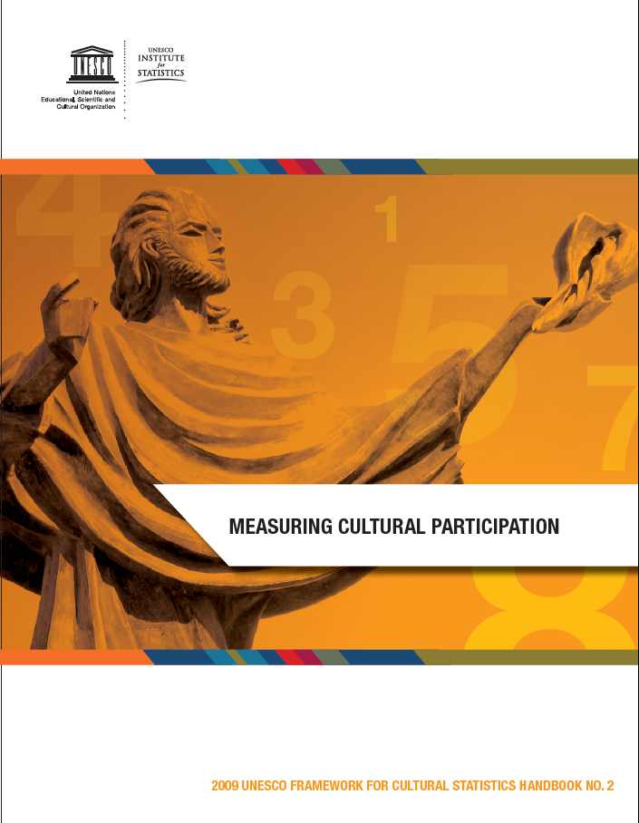
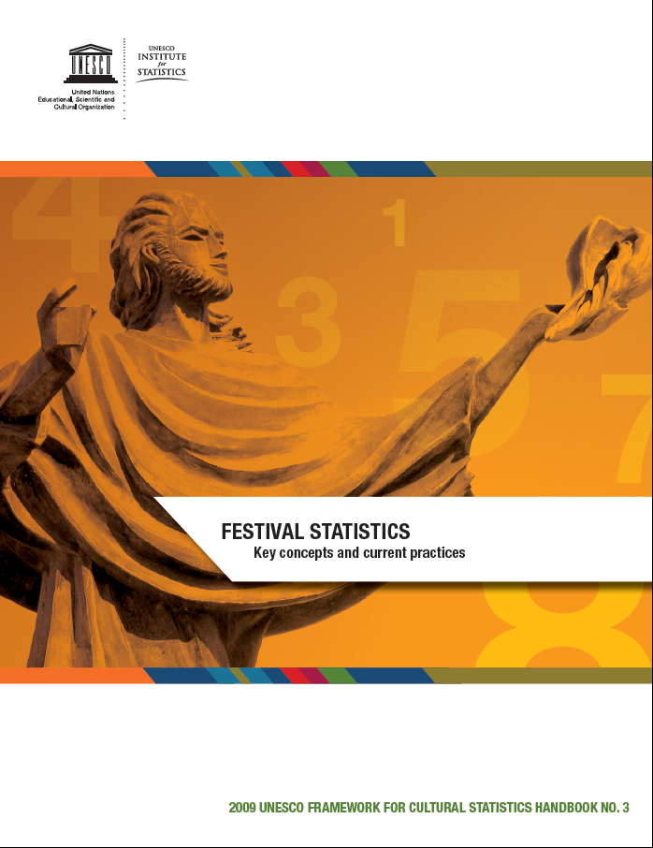
Methodological Resource Documents: Handbooks and Guidelines: Social dimension

Slide 7
Global Culture Surveys
UIS Survey of Feature Film Statistics
Survey Cycle: 2014, 2016, 2018, 2020…
Global Survey of Cultural Employment
Survey Cycle: 2015, 2016, 2017, 2018…
Database of Cultural Goods and Services Trade Statistics
Secondary data collection (UNSD and WTO)
Update and new analysis (2015)

Slide 8
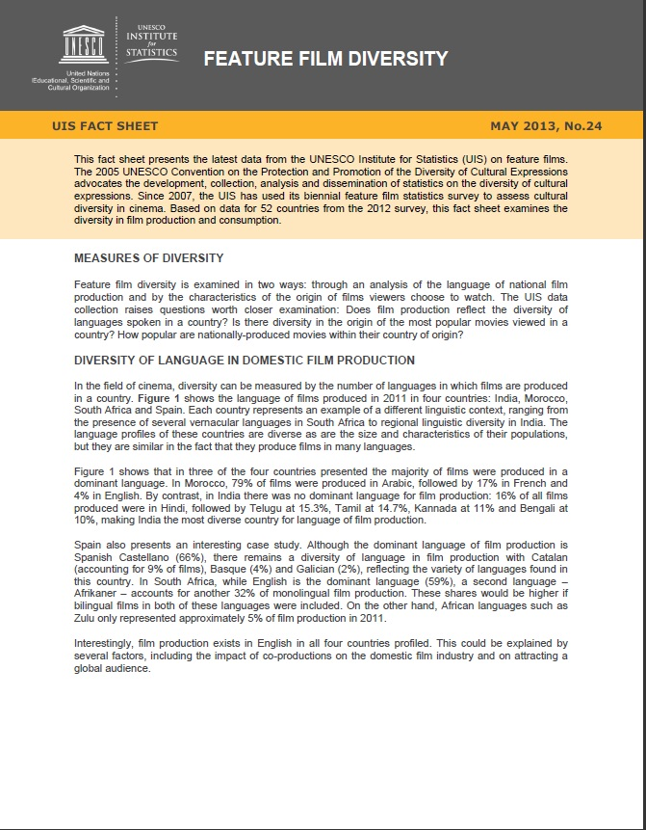
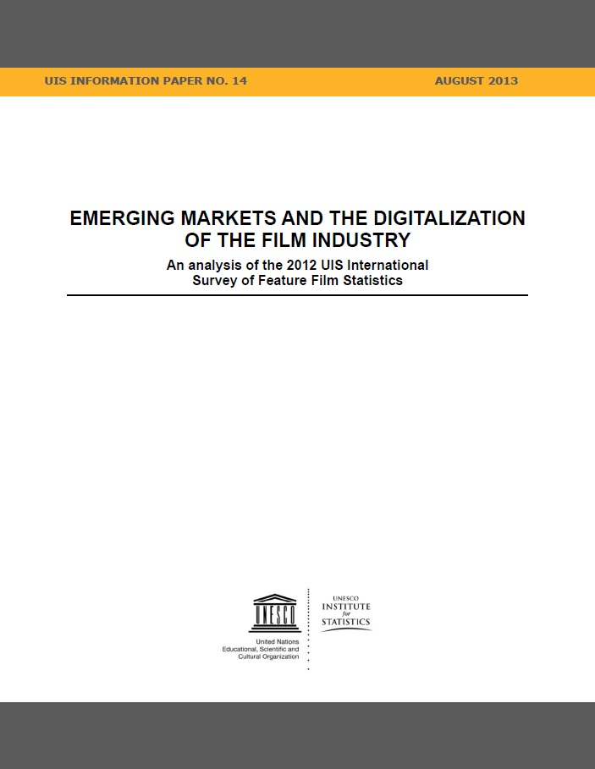
Global Survey of Feature Film Statistics Analysis of the Global Film Sector

Slide 9
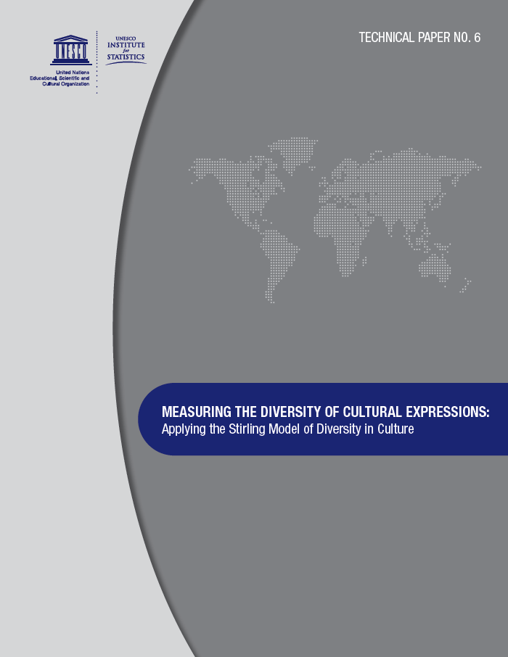
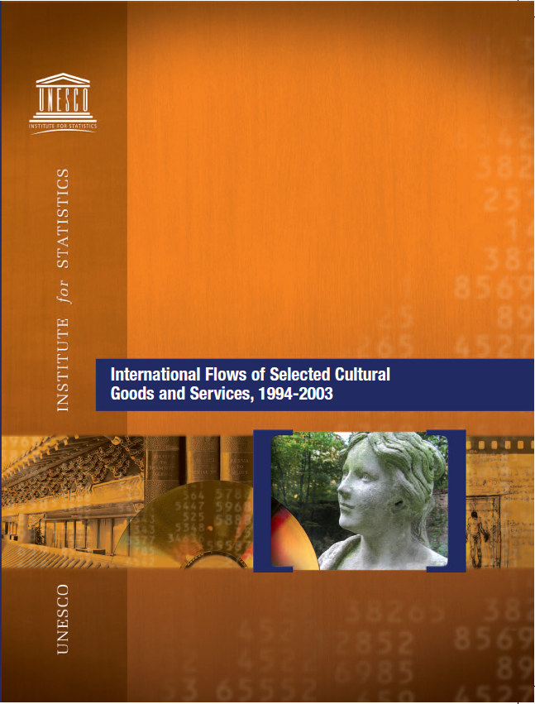
Analysis of the Diversity of the Film Sector; International Cultural Trade

Slide 10
Technical assistance and training in Cultural Statistics
Regional Workshops (2008-2015)
Training on 2009 UNESCO FCS and selected topics in cultural statistics
Technical assistance on request
National Workshops
Country specific

Slide 11
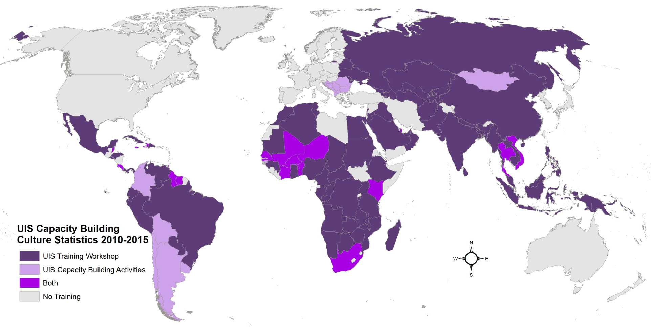
Technical Assistance and Training in Culture Statistics

Slide 12
Contribution of current work to CSA
2009 UNESCO FCS
Survey of Cultural Employment
Culture Trade Statistics

Slide 13
2009 UNESCO FCS: Defining Culture for CSA
To provide concepts and definitions
To guide the production of comparable statistics
To support the development of indicators and analytical research in the culture sector

Slide 14
What is the 2009 UNESCO FCS?
Conceptual model for defining culture for statistical purposes
Tool for organizing cultural statistics internationally and nationally
Methodology to support the production of harmonized data and indicators
Classification instrument that includes taxonomies from recognized international standard classifications for use in cultural statistics.
Occupations
Industries/
Activities
Goods and Services

Slide 15
Defining Culture for Statistical Purposes:
The behaviors and practices resulting from the set of distinctive spiritual, material, intellectual and emotional features of a society or a social group
These activities, goods and services are categorized by the FCS domains and constituents

Slide 16
The Cultural Cycle
Describes the physical process by which cultural goods and services are created, produced or performed, distributed and preserved
It helps us to understand the relationship between different cultural processes
Illustrates the totality of practices, activities and necessary resources that are required to transform ideas into cultural goods and services that, in turn, reach consumers, participants or users

Slide 17
The Culture Cycle (cont.)

Slide 18
FCS Cultural Domains

Slide 19
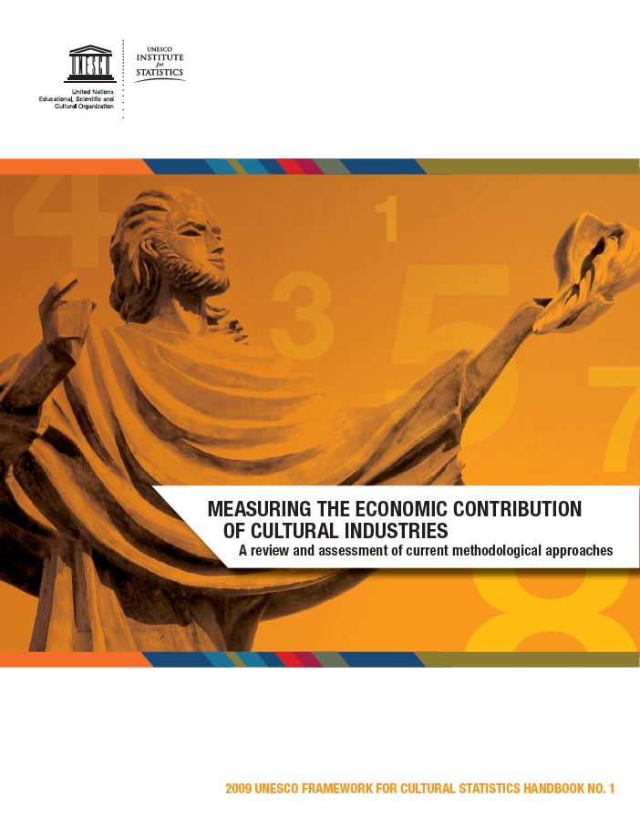
Methodological Resource Documents: 2 Handbooks on economic contribution of culture

Slide 20
FSC 2009 Cultural Employment Approach
 | Cultural Industries | Non- Cultural Industries
Cultural occupations | A | B
Non-cultural occupations | C
Cultural occupations
Ex: visual and performing artists, musicians, film directors, editors, librarians, architects, craftsmen, arts teachers and designers
Employment in cultural industries includes
Ex: those working in companies, enterprises and establishments dedicated to cultural activities such as publishing houses, theater companies, television and broadcasting enterprises, crafts workshops, art schools, bookstores, museums and libraries

Slide 21
The Classifications Used in the 2009 UNESCO FCS
Type of measures | Names of classifications
Economic Classifications Production: | International Standard Industrial Classification (ISIC 4)
Production | Central Product Classification Version 2
Trade | Goods: Harmonized Commodity Description and Coding System (HS) Services: Extended Balance of Payments (EBOPS)
Employment | International Standard Classification of Occupations (ISCO 08)
Social | International Classification of Activities for Time-Use (ICATUS)
? | Others to be added as required

Slide 22
CSAEM Meeting purpose

Slide 23
CSAEM’S Purpose
Identify lessons learnt from national and regional experiences on CSA
Study the feasibility of developing international instrument on CSA
Review of the Study on CSA: An examination of Current Methodologies and Country Experience
Study link with other standards: TSA
Identify the different steps needed for the development of an international standard on CSA

Slide 24
Thank you!

