Slide 1
Quarterly National Accounts of Pakistan
by
Attiq-ur-Rehman
Director,
National Accounts,
Pakistan Bureau of Statistics

Slide 2
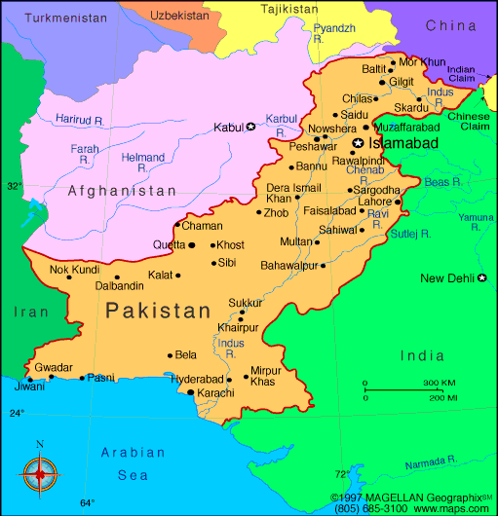

Slide 3
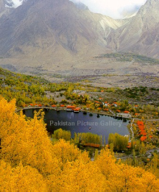
GEOGRAPHICAL FEATURES
Population: 188 Million
Population growth rate: 1.8%
GDP Growth: 4.1%
Area: 804 th. sq km
Per Capita Income: 1386 US $
Highest point: K2 (Mt. Godwin-Austen) 8,611 m
Literacy: Total popn: 60% (M: 71% ,F: 48% )
Labor force: 60.3 million

Slide 4
History of QNA in Pakistan
PBS initiated the work of Quarterly National Accounts (QNA) on experimental basis in 2013-14.
Prepared first quarter estimates for 2013-14 in January 2014.
Prepared half yearly estimates for 2013-14 in April 2014.

Slide 5
National Account‘s Base & other Surveys
First base: 1959-60
Second base : 1980-81
Third base : 1999-2000
Fourth base : 2005-06
Fifth 2015-16 (under way)
LFS conducted on Quarterly Basis.
Pakistan Living Standard Measurement Survey conducted on Quarterly Basis.

Slide 6
Sectors of Pakistan Economy
A. Agriculture Sector
Crops
Important Crops
Other Crop
Livestock
Fishing
Forestry

Slide 7
Sectors of Pakistan Economy
B. Industrial Sector
Mining and Quarrying
Manufacturing
Large Scale
Small Scale
Construction
Electricity Generation & Distribution , & Gas Distribution

Slide 8
Sectors of Pakistan Economy
C. Services Sector
Transport, Storage & Communication
Wholesale & Retail Trade
Finance & Insurance
Housing Services
General Government Services
Other Services

Slide 9
Crops
Important Crops: Rice, Wheat, Cotton, Sugarcane, Maize
Other Crops: Pulses, Vegetables, Fruits, Oil seeds, Condiments, etc. (105 crops and 15 byproducts)
Output (Constant): Base year Prices are multiplied by Production.
I.C: Seed, Fertilizer, Pesticides, Water, Ploughing & Planking, transportation, Wastage, etc.
Source: Provincial Crop Reporting Departments. They provide area and production only.
Data of Fertilizer, Pestisides and Water is provided by the concerned departments.

Slide 10
Crops (Quarterly)
Output: Output of crops is distributed in quarters according to its harvest period. Ratios have been developed on the basis of studies and experts opinion.
Inputs: Input is bifurcated on basis of quarterly share of Out put in the quarters.
- Issues: How to incorporate Work in progress?

Slide 11
Livestock and Poultry
Livestock
Buffaloes
Cattle
Sheep
Goats
Camels
Horses
Mules
Asses
Poultry Products
Broilers (Farming)
Layers (Farming)
Poultry (Desi)
Ducklings
Eggs (Farming)
Eggs (Desi)
Livestock Products
Milk
Draught Power
Dung & Urine
Wool & Hair

Slide 12
Live Stock
Net Sale (Sale – Purchase of Animals) = Sale of Animals for Slaughtering
Natural Growth
Livestock Products
Milk
Draught Power
Dung & Urine
Wool & Hair
Poultry Products
Broilers (Farming)
Layers (Farming)
Poultry (Desi)
Eggs (Farming)
Eggs (Desi)

Slide 13
Intermediate Consumption
Fodder
Green
Dry
Concentrate( grains, oil cakes)
Poultry Inputs
Other Inputs
Transportation, POL, etc
Medical care Medicines etc
Interest (Bank charges)
Repair & Maintenance
Rent Paid (Building, Machinery etc)
Value of chicks
Salt
Issue : Having no Quarterly data certain coefficients have been derived for each component of gross output for the base year.

Slide 14
Forestry
Gross Output
Timber
Firewood (Used by Industry and Used by house hold Non wood Forest Products/Own A/C Capital Formation
Medicinal Herbs
Mazari & Gum
Wild Mushroom
Honey & Wax
Silk Worms
Wild Fruits
Intermediate Consumption=24.99% of Timber and Firewood

Slide 15
Forestry
Output, Intermediate Consumption and value added have been calculated for base year in detail. Input output ratio of the base year is applied for calculation of IC and GVA.

Slide 16
Mining & Quarrying
Composition: Crude oil, Natural Gas, Coal including other minerals, e.g. Rock Salt, Lime Stone, Dolomite, Gypsum, Fire clay, Phosphate, Marble, and Surface Minerals.
Output: Production data is available on monthly basis which is multiplied with base year prices to calculate out put at constant prices.
Intermediate Consumption:
Intermediate consumption is calculated by multiplying the output at constant prices with the respective input-output ratio of the base year.

Slide 17
Large-scale manufacturing
Composition: Food, Beverages, Tobacco, Textile, Leather, Wood & Wood Products, Paper & Boards, Chemicals, Pharmaceutical, Petroleum, Metal, Engineering, Electrical, Automobile and other Industrial products/ groups.
For calculating growth rate of value added, Quantum Index of Manufacturing (QIM) is computed based on production data of 112 items having 70.33% weight (bench-mark 2005-06) of Large Scale Manufacturing Sector.
Production data of 112 items is available on monthly/ Quarterly basis.

Slide 18
Small-scale manufacturing
Composition: All small and household manufacturing establishments
Benchmark Estimates of Gross Value Added:
Based on SHMI Surveys 1996-97 and 2006-07.
Annual Growth: A constant growth rate is applied to extrapolate the estimates
-Issue: Constant growth rate is applied on each quarter as there is no direct data available.

Slide 19
Construction
Composition: All major construction activities including repairs, additions/alterations, Land Improvement; Buildings; Roads, Bridges, Streets; Highways; Runways; Transport & Railway Tracts; Telephone, Power, Gas, Oil, Utility lines; Canals; Dams; Harbour & Barrages etc.
Sources: Federal, Provincial & Local Bodies, Development Authorities, Major Public & Private Construction Establishments, Pakistan Bureau of Statistics.
Value added coefficients of Investment by kind of construction calculated for the base year are multiplied to Investment made in that activity during the year. Value additions of all activities are summed up.

Slide 20
Electricity, gas distribution
Composition: Electricity, Gas distribution
Output: Quarterly data from the sources is available.
Intermediate Consumption:
Quarterly data from the sources is available.

Slide 21
Transport, storage & communication
Composition: Land, Air, Water transport and Storage & Communication
Output: Quarterly data from the sources is available.
Intermediate Consumption:
In most of the cases the quarterly data is available.
Gross Value Added: Value of output (plus) Misc. Receipts (minus) intermediate consumption

Slide 22
Finance & insurance
Composition: State Bank of Pakistan, Scheduled Banks, DFIs, Insurance Companies, Modaraba & Leasing Companies.
Sources: State Bank of Pakistan, Scheduled Banks, Development Financial Institutions, Life and General Insurance Cos, Modarabas & Leasing Companies.
Gross Value Added:
Computed on the basis of quarterly data/reports from the sources

Slide 23
Wholesale & retail trade
Composition: | All Agricultural Products ,Forestry and fishing, Industrial Products(Large scale ,Small scale & Slaughtering and Imports, CNG, Maintenance and Repair of Vehicles
Sources: | Provincial Governments & Pakistan Bureau of Statistics
Value Added: | Total value of trade margins applied on the marketed portions of Agriculture and Industrial Output as well as Imports.

Slide 24
Hotels & Restaurants
Composition: Accommodation and food Services
Food and Beverages Services
A constant Growth rate of 4.92% is applied based on two surveys 1984-85,2005-06.
Issue: Constant growth is applied on each quarter.

Slide 25
Housing Services
Coverage: | Number of dwelling Units (rented as well as self occupied or rent free) in urban and rural areas
Sources: | Housing Census 1981 &1998 & Rent Survey2007-08
Gross Value Added: | Gross Rentals (No. of Dwellings multiplied by average annual rent (minus) Value of current repairs and maintenance, commission paid to real estate agents.

Slide 26
General Government Services
Composition: | Federal, Provincial , District, TMAs and Cantonment Boards.
Sources: | Budget documents of Federal, Provincial, District, TMAs and Cantonment Boards.
Gross Value Added: | Sum of the compensation of employees and consumption of fixed capital
Issue: | Budget data is available on annual basis. Quarterly figures compiled on the basis of ratio of wages and salaries.

Slide 27
Other Private Services
Composition: | Renting of machinery , computer related activities ,education, health, other business (Accounting, Auditing, Advertising, Photography etc.), recreation cultural and sporting activities, membership organisation ,NGOs, other services & domestic staff, etc.
Sources: GVA : | PSEB, PASHA, Ministry of Education, PMDC, PNC, PEC, ACA, etc. Per worker value added multiplied by number of workers.

Slide 28
THANK YOU

