Slide 1
"Utilizing a Traditional Pensions Income Measurement Approach on Islamic Pensions: Applications & Challenges"
RAGHEED IMAD MOGHRABI, MA, MBA
Finance Expert
Rafik Hariri University, Lebanon
rmoghrabi@protomail.com

Slide 2
Pensions
Primary Sources in Support of Pensions/Saving in Islam
Holy Quran-Surat Yusuf
Hadith
What about today? What is the position of scholars on public pensions that are imposed by the state on citizens?

Slide 3
Pensions
Types of Pension Accounts
Percentage of the global pensions of AUMs that Islamic Pensions comprises
Top 5 countries: US, UK, Japan, Canada, Australia
OIC members that are significant members of the “Pension Club”
Defined Benefit
Defined Contribution
SIPPs (Self-Invested Personal Pensions) or SSASs (Small Self Administered Schemes)
Takaful-linked products that serve as a self-initiated pension vehicle
(see Appendix)

Slide 4
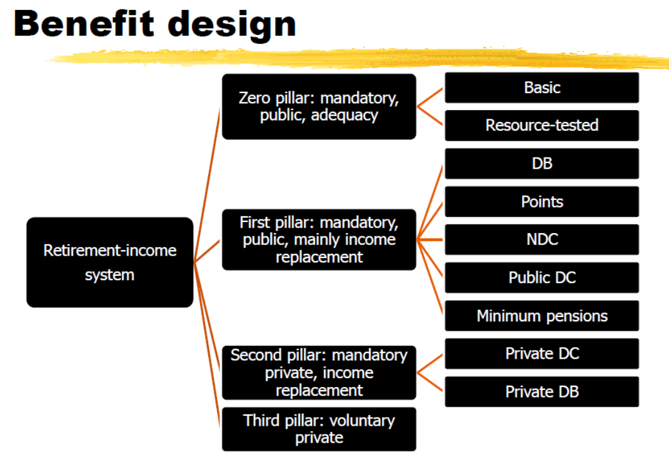
Pensions
Source: World Bank 2014

Slide 5
Pensions
Output calculation framework: Questions to Ask
Is the population “ageing”? Total population = Children + Worker + Retirees
What is the fertility rate in the population/replacement ratio for workers? How do these dynamics change over time?
Childbearing age for women (i.e. Unit period used to calculate) = [Average age of pensioner – Average age of Worker]
Real Interest Rate: Real Wage Growth + Inflation

Slide 6
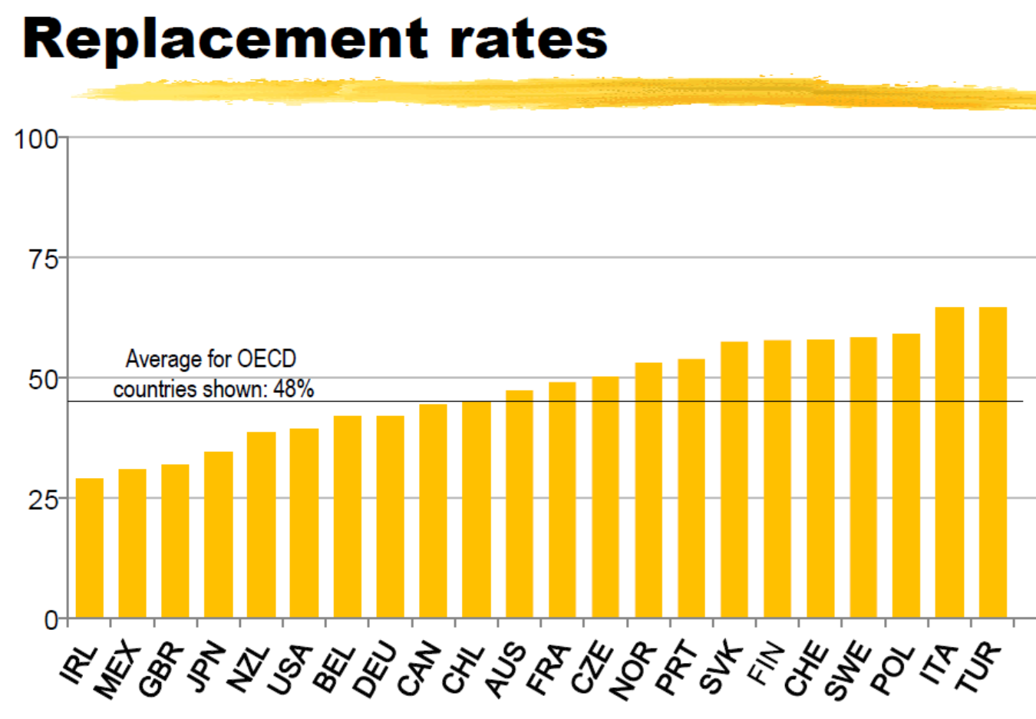
Pensions

Slide 7
Pensions
Output calculation framework: Methodology 1 (A Three-Step Process)
Assumptions:
Unfunded (“pay as you go”) System in in Public National Pension with Replacement Rate of 60%
With 40 working years 1.5% of wages are accrued p.a. (with pension rights tied to wages)
Step 1: What is the contribution rate into the system?
Using an example: 60 years old x 18 years of retirement/40 average age of the worker=27%
Step 2: What is the net wage bill (net of pension contributions)?
Using an example: Assume Net Wage Bill as Percentage of GDP = 40%
Step 3: What is the pension expenditure as percentage of GDP?
Net Wage Bill as Percentage of GDP x Contribution Rate into System = 0.40 x 27%= 10.8% of GDP
Note: review and evaluate how this compares to regional statistical calculations of regional bodies.
(Source: OKSANEN, H. (2005). Public pensions in the national accounts and public finance targets. Journal of Pension Economics and Finance, 4(3), 291-312.)

Slide 8
Pensions
Output calculation framework: Methodology 2 (The Fee based Approach for Funds)
- What happens when we utilize SIPPs or SSASs and how would our approach differ for the purposes of Output calculation?

Slide 9
Appendix

Slide 10


برنامج أمــان للتكافل والادخار
AMAN Takaful & Savings Programme

Slide 11


Partners
الشركاء
- Bank Distributor of the product
- Dubai Islamic Insurance and Re-Insurance Company (AMAN) The Wakeel (Insurer) for the programme
- FWU AG Product & System developer and Bank’s Sales support provider
- البنـــك الموزع لبرنامج التكافل
- شركة دبي الاسلامية للتامين واعادة التامين (أمان) شركة تكافل اماراتية وهي الوكيل للبرنامج
- مجموعةFWU AG الشركة المطورة للمنتج والنظام بالاضافة الى تقديم الدعـم لمبيعات البنوك

Slide 12
Takaful Overview
نظرة عامة
Takaful
The concept of Takaful or Islamic Insurance is pooling of resources to help the needy in line with the principles of compensation and shared responsibilities among the community based on teachings of Quran and Hadeeth.
التــكافل
فكرة التكافل او التامين الاسلامي تعتمد على جمع الموارد لمساعدة المحتاجين بالتزامن مع مبدا التعويض والمسؤولية الجماعية في المجتمع كما تعلمناها من القران الكريم والحديث الشريف
قال تعالى: ”وتعاونوا على البر والتقوى ولاتعاونوا على الاثم والعدوان“ صدق الله العظيم “But help ye one another into righteousness and pious duty. Help not one another into sin and transgression. ” (Truthful is Allah) قال رسول الله صلى الله علية وسلم: ”مثل المؤمنين في توادهم وتراحمهم كمثل الجسد الواحد اذا اشتكى منه عضو تداعى له سائر الجسد بالسهر والحمى“ (صدق رسول الله صلى الله علية وسلم) “The example of Believers in their affection, mercy and sympathy is like the example of the human body, if any one of its limbs complains, all other parts complain with vigilance and fever” (Truthful is the Messenger of Allah)

Slide 13
Why Takaful?
Avoidance of :
Al-Riba
Al-Maisyir
Al Gharar
Uncertainty is eliminated in respect of subscription and compensation
  Every participant donates his subscription to help those that need assistance
  It does not derive advantage at the cost of others
  Participants co-operate among themselves for their common good
Losses are divided and liabilities spread according to the community pooling system
Through "Tabarru" contributions / donations it allows Participants to achieve self-purification and peace of mind
Takaful is an equitable and socially responsible insurance concept based on the above principles:
14

Slide 14
Why Takaful?
باختصــار...
يعمل التــكافل بمـبدأ
التعــاون
والمســؤولية
و التغطــية المتـبادلة
  In a nutshell…..
  Takaful works on the Basis of
  Co-operation,
  Responsibility, and
  Mutual Protection
15

Slide 15
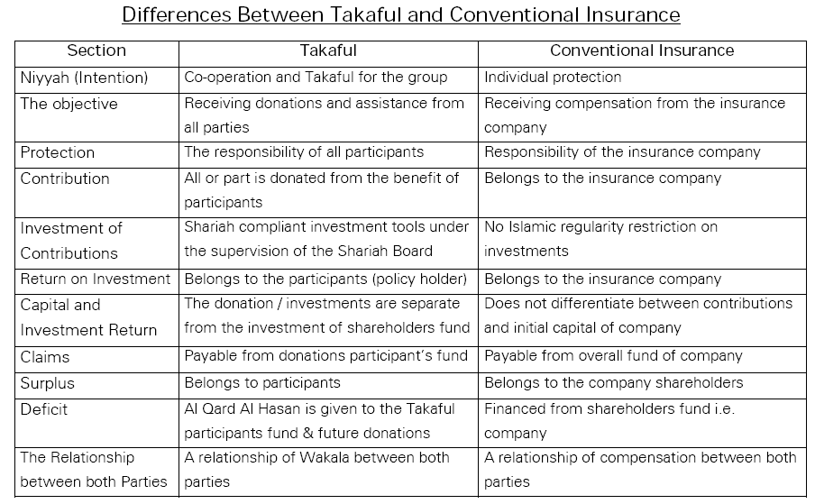

Slide 16
The Product

Slide 17
Product features
FEATURES | REGULAR | LUMP SUM
Participant Age | 18 – 60 years old Maximum age at maturity cannot be more than70 years old
Contract Tenure | Min 7 years, Max 30 years 10 years for Dynamic Protection Programme | Min 3 years Max 30 years
Min. Contribution | Monthly – AED 500 Yearly – AED 6,000 | Minimum AED 25,000 Maximum AED 3,500,000
Payment Frequency | Monthly and Yearly | One time
Takaful Cover | 60% or 100% | 100% of LS investment - maximum amount Age 18-55 – AED 510,000 (healthy) or AED 155,000 (unhealthy) Age 56-60 – AED 155,000(healthy) or AED 78,000 (unhealthy)

Slide 18



Product Components
Product Benefits
Takaful & Savings Programme
Savings / Investments
Protection (Takaful Benefits)

Slide 19
Product Benefits
Protection:
Supplementary Takaful benefit | amount is equal to the Takaful Benefits payable upon death at the contract start date to cover the period between contract activation and start date.
Takaful Benefits payable upon Death | Cover selected or the investment cash value which ever is higher
long term Saving:
The regular contributions (after the nominal deduction of Takaful Solidarity donation) are invested in one of the two professionally managed Shari’ah compliant strategies designed to help the savings grow to match the Participant’s choice of personal savings intention
Benefits payable upon Maturity | Non- DPP Customers (Less than 10 yrs): Payable in lump sum at market price DPP customers: Payable in lump sum at protected unit price or market price which ever is higher

Slide 20
Product Options
 | REGULAR | LUMP SUM
Appoint Beneficiaries | Up to 4 beneficiaries can be appointed for each contract
Increase of Contribution | Min Monthly AED 300 or Yearly AED 3,000 no change in Takaful Benefits | NA
Decrease of Contribution | Cannot decrease below the minimum required monthly (500AED) or yearly (6,000AED) contribution Any time after 1st contract anniversary Changes in Takaful Benefits | NA
Additional L/S Contribution | Minimum AED 3,000 No change on Takaful Benefits | Minimum AED 3,300 No change in Takaful Benefits
Partial Withdrawal | Possible any time before maturity provided participant’s share value doesn’t fall below 10,000 AED

Slide 21
Product Options
 | REGULAR | LUMP SUM
Deferral of contribution | After 18 months of regular payment for max 12months with Takaful Benefits | NA
Change of frequency | On anniversary only after full fees recovery | NA
Surrender | Any time without penalty Surrender Proceeds = cash value less any outstanding fees
Paid-up | After 18 months provided cash value is not less than AED 10,000 No Takaful Benefits during the period | NA
Reinstatement | Only for paid-up contracts Subject to underwriting process if after 6 months and above | NA
Continuing after maturity | Continuation in investment strategies possible after maturity (only in years) No Takaful Benefit applicable

Slide 22
Surplus Distribution
Participants are entitled to receive surplus distributions from the AMAN Takaful Solidarity Fund.
Previous surplus distributions paid from the AMAN Takaful Solidarity Fund
2005: 76.23%
2006: 78.95%
2007: 58.61%
2008: 48.35%
2009: 61.43%
2010: 51.20%
At every year end the surplus balance in the Solidarity Fund ( net death claims ),
is distributed to the participants in the form of additional units

Slide 23
Wakalah Fees and Charges
Entrance Fees | 1.2% of Total Regular Contributions (Capped 18 years) 75% of fees paid over 12 months 25% of fees paid on the 13th month
Acquisition Fees | 5.55% of total regular contributions (Capped 15 years) Any increase part of regular contribution or any additional LS 75% of fees paid over 12 months 25% of fees paid on the 13th month
Administration Fees | Monthly FEE of AED 26 or 0.125% of value of participant’s share whichever is higher
Takaful Solidarity Fund Fees | 15% of the difference between Takaful Solidarity Donations and Re-takaful contributions
Switch Fees | 1 % of value of units switched ( after 4 FREE switches)
Statement Fees | AED 92 for additional statements
Total Contribution = AED 1000 x 12 x ( 10 yrs ) = AED 120,000

Slide 24
Investment

Slide 25

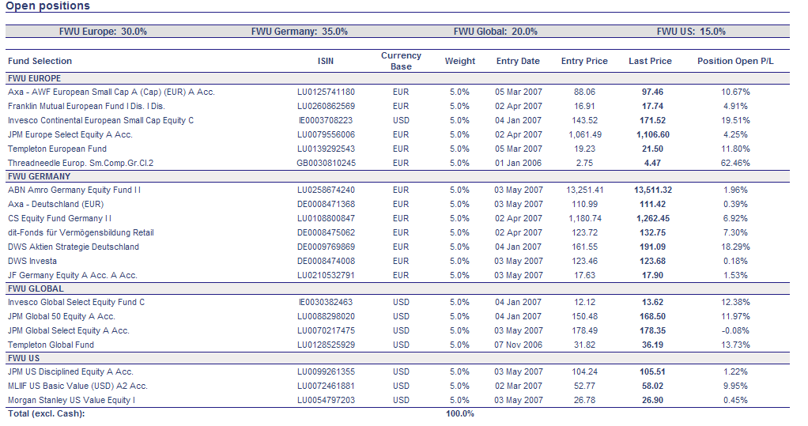



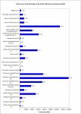

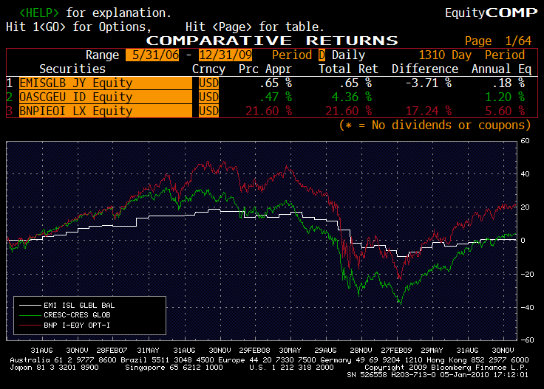
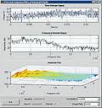
Investment Approach – Overview
FWU Sharia compliant Investment Universe
The funds are scrutinised whether they pass a strict list of investment criteria in terms of size, track record, etc.
Sophisticated algorithms of the proprietary FWU quant model assign weights to the funds in the portfolio in order to optimize the trade-off between performance and drawdown
FWU Sharia Board
Automated delivery of reporting of results to operations team
The best-in-class funds are „distilled“ from the Sharia compliant universe
Investment is executed
FWU Quant Model
PSL monitors markets and
Islamic Funds worldwide,
and suggests funds for approval

Slide 26
Takaful Investment Linked Savings Plan
Long Term Savings / Investment Strategies
It’s a long term savings & investment plan that aims to grow your wealth. Our investment process is designed to preserve capital, control volatility and take advantage of the rapidly evolving conditions in the various financial markets.
Regular savings
Lump Sum
Participant Investment Strategies
Cash Strategy
Equity Strategy
With DPP
Participants can choose Depending on their investment requirements

Slide 27
General Investment Approach
Investment Process – PSL Fund Managers
System driven approach – SAM – Selection Allocation Model (based on technical model with track record)
Equity Strategy is rebalanced regularly
Cash Strategy – cash deposits (Shari’ah compliant), Sukuks
Choose the best of breed funds from Shari’ah compliant universe of funds Model ranks all chosen mutual funds from best to worst , based on their relative strength
Funds are invested in top quartile Islamic mutual funds

Slide 28

The pillars of our investment architecture…
Experienced Investment Team
Technical Investment Model - SAM
Shari’ah Compliant Equity Funds
Monthly Re-Balancing
Global Diversifications

Slide 29
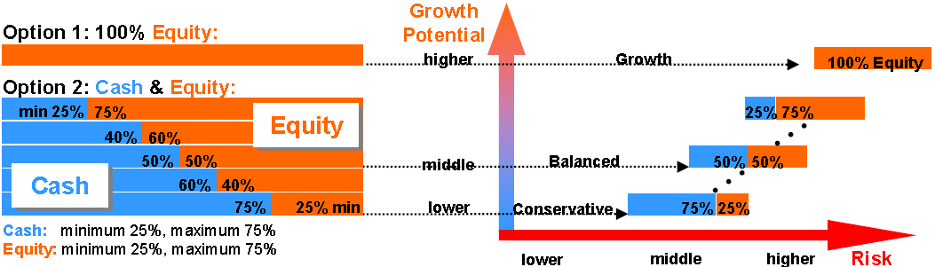
Allocation of Investment
Investment Profiles

Slide 30
What is Dynamic Protection Program ?
- DPP is an investment structure built into your existing equity strategies
- Designed to allow your customers to participate in the upward trends of the equity markets whilst being protected from suffering in bear markets
- Full compliance with Shari’ah requirements
At least 100% of the invested capital will be redeemed at maturity

Slide 31
Pensions
Conclusion
The Pensions issue will need to be addressed by governments more in future.
Contribution to output and measurement can utilize traditional investment measurement approaches, with caveats.
Self-Managed plans are the current, popular method for consumer access. They are both a complement and used in place of government pension.
Greater research on the standalone nature of pensions could be done going forward.

