Slide 1

USING ISLAMIC FINANCIAL STATEMENTS
TO COMPILE
NATIONAL ACCOUNTS
KHAIRUL AIDAH SAMAH
National Accounts Statistics Division
Department of Statistics Malaysia
Workshop on Islamic Finance in the National Accounts
31 October - 2 November 2018
Ankara, Turkey

Slide 2
PRESENTATION OUTLINE
INTRODUTION
ISLAMIC BANKING
TAKAFUL

Slide 3
INTRODUCTION

Slide 4
MALAYSIA FINANCIAL SYSTEM & STRUCTURE
Financial System
Provident Fund (EPF)
Capital Market
Non-Bank Financial Intermediaries
Insurance & Takaful
Development Financial Institutions
Money Market / Foreign Exchange
Stock / Equity
Bond & Sukuk
Derivatives
Offshore
Labuan
Offshore
Banking System
Bank Negara Malaysia
Banking Institutions
Saving Institutions
Foreign Exchange/ Money Changer
Conventional
Islamic Banks
Notes:
In Malaysia’s dual banking environment, the Islamic financial system operates in parallel with the conventional financial system.
The Islamic financial system encompasses the Islamic banking system, Islamic money market, Islamic insurance or takaful, Islamic capital market and the specialised financial institutions which provide alternative sources of financing.
This structure enhances the resilience and robustness of the Islamic financial system to withstand financial shocks and contributes to the overall stability of the Islamic financial system.

Slide 5
GOVERNANCE OF ISLAMIC FINANCIAL SERVICES IN MALAYSIA
LEGAL & REGULATORY FRAMEWORK
(BNM, SC & Other Regulatory Bodies)
SHARIAH ADVISORY COUNCIL (BNM)
& Shariah Committee (IFI)
ISLAMIC FINANCIAL INSTITUTIONS
Islamic Banks
Takaful
Islamic Capital Market
Specialized Institutions
ISLAMIC FINANCIAL INSTRUMENTS
Abbreviation :
BNM : Bank Negara Malaysia
SC : Securities Commission
IFI : Islamic Financial Institution
ACCOUNTING & REPORTING STANDARD IN ISLAMIC FINANCE
Notes:
One of the pre-requisites for a strong and stable Islamic banking system is the existence of a comprehensive Shariah and legal infrastructure.
A strong Shariah framework combined with a sound legal structure would accelerate the pace of development and innovation of the Islamic banking industry in Malaysia.

Slide 6
MEASUREMENT OF FISIM IN MALAYSIA
Conventional Bank
Estimation of FISIM - Conventional
  FISIM is calculated using the following formula:
  FISIM = FISIM on Loans + FISIM on Deposits
  Where:
  FISIM on Loans = Stock of Loans * [Lending Rate – Reference Rate]
  FISIM on Deposits = Stock of Deposits * [Reference Rate - Deposits Rate]
Reference Rate: Midpoint between the loan and deposit rate
less volatile
FISIM values with greater transparency

Slide 7
MEASUREMENT OF FISIM IN MALAYSIA
Islamic Bank
Estimation of FISIM – Islamic Finance
  FISIM is calculated using the following formula:
  FISIM = FISIM on Financing + FISIM on Deposits
  Where:
  FISIM on Financing = Stock of Financing* [Financing Rate – Reference Rate]
  FISIM on Deposits = Stock of Deposits * [Reference Rate – Profit Rate]
Reference Rate: Midpoint between the financing and deposit rate
less volatile
FISIM values with greater transparency

Slide 8
MEASUREMENT OF FISIM
Conventioan/ Islamic Bank
FISIM – Calculation
Output of FISIM should be calculated according to the formula
(rL - rr) yL + (rr - rD) yD
Where by:
yL- loans/finance
yD- deposits
rr - reference rate
rL - interest rates on loans/finance income received
rD - interest rates deposits

Slide 9
MEASUREMENT OF FISIM
OUTPUT CALCULATION:
Source | Item | Formula |  | Remark
Assets, Liabilities and Equities Statements | Financing and Advances | a |  | yL
Income and Expenditure Statement | Finance Income | b
Derive | Notional Financing Rate | c=b/a |  | rL
Assets, Liabilities and Equities Statements | Deposits Accepted | d |  | yD
Income and Expenditure Statement | Finance Expense | e
Derive | Notional Deposits Rate | f=e/d |  | rD
Derive | Reference Rate | g=(c+f)/2 |  | rr
Derive | Finance Rate Spread Current | h=c-g
Derive | FISIM on Finance | i=h*a
Derive | FISIM on Deposits | j=h*d
Derive | Total FISIM | k=i+j |  | FISIM
Income and Expenditure Statement | Fee and Commission Income | l |  | Explicit Service Charges
 | Total Output | k+l+m+n
Output of FISIM = (rL - rr) yL + (rr - rD) yD

Slide 10
ASSETS & LIABILITIES STATEMENT

Slide 11
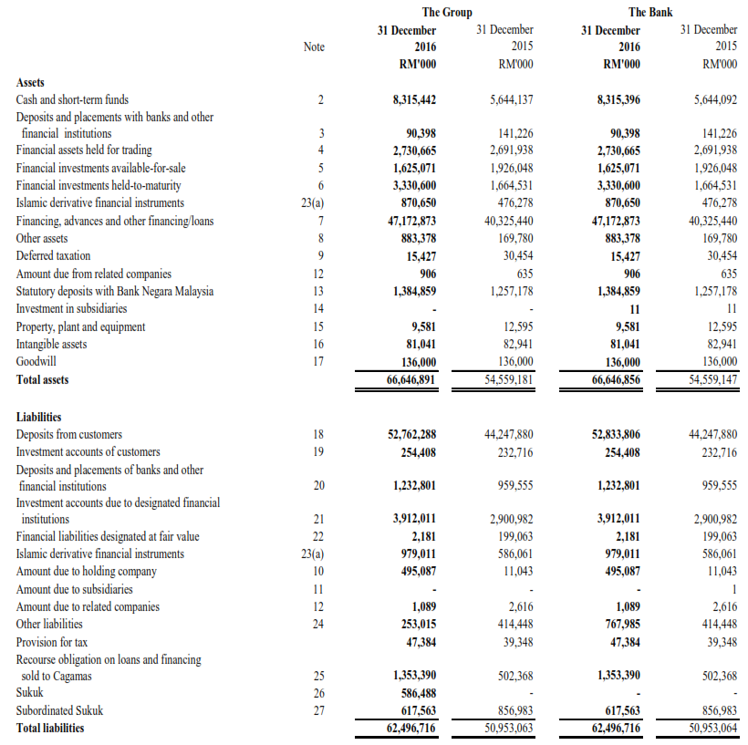
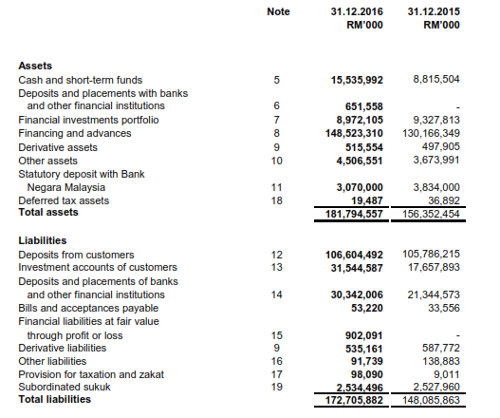
STATEMENTS OF FINANCIAL POSITION
BANK A
BANK B
Financing & Advances
Deposit Accepted

Slide 12
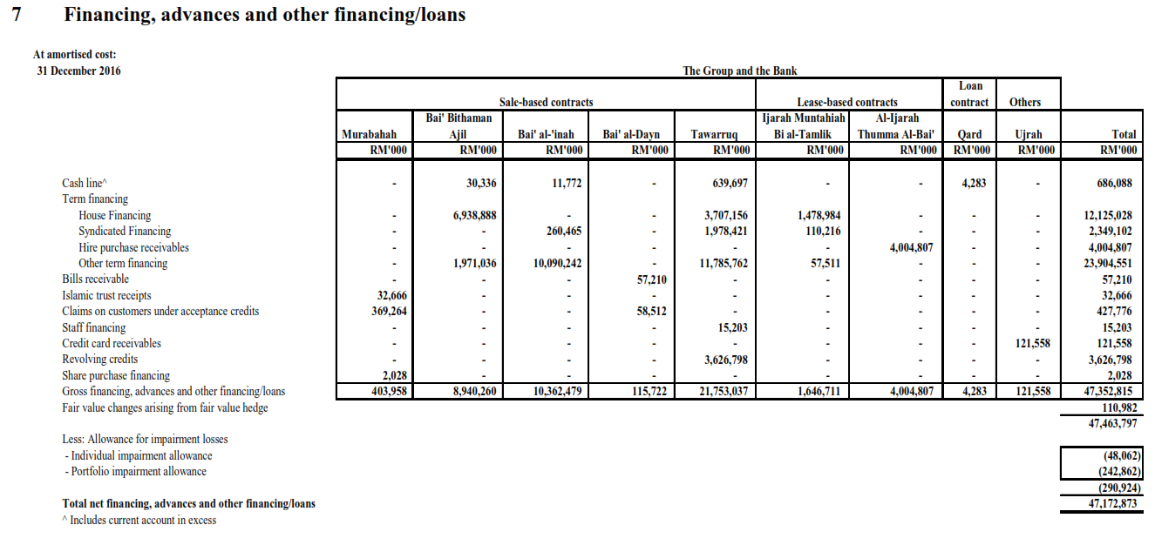
STATEMENTS OF FINANCIAL POSITION
Financing & Advances
BANK A
Stocks of Financing

Slide 13
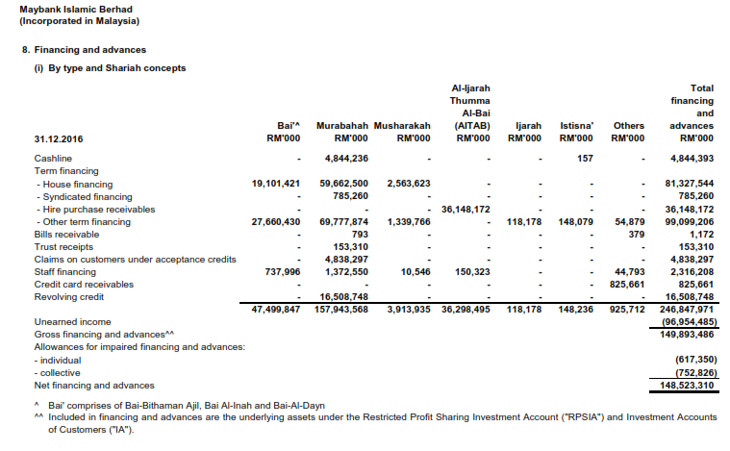
STATEMENTS OF FINANCIAL POSITION
Financing & Advances
BANK B
Stocks of Financing

Slide 14
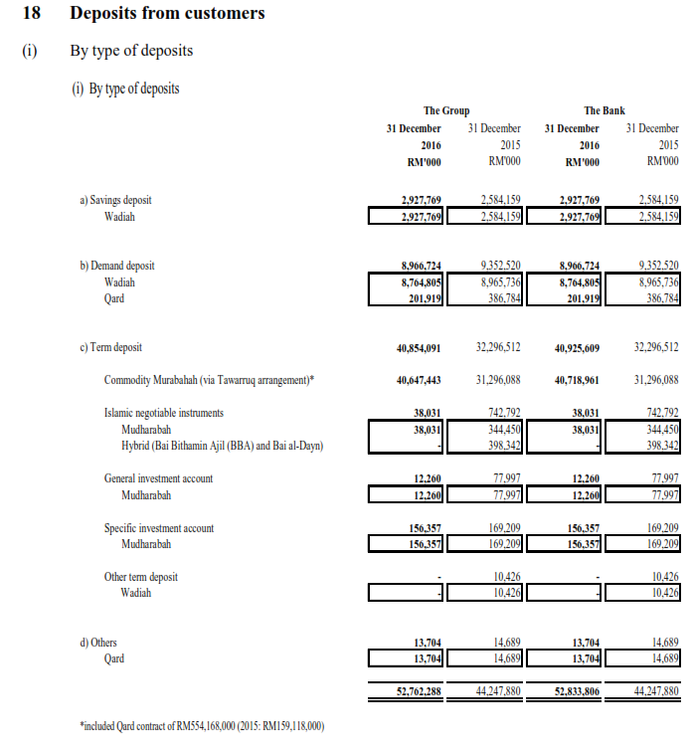
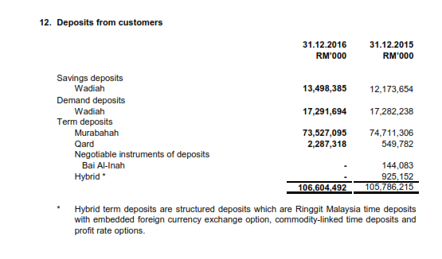
STATEMENTS OF FINANCIAL POSITION
Deposits
BANK A
BANK B
Stocks of deposits accepted

Slide 15
MEASUREMENT OF FISIM
OUTPUT CALCULATION: |  |  |  | Bank A | Bank B
Source | Item | Formula |  | RM '000 | RM '000 | Remark
Assets, Liabilities and Equities Statements | Financing and Advances | a |  | 47,352,815 | 149,893,486 | yL
Income and Expenditure Statement | Finance Income | b
Derive | Notional Financing Rate | c=b/a |  |  |  | rL
Assets, Liabilities and Equities Statements | Deposits Accepted | d |  | 52,833,806 | 106,604,492 | yD
Income and Expenditure Statement | Finance Expense | e
Derive | Notional Deposits Rate | f=e/d |  |  |  | rD
Derive | Reference Rate | g=(c+f)/2 |  |  |  | rr
Derive | Finance Rate Spread Current | h=c-g
Derive | FISIM on Finance | i=h*a
Derive | FISIM on Deposits | j=h*d
Derive | Total FISIM | k=i+j |  |  |  | FISIM
Income and Expenditure Statement | Fee and Commission Income | l |  |  |  | Explicit Service Charges
 | Total Output | k+l+m+n
Output of FISIM = (rL - rr) yL + (rr - rD) yD

Slide 16
INCOME & EXPENDITURE STATEMENT

Slide 17
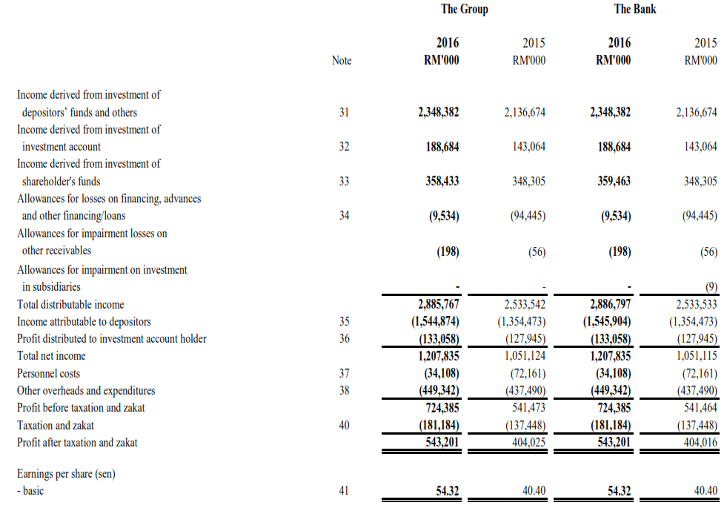
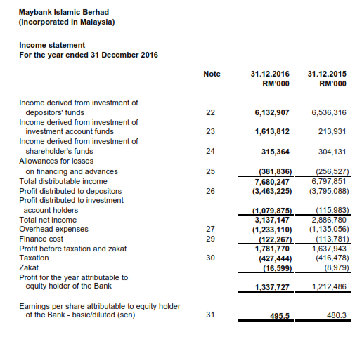
STATEMENTS OF INCOME
BANK A
Finance Income
BANK B
Finance Expense

Slide 18
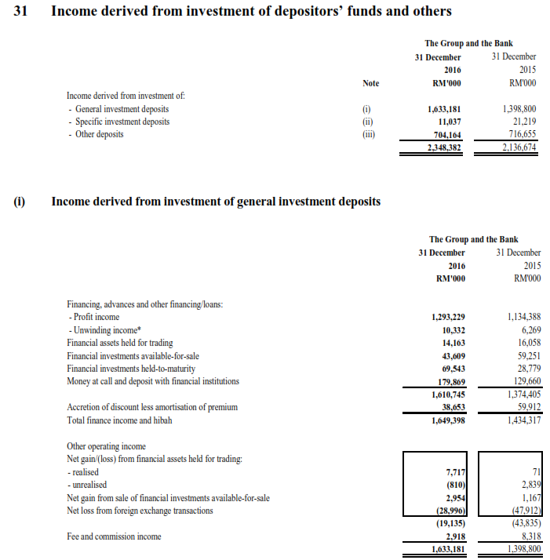
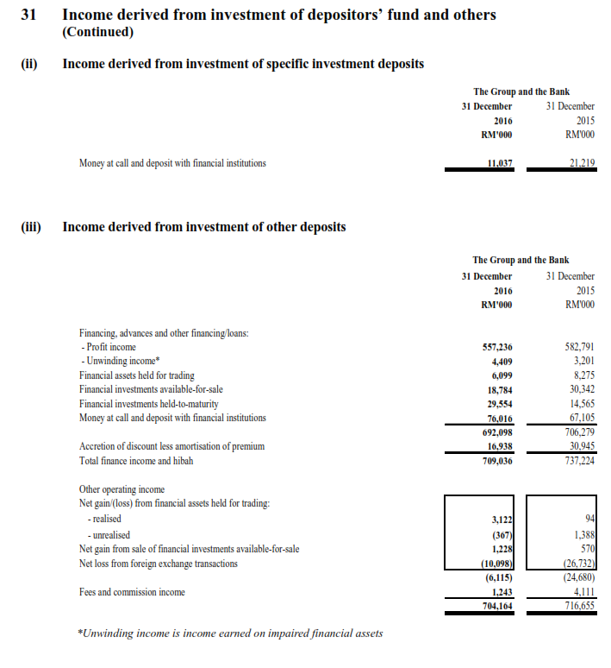
STATEMENTS OF INCOME : Finance Income
BANK A
Total Finance Income
RM2,369,471
Total Fee and Commission Income
RM4,161

Slide 19
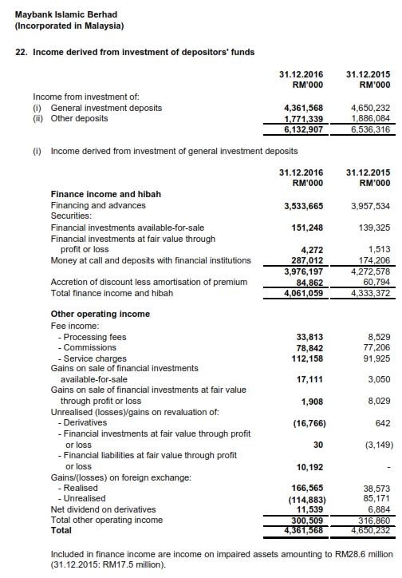
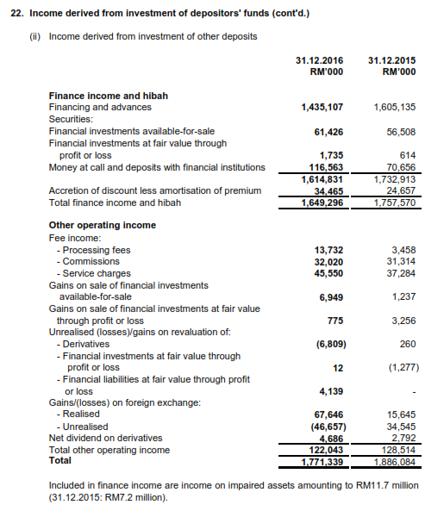
STATEMENTS OF INCOME : Finance Income
BANK B
Total Finance Income
RM5,710,355
Total Fee and Commission (explicit service charges)
RM316,115

Slide 20
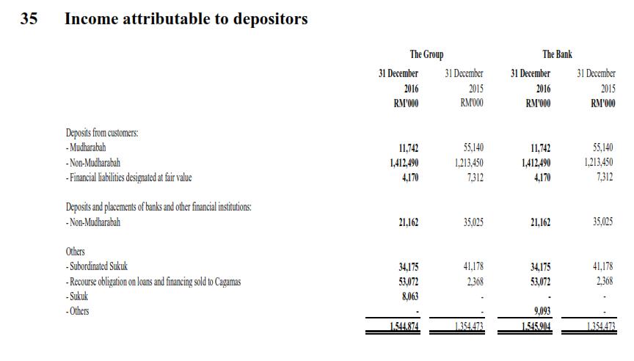
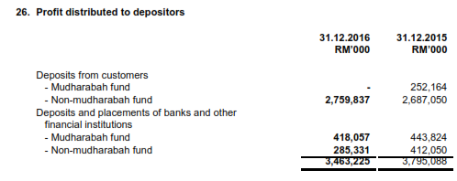
STATEMENTS OF INCOME
Financing Expense
BANK A
BANK B
Total Finance Expanse
Bank A: RM1,545,904
Bank B: RM3,463,225

Slide 21
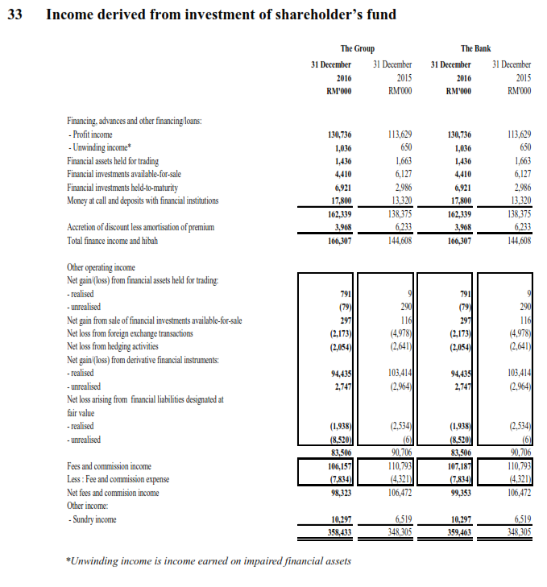
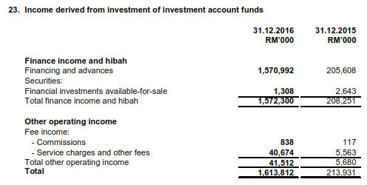
STATEMENTS OF INCOME
BANK A
Explicit Service Charges
BANK B
Total Fee and Commission (explicit service charges)
Bank B : RM41,512
Bank A : RM107,187

Slide 22
MEASUREMENT OF FISIM
OUTPUT CALCULATION: |  |  |  | Bank A | Bank B
Source | Item | Formula |  | RM '000 | RM '000 | Remark
Assets, Liabilities and Equities Statements | Financing and Advances | a
Income and Expenditure Statement | Finance Income | b |  | 2,369,471 | 5,710,355
Derive | Notional Financing Rate | c=b/a
Assets, Liabilities and Equities Statements | Deposits Accepted | d
Income and Expenditure Statement | Finance Expense | e |  | 1,545,904 | 3,463,225
Derive | Notional Deposits Rate | f=e/d |  |  |  | rD
Derive | Reference Rate | g=(c+f)/2 |  |  |  | rr
Derive | Finance Rate Spread Current | h=c-g
Derive | FISIM on Finance | i=h*a
Derive | FISIM on Deposits | j=h*d
Derive | Total FISIM | k=i+j |  |  |  | FISIM
Income and Expenditure Statement | Fee and Commission Income | l |  | 111,348 | 357,627 | Explicit Service Charges
 | Total Output | k+l+m+n
Output of FISIM = (rL - rr) yL + (rr - rD) yD

Slide 23
MEASUREMENT OF FISIM
OUTPUT CALCULATION: |  |  |  | Bank A | Bank B
Source | Item | Formula |  | RM '000 | RM '000 | Remark
Assets, Liabilities and Equities Statements | Financing and Advances | a |  | 47,352,815 | 149,893,486 | yL
Income and Expenditure Statement | Finance Income | b |  | 2,369,471 | 5,710,355
Derive | Notional Financing Rate | c=b/a |  | 0.0500 | 0.0381 | rL
Assets, Liabilities and Equities Statements | Deposits Accepted | d |  | 52,833,806 | 106,604,492 | yD
Income and Expenditure Statement | Finance Expense | e |  | 1,545,904 | 3,463,225
Derive | Notional Deposits Rate | f=e/d |  | 0.0293 | 0.0325 | rD
Derive | Reference Rate | g=(c+f)/2 |  | 0.0396 | 0.0353 | rr
Derive | Finance Rate Spread Current | h=c-g |  | 0.0104 | 0.0028
Derive | FISIM on Finance | i=h*a |  | 491,970 | 420,407
Derive | FISIM on Deposits | j=h*d |  | 548,914 | 298,994
Derive | Total FISIM | k=i+j |  | 1,040,884 | 719,402 | FISIM
Income and Expenditure Statement | Fee and Commission Income | l |  | 111,348 | 357,627 | Explicit Service Charges
 | Total Output | k+l+m+n |  | 1,152,232 | 1,077,029
Output of FISIM = (rL - rr) yL + (rr - rD) yD

Slide 24
DATA AVAILABILITY : CENTRAL BANK
Asset & Liabilities Statement
Continue…

Slide 25
DATA AVAILABILITU : CENTRAL BANK
Income & Expenditure Statement
Continue…
Continue…

Slide 26
TAKAFUL

Slide 27
MEASUREMENT OF INSURANCE IN MALAYSIA
Insurance/ Takaful
The measurement of value of gross output for insurance/ takaful services includes the following elements:
  Insurance/ Takaful = Premium/ Contribution income
    + Investment income (premiums supplement)
    - Claims paid

Slide 28
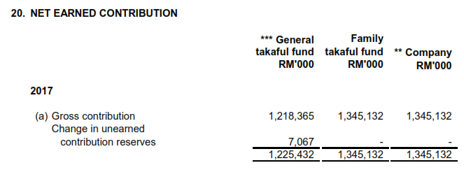
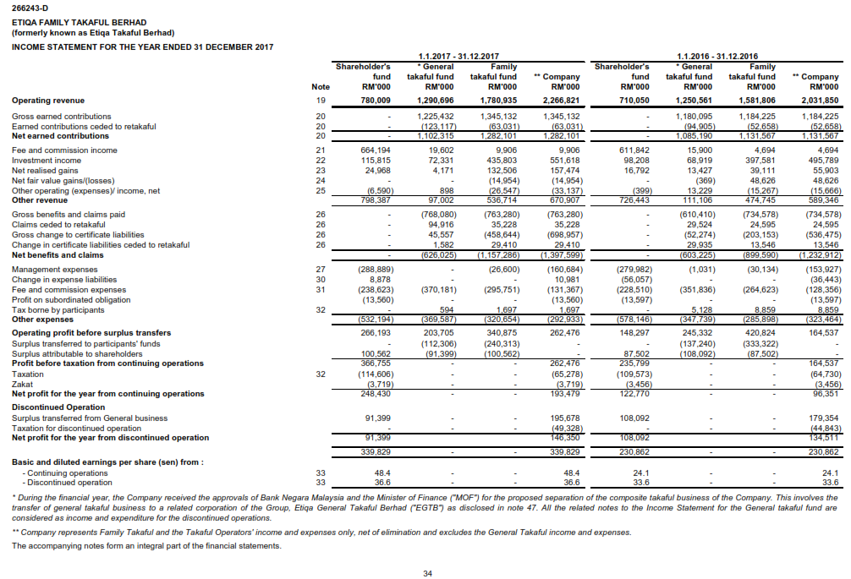
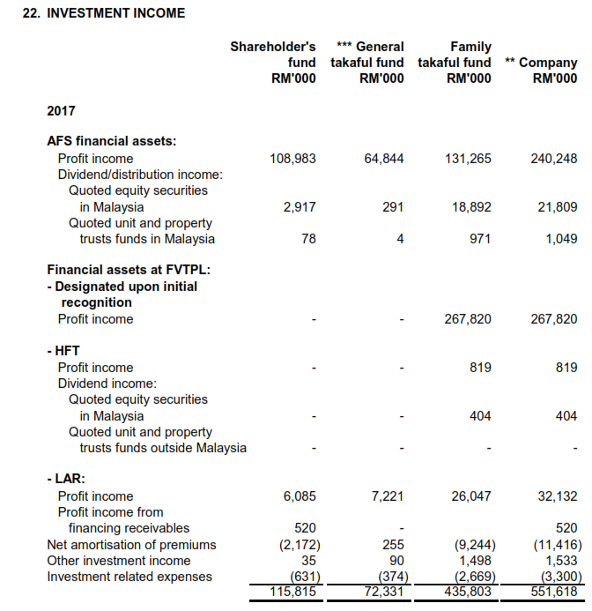
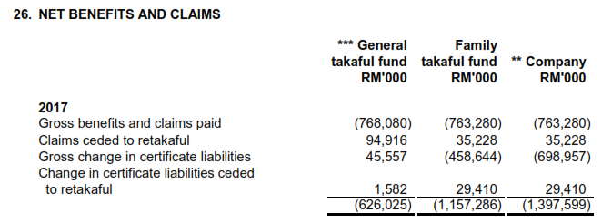
STATEMENTS OF INCOME
COMPANY A

Slide 29
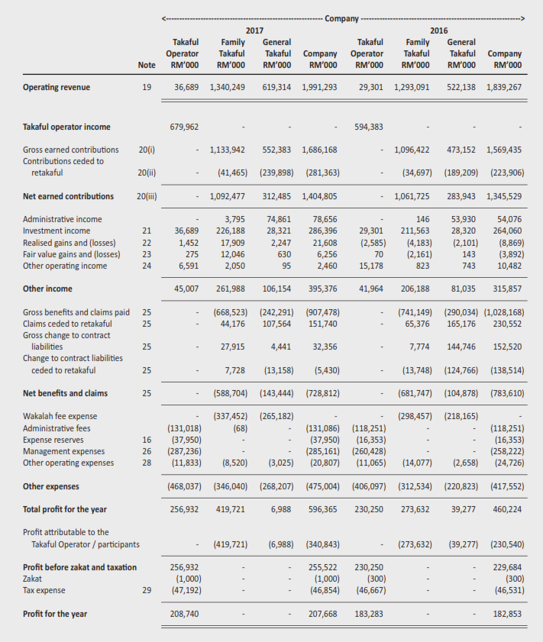
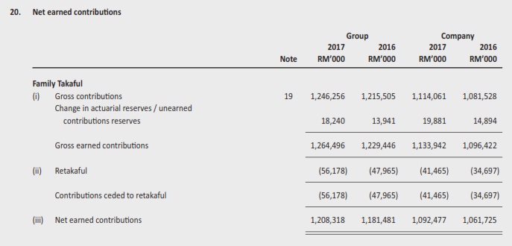
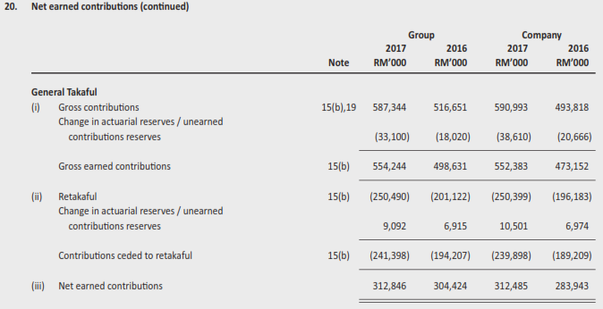
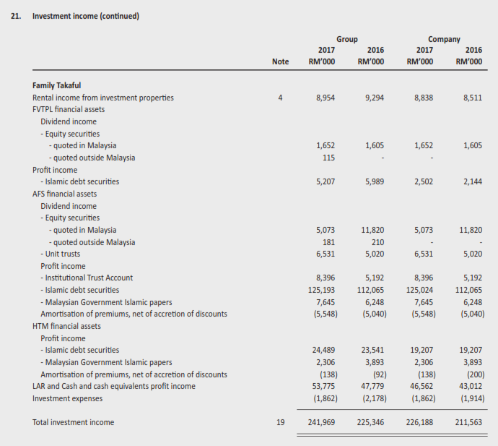
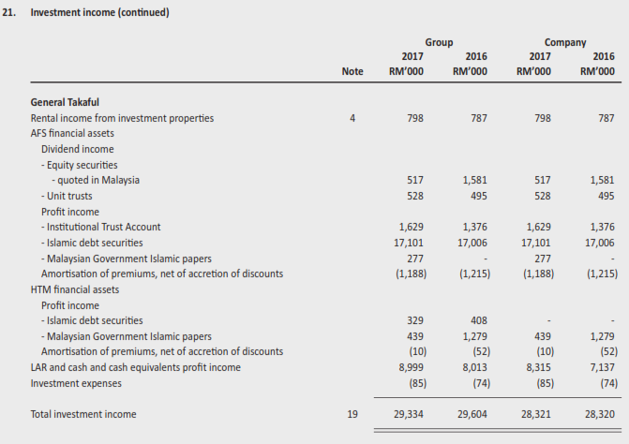
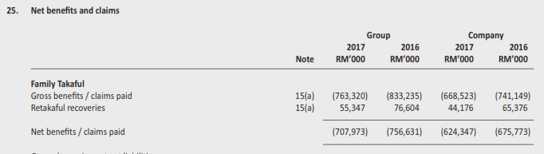
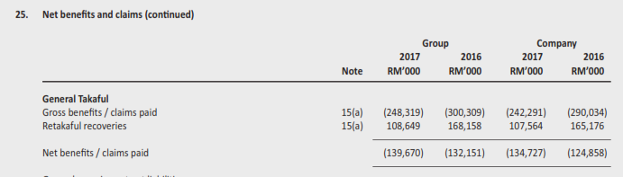
STATEMENTS OF INCOME
COMPANY B
Family Takaful
General Takaful
Contribution Income
Investment Income
Claim paid

Slide 30
MEASUREMENT OF INSURANCE IN MALAYSIA
OUTPUT CALCULATION: |  |  |  | Company A |  | Company B
Source | Item | Formula |  | RM '000 |  | RM '000
 |  |  |  | Family Takaful | General Takaful | Family Takaful | General Takaful
Income and Expenditure Statement | Gross earned Contribution | a |  | 1,345,132 | 1,225,432 | 1,133,942 | 552,383
Income and Expenditure Statement | Investment income | b |  | 435,803 | 72,331 | 226,188 | 28,321
Income and Expenditure Statement | Gross benefits/claims paid | c |  | 763,280 | 768,080 | 668,523 | 242,291
 | Output | a + b - c |  | 1,017,655 | 529,683 | 691,607 | 338,413

Slide 31
DATA AVAILABILITY : CENTRAL BANK
Continue…
Item Description | Family | General
Total Income
Net contributions | For calculating Output
Earned Contribution Income |  | For calculating Output
Fire
MAT
Aviation
Cargo
Marine Hull
Offshore Oil-related
Motor
Motor Act
Motor Others
Miscellaneous
Bonds
Contractors' All Risks & Engineering
Liabilities
Medical and Health
Personal Accident
Workmen's Compensation & Employers' Liability
Others
Net investment income | For calculating Output
Income
Investment accounts/ Islamic money market
Financing
Others
Gross dividends
Rent
Others (including net investment income for investment-linked fund)
Less : Investment expenses
Unrealised capital gains
Other Income
Profit on disposal
Bad debts recovery
Accretion of discounts on securities
Others
Item Description | Family | General
Total Outgo
Net certificate benefits | For calculating Output
Net claims incurred |  | For calculating Output
Fire
MAT
Aviation
Cargo
Marine Hull
Offshore Oil-related
Motor
Motor Act
Motor Others
Miscellaneous
Bonds
Contractors' All Risks & Engineering
Liabilities
Medical and Health
Personal Accident
Workmen's Compensation & Employers' Liability
Others
Net Commission (including wakalah) | Intermediate Consumption
Management expenses
Management expenses (Wakalah Fee)
Salaries | Compensation of Employees
Bonus | Compensation of Employees
Staff benefits | Compensation of Employees
Marketing bonus | Compensation of Employees
Directors' remuneration and related expenses | Compensation of Employees
Syariah supervisory council members' remuneration & related expenses | Compensation of Employees
Entertainment | Intermediate Consumption
Training expenses | Intermediate Consumption
Auditors' fees | Intermediate Consumption
Legal expenses | Intermediate Consumption
Management fees | Intermediate Consumption
Rent and rates | Intermediate Consumption
Repairs and maintenance | Intermediate Consumption
Motor vehicle expenses | Intermediate Consumption
EDP expenses | Intermediate Consumption
Depreciation
Miscellaneous expenses
Travelling expenses | Intermediate Consumption
Advertising | Intermediate Consumption
Printing & stationery | Intermediate Consumption
Electricity & water | Intermediate Consumption
Postage/ telephone/ telex/ telefax | Intermediate Consumption
TGSF levy
Others | Intermediate Consumption
Continue…
Item Description | Family | General
Unrealised capital loss
Other Outgo
Loss on disposal
Bad and doubtful debts
Amortisation of premium on securities
Diminution in value of
Provision for tax on unrealised capital gains
Investment charge
Taxation
Finance Cost
Others
Excess of Income over Outgo

Slide 32
CHALLENGES, RECOMMENDATION & MOVING FORWARD
In the absence of official guidelines on calculating Islamic finance output, the present method applied has served adequate/ acceptable way of estimating its contribution to the economy.
Knowledge of Islamic terms (e.g: Qard, Mudarabah, Wakalah etc) in finance and insurance sector need to be strengthen by making partner with the bank.
Opportunity to attend Islamic conference, workshop etc:
  To build up capacity;
  To keep update changes of Islamic finance/takaful in the community.
Recommend to encourage the setup of Islamic finance framework.
Moving forward, a universal guidelines is needed to ensure the estimation Islamic banking and finance in the national accounts is comparable among countries.

Slide 33
CONCLUSION
The contribution of Islamic Finance in Malaysia’s economy is getting more significant, in line with the expansion and innovation in the Islamic Financial Services.
With rapid development in Islamic banking and Islamic finance, DOSM continuously evaluating the methodology used in compiling the value added of Islamic banking, Takaful and Islamic Capital Market.
Malaysia manage to calculate Islamic finance/Takaful by using conventional formula backed by Islamic concept govern by the shariah advisory and committee.
At least with this calculation, it was serve well in the GDP compilation to avoid left out from the GDP compilation.
The estimation supported by the strong and consistency data.
The Islamic finance compilation and estimation was not limited to the production account, but beyond to the other accounts (accumulation accounts, financial accounts etc.). Therefore, discussion/workshop will increased the knowledge of Islamic finance compilation.

Slide 34


THANK YOU

