Slide 1
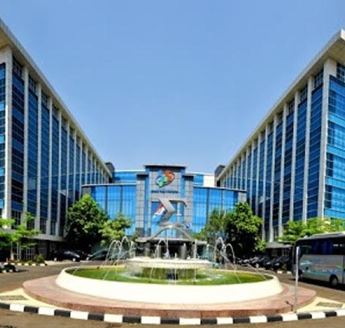
Compilation Income Flow for Islamic Finance in Indonesia
By Suswandi
BPS-Statistics Indonesia
Workshop Islamic Finance 29 – 2 November 2018
Ankara, Turkey

Slide 2
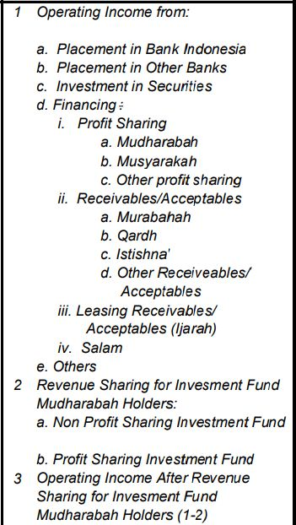
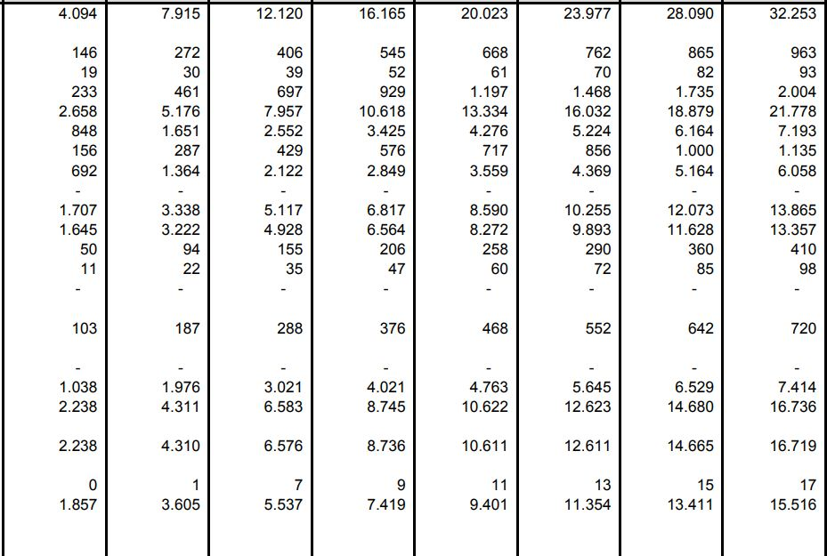
Table 1. Sharia Commercial Bank and Sharia Business Unit Condensed Income Statement
in Billion IDR

Slide 3
Table 1. Sharia Commercial Bank and Sharia Business Unit Condensed Income Statement (cont.)
in Billion IDR

Slide 4
Table 1. Sharia Commercial Bank and Sharia Business Unit Condensed Income Statement (cont.)
in Billion IDR

Slide 5
Table 1. Sharia Commercial Bank and Sharia Business Unit Condensed Income Statement (cont.)
in Billion IDR

Slide 6
Total Output
= Implicit Service Charge + Explicit Service Charge

Slide 7
Explicit Service Charge
In Billion IDR
Indicator | Ags 2018
Other Operating Income c. Income from Investment, Fees, Commission, Provision d. Other Income Non Operating Income | 1.368 4.997 272
Total Explicit | 6.637

Slide 8
Implisit Service Charge
[(R_{L}-R_{r})L + (R_{r} – R_{D})D]
R_{L} : Equivalent of yield rate for financing, receivables/acceptables, ijarah and salam
R_{D} : Equivalent of yield rate for third party fund

Slide 9
R_{r}
= (Financing, receivables/acceptables, ijarah and salam’s yield rate + Third party fund’s yield rate)/2
= (10,78 + 4,44)/2
= 7,61

Slide 10
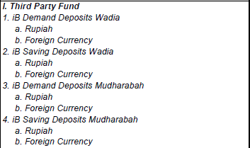
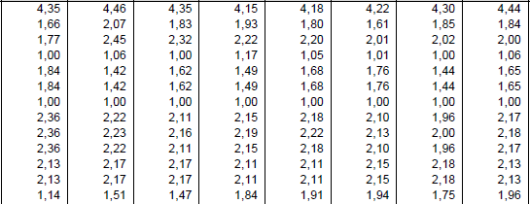
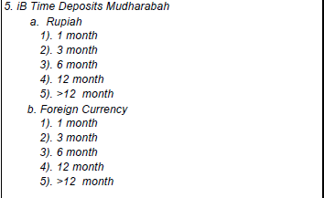
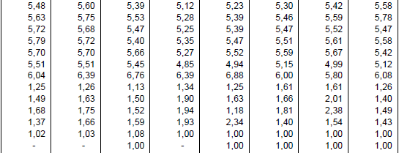
Table 2. Equivalent of Yield Rate/Distribution/Fees/Bonuses of Sharia Commercial Banks and Sharia Business Units (%)
R_{D}

Slide 11
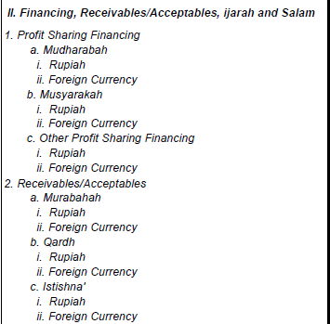
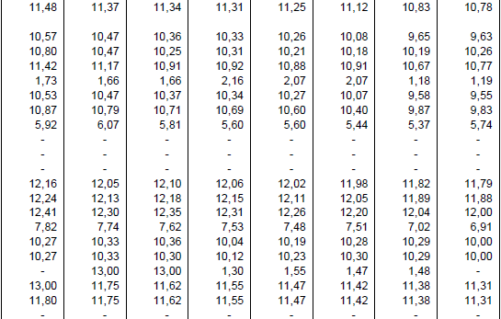
Table 2. Equivalent of Yield Rate/Distribution/Fees/Bonuses of Sharia Commercial Banks and Sharia Business Units (%) -cont
R_{L}

Slide 12
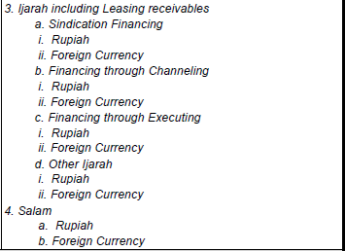
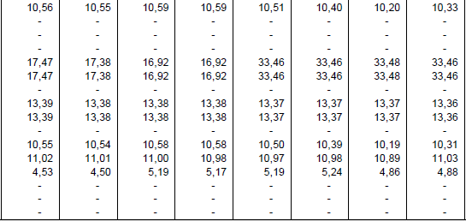
Table 2. Equivalent of Yield Rate/Distribution/Fees/Bonuses of Sharia Commercial Banks and Sharia Business Units (%) -cont
R_{D}

Slide 13
Table 3. Financing and Non Performance Financing based on type of Shariah-compliant contract of Sharia Commercial Banks and Sharia Business Unit (Billion IDR)
L

Slide 14
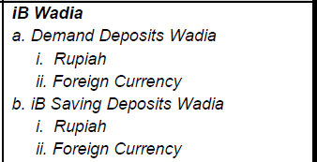
Table 4. Depositor Funds Composition of Sharia Commercial Bank and Sharia Business Unit
In Billion IDR
D

Slide 15
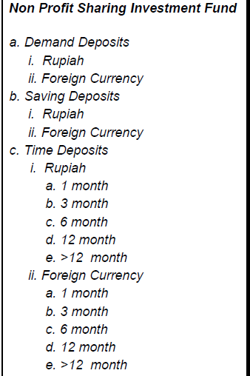
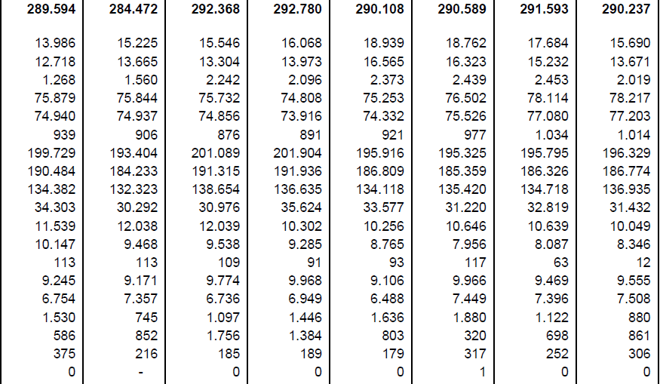
Table 4. Depositor Funds Composition of Sharia Commercial Bank and Sharia Business Unit (cont.)
In Billion IDR
D

Slide 16
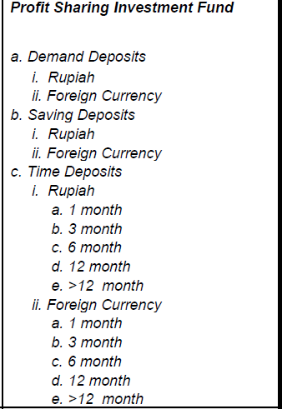
Table 4. Depositor Funds Composition of Sharia Commercial Bank and Sharia Business Unit (cont.)
In Billion IDR

Slide 17
Implicit Service Charge
21.613,12 (Billion IDR)
Explicit Service Charge
6.637 (Billion IDR)
Total Output
28.250,12 (Billion IDR)

Slide 18
Other Income Flow
In Billion IDR
Indicator | Ags 2018 | Mapping to SNA
Operating Income from : Placement in Bank Indonesia – Yield to BI Placement in Other Bank – Wadiah Bonuses Investment in Securities Other Operating Income: a. Income from Mark to Market and sale securities Operational Costs : Yield to BI Wadiah Bonuses Loss from Mark-to-Market and Sale of Securities Loss from Invesment and Cost of Commission/Provision Impairment Depreciation/Amortization and Cost of Fixed Assets Maintenance Cost of Operation Risk Loss from Financing Restructuring Cost of Human Resources Labour Cost Training Cost Research and Development Other Operating Cost Non Operating Cost Transfer of Profit/Loss Income Tax | 963 93 2.004 122 2 247 6 242 7.122 777 7 16 5.028 122 3 3.613 264 - (812) | Interest Receivable Interest Receivable Interest Receivable Revaluation Account Interest Payable Interest Payable Revaluation Account Revaluation Account and Intermediate Consumption Revaluation Account Revaluation Account and Intermediate Consumption Revaluation Account Other changes in valume account Compensation of Employee Intermediate Consumption Gross Fixed Capital Formation Intermediate Consumption Intermediate Consumption Other Current Transfer

Slide 19
ISSUES
Some transaction need to be separated

