Slide 1
The Added Value of Implementing Islamic Finance in Turkish Economy
Dr. Tawfik Azrak
Assistant Professor
Social Sciences University of Ankara (ASBU)
Workshop on Islamic Finance in the National Accounts
Ankara - TURKEY

Slide 2
Presentation Outflow:
Components of Islamic Finance
Share of Islamic Finance Market 2017
The Banking System of Turkey
Participation Banking
Distinguishing Features of Participation Banking
History and Key Indicators of Participation banks at 2016
The Importance of Islamic Finance to the Economic Development
Moving Forward
Conclusion

Slide 3
Components of Islamic Finance
Islamic Finance
Islamic Money Market
Islamic Banking
Takaful
Islamic Capital Market
Islamic Wealth Planning
Notes:
First of all it is important to know that there are man components for Islamic finance industry, which are they:

Slide 4
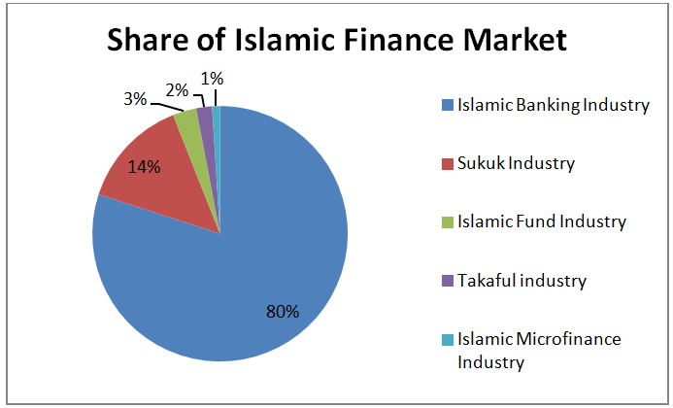
Share of Islamic Finance Market 2017
Source: http://uaebusiness.com
Notes:
But it is clear that the higher share of this industry goes to Islamic banking as it represent almost 80% of the industry. While the sukuk (Islamic bonds) come at the second place with almost 14 % >> so based on this we have to know that participation banks and sukuk market will be the major effects of this industry to any economics.

Slide 5
The Banking System of Turkey
Banking System
Participation Banks
(Islamic Banks)
Development and Investment Banks
Deposit Banks (Conventional Banks)
Notes:
Since our study focusing on Turkey, so first of all we have to know the main components of banking system in Turkey. And they are:

Slide 6
PARTICIPATION BANKING:
Based on interest-free banking, also known as participation banking in Turkey
Not an alternative, but an integral component of Turkish Banking Sector.
A third type of banking, together with Deposit Banks and Development and Investment Banks.
PARTICIPATION BANKS (PBs) are;
Functionally similar to Deposit Banks. They are also bridges between savers and investors as seen in Deposit Banks. But funds raising and financing methods are different.
Raising funds through profit and loss partnership, financing through mainly trading (Murabaha), leasing (Ijara) and profit and loss partnership (Mudaraba and Musharaka).
Notes:
So our focus from this banking system will be participations banks
Which is defined as:

Slide 7
Distinguishing Features of Participation Banking
No guaranteed a fixed return to deposit customers
No investment in interest bearing assets (i.e. bonds)
No exposure to direct interest rate risk
No direct lending to credit customers, payments are made to sellers
Not exposed to currency risk
Speculative transactions are not allowed
Transactions of goods and services which are not compatible with Islamic rules are not allowed
Efficient allocation of funds: Investments in more productive projects.

Slide 8
Historical Background
1985
1989
1991
1995
Albaraka Turk and Faisal Finans established
Kuveyt Turk established
Anadolu Finans established
İhlas Finans established
Asya Finans
established
SFH under Banking Law
Establishment of Special Finance House Association
Transformation to Participation Banks from Special Finance Houses
Turkiye Finans acquired by National Commerce Bank
First Corporate Sukuk issued by Kuveyt Türk
-First Sovereign Sukuk issued by TREASURY
-Stock Exchange Investment Fund Based on Participation Index.
Global Islamic Finance Development Center
2005
2001
1999
1996
2008
2010
2012
2015

Slide 9
Key Indicators of Participation banks 2016
Fund collected
TL 81,505 billion
Funds allocated
TL 84,880 billion
Total assets
TL 132,776 billion
Shareholders’ equity
TL 11,495 billion
Number of personnel
14,465
Number of branches
959
Source: Participation Banks Association Of Turkey

Slide 10
The Importance of Islamic Finance to the Economic Development

Slide 11
Key Principles of Islamic Finance which promote Real Economic Development
Deploying finance service of the real economy
Profit and Loss Sharing so as to structure equity partnership
Redistribution of Wealth and opportunity
Risk Sharing modes of financing
Source: United Nations ESCAP (Economic and Social Commission for Asia and the Pacific)
Notes:
1- Deploying >> since Islamic finance prohibit dealing with interest, so the alternative was to deal with commodity and assets as real assets in banks or takaful companies.
2- Profit and Loss >> The main features of Islamic finance is Profit and Loss contracts like Mudarabha or Musharkha, which will distributed the profit and loss In quitabl way, and not just relying on interest rate in the market.
3- Risk Sharing >> means, all the parties will burden risk in their investments.. In islam: we have the figh rule:Al-ghunm bil-ghurm means that if you would benefit from a deal or products, then you have to pay for it's expenses and take the risk.
And risk sharing here means: in implementing the profit loss sharing contracts each party have to take responsibility in case of loss.
4- Redistributions of wealth: because Islamic finance institutions are just investing in money > so they create a new modes of financing which is in the real assets and services

Slide 12
Cont.
Firstly, the sustainable development nature of Islamic finance offers benefits for economic growth, reducing poverty and fostering shared prosperity. In addition, it can significantly contribute to economic development, given its direct link to physical assets and the real economy.
Secondly, greater emphasis on profit and loss sharing encourages the provision of financial support to productive enterprises that can increase output and generate jobs. The emphasis on tangible assets ensures that the industry supports only transactions that serve a real purpose, thus discouraging financial speculation.
Thirdly, the redistribution of wealth and opportunity in Islamic finance helps to promote financial sector development and broadens financial inclusion. This is because Islamic finance could help improve financial access and foster the inclusion of those deprived of financial services.
Finally, the risk-sharing modes of financing could be useful in improving access to finance for the poor and small businesses.
Notes:
Overall, these key principles of Islamic finance can help to create a better understanding of the positive role that Islamic finance can play in promoting real economic development.

Slide 13
Cont.
It is noteworthy to inform that Islamic finance not only offers an alternative source of financing for real economic development but also has inherent characteristics and principles that lend themselves well to catalyzing and promoting real economic development.
Some characteristics and principles of Islamic finance include being an equity based, asset-backed, ethical, sustainable, environmentally and socially-responsible type of financing which promotes risk sharing, connects the financial sector with the real economy, and emphasizes financial inclusion and social welfare in the economy.
As the 2008 global financial crisis witnessed a series of unparalleled financial meltdown and disruptions of the international financial system, Islamic financial institutions (IFIs) were less affected, protected by their fundamental operating principles of risk-sharing and the avoidance of leverage and speculative financial products.
This has led to a greater appreciation on the distinct nature of Islamic finance in addition to its explicit in-built strengths that supports financial stability.

Slide 14
Moving Forward
In order to ensure the Turkish Economics will acquired the right value and development from Islamic financial system:
There is need to highlight with greater clarity the value proposition of Islamic finance, ensuring it serves the real economy and it will continue to be beneficial to the society. This requires further in-depth applied research to develop more financial products that create closer links between Islamic finance and real economic activity, in terms of its operating models, risk management and supporting infrastructure.
The outreach of Islamic finance should be inclusive and accessible to all, particularly the lower income groups and small businesses. This is because an important agenda in the global economy is to achieve a more balanced growth with reduced income disparities.
There is need to keep this sector well regulated, efficient, and effective all the time by central bank of Turkey, in order to ensure the right implementation by the industry players, and to ensure there transaction are Shariah compliant all the time.

Slide 15
Conclusion
Turkey is a leading Country in its region with great potentials in Islamic finance and banking with its stakeholders, as corporate and state partners.
Overall Islamic finance not only offers an alternative source of financing for sustainable development activities and projects but more importantly it has inherent characteristics and principles that lend themselves well to catalysing and promoting real economic development for Turkey.
The contribution of Islamic finance to real economic development in Turkey include the inherent nature of Islamic finance which promotes real economic development, the availability of socio-economic tools that could help to improve financial access and foster the inclusion of those deprived of financial services to achieve real economic growth.

Slide 16
Thank You

