Slide 1
In-depth review of satellite accounting
Advisory Expert Group
November 2018

Slide 2
In-depth review of satellite accounting
Given the apparent proliferation of satellite accounts, the CES Bureau decided to conduct an in-depth review to determine if the international community should develop general guidance on priority areas and recommended approaches in the development of satellite accounts.
This guidance could include the relationship of satellite accounts to the central framework of national accounts, priority areas of development, and the allocation of resources and responsibilities for compiling the respective satellite accounts.
The Bureau noted that some form of typology is also required, given the increasingly diverse nature of satellite accounting.
The in-depth review is is led by Statistics Canada in collaboration with UNECE, Eurostat, OECD, UNSD, and the IMF.

Slide 3
2008 SNA and Satellite Accounts
Type 1
(Thematic)
Rearrangement of the classifications, presentation and possible addition of complimentary information not found in the existing core accounts.
Type 2
(Extensions)
Modification of the underlying concepts, boundaries of the core system and/or testing new methods. (e.g. including volunteer activities as production)
“Type 3”
(Thematic / Extensions)
Any combination of 1 and 2
No change to the underlying concepts of the core system

Slide 4
Discussion at the Advisory Expert Group (AEG)
Thematic Satellite Accounts
Sustainability and well-being extensions
System of National Economic Accounts
General guidance to a range of compilers (including experts working outside the domain of national accounts) around the development of thematic accounts.
A more strategic and global orientation on the compilation of satellite accounts for ‘Type 2” satellite accounts
Peter Van de Ven - A Future Strategy for Compiling Satellite Accounts

Slide 5
In-depth review – Key areas of investigation
The in-depth review of satellite accounting will attempt to answer the following questions:
What is the current state of play?
What are the factors that underlie demand?
What type of accounts are being compiled?
How are satellite accounts being compiled and who is undertaking the compilation?
What type of guidance is being used?
What type of guidance is being requested?

Slide 6
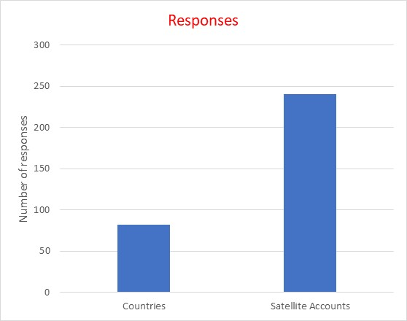
In-depth review – Preliminary Results
82 countries responded to the survey.
Data was provided for 241 unique satellite accounts.

Slide 7
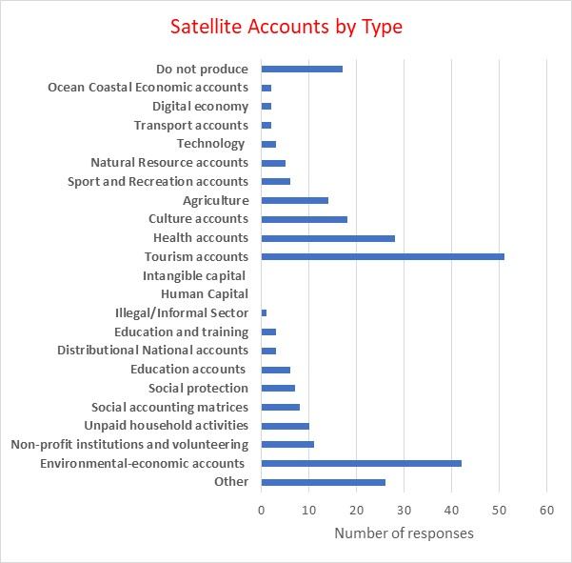
In-depth Review – Preliminary Results
Thematic or activity accounts appear to be more prevalent than well-being and sustainability type accounts.

Slide 8
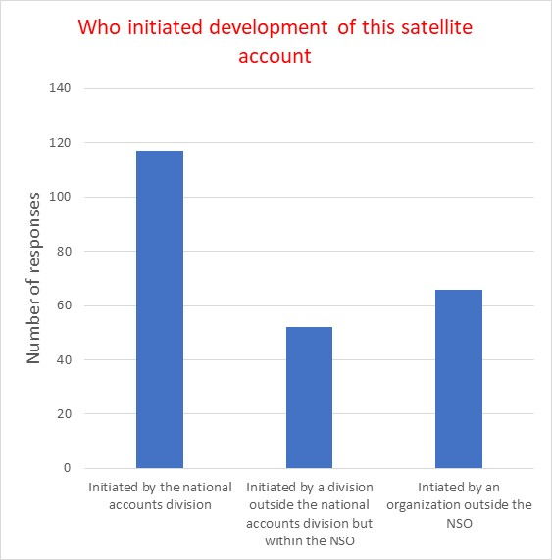
In-depth Review – Drivers
The majority of satellite accounts were initiated by the NSO.
The majority of the satellite accounts were funded by the NSO

Slide 9
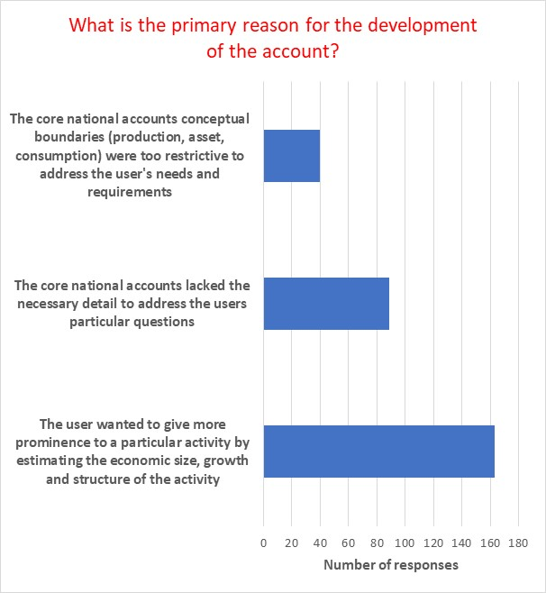
In-depth Review – Motivation
Most satellite accounts are developed in order to give more prominence to an activity or subject.
Most satellite accounts do not deviate from the core SNA concepts..

Slide 10
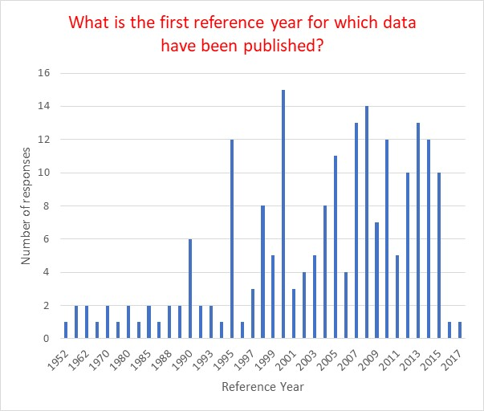
In-depth Review – Reference Years
The majority of reference start dates are 2000 or later.
Most countries have on-going programs.

Slide 11
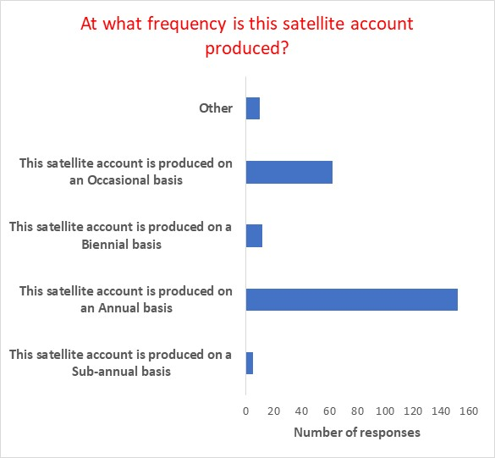
In-depth Review – Frequency and Timeliness
The majority of countries produce annual estimates.
Most accounts are released well after the reference period.

Slide 12
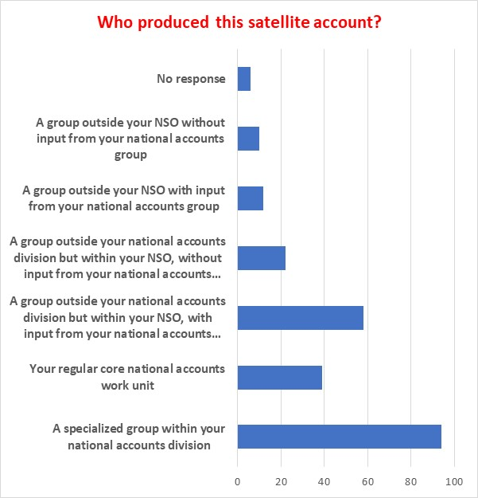
In-depth Review – Compilation
Most statistical organizations have established specialized groups to develop and compile national accounts.
International guidance was readily available.

Slide 13
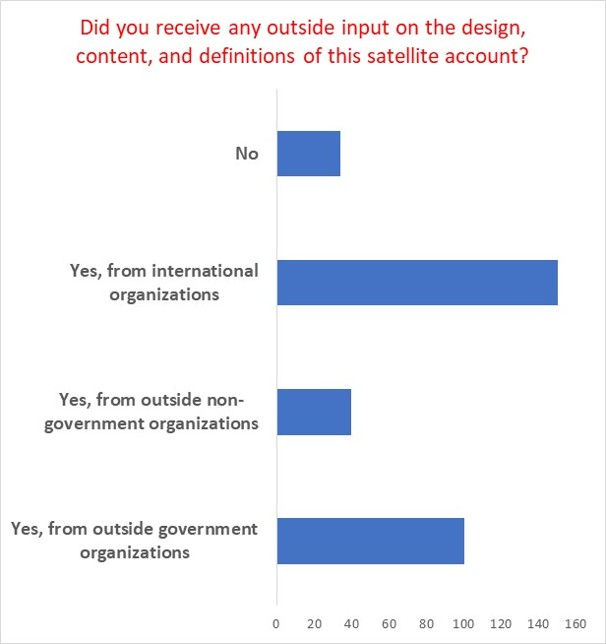
In-depth Review – Design / Input
Most NSOs rely on international organizations for input into the development of satellite accounts.
Most NSOs only consult one organization when compiling their accounts.

Slide 14
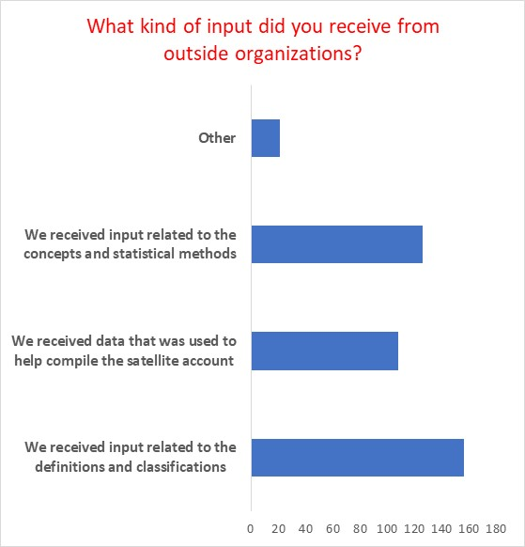
In-depth Review – Design / Input
NSOs received a wide range of input from outside organizations.

Slide 15
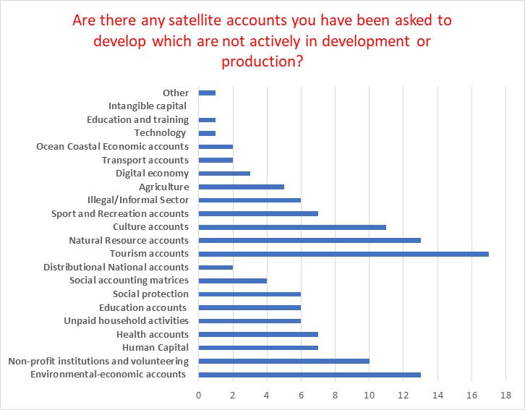
In-depth Review – Demand
There is significant unmet demand. There are a total of 241 satellite accounts produced – 130 are demanded but not produced.
Unmet demand is evenly split between Thematic Satellite Accounts and Extensions.

Slide 16
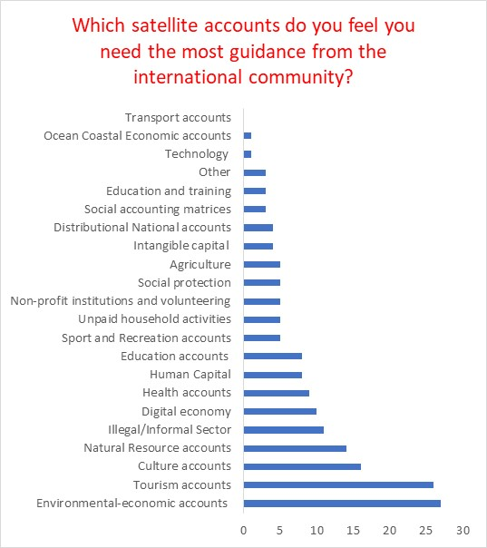
In-depth Review – Guidance
Countries are seeking guidance on a wide range of satellite accounts.
Requirement for guidance aligns with priority areas of development.

Slide 17
In-depth review of satellite accounts Next Steps
Prepare file and analyse results (November 2018)
Draft report outline (November 2018)
Draft report (December 2018)
Circulate for discussion (mid-January 2019)
Present report to the CES Bureau in February 2019 and to the CES in June 2019

Slide 18
In-depth review of satellite accounts Questions for discussion
Are there other questions we should address with this review?
Which issues we should bring to the attention of the CES and the Bureau?
What are your thoughts on developing a set of well-being accounts – similar to the system of environmental and economic accounts?
What does this look like in the context of the SNA? Additional chapters? Supplementary guide?

Slide 19
THANK YOU!
For more information, please visit
www.statcan.gc.ca #StatCan100

