Slide 1
UN Global Working Group on Big Data for Official Statistics
Ronald Jansen
Assistant Director
United Nations Statistics Division

Slide 2
UN Global Working Group on
Big Data for Official Statistics
Created in March 2014 under the UN Statistical Commission
Mandated to give direction to the use of Big Data for Official Statistics

Slide 3
Conference
Global Working Group
UN Global Platform
Bureau
Task Teams
Technical Delivery Board
Organizing Committee
Technical Support Team
Programme Committee
Legal &Ethics Team
Programme Committee
Satellite Data
Mobile data
Big Data for SDGs
Agriculture
Social Media Data
Training & Skills
Trade Data Lake
Land cover
Scanner data
Water & Oceans
Privacy techniques

Slide 4
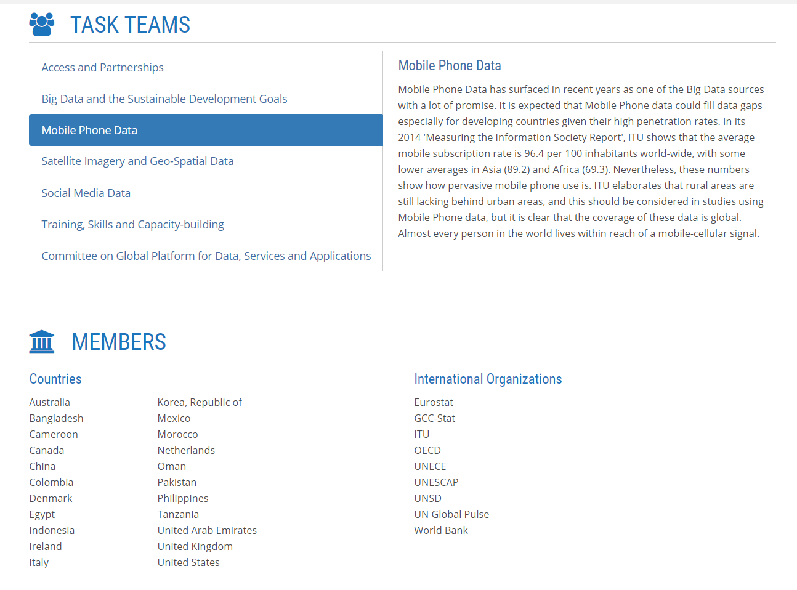

Slide 5
Task Team on Scanner Data
Initial focus on the use of scanner data from retailers to aid the calculation of price indices
Time frame: April 2017 – Dec 2018

Slide 6
Task team members
Nathalie Brault (chair) and Jonathan Wylie (Canada)
Antonio Chessa (Netherlands)
Thomas Hjorth Jacobsen (Denmark)
Michael Holt (Australia)
Tanya Flower (UK)
Donal Lynch, Alan Bentley (New Zealand)
Ken van Loon (Belgium)
Michael Smedes (UN)

Slide 7
Task Team on Scanner Data
Aim: Increase the effective use of scanner data in official statistics…
..through lowering the barriers of entry for countries by providing a library of methods, guidance and training
..via the sharing of experience, practice and learning between countries on the use of scanner data
..and through supporting Public-Private collobaration in the acquisition and use of scanner data

Slide 8
Task Team on Scanner Data
Deliverables:
Delivery of a tool hosted on the UN Global Platform for analysis, monitoring and index estimation using historic scanner data from Nielsen
Accompanying training and instructional material on the use of the tool
Accompanying methodological guidance material summarising and referencing to literature, recommendations and cataloging good practice
Notes:
The accompanying material 3 will be a living document, and will be circulated to international groups such as the IWGPS, the Ottawa Group and the EU scanner data expert group for review and input. Recommendations on methodology will be out of scope. The development of an tool which enables applications of any method will contribute to the empirical and theoretical research still underway. In other words, the task team will develop documentation, tools and applications, which can be used by the statistical community.

Slide 9
UN Global Platform
The aim of this tool is to allow NSIs access to tested index method code, and to practise using the different methodologies on some training data

Slide 10
Nielsen data
2 data sets for milk and cauliflower
Canada, June 2015 to June 2018
Key variables: unique ID, product name, salesunits (quantity), salestonnage or saleslitres (quantity), salesCAD (expenditure)
Derive a unit price for each product
Notes:
93,000 observations for cauliflower (87 unique product codes)

Slide 11
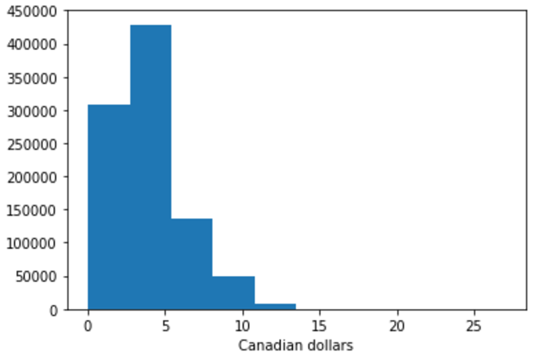
Monitoring the data
Histogram of unit values (milk)

Slide 12
Price indices - milk
Notes:
Same for milk, this time compared to Stats Canada series for milk. Note the change in the axis scale – both indices are very stable.

Slide 13
Lessons learnt so far – Nielsen
Comprehensive clean data
Value in establishing a partnership to establish best practices
Adding a data dictionary would facilitate data understanding
Run basic data exploration first to provide feedback quickly

