Slide 1
Data for the SDGs
12th Meeting of the Advisory Expert Group on National Accounts
27-29 November 2018, Luxembourg
United Nations Statistics Division

Slide 2
Data for the 2030 Agenda
…To support accountability to our citizens, we will provide for systematic follow-up and review at the various levels…
These reviews will be based on
… data which is high-quality, accessible, timely, reliable and disaggregated by income, sex, age, race, ethnicity, migration status, disability and geographic location ..
Quality, accessible, timely and reliable disaggregated data will be needed to help with the measurement of progress and to ensure that no one is left behind. Such data is key to decision- making.
1

Slide 3
New data requirements
Accessible, timely and reliable and disaggregated data for the full implementation of the Agenda.
SDG Indicators for thorough rev
iews
2

Slide 4
The Global Indicator Framework
The Global Indicator Framework for the SDGs was first agreed by UNSC in March 2016 as a starting point and adopted by UNSC at its 48th session in March 2017
Draft resolution, including the global indicator framework, adopted by the Statistical Commission at UNSC48
Draft resolution adopted by ECOSOC in June 2017
Resolution 71/313 adopted by the GA in July 2017

Slide 5
Implementation of the global indicators
232 unique indicators, addressing each and every one of the Goals and targets of the 2030 Agenda.
The global indicators will be yearly refined
There will be two comprehensive reviews by UNSC 51 in 2020 and UNSC 56 in 2025.
4

Slide 6
Tier system of the global indicators
Global reporting is currently based on Tier I and a few Tier II indicators (where regional aggregates are possible)
Capacity building efforts will focus on Tier II
Methodological work is taking place on approximately one third of the indicators (Tier III)

Slide 7
Time to focus on implementation at the
country level
The global SDG monitoring system needs to build on local and national data reporting
National reporting is the most significant level of the SDG review process
Data derived from national sources is the foundation for SDG reviews at all levels
It is crucial to create opportunities for countries to directly contribute to global reporting

Slide 8
Challenges
New areas of work
Strengthen the role of NSOs/institutional changes Redefining the NSS
Scope
> 230 indicators
Conceptualization/definition of new indicators
Data disaggregation
Coverage of all population groups
Development of new standards and methods
Integration of data sources, including new ones
Partnerships with different data communities
Quality, timeliness reliability, accessibility, openness
New legal framework

Slide 9
Technology as a key enabler
While there are challenges, digital technology available today allows for the necessary transformation to leverage:
New sources of data and information
New approaches to data collection, management, processing and dissemination
New partnerships among data producers – NSS and civil society, the private sector and academia
Integration of geospatial and statistical information systems

Slide 10
What needs to happen
Strengthen capacities/new approach to capacity building
Expand existing data collection programmes
Promote interoperability of data sets/develop tools for interoperability
Implement open data practices
Use new data technology/innovation
Develop and establish national SDG platforms
Develop better visualization and dissemination
tools
9

Slide 11
The need for data interoperability
Need for quality, accessible, timely and reliable disaggregated data
Need to include all parts of the statistical system and new data sources
Data on a wide range of topics -- unprecedented amount of data
Interoperability of systems is crucial to harnessing the potential of all types of data

Slide 12
Integrating new data sources
New data sources are a large and increasing portion
of data available to the public
Statistical offices can consider new data sources and establish mechanisms to integrate them in the statistical process.
Key is to ensure that the necessary resources and skills are available
Need to establish partnerships
Legal framework

Slide 13
Collaborative on data interoperability
Joint initiative by the Global Partnership on Sustainable Development Data and UNSD
The vision of the Collaborative is a world in which contextual and holistic information on SDG targets derived from multiple sources can be easily assessed by anyone and integrated with other information enabling improved analysis, decision-making and accountability

Slide 14
Why data interoperability?
To implement an open, service-oriented, standards- driven “system-of-systems” architecture to link subnational, national and global datasets
To promote the use (and re-use) of available data assets and services by making them widely accessible through different data ecosystems
To enable the development of modern platforms for collaboration among data producers and data users around SDG policy initiatives
To strengthen ability of National Statistical Systems and all SDG stakeholders to share data, knowledge, and expertise for the 2030 Agenda

Slide 15
Key enablers of data interoperability
Content and technology standards
Application Programming Interfaces (APIs) and Integration Applications
Data governance and coordination
mechanisms
Quality assurance
Data validation
Technical challenges (syntactic and semantic)

Slide 16
Specific work areas to improve
data interoperability for SDGs
Integrate geospatial and statistical information
Adopt of SDMX and other open standards through accessible and user-friendly templates, adaptors and interfaces
Develop and promote open APIs for accessing, integrating and analysing data for sustainable development from multiple sources
Coordinate classification systems to enhance the integration of data from different sources
Improve of interoperability of microdata from surveys and administrative records

Slide 17
Evolution to a system of open data
A network of open data that enables new types of collaboration for SDG implementation, monitoring and reporting
A framework for data integration and management, data analysis, and stakeholder engagement
Implemented through:
Open data platform
GIS and other data analytics capabilities
Web-based tools for communication and user engagement

Slide 18
The Global SDG database and metadata repository
SDG Indicator database contains data on the global Sustainable Development Goal indicators
The data and accompanying metadata have been provided by international agencies and entities according to their respective mandates.

Slide 19
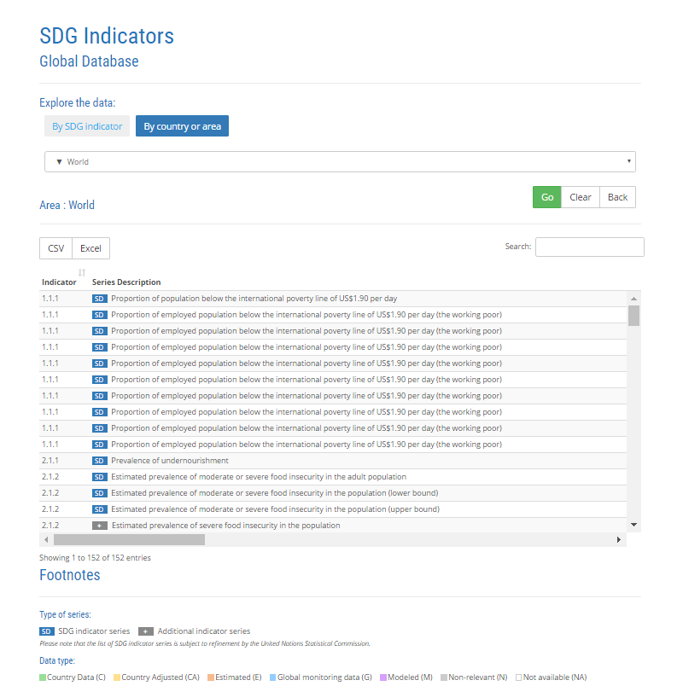
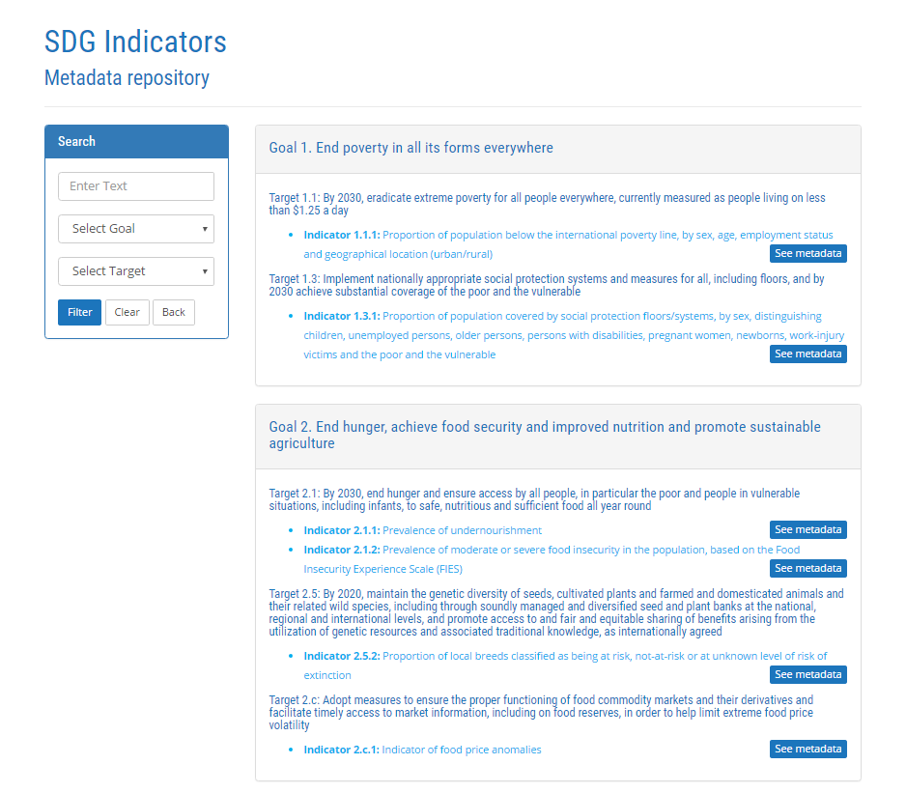
SDG Website: http://unstats.un.org/sdgs/
SDG Indicators Global Database with country-level data
SDG Indicator Metadata available

Slide 20
The Global SDG database and metadata repository – current status
Presents data for over 130 indicators from the SDG indicator framework
Contains almost 500 unique data series, with a total of around 455,000 data records.
Contains global, regional and national data
Metadata for more than 160 indicators are available online, including for some indicators for which data is currently not available.
UNSD is working on integrating the metadata next to the data (currently on a separate webpage)
SDG data is available on UNdata
Via UNdata data will shortly be accessible through an API

Slide 21
Conclusions
SDGs need to happen in countries
Availability and use of data at the national and sub-national level are central to the development of the necessary policies and interventions
Not only SDG Indicators but SDG Data!
Data that is open, timely, disaggregated, but also relevant to users’ needs and fully usable by those who need it

