Slide 1
Developments in environmental-economic accounting
Anton Steurer, Eurostat E2 – Environment statistics and accounts; sustainable development
Meeting of the Advisory Expert Group on National Accounts, Luxembourg, 27 – 29 November 2018

Slide 2
Overview of presentation
Introduction to environmental-economic accounting and the SEEA CF and SEEA EEA handbooks
Research agenda items of relevance for environmental accounting

Slide 3
What is environmental-economic accounting?
Presents environmental information in a way compatible with national accounts using the same concepts and classifications
Integrates existing data into a coherent system
Permits analysis and modelling of environmental effects of economic activities and policy measures
Basic frameworks supply-use tables (what goes in comes out) and balance sheets (opening stock plus change gives closing stock)
Main areas:
Physical flow accounts (air emission, energy…)
Monetary accounts (taxes, environmental outlays…)
Asset accounts (physical and monetary)
New area: ecosystem accounting

Slide 4
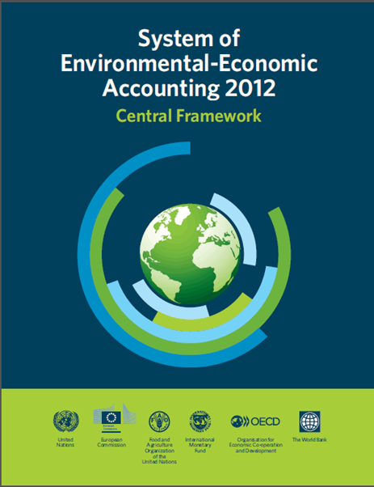
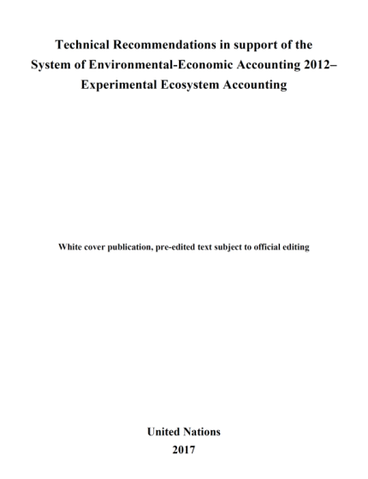
Environmental accounting: international guidance
United Nations, European Commission, FAO, IMF, OECD and World Bank (2013): System of Environmental-Economic Accounting 2012 – Central Framework (International Statistical Standard) = SEEA CF
https://seea.un.org/sites/seea.un.org/files/seea_cf_final_en.pdf
United Nations, European Commission, FAO, OECD and World Bank (2014): System of Environmental-Economic Accounting 2012 - Experimental Ecosystem Accounting = SEEA EEA https://seea.un.org/sites/seea.un.org/files/seea_cf_final_en.pdf
United Nations: Technical Recommendations in support of the System of Environmental-Economic Accounting 2012–Experimental Ecosystem Accounting 2017
Several other

Slide 5
Environmental accounting: State of play
Research agendas exist for both SEEA CF and SEEA EEA
SEEA EEA revision process ongoing with planned completion at the en of 2020
Global DSDs are being established for key environmental accounts
Use of indicators from environmental accounts for SDG monitoring increases
Several meetings in the next 2 years linked to the revision of the SEEA EEA could be put to use for strengthening the link to the SNA research agenda

Slide 6
Research agenda items of particular relevance for environmental accounting
SEEA CF and SEEA EEA
SEEA1 - Development of consistent valuation techniques
SEEA2 - Depletion of natural biological resources
SEEA3 - Losses
SEEA5 - Ecosystem services
SEEA4 - Fossil fuel subsidies by industry as part of climate statistics
Many other items have an impact on EA

Slide 7
Research agenda items of particular relevance for environmental accounting (cont.)
SNA research agenda draft
SNA28 - Tradable emission permits
SNA29 - Leases to use or exploit natural resources
SNA35 - Valuation of natural resources
GFS research agenda
(GFS11 = SNA35)
GFS2 - Application of re-routing
GFS3 - Terminal costs

Slide 8
Losses – key issues
There are a number of issues related to losses which are not yet fully described in the SEEA CF. These include losses of natural gas, electric energy and water. Papers were drafted during the drafting of the SEEA CF which should be reviewed for better clarification of the terminology and conceptual issues and how to address them.
Example: physical losses (and hence unit prices) depend on number of units – separate units for production and distribution mean higher recorded losses (and higher intermediate consumption)

Slide 9
Fossil fuel subsidies
Important Tier 3 SDG indicator (tier 3 = in need of definition). Data available at the International Energy Agency and OECD. IEA uses price-gap method. Data used by IMF include calculations of external costs. Connecting these data sets to SEEA should be possible.
Issues: links to consumer subsidies, treatment of tax differentials as transfers and re-routing.

Slide 10
Depletion of biological resources
More challenging than non-renewable as they proper management can make them recover. Depletion in physical terms to come from SEEA.
Issues: asses valuation using net present value approaches. Institutional setting.

Slide 11
Ecosystems and ecosystem services
Topic of SEEA EEA. Services of ecosystems include provisioning (e.g. crop production), maintenance (e.g. flood protection) and cultural services (e.g. recreation). Some ecosystem services are captured by the SNA (e.g. the contribution of ecosystems to crop or timber or fish production or some parts of recreational services in rentals or in tourism), others not (cleaner air, parts of recreation…).
Issues: production boundary, many valuation challenges relevant for SNA incl. consistency and institutional assumptions, issues of ownership.

Slide 12
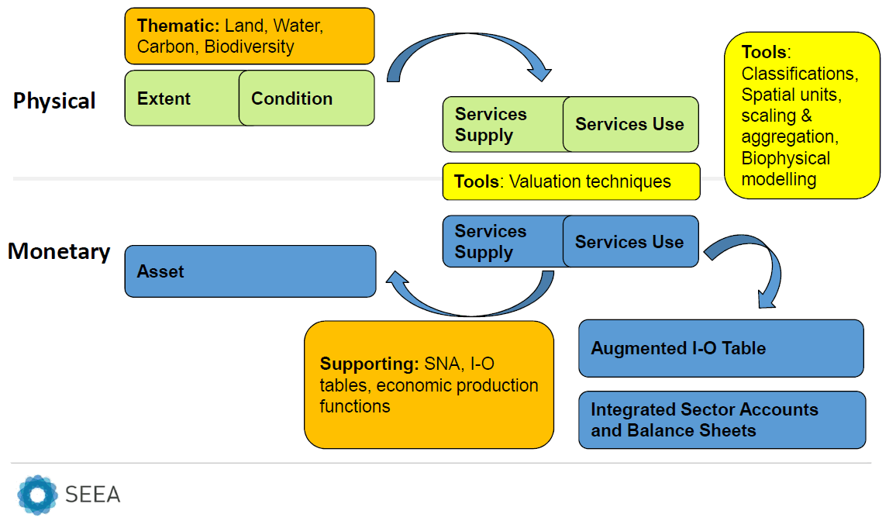
Components of ecosystem accounting
Current focus
Notes:
This figure shows the key components of an ecosystem accounting system as described in the SEEA experimental ecosystem accounting handbook published by the European Commission, the OECD, FAO, World Bank and the UN in 2014. The physical core accounts are in green: accounts for ecosystem extent, condition, ecosystem service supply and ecosystem service use. There are thematic accounts that describe water or carbon. And there are monetary accounts, shown in blue. The later depend on reliable methods for valuation which is a major challenge and are a satellite extension to the standard national accounts.

Slide 13
Households producing energy – re-routing
Increasingly, buildings are equipped with installations to e.g. capture solar heat and to generate photovoltaic electricity. In Europe support measures have different setups, ranging from a legally requiring electricity companies to pay high feed-in tariffs, to direct taxes and subsidies. While economic reality is similar, the recorded transactions are not.
Issues: imputing forced transactions, production boundary.

Slide 14
Many other areas of interest
All other items under Economic well-being and sustainability are relevant in an ecosystem accounting context.
Also SNA44 on leasing, SNA10 on the concept of income, SNA 19 on income from assets, SNA5 on output of government, SNA32 on maintenance and capital repairs, SNA24 on provisions and more widely SNA1 on the link to IASB.
An issue to note is the discussion on treatment of restoration costs and liabilities – especially in the context of leases – that might be a specific area for discussion.

Slide 15
Environmental accounting key dates (tentative) where links to SNA could be discussed
22-24 Jan 2019 valuation of ecosystem services meeting in NY
April or June 2019 Forum of Experts on ecosystem accounting in NY
June 2019 UN Committee of experts on environmental accounting (UNCEEA) in NY
Oct 2019 London Group on environmental accounting in Canberra

Slide 16
Thank you!

