Slide 1
A statistical information system for capturing well-being and sustainability
Meeting of the Advisory Expert Group (AEG) on National Accounts
Luxembourg, November 27 – 29, 2018
Peter van de Ven
Head of National Accounts, OECD

Slide 2
Introduction
Lots of criticism on GDP in providing adequate guidance for policy:
Does not appropriately measure well-being (including its distribution), or progress of society more generally
Does not address environmental issues and ecological boundaries
GDP ≠ (sustainable) well-being
GDP ≈ measure of economic activity
But what then?

Slide 3
Staying Within the Current System of National Accounts
“It’s about households, stupid!” (paraphrasing President Clinton)

Slide 4
Putting people at the centre
Very valid recommendations made in the Stiglitz-Sen-Fitoussi Report, in respect of macro-economic statistics:
When evaluating material well-being, look at income and consumption rather than production
Emphasise the household perspective
Consider income and consumption jointly with wealth
Give more prominence to the distribution of income, consumption and wealth
Broaden income measures to non-market activities

Slide 5
At the OECD …
Analysis of differences in the development of economic growth and real household disposable income
Quarterly news releases on household disposable income
Households’ Economic Well-being Dashboard
Integrating distributional information witin the system of national accounts (together with Eurostat)

Slide 6
GDP growth versus real household adjusted disposable income

Slide 7
Households’ Economic Well-being Dashboard
Moving beyond GDP to focus on household economic resources …
GDP and household income – 3 indicators
Confidence, consumption, and savings – 3 indicators
Debt and net worth – 2 indicators
Unemployment – 2 indicators
Updated quarterly approximately 4.5 months after the end of the reference quarter
A blog each quarter focusing on one country’s indicators
http://www.oecd.org/std/na/household-dashboard.htm

Slide 8
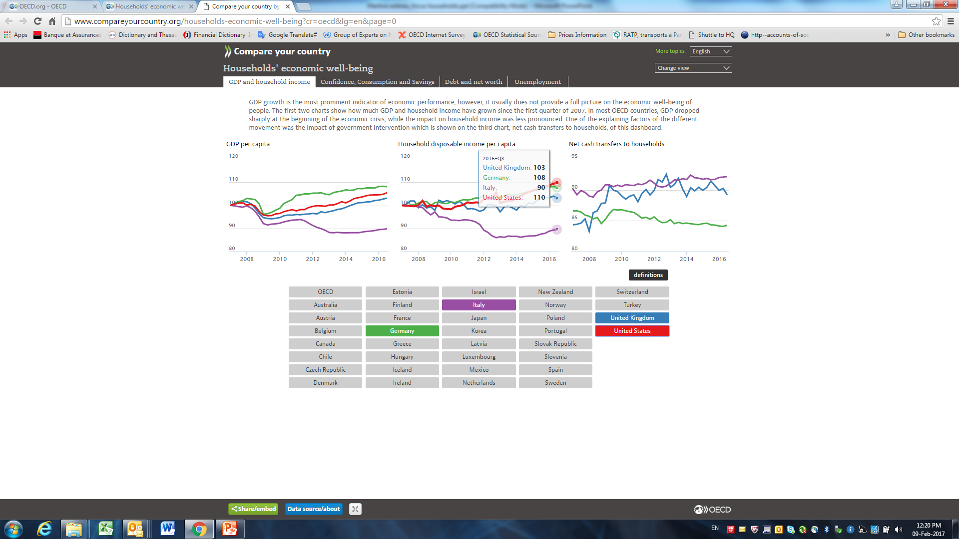

Slide 9
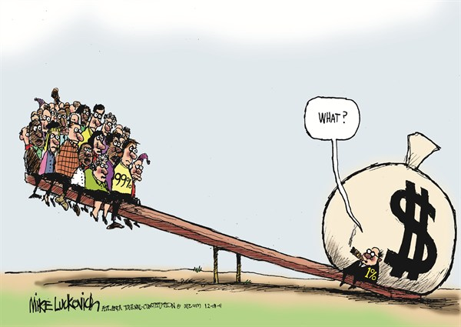
Distributional aspects
Sub-classifications per main sector
Non-financial corporations: 11
Financial corporations: 96
General government: 15
Households: 7
NPISHs: 2
Need to integrate micro-data on households, to arrive at consistent and timely distributional information on income, consumption, saving and wealth
More details on households, by income quintile/decile, by type of income, by composition of households
Expert Group Disparities in National Accounts (EG-DNA)
May also improve both micro-data and national accounts

Slide 10
Coverage rates (micro vs. macro)

Slide 11
Results from 2015 exercise: Savings ratios
France
United States
Mexico

Slide 12
Going Beyond the Current System of National Accounts

Slide 13
At the OECD …
Estimating unpaid household activities
Implementing System of Environmental-Economic Accounting (SEEA)
Measuring (sustainable) well-being using a dashboard of indicators (e.g. OECD Better Life index)

Slide 14
A Vision for the Future
“So, it has come to this. The global diversity crisis is so severe that brilliant scientists, political leaders, eco-warriors, and religious gurus can no longer save us from ourselves. The military are powerless, but there may be one last hope for life on earth: accountants” (Jonathan Watts)

Slide 15
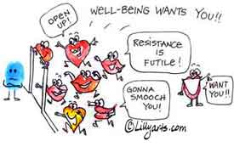
Measuring well-being
Starting point: Well-being is a multidimensional phenomenon
One single measure not feasible
OECD Better Life Index, various dimensions:
Housing
Income
Jobs
Education
Civic engagement
Health
Life satisfaction
Safety
Work-life balance, etc.

Slide 16
I have a dream!
Accept and communicate that GDP is first and foremost an indicator of (monetary) income or economic activity
Establish a much better link between macro accounting framework and the work on (sustainable) well-being
Embed the framework of national (monetary) accounts into a much broader framework of “national accounts”
Practical approach: start with including and regularly updating of accounts for environment, unpaid household activities, health, and education
Such an accounting system may provide …
underlying accounting framework for several aspects of well-being
an improved information basis for analysing trade-offs and win-wins between various aspects of sustainability and well-being
Developing such a framework could be the objective of the guidance note on sustainability and well-being

Slide 17
Questions to the AEG

Slide 18
Questions and issues for the AEG
The AEG is requested:
To provide its opinion on the proposal put forward to define a broader framework of national accounts, which could be used as a starting point for developing the guidance note on sustainability and well-being
To provide further ideas and suggestions to arrive at a better link with the work being done in the area of (sustainable) well-being

Slide 19
Thank you for your attention!

