Slide 1
Accounting for Unpaid household activities
Meeting of the Advisory Expert Group (AEG) on National Accounts
Luxembourg, November 27 – 29, 2018
Peter van de Ven
Head of National Accounts, OECD

Slide 2
Introduction
One of the most persistent criticisms on the System of National Accounts is the non-recognition of unpaid household services
A clear link with the digital transformation of the economy:
Participative role of consumers (booking flights and holidays, self-service at supermarkets, etc.) => blurring the delineation between market production, unpaid household activities and leisure
“Free” services financed via advertising and provision of data (Internet, social media, etc.)
Free assets produced by communities of people (Wikipedia, open-source software)

Slide 3
Introduction
2008 SNA standards and other conceptual issues
Basic methodology and measurement issues
Results
Way forward

Slide 4
2008 SNA standards

Slide 5
2008 SNA standards
§ 6.24: “Economic production may be defined as an activity carried out under the control and responsibility of an institutional unit that uses inputs of labour, capital, and goods and services to produce outputs of goods or services”
§ 6.26: “… activities undertaken by households that produce services for their own use are excluded from the concept of production in the SNA, except for services provided by owner-occupied dwellings and services produced by employing paid domestic staff”

Slide 6
2008 SNA standards
§ 6.30: “…, the reluctance of national accountants to impute values for the outputs, incomes and expenditures associated with the production and consumption of services within households is explained by a combination of factors, namely the relative isolation and independence of these activities from markets, the extreme difficulty of making economically meaningful estimates of their values, and the adverse effects it would have on the usefulness of the accounts for policy purposes and the analysis of markets and market disequilibria”

Slide 7
Conceptual issues
Primary concerns of the 2008 SNA relate more to practical measurement type of issues
Impact on, and interpretability of, other headline indicators (e.g. household disposable income)
Delineation with leisure time, e.g. travelling time, and eating and drinking time, but also e.g. gardening
Proper allocation of simultaneous activities, e.g. taking care of children while cooking or cleaning
Services from unpaid household activities can often not be put on a par with related market services, e.g. taking care of children by (grand)parents versus paid childcare in a kindergarten

Slide 8
Basic methodology and measurement issues

Slide 9
Basic methodology (1)
Starting point: time use surveys
Valuation of services:
Market-equivalent prices of similar services
Cost-based approaches
Not easy to define (units of) services provided within households, therefore often rely on cost-based approaches:
Labour costs
Use of intermediate goods and services
Consumption of fixed capital

Slide 10
Basic methodology (2)
Main valuation issue regarding labour costs:
Replacement cost approach: wage costs of similar activities
Opportunity cost approach: income foregone
Intermediate consumption: difficult to delineate relevant consumption categories, but no impact on value added and GDP
Consumption of fixed capital (CFC):
Starting point: certain categories of consumer durables
Perpetual Inventory Method to estimate CFC
But … appropriate delineation? service lives?

Slide 11
Measurement issues
Time use survey data of good quality needed:
Frequency: data often only available every 3-5 years
Timeliness: time lag of several years
Consistency: quite a number of discontinuities over time, also issues in relation to international comparability
Granularity: for more detailed analysis, e.g. the impact of digital transformation, more details are needed
Issues related to measuring productivity over time
Issues related to capturing significant differences in quality of output (e.g. cooking of meals)

Slide 12
Results

Slide 13
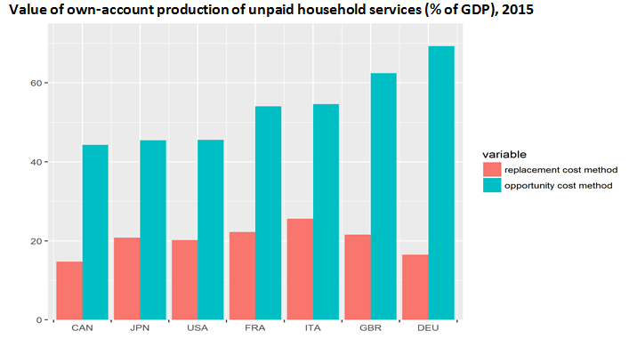
Experimental results

Slide 14
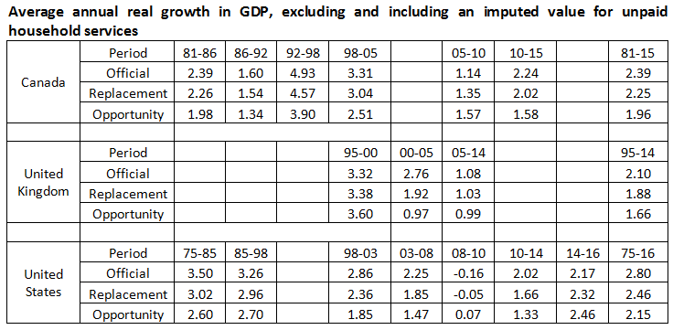
Impact on growth rates

Slide 15
Way forward

Slide 16
Way forward?
Improving granularity, frequency and timeliness of time use surveys:
=> big data?
=> using and integrating other official data sources (e.g. labour force survey)?
Developing an internationally agreed methodology
Looks for ways to motivate countries to compile estimates at a regular interval
Make unpaid household activities part of a broader framework of national accounts (see next presentation)

Slide 17
Questions to the AEG

Slide 18
Questions and issues for the AEG
The AEG is requested to provide its opinion on:
… how to move forward the agenda on monitoring unpaid household activities in an internationally comparable way, and to motivate countries to compile such estimates on a more regular basis, say every 3-5 years
… developing a more standardized methodology for measuring unpaid household activities, to arrive at internationally comparable results

Slide 19
Thank you for your attention!

