Slide 1
A PROPOSAL FOR A SATELLITE Framework ON THE DIGITAL ECONOMY
Twelfth Meeting of the Advisory Expert Group on National Accounts
27-29 November 2018
Luxembourg
John Mitchell OECD
Erich H. Strassner Bureau of Economic Analysis

Slide 2
Supply-Use Tables for the Digital Economy
1) Present some background
2) Provide an outline of the digital supply-use tables (SUTs)
3) Cover some of the specific questions in more detail
4) AEG input and way forward

Slide 3
Digital SUTs Background
The basic framework presented last year, the proposal is broadly in line with this but with additional clarifications and definitions.

Slide 4
Digital SUTs Background
This framework has been developed into something that,
Countries could fit within their current statistical framework and measurement processes.
Found a balance between practically possible and statistically informative.
Include definitions that could be agreed upon.
Does not produce “Digital GDP” but provides various indicators that can be internationally compared such as,
The total output of the digitally enabling industries.
The total value of e-commerce (i.e. digitally ordered goods and services).
The total value of services provided by intermediary platforms as a separate proportion of the overall value of the goods and services

Slide 5
Digital SUTs Outline
Supply table: includes domestic production and imports.
Use table: includes use by domestic producers (intermediate consumption), final consumption, investments, and exports.
This framework was turned into digital supply and use tables,
additional breakdowns of certain digital products, with space for the different digital and non digital margins, and digital producers.
also include “free” digital services, that are not currently in the SNA production boundary.

Slide 6
Digital SUTs Outline
We didn’t need to create a new table…
Current SUTs provided to the OECD includes 98 industries (ISIC sub-division level) corresponding to 98 products (CPA division level).
5 newly defined products.
10 traditional products broken down by type of transaction involved.
6 newly defined “digital industries” based on the characteristics of the unit.

Slide 7
Digital SUTs Example

Slide 8
Digital SUTs Example

Slide 9
Digital SUTs Example

Slide 10
Digital SUTs- outline Transactions type
The most significant determinant of something being considered digital is the method of transaction.
Various products in the SUTs are further broken down depending on if they were,
digitally ordered,
digitally delivered,
platform enabled,
non digitally ordered
The split of transaction type is the most important data requirement for countries looking to populate the tables.

Slide 11
Digital SUTs- outline Products
The proposal includes 5 newly defined products as well as 10 traditional products that are further broken down by this transactional information.
These are products that have been heavily impacted by the uptake in digital technology.
The first 5 on the list are not at CPA division level.
Digital goods and services include products from a range of product classifications.
Product 3 & 4 are below CPA level but are key areas of interest for users.
Product 5 is currently outside of SNA boundary.
Digital goods
Digital services – except cloud computing services and digital intermediary service products
Digital intermediary service products
Cloud computing services
Free digital services
Accommodation services
Food and beverage service activities
Land transport services
Travel agent, tour operator, reservation services and related activities
Advertising and market research services
Education services
Motion picture video and TV program production services
Financial and insurance services
Gambling and betting activities
Retail trade
Countries are free to further break down additional products if they have the data and if they are of importance to their economy.

Slide 12
Digital SUTs- outline Industries
The proposal includes 6 “Digital Industries” as well as an “other industry” category which includes data split by ISIC and currently provided in the SUTs.
Units can be placed into these industries based on shared activities / characteristics.
Digitally enabling industries
Digital intermediary platforms
Firms dependent on intermediary platforms (further separated into those that are incorporated and unincorporated)
E-Sellers (split into E-Tailers and E-Vendors)
Digital only firms providing finance
Other digital businesses
Other industries (broken down according to the standard supply and use tables)

Slide 13
Digital SUTs Broad assumptions, clarifications, notes etc
Digital services does not include providing access to non digital services (i.e. Airline tickets).
Goods can not be delivered digitally. (Assumed that 3D printing does not constitute “delivery”).
It’s likely that the definitions or decision tree needs some clarification, a small amount of units may fit into more than one category.
Matching a consumer to advertising is not a transaction, even if the viewing of it generates some revenue for the platform.
Does the AEG have any clarifying questions on the outline of the digital SUTs?

Slide 14
Digital SUTs
Issues that need to be addressed
The products chosen to be separately identified.
Where to place units that receive orders via different transaction types.
Units producing non digital services that are ordered digitally.
Confirmation of how to treat transactions involving intermediary platforms in the SUTs.
Further classification of units that are categorised to “other digital businesses.”

Slide 15
Digital SUTs Separately identified products
15 products chosen for initial proposal, the more the better but there is no set number.
Cloud computing identified due to increasing importance in enabling digitalisation.
Digital intermediary service products chosen to assist in measuring the output of the intermediary platforms.
“Free” digital service included to generate an estimate of their value (despite being outside the SNA production boundary).
Other digital products aggregated into either digital goods or digital services.
It is not suggested that the non-digital products listed are the only ones impacted by the digital economy, rather they provide the opportunity for measurement of the altered production chains.
Does the AEG agree with the products proposed for separate identification and additional delineation?

Slide 16
Digital SUTs Transactions involving intermediary platforms
Option 2 is considered reflective of real world activity and the most practical to measure, and was widely endorsed by the OECD informal Advisory Group on Measuring GDP in a Digitalized Economy.

Slide 17
Does the AEG agree with the proposal to use option 2 as the basis for recording transactions involving intermediary platforms?

Slide 18
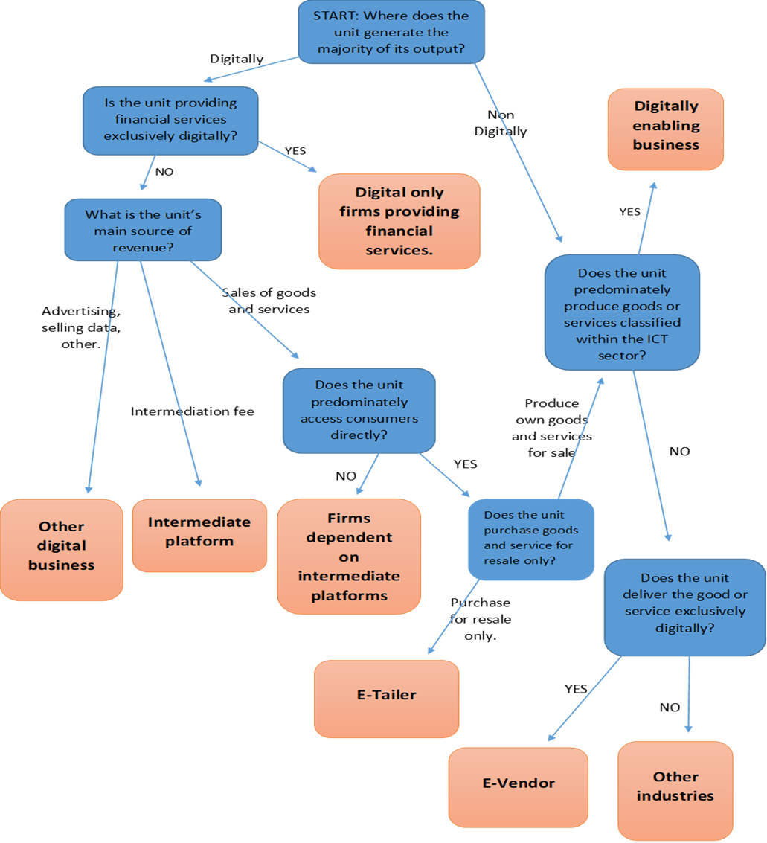
Digital SUTs Decision Tree
Where would the following units end up?
Google
The local boulangerie
Trivago
Apple
KLM
Instagram
Paypal
ASOS
BET 365
CARL (an UBER driver)

Slide 19
Digital SUTs Classification of units

Slide 20
Digital SUTs Classification of mixed businesses
The most important delineation is the transactional split between non-digitally ordered, digitally ordered direct or via platform.
When this information is available producers utilising multiple channels can remain in the ISIC classification under “other industries”. The transaction type is used to separate the digital component from the non digital component.
What happens when this split is not available and the entire unit needs to be placed in one transaction type? Do we base it on majority?

Slide 21
Digital SUTs Classification of mixed businesses
When does a retailer become an e-tailer 1%, 51%, 100%?
When does a firm become dependent on platforms 1%, 51%, 100%? (What does this mean for hotels?)
In the proposed SUTs the majority criterion has been taken for both of these decisions.
Is it OK that “the Ritz Paris” and Carl (the UBER driver) may be in the same “digital industry”?
Does the AEG agree with the proposal to place units into some categories based on a simple majority?

Slide 22
Digital SUTs E-Vendors and digital firms providing finance
However E-Vendor and digital firms providing finance categories will be 100% (otherwise a large portion of the economy would be “digital”)
Airlines, live sport, utility companies. Most of these receive the majority of orders digitally but we do not want to treat them as E-Vendors as they are providing non digital goods and services.
Consumers interact with financial services digitally most of the time.
Does the AEG agree with the proposal to separately identify “E-Vendors” and “Units providing finance” and to limit the category to those that operate exclusively digital?

Slide 23
Digital SUTs Other digital businesses
“Other digital businesses” include units that are not explicitly charging consumers for their service.
Therefore the service product being produced by these units is likely the free digital service.
The majority of these will be for profit enterprises who generate revenue from advertising, selling data or providing a service outside of the SNA production boundary.
The proposed tables do not stop compilers from further delineating these businesses, rather it creates a grouping of different but broadly similar businesses.
A few will be non profit (do we need to separate out these units?)
Does the AEG consider it useful to separately distinguish market and non market units within the “other digital businesses”?

Slide 24
Digital SUTs Way forward
It is hoped that agreement on the framework can be had by the end of 2018.
Some countries would be able to begin populating the digital tables (or parts thereof) in 2019.
OECD to produce aggregate estimates of economic indicators based on a set definition relating to the digital economy.
Does the AEG agree with the proposed digital unit decision tree?
Does the AEG generally agree with the proposed digital SUTs, and the information that can be derived from them?

Slide 25
Digital SUTs Issues discussed at informal advisory group
The products chosen to be separately identified.
Terminology around some of the decision tree, but the need to keep definitions a little flexible.
The difficulty in classifying units that receive orders via different transaction types, this highlighted the importance of the data on the transaction type.
The policy need for differentiating businesses that leverage of the internet and those that require digital intermediation.
Units producing non digital services that are ordered digitally.
Confirmation of how to treat transactions involving intermediary platforms in the supply-use tables.
Further classification of units that are categorised to “other digital businesses.”
Notes:
Feedback on Friday was general positive. But was also extensive, reflecting the complexity and challenges that comes with this work. While the proposal and the framework does not specifically address measurement issues since we were dealing with a group of national statistical offices, these naturally came up.
There was a little concern regarding units that are transacting on multiple platforms that constitutes a large proportion of the business, this highlights the importance of the transaction type data. While we may shift units in the columns based on shared activities, ideally we would be keeping them in the same ISIC columns and separating out the amount of output derived digitally and not digitally based on the transaction.
We are not trying to define new industries and work out what goes in and what goes out. The digital decision tree is more for splitting up the firms involved in production using digital means than trying to pigeon hole a non digital firm into a digital classification.

Slide 26
Digital SUTs Way forward
Additional feedback will be received when the proposed satellite account will be presented at the Advisory Expert Group on National Accounts in Nov 27 – 29.
It is hoped that following these discussion a final proposal can be sent out to countries by the end of 2018.
Some countries have already indicated that they may be able to begin populating some components of the table in 2019.
It is aimed to present the final template (although not estimates) to the Committee on Statistics and Statistical Policy in June 2019

Slide 27
A PROPOSAL FOR A SATELLITE Framework ON THE DIGITAL ECONOMY Contact details
John Mitchell
National Accounts Division,
Statistics and Data Directorate.
John.MITCHELL@oecd.org
Erich H. Strassner
Chair, OECD Advisory Group on Measuring GDP in a Digitalized Economy
Erich.Strassner@bea.gov

