Slide 1
How to deal with globalisation in the system of national accounts
Meeting of the Advisory Expert Group (AEG) on National Accounts
Luxembourg, November 27 – 29, 2018
Peter van de Ven
Head of National Accounts, OECD

Slide 2
Overview
What are the main problems?
Solutions within the current international standards
Challenges with and implication for the current international standards
Practical considerations
Wrap-up and way forward

Slide 3
What Are the Main Problems?

Slide 4
Global production versus national statistics
Global production arrangements between firms and within MNEs
Statistical complications have long been recognised and discussed:
Goods for processing/merchanting
Transfer pricing
Special Purpose Entities
Relocations/reorganisations
Asymmetries in trade data
Clear friction between national statistics based on residency and global behavior of MNEs
www.oecd.org/trade/valueadded

Slide 5
Adding IPPs and digitalisation
Challenges exacerbated when globalisation meets IPPs and digitalisation
IPPs have no physical and local constraints => relatively easy to relocate from one country to another
Impact can be large, especially in small economies
Is GDP still valid as a measure of domestic production? For designing monetary, fiscal and structural policies?

Slide 6
Discussions at international level
NBER/CRIW Conference (Washington DC, March 9-10, 2018)
Reflection Group of CSSP (reported to June 2018 Meeting of the CSSP)
Advisory Expert Group (AEG) on National Accounts (next meeting: end November 2018)
ECE/Eurostat/OECD Group of Experts on National Accounts: Special Meeting on Measuring Global Production (Geneva, April 10-12, 2019)
Etc., etc.

Slide 7
Solutions within the Current International Standards

Slide 8
Improved accounting
Better accounting for global production arrangements
Improving consistency at national level (e.g. by establishing Large Case Units)
Improving international consistency of recording MNE-activities (EuroGroups Register, Early Warning System, etc.)

Slide 9
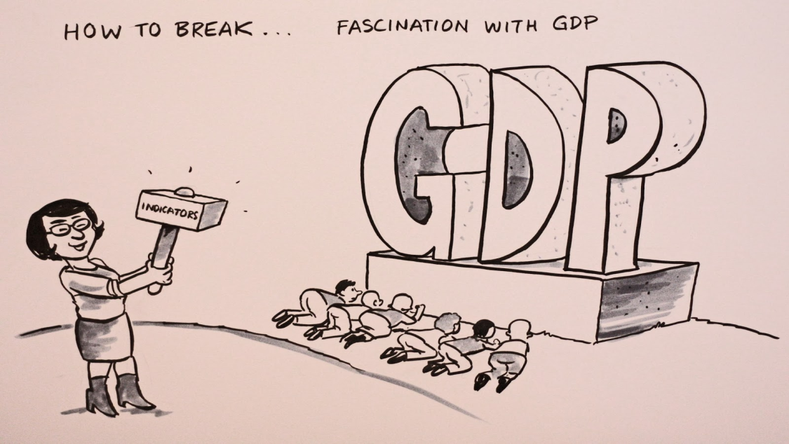
Emphasising existing complementary indicators, …
National Accounts ≠ GDP
The System of National Accounts is a framework from which a variety of indicators can be derived
Some indicators such as NNI and Household Disposable Income hardly/not affected by e.g. relocations
Better use and communication needed

Slide 10
…, including greater granularity, …
Proposed additional breakdowns in supply and use tables and/or in institutional sector accounts:
By type of ownership:
Public corporations
National private corporations, not part of domestic MNE
National private corporations, part of domestic MNEs
Foreign-controlled corporations
Of which: Special Purpose Entities (SPEs) (Note: may only be relevant for some countries)
By type of firm:
Factoryless producers, merchanters, contract manufacturers, processors
By business function?

Slide 11
…, and defining additional indicators and datasets
Additional indicators:
GNI* (= GNI minus retained earnings of re-domiciled firms minus depreciation of categories of foreign-owned domestic capital assets (such as IP capital assets))
Contributions of inputs to (growth of) GDP (e.g. separating value added from IPPs and other movable assets, from labour and other assets)
Creating supplementary global datasets on multinational enterprises, to better monitor and understand economic behaviour (EGR, ADIMA)

Slide 12
Challenges with and Implication for the Current International Standards

Slide 13
Main characteristics of IPPs
No physical or local constraints
Often no direct link to the production process (e.g. basic research)
Often no direct link between today’s stock of assets and today’s production of goods and services
Often concern the whole value chain, not a particular part of the process (e.g. product and process innovations)
Once produced, they are usually easily scalable
…

Slide 14
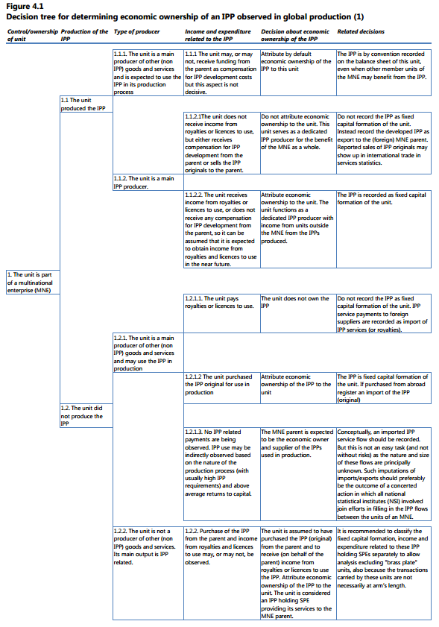
Who owns the IPPs?
2008 SNA makes distinction between economic (risks and rewards) and legal ownership
But, despite best efforts, guidance on identifying economic ownership arguably falls short

Slide 15
Emerging suggestions “outside of the current thinking”
Not allocating IPPs (and related income) to any country
Proportional allocation of IPPs (and related income), e.g. based on compensation of employees or domestic sales
Allocation of IPPs (and related income) to the parent company

Slide 16
Advantages and disadvantages
Option 1:
∑ GDP of national economies ≠ World GDP
Option 2:
Would be consistent with some of the ideas about taxing MNEs
More stable macro-economic data, but would it lead to better, more, interpretable results from an economic substance point of view, e.g. allocating IPPs to countries with low knowledge-intensive activities
Resulting data are largely imputed, with contentious economic rationale, thus creating and measuring a fictitious world

Slide 17
Advantages and disadvantages
Option 3:
More prescriptive guidance on economic ownership needed anyhow
IPPs relate to the whole value chain
IPPs are basically controlled by the parent
National accounts less affected by fiscal arrangements => current measures of (distributed and reinvested) earnings would shift from GNI to GDP in the parent economy
Need for international alignment and exchange of data across countries (see below)
What about relocation of parent companies?

Slide 18
A panacea or a sticking plaster? Who is the ultimate parent??
Centre of economic decisions = location from where decisions are made on:
global arrangements of production
R&D and other corporate investments
corporate finance
appointment at senior management level
etc.
Location of board of directors
…
Corporate inversion by setting up a holding type of SPE to minimise tax burden would thus not affect centre of economic decisions

Slide 19
And more: consolidating SPEs
SPEs are typically pass-through types of units, often set up to minimize global tax burden
No economic substance; often brass plates
Currently only treated as separate institutional units, because associated corporation is located in another country
If not located in another country, they would not be considered as separate institutional units and would be consolidated
Assigning e.g. ownership of IPPs to these units is matter of legality or practicality
Consolidate SPEs with the ultimate owner

Slide 20
Practical Considerations

Slide 21
“In between dream and act there are hindering laws and practical issues” *
Alternative recordings require extensive exchange, or coordination, of individual enterprise information at the international level
Top-down approach (e.g. BEPS-data, or alternative/additional collection of data on MNEs at the international level)
Bottom-up approach (monitoring and analysis of MNEs primarily based on collection of data on the national level)
But … we already have major problems in arriving at consistency at the national and international level, even problems in arriving at exhaustive estimates at international level
Need for enhancing (the possibilities for) international co-operation and co-ordination
* Quote from the poem “The Marriage” by Willem Elsschot

Slide 22
Summary and questions

Slide 23
Wrap-up and way forward
At the national level, no conceptual issues in applying solutions within the current framework, among which more granularity, decomposition of value added
But … it does require sources, resources and time to implement
Need to continue and step up current initiatives:
At national level: Large Cases Units
At international level:
Early Warning System
International databases on MNEs (EGR and ADIMA)
Need to rethink (interpretation of) the current international standards (2008 SNA) regarding economic ownership of IPPs and treatment of SPEs, including considerations on how to implement it in practice
Need to move forward quickly
Further discussion as part of the development of the guidance note on globalisation

Slide 24
Questions and issues for the AEG
The AEG is requested to provide its opinion/advice on:
… the various alternatives to provide further information on the activities of multinational enterprises, by promoting further breakdowns in the supply and use tables and in the institutional sector accounts, and by having improved statistics on the global activities of these enterprises
… the recording of economic ownership of intellectual property products (IPPs) within (multinational) enterprises, and the subsequent allocation of IPPs and related income across countries
… the recording of Special Purpose Entities (SPEs), for which it is evident that they do not have any autonomy of decision
… the way forward in dealing with the above issues

Slide 25
Thank you for your attention!

