Slide 1
Satellite Accounting at Statistics Canada
www.statcan.gc.ca
Telling Canada’s story in numbers
James Tebrake
Statistics Canada
December 2017

Slide 2
Motivation – Satellite Accounting and the National Accounts
Premise: We are / Are we starting to see a proliferation of satellite accounts?
Main Question: What role should the AEG (or the international community) play in the development of satellite accounts?

Slide 3
Outline – Satellite Accounting at Statistics Canada
Types and Uses/Users
A brief history in Canada
Questions for the AEG to consider

Slide 4
Satellite Accounting at Statistics Canada (and according to 2008 SNA) – Three types of satellite accounts
“Type 1” - One type of satellite accounts involves a rearrangement of the classifications, presentation and possible addition of complimentary information not found in the existing core accounts. (e.g. more detail, alternative aggregations). These satellite accounts do not change the underlying concepts of the core system but provide an expanded perspective on a particular sector, group of products or activity.
“Type 2” - The second type of satellite accounts seeks to change the underlying concepts, boundaries of the core system and/or testing new methods. This would involve, for example, changing the concept of production (e.g. including volunteer activities as production), consumption or capital formation.
“Type 3” - The third type involves changes to both the classifications, presentations, boundaries, concepts and methods.

Slide 5
Satellite Accounting at Statistics Canada – Users and Uses
Main uses/users – Type 1 Satellite Accounts
Address key/emerging information needs (usually by governments) that are not always evident in the core accounts.
The data products are structured in in such a way that the information can be ‘consumed’ by the user (e.g. ‘X% of GDP).
In the case of Canada – key users/clients include specific departments (e.g. tourism authorities, culture, agriculture) of the federal government, provincial and territorial governments.

Slide 6
Satellite Accounting at Statistics Canada – Users and Uses
Main users/uses – Type 2 Satellite Accounts
A way to introduce information into the core accounts in a ‘research and development’ fashion where users are provided with experimental/provisional estimates prior to their integration into the accounts. Focus is often on changes to the level and growth of GDP.
In Canada, key users include the Finance ministry, central bank, economic forecasters and modelers.

Slide 7
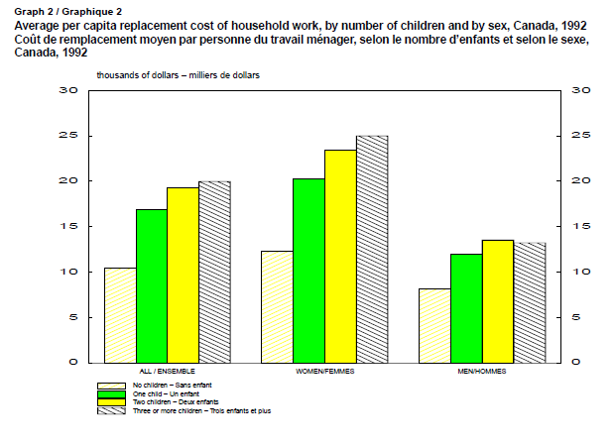
Satellite Accounting at Statistics Canada – Value of unpaid work
First produced in 1992
Followed a large surge in female participation in the labour market.
Mainly used for academic purposes but some obscure uses such as determining compensation in court cases in calculating damages.
Periodic updates made over the years with most of the recent focus on valuing volunteer activities.

Slide 8
Satellite Accounting at Statistics Canada – Research and development satellite account
First published in 2005
Provided users with a ‘heads-up’ on growth and level changes to GDP in advance of 2008 SNA.
Allowed Statistics Canada to identify the data sources and methods required to capitalize research and development.
The Canadian Research and Development Satellite Account, 1997 to 2004

Slide 9
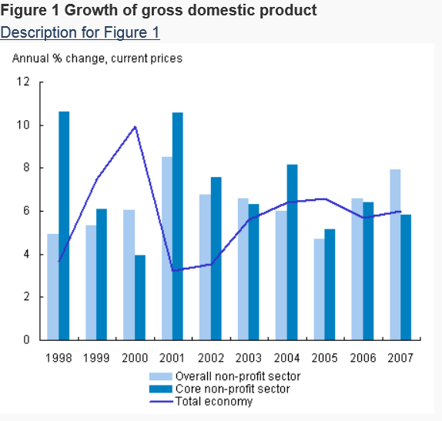
Satellite Accounting at Statistics Canada – Nonprofit sector and volunteering satellite account
Key client was the non-profit sector: Imagine Canada / John Hopkins University.
Main goal was to quantify the importance of the non-profit and volunteering sector in Canada.
Some ‘national accounting’ compromises with respect to the inclusion of government sector entities in the non-profit boundary for international comparisons.

Slide 10
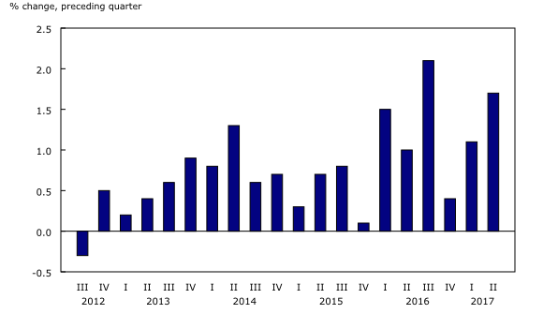
Satellite Accounting at Statistics Canada – Tourism satellite account
Tourism spending in Canada increases
Key client is the Canadian Tourism Commission
Key goal of the program is to increase the visibility and understanding of the role tourism plays in the Canadian economy.
Numerous spin-off products developed such as government revenues attributable to tourism, quarterly national tourism indicators, tourism human resource module (wage rates by occupation)

Slide 11
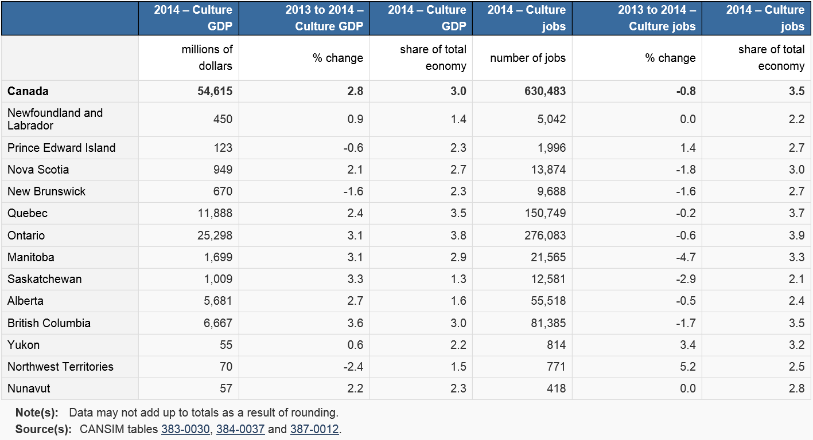
Satellite Accounting at Statistics Canada – Culture Satellite Account
Consortium of clients – headed by Heritage Canada.
Products include a satellite account, provincial and territorial satellite account, trade in culture.
Main needs include the size and evolution of culture. Distinguishes between ‘culture industry GDP’ and ‘Culture GDP’

Slide 12
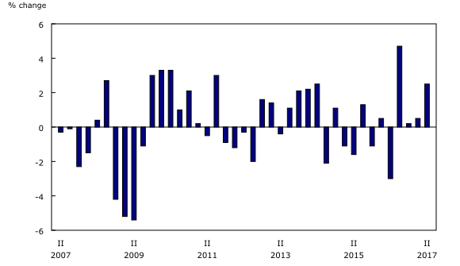
Satellite Accounting at Statistics Canada – Natural Resources Satellite Account
Main client includes Natural Resources Canada.
Main use is to synthesize all the data in one place.
Quarterly indicators used to monitor the sector which is very volatile due to both economic and political factors (e.g. softwood lumber, pipeline expansions)
Growth in real gross domestic product attributable to natural resource activity

Slide 13
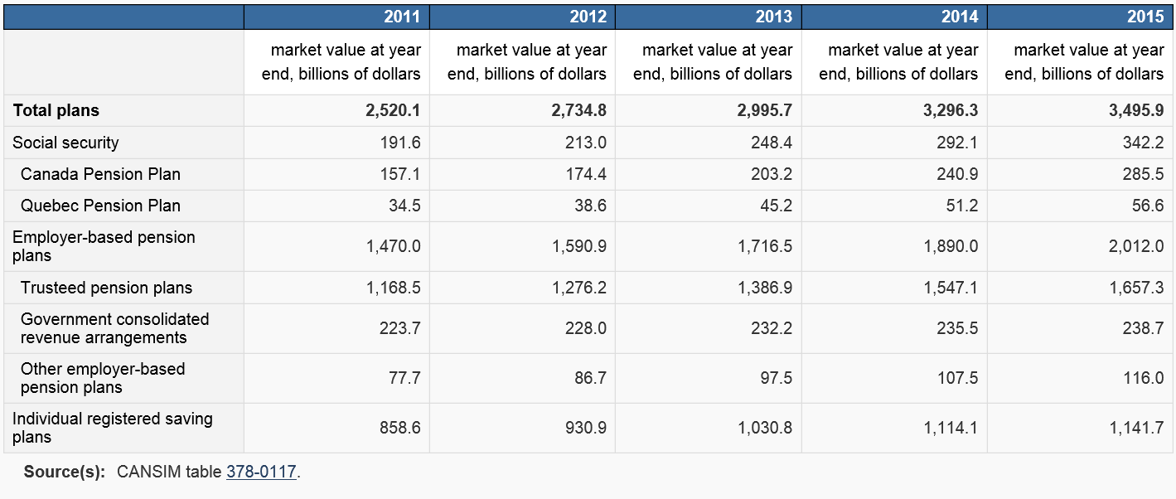
Satellite Accounting at Statistics Canada – Pension Satellite Account
The main client is Finance Canada. The account originated during debates around pension reforms.
This is the Canadian version of the Pensions supplementary table.
Planned extensions include adding distributional information.

Slide 14
Satellite Accounting at Statistics Canada – Cannabis Economic Account
On April 13, 2017 the Government of Canada tabled legislation in the House of Commons to legalize, regulate and restrict access to cannabis for non-medical purposes. If legislation is approved by Parliament the drug’s new status might come into effect by mid-2018.
Given the fact that significant non-medical use currently exists in Canada it is incumbent upon the agency to try to measure the production, sale and use pre-legalization—despite the obvious difficulties of doing so—as well as post-legalization in order to provide Canadians, governments and businesses with as clear a picture as possible of the economic and social consequences of the legalization.

Slide 15
Satellite Accounting at Statistics Canada – Cannabis Satellite Account
Updated NAICS, NAPCS, NOCs, COFOG, COICOP classification to reflect the non-medical use of Cannabis.
Pieced together 50 years of health data that intermittently tracked cannabis use among Canadian and used these data to develop estimates of prevalence and consumption.
Crowdsourced/webscraped ‘street prices’ in order to obtain estimates of price and expenditures.
Used Justice and related data to develop models to estimate production, imports, exports, own-account production and use.

Slide 16
Satellite Accounting at Statistics Canada – Cannabis Economic Accounts
Data collection vehicles (pre-legalization).
Wastewater
Crowdsourcing for prices
Household use/expenditure mobile app / electronic questionnaire.
Webscraping
Social Media / AI
Co-development of regulatory forms.

Slide 17
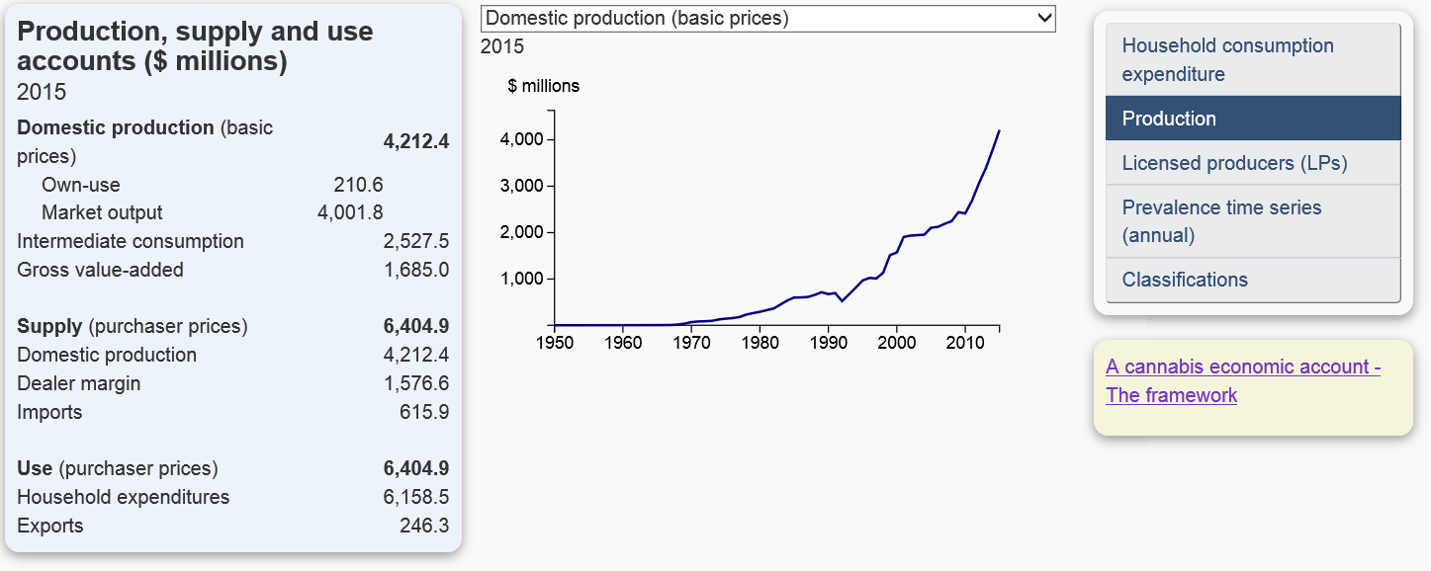
Satellite Accounting at Statistics Canada – Cannabis Economic Accounts
On January 23rd we will be releasing a set of Cannabis Economic Accounts
Back-casted estimates to 1961 - national, provincial and territorial estimates
Will continue to measure illegal production post legalization.
Will introduce a break in 2018 and include back-casted data in 2019 at the time of the next comprehensive revision.

Slide 18
On the horizon….
Clean Technology Satellite Account
Transportation Satellite Account
Agriculture Satellite Account
Digital Economy Satellite Account
Global Value Chain Satellite Account

Slide 19
Why the proliferation – from the perspective of Statistics Canada
Users do not know how to fully use the national account ‘toolbox’. Satellite Accounts are as much a communication tool as they are an accounting tool.
The terminology, concepts and accounting structures inherit in the national accounts are not well understood, are not easily digestible and are not presented in an intuitive manner.
The economy is changing so fast that satellite accounting permits compilers to ‘get data out fast’ while taking a more conservative approach to integrating into the core accounts.

Slide 20
Questions for the AEG
Should the AEG provide more guidance in the development of satellite accounts?
Each satellite account is different, with varying degrees of quality, structure and conceptual rigour. Labelling something as a ‘satellite account’ of the SNA gives it instant credibility that may not be justified. Should there be criteria developed that constitutes when something can be ‘tagged’ a satellite account.
Pet Peeve Issue: Would the AEG support a change in the name ‘satellite account’ to something more intuitive to users such as economic acounts?

