Slide 1
7.2 Economic well-being and sustainability Informal Sector
Eleventh Meeting of the Advisory Expert Group on National Accounts
New York
5-7 December 2017
Margarida Martins

Slide 2
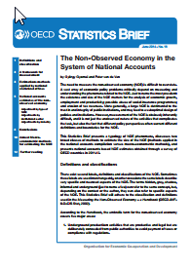
I. Background
Accuracy of data
Data gaps
Size of the informal economy
Existing manuals provide guidance
2002, OECD, Measuring the Non-Observed Economy A Handbook
2008, UNECE, Non-Observed Economy in National Accounts Survey of country practices
2013, ILO, Measuring informality: A Statistical manual on the informal sector and informal employment
2014, OECD, The Non-Observed Economy in the System of National Accounts

Slide 3

I. Background
Courtesy of UN.
Delhi Group on Informal Sector Statistics
1997 - set up and first meeting
International forum to exchange experience in the measurement of the informal sector, document the data-collection practices, including definitions and survey methodologies followed by member countries, and recommend measures for improving the quality and comparability of informal sector statistics.
As a culmination of 11 meetings, the Manual Measuring Informality: A Statistical Manual on the Informal Sector and Informal Employment was published in 2013.
https://unstats.un.org/unsd/methodology/citygroups/delhi.cshtml

Slide 4

II. Non-Observed activities
Non-observed activities: range of activities that are most likely to be non-observed as well as activities that may be missed because of deficiencies in the regular data collection programs.
(The Handbook on Measuring the Non-Observed Economy, OECD, 2008)
Informal activities
Underground activities
Illegal activities
Where is the frontier between the three?

Slide 5
III. Statistical challenges
  Overlap between informal and formal activities
  Scope differs across countries and lack of general guidelines on informal activity associated with cross border transactions
Boundary issues and overlaps
Measurement framework
  Imperfect estimation methods
  Inaccuracy of transactions: problems of coverage, economic unit, and valuation
Source data collection
  Out-of-reach source data
  High costs

Slide 6
IV. Informal activity and IMF surveillance
IMF focus on the measurement of informal activities
The size of the informal sector has implications for the accuracy and reliability of the statistics used in Fund surveillance.
Accurate measurement of the informal sector is important for policy analysis.
  High levels of informal activity are generally associated with tax evasion, the economic tax base, and social welfare effects.
  The informal sector represents an important part of the economy and the labor market in many countries.
The Fund, through capacity development and surveillance efforts, continues to work with member countries to improve the measurement of the NOE and to implement various reforms aimed at reducing informal activity.

Slide 7
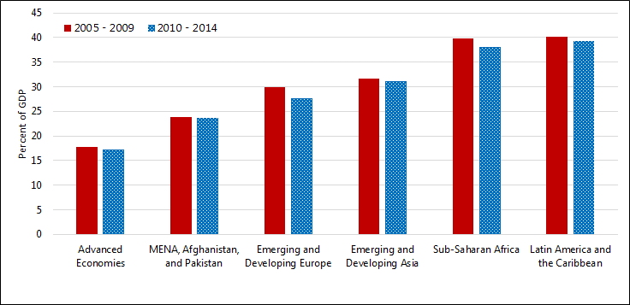
IV. Informal activity and IMF surveillance
In general, non-observed activities are a significant part of low and middle income economies.
  Countries with higher income tend to have lower levels of informal activity.
  There has been a small global decline over time.
Source: IMF Staff estimates

Slide 8
V. Further Developments
The IMF is currently conducting a survey on non-observed activity
  To provide information on the measurement, size, prevalence, and gender differences in employment in the informal sectors of these economies.
  Covering over 100 economies.
  Through the Fund’s Regional Technical Assistance Centers.
  Deadline by mid-December 2017.
  Published Report expected in first quarter of 2018.

Slide 9
VI. Questions
The AEG is requested to take note of the ongoing work and provide feedback on:
New guidance on the use of new data sources, such as big data, to estimate some components of the non-observed economy.
Should there be guidance for the dissemination of metadata on the non-observed economy?

