Slide 1
State of play
-
Expert Group on disparities in national accounts
11th Meeting of the Advisory Expert Group on National Accounts
5-7 December 2017, New York
Presented by Jennifer Ribarsky (OECD)
Prepared by Jorrit Zwijnenburg (OECD)

Slide 2
Contents
Aim of the EGDNA project
Main activities since last AEG meeting
  Publication of results of 2015 exercise
  Development of framework for allocating micro-macro gaps
  Set up of voluntary regular data collection
  Drafting of a handbook
  Paper on differences with DINA project
Continuation as joint OECD-Eurostat EG DNA
Notes:
Since the last AEG meeting, the expert group has met one time (i.e. 6-7 October 2016 in Paris).

Slide 3
Aim of the project
Develop methodology to produce distributional results for household income, consumption and saving consistent with national accounts concepts using micro data sources
Household groups
MACRO DATA
Macro concepts
-> Totals, growth
Q2
Q1
Q3
Q5
MICRO DATA
Micro concepts
-> Distribution
Q4
Notes:
Distributional results for three household groupings:
Disposable income quintile (5 groups)
Main source of income (4 groups)
Household type (8 groups)
The unit of analysis is the household
OECD-modified equivalence scale is used to allocate households to quintile groups
Distributional results for household income, consumption and saving consistent with national accounts aggregates
Calculations performed by members of the EG DNA: AUS, AUT, CHE, FRA, GBR, ISR, JPN, MEX, NLD, PRT, SVN, SWE, USA

Slide 4
Publication of results of 2015 exercise

Slide 5
Publication of results of 2015 exercise
Some results (1)

Slide 6
Publication of results of 2015 exercise Some results (2)

Slide 7
Publication of results of 2015 exercise Some results (3)
France
Mexico
United States

Slide 8
Development of framework for allocating micro-macro gaps

Slide 9
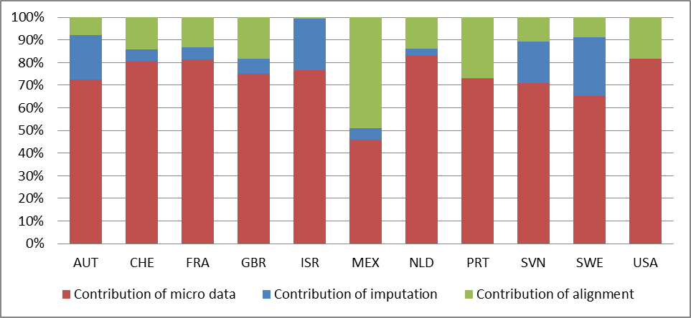
Role in compilation process
Contributions to adjusted disposable income flows

Slide 10
Possible reasons for the gaps
Step 1: Adjustment of the NA totals
  Quality of national accounts totals
  Quality of adjustments to the NA totals
Step 2: Linking micro data source variables to the NA variables
  Assumptions regarding conceptual and classification differences
Step 3: Imputation for missing elements and aligning data to NA totals
  Quality of correction for underground economy and illegal activities
  Quality of micro data – Estimation errors
  Quality of micro data – Measurement errors
Underlying reason(s) for gap may vary across items
Allocation to households may differ per cause and item

Slide 11
Framework – Allocation to quintiles
Notes:
It is difficult to find the exact underlying reasons for gaps
However, discussion between micro and macro experts provides more insight in possible reasons
Time series analyses proof helpful in finding possible reasons
As a result, large part of the gap can be attributed to most likely causes
It turns out that allocation of gaps may indeed depend on underlying reason and may affect distributional results
Applying the framework leads to improved distributional results in comparison with a proportional allocation
Countries deal with similar issues, so may benefit from further exchange of best practices
Conceptual and classification issues:
Wages and salaries: Micro data do not include expenses for food and transport to and from work, reimbursement for annual vacation, et cetera.
Restaurant and hotels: In micro data all holiday spending is assigned to recreation and culture, including spending on restaurant and hotels.
Corrections for underground economy:
Mixed income : Activities not required to register, such as own account production, building for self-purposes, honoraria payments.
Operating surplus: OS on secondary residences, vacant dwellings, and garages.
Measurement errors:
Compensation of employees: Underreporting of bonuses, etc.
Distributed income of corporations: under-coverage of high-income households receiving a disproportionate share of dividends.
……..

Slide 12
Set up of voluntary regular data collection

Slide 13
Regular data collection
Template and guidelines have been updated
Request for additional data was sent out in June 2017
Five countries provided additional data (AUS, GBR, NLD, PRT and SVN) and two countries (will) provide data for a first time (CAN and NZL)
Plan is to send out data request for additional distributional data on annual basis.

Slide 14
Drafting of a handbook

Slide 15
Handbook
Preparation of a handbook that combines all knowledge built up so far within the project
Draft version expected to be available by the end of 2017
Early 2018: Consultation of EG DNA members
Second half of 2018: Publication

Slide 16
Paper on differences with DINA approach

Slide 17
Main differences
In scope:
  Coverage: Income, Consumption and Savings (EG DNA) vs. Income and Wealth (DINA)
  Output: Aggregated breakdowns of the household sector (EG DNA) vs. synthetic micro files and more detailed breakdowns (DINA)
In concepts:
  Target population: Private households (EG DNA) vs. adult individual (DINA)
  Unit of analysis: Equivalized households (EG DNA) vs. individual (DINA)
  Income concept: Household income (EG DNA) vs. national income (DINA). This means DINA also allocates other income flows to individuals
In methodology:
  Treatment of micro-macro gaps: Informed or proportional allocation? Impact in EGDNA is significant; what is size of the gaps in DINA project?
  Allocation of imputed items: Equal distribution or proportional allocation? Applied methodology may have big impact on the results

Slide 18
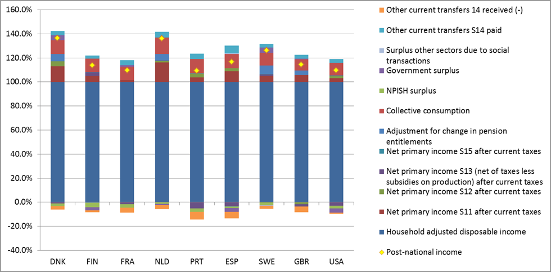
Conceptual difference:
Example of post-tax national income
Composition of post-tax national income (DINA) in percentages of net household adjusted disposable income, 2015

Slide 19
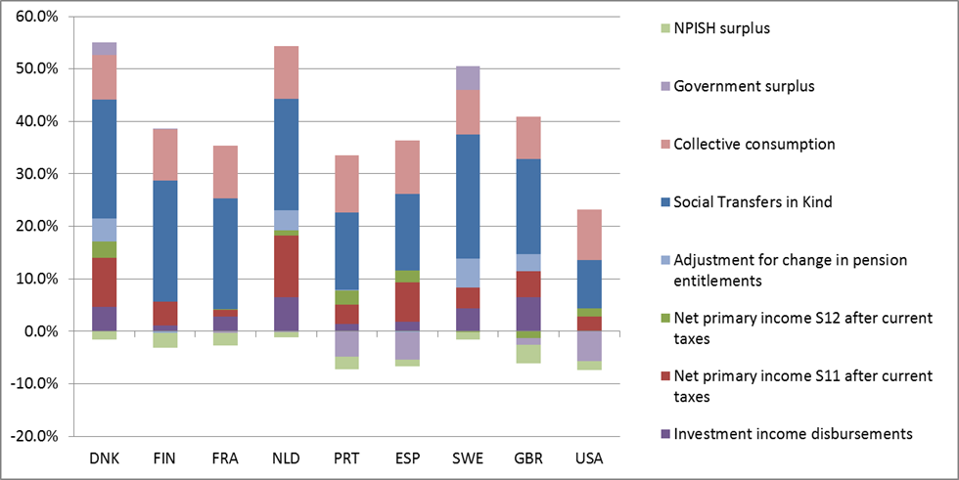
Methodological difference:
Impact of imputations
Size of components of post-tax national income for which micro-information is assumed to be missing (in % of post-tax national income)

Slide 20
Continuation as joint
OECD-Eurostat Expert Group

Slide 21
Joint OECD-Eurostat EG DNA
At 2016 DGINS Eurostat expressed their interest in harmonised data on distribution of ICW at EU level
This led to two initiatives:
  Joint EG ICW working on the joint distribution of households’ income, consumption and wealth at the micro level
  Joint EG DNA working on the distribution of income, consumption and wealth consistent with NA totals
The new EG DNA will develop distributional data on ICW in line with NA totals, with the aim of publishing them on a regular basis
The first meeting will take place in the first quarter of 2018
The new EG will include new member states
Eurostat and OECD are also involved in the ECB EG LMM which focuses on wealth distribution

Slide 22

Thank you for your attention!

