Slide 1
7.1 Economic well-being and sustainability Distributional Aspects
Eleventh Meeting of the Advisory Expert Group on National Accounts New York
5-7 December 2017
Margarida Martins

Slide 2
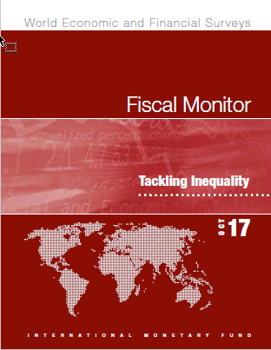
I. Introduction
Why is inequality an important topic in the IMF?
IMF research (…) has shown that rising inequality poses risks to the durability of economic growth, that the design of government policies has an impact on income distribution, and that government also can help address the situation.
(IMF Annual Report 2017, Promoting Inclusive Growth)
Global inequality (…) has been declining in recent decades, reflecting strong income growth in some large emerging market economies such as China and India. However, the picture of inequality within countries is mixed. (IMF, 2017 Fiscal Monitor, Tackling Inequality)

Slide 3
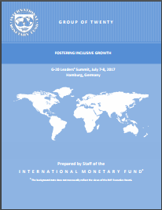
I. Introduction
IMF Work on Operationalizing Inequality Analysis
Analytical Work
Capacity Development
Surveillance and Fund-supported programs
Inequality incorporated as one element of the Fund’s policy advice
Three waves of pilot consultations
2015/16, 2016/17, and 2017/18
More than 25 completed pilots
http://www.imf.org/external/np/fad/inequality/

Slide 4
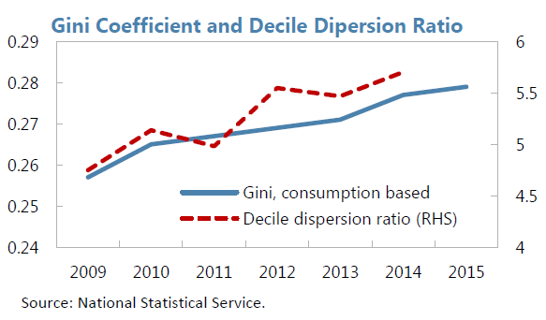
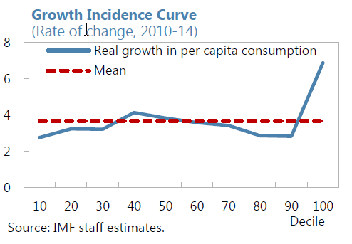
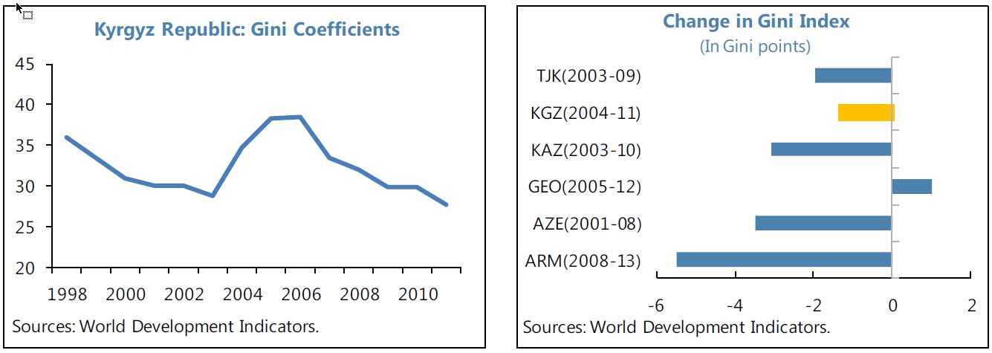
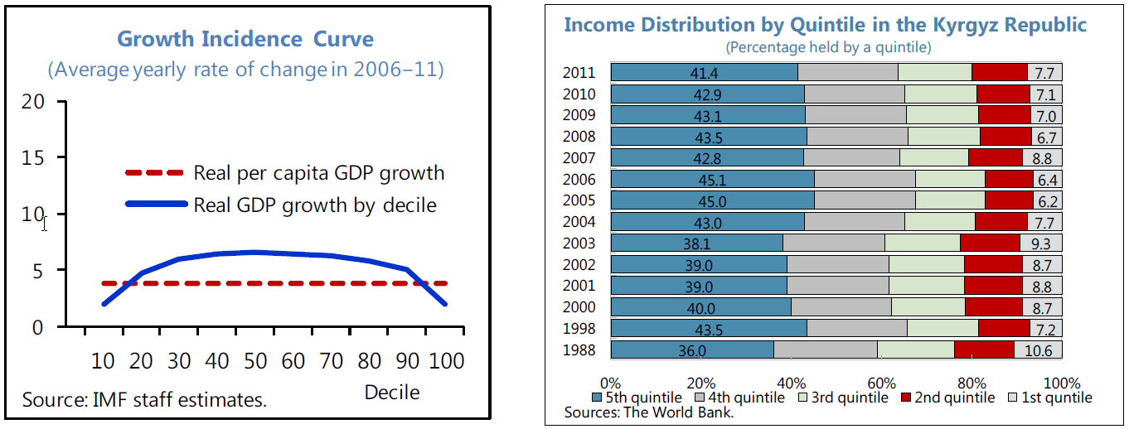
II. IMF Surveillance and inequalities
Armenia (2015 Art. IV Report)
Gini coefficient
Decile dispersion ratio
Growth incidence curve
Kyrgyz Republic (2015 Art. IV Report)
Gini coefficient
Income inequality
Land inequality
Growth incidence curve
Income distribution by quintile

Slide 5
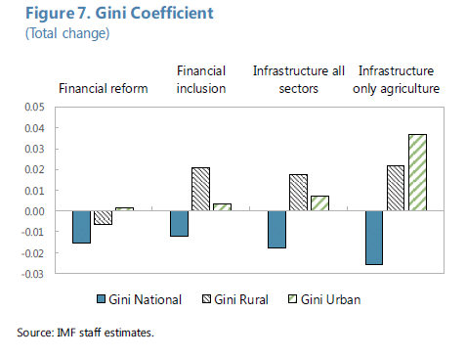
II. IMF Surveillance and inequalities
Myanmar (2015 Art. IV Report)
Dynamic Stochastic General Equilibrium (DSGE) Model to study the macro and distributional impact of economic reforms (in this case, to examine the macro and distributional impact of financial sector reform).
Quantitatively reproduces key macroeconomic trends in the country modelled and replicates key distributional features of household-level data.
Two versions of the model used for Ethiopia (2015), Malawi (2015), Honduras (2016), Guatemala (2016), Bolivia (2016), and the Republic of Congo (2016).

Slide 6
III. Measuring inequality for policy advice
Measuring distribution presents empirical and conceptual issues
Traditional measures
> Based only on surveys
No international standards for surveys
Different definitions, units
Refusal to response
Short time series
> Based only on tax records
People who do not pay taxes
Disposable income calculation
Availability of data
Measurement errors
Advantage: easier to compile
SNA framework
Consistent measures of income, consumption, and wealth
Consistent measures across countries
Measures of income before/after redistribution
Data including informal sector and production for own-final use
> Eurostat-OECD Expert Group
Results show that producing data is feasible
Disadvantage: resources demanding and assumptions for missing data

Slide 7
IV. Questions
The AEG is requested to provide feedback on:
the inclusion of distributional measures of income, consumption, and wealth in the SNA framework.
the need to have international agreed templates.
the frequency of publishing data (for example, annual, every 3-5 years).
the resources required to produce data for the templates.
particular issues pertaining to developing countries.

