Slide 1
Globalization 3.5 Technological Innovations in Financial Services
Eleventh Meeting of the Advisory Expert Group on National Accounts New York
5-7 December 2017
Margarida Martins

Slide 2
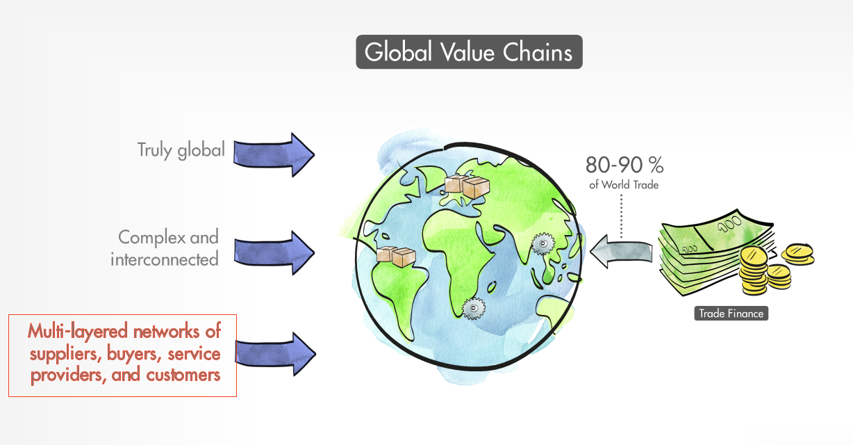
Trade is heavily dependent on financial support
Trade finance ‘oils the wheels of trade’- underpins around 90 percent of world trade (WTO 2016)
Data are thin, but the market is huge: roughly $17 trillion in trade finance flows in 2015, with estimated $6 trillion outstanding
Long perceived as safe – but during the stress and disruptions of the 2008 GFC, the crunch of the trade finance market posed systemic risks to world trade and GVCs, exacerbating the collapse in trade volumes
Notes:
•

Slide 3
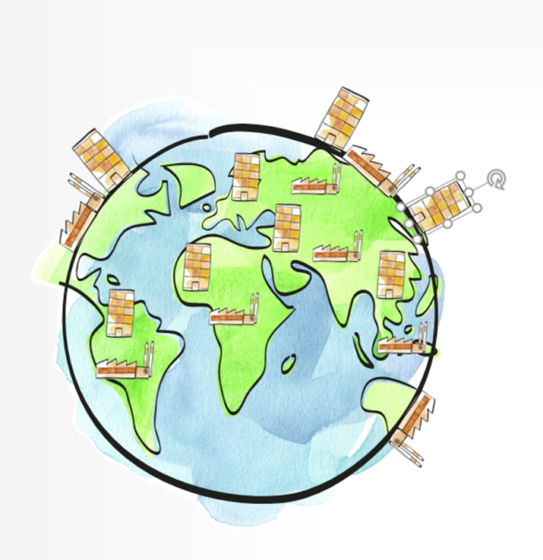
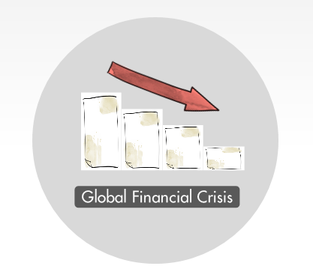
The crisis showed vulnerabilities in the GVC markets
GFC affected the cost, volumes, and modalities of trade finance and led to adverse feedback loops between the financial system and the real economy (IMF 2009)
SMEs account for some 95 percent of all companies (WB) integrating in long- and wide-growing networks of upstream and downstream supply chains around the world
SMEs beyond the boundary of FDI relationships are most vulnerable to unmet demand for liquidity, because traditional trade financing is costly and often not accessible
Disruptions to trade financing are highly damaging with ripple effects throughout the entire value chain
In 2009/2010, the G-20 committed $250 billion to support trade finance

Slide 4
Structural changes to the trade finance market (1/2)
Modern-day GVCs have largely phased out bank-intermediated Letters of credit (L/Cs) and moved to inter-firm open account trading, often supplemented by third-party financing of suppliers
However, structural difficulties for SMEs to obtain trade finance -- in combination with the GFC -- exposed an incomplete trade finance market with demand exceeding supply
An estimated US$1.6 trillion shortfall in trade finance has built up globally since the peak of the 2009 financial crisis (UN)

Slide 5
Structural changes to the trade finance market (2/2)
New forms of trade financing have emerged and new players entered the market
Supply Chain Financing (SCF) is a growing business where an integrated technology platform makes it possible to extend payment terms to buyers while accelerating payment to suppliers. The largest company inside a supply chain uses its superior financial credit rating to help its lower-rated suppliers obtain access to financing at more favorable market rates than they would get otherwise.
FinTechs (financial technology) are innovative nonbank institutions that use big data and leading-edge cloud-based technology to perform banking activities
Market dynamics are still evolving: The global FinTech industry is growing rapidly, partly through integration with banks, or focusing on the “long-tail” non-listed SMEs

Slide 6
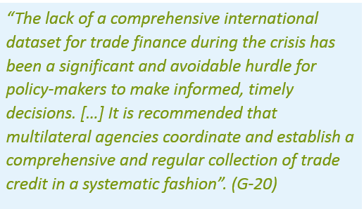
Data may be thin, but the trade finance market is huge
Currently, there is no single comprehensive source for measuring the magnitude, composition, and dynamics of the trade finance market, nor the role that newly developed financial institutions play
Policymakers need a tool to assess these developments and receive early warnings of possible liquidity crunches harming global trade and GDP growth

