Slide 1
Deglobalised GDP etc
Michael Connolly
CSO (Ireland) National Accounts Integration and LCU
December 2017
AEG on National Accounts

Slide 2
The coincidence of ESA 2010 and BEPS / Irish legislation major consequences for Irish economy in 2015…….
Published NIE 2015 – July 12, 2016
GDP Constant Prices – growth 26.3%
GNP Constant Prices – growth 18.7%
Represented a level shift in our figures

Slide 3
Corporate Relocations Increase the Stock
of Capital Assets
Increased Capital Assets
Increased Production of Goods and Services
Increased Depreciation
Increased Profits
Increased Exports

Slide 4
Balance Sheet Impact: Impact on Capital Stocks (Incl. transactions and reclassifications)

Slide 5
Changes in Stock of Capital Assets

Slide 6
Balance Sheet Impact – Intl Accounts Ireland’s Net International Investment Position
Notes:
Revised net International Investment Position:
Irelands net liabilities to non residents, has increased through the accumulation of Irish Capital Assets and non-resident financing.
Net IIP -530bn, see IIP release in pack for details.

Slide 7
Centre of Economic Interest – Residency
Management and Control
Ownership of lands and buildings
Engage in production, finance, insurance or redistribution
Can incur liabilities and take on other obligations
Produce a complete set of accounts
Tax resident - Permanent Establishment

Slide 8
Some Details
National Accounts data related to relocations were based on hard data from respondents
Important role of CSO’s Large Cases Unit (LCU) – quality and consistency across macro and business statistics
Changes driven by globalisation activities
Ongoing trend – but scale was different
Significantly – a small number of entities involved
Figures compiled in compliance with ESA 2010
Figures were verified by Eurostat

Slide 9
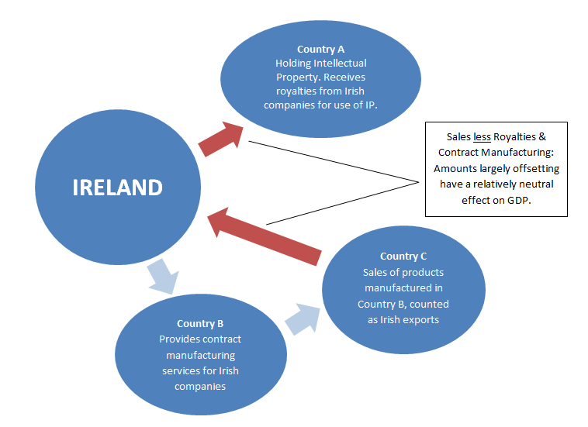
Contract Manufacturing in Ireland
where IP is located abroad

Slide 10
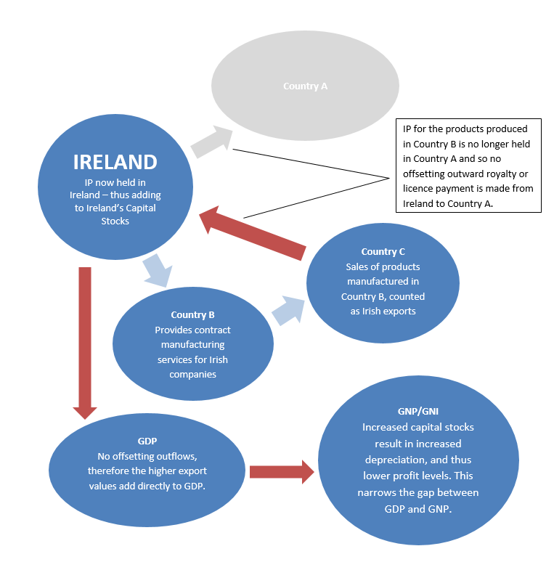
Contract Manufacturing in Ireland
and IP located in Ireland

Slide 11
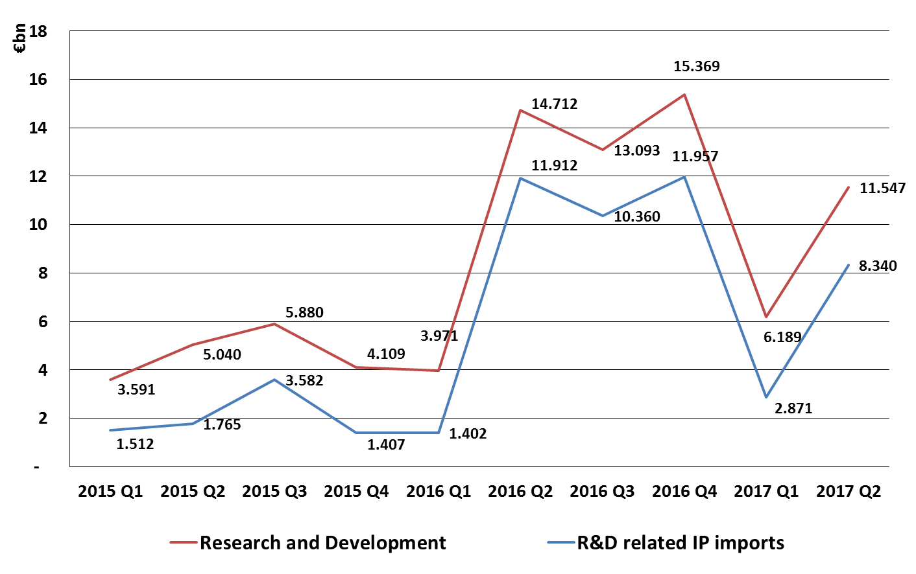
Business Services:
Research and Development

Slide 12
1.Challenges of Globalisation
2. Globalisation in the Standards
3.Unexpected consequences
ESRG Recommendations

Slide 13
Impact of relocations on GDP – GNI transition
BOP Primary income is calculated after depreciation
Impact of additional depreciation
Year | GDP | Depreciation | Net Factor Flows | GNI | NNI
2014 | 193,160 | 30,891 | -29,715 | 161,759 | 130,868
2015 | 255,815 | 61,558 | -53,173 | 200,762 | 139,204
Diff | 62,655 | 30,667 | -23,458 | 39,003 | 8,336
Change | 32.4% |  |  | 24.1% | 6.4%

Slide 14
Unintended Impact of Changes
Depreciation and Income
New standards for R&D
Alignment of Operating Surplus and Primary Income in BOP

Slide 15
1.Challenges of Globalisation
2. Globalisation in the Standards
3.Unexpected consequences
ESRG convened

Slide 16
Expert Group
Increasingly difficult to represent the complexities of Irish economic activity using single headline indicators such as GDP or GNP
Expert group focus on recommendations for the improvement and development of indicators and analyses giving additional insight to the domestic economy
First meeting of the group September 19th and the group met six times between mid-September and November 2016
Group reported to the Director General of CSO on 23 December 2016

Slide 17
Level Indicator
An adjusted indicator (GNI*) of the size of the economy should be published, appropriately
adjusted for the retained earnings of redomiciled firms and depreciation on foreign-owned domestic capital assets.
Structural Indicators
CSO to implement Large Cases Unit/Remainder presentation to elements of National Income and Expenditure accounts and the Non-Financial Sector of the Institutional Sector Accounts.
Cyclical Indicators
Quarterly publication of underlying investment and underlying domestic demand measures
that take account of the impact of IP relocations, contract manufacturing, aircraft leasing
and re-domiciled firms.

Slide 18
2017: Implementation of Modified GNI (GNI*)

Slide 19
Modified GNI (GNI*) - 2016
GDP
€275,567m
Net Factor Flows
- €48,818m
GNP
€226,749m
EU Taxes and Subsidies
+ €994m
GNI
€227,742m
Adj. for aircraft, IP depreciationand redomiciled companies
- €38,579m
GNI*
€189,163m

Slide 20
Debt to GDP/GNI* Ratios

Slide 21
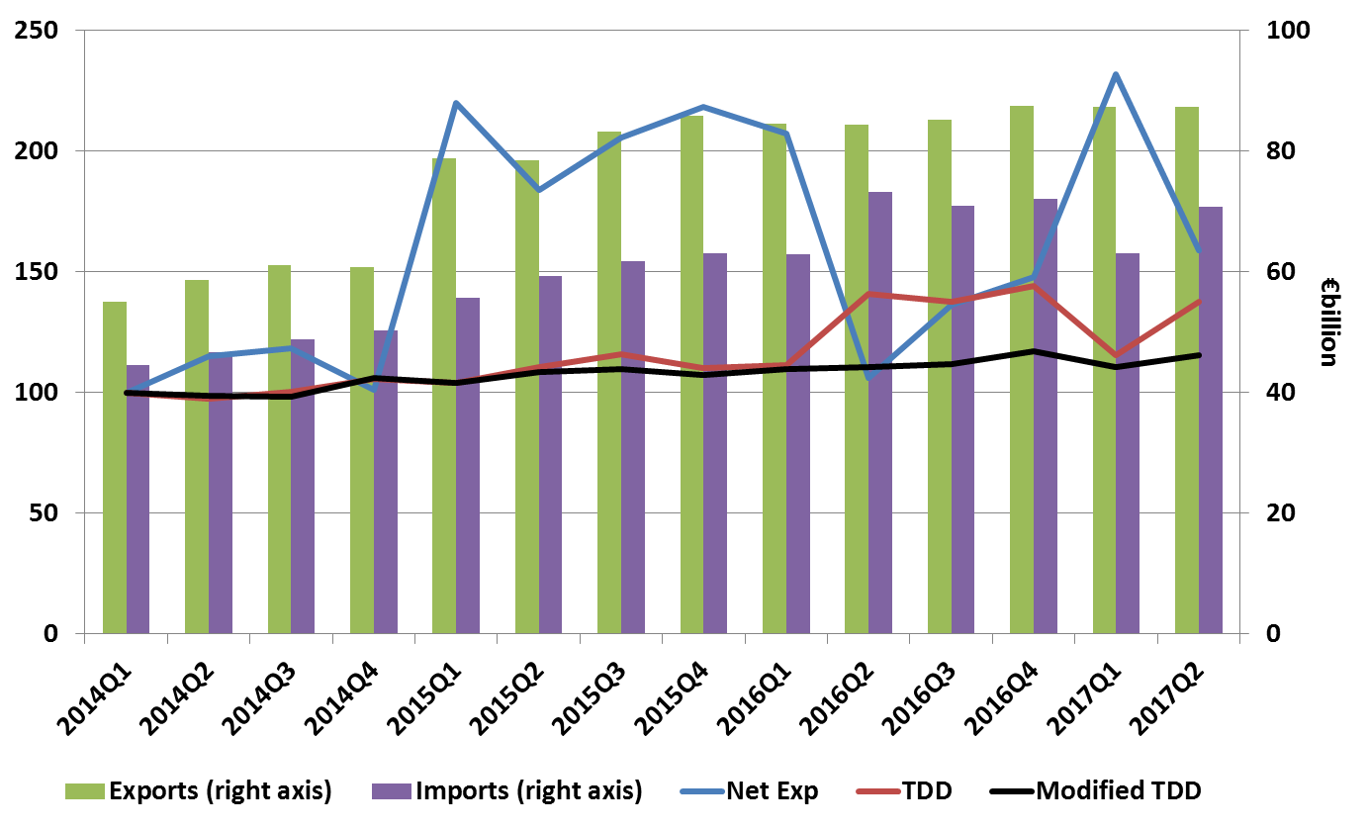
Total Exports and Imports v’s Trends in Net Exports, Total Domestic Demand and Modified Domestic Demand 2014 Q1 = 100

Slide 22
Contribution of Domestic Demand and Net Exports to Annual GDP

Slide 23
Large Foreign-Owned Multi-Nationals
in the Non-Financial Corporation Sector

Slide 24
Growth of Household Gross Disposable Income by Component

Slide 25
An Alternative Solution
Could IP assets be regarded as Financial Assets ?
As a type of securitised asset?
Attractive solution in terms of
Intl Investment Position recording
impact on depreciation and income/services

Slide 26
Impact of relocations on GDP – GNI transition
BOP Primary income is calculated after depreciation
Impact of additional depreciation
Year | GDP | Depreciation | Net Factor Flows | GNI | NNI
2014 | 193,160 | 30,891 | -29,715 | 161,759 | 130,868
2015 | 255,815 | 31,558 | -83,037 | 172,778 | 139,204
Diff | 62,655 | 9,333 | -53,322 | 11,019 | 8,336
Change | 32.4% |  |  | 6.8% | 6.4%

Slide 27
Balance Sheet Impact: Impact on Capital Stocks (Incl. transactions and reclassifications)

Slide 29
An Alternative Solution
Difficult to justify
IP is involved in production
Essential element of productivity calculations - capital services

Slide 30
Net National Product

Slide 31
Overall Conclusions
The cross border movements of IP or corporate relocations such as that experienced in Ireland was probably not foreseen or anticipated when agreeing SNA 2008/ESA2010
When these Globalisation events occur - need to ensure a consistent and coordinated set of results across the accounting framework – the impact of depreciation being a case in point
New Standards did recognise what activities needed to be included in the National Accounts i.e. R&D
ESRG and Irish Case highlighted show how introduction of new indicators to address the impact of globalisation in the short term assist users understanding but ultimately the next standards should consider how to address these events within the framework
Is a Net presentation the only answer - such as NNI ?

Slide 32
The AEG is requested to:
Express their views on the usefulness of GNI* and the other analytical indicators discussed in helping users arrive at a more informed understanding of developments in the underlying economic conditions particularly in extreme scenarios for the economy such as the GDP and GNI results for Ireland in 2015.
Express their views on the proposed alternative approach to the recording of the inter affiliate flows of Intellectual Property as described in the paper.

Slide 33
michael.connolly@cso.ie

