Slide 1
Exchange and Sharing of Economic Data
Rami Peltola, UNECE Task Force
STATISTICS

Slide 2
Background
Emerging need to advance data exchange
STATISTICS
Multinational enterprises (MNEs) are increasingly global
This challenges the quality and accuracy of economic statistics
Full picture of MNEs activities missing
Need to develop more consistent and effective measurement
Need to advance exchange and sharing of economic data
What data should be exchanged?
What kind of circumstances, legal frameworks and technological tools are needed?
How to exchange data securely?
What are the possible risks? How to deal with them?
The Bureau of the Conference of European Statisticians (CES) decided to carry out an in-depth review of the topic

Slide 3
Conclusions of the in-depth review
Current practices in data exchange
STATISTICS
A survey of statistical offices with 48 replies on the:
Scope of economic data exchange nationally and internationally
Organizational aspects of data sharing
Benefits and challenges experienced
Possible international support activities
Current practices of national statistical offices:
100% exchange data nationally in some form
80% receive microdata nationally
60% provide microdata to other producers
94% engage in international data exchange
37% exchange microdata internationally
Mainly data are exchanged to record cross-border transactions

Slide 4
Conclusions of the in-depth review
Benefits and obstacles of data exchange
STATISTICS
The survey showed many benefits, such as:
Improved consistency
Better quality of statistics
Efficiency gains in statistical production
Reduced response burden
Better understanding of complex enterprises
The obstacles to data exchange include:
Confidentiality constraints
Legal constraints
Technological readiness to link and exchange data
Increased dependency from external data
Quality issues and different definitions used

Slide 5
Task Force to advance work
Exchange and Sharing of Economic Data
STATISTICS
The CES Bureau set up a Task Force (Canada, Denmark, Finland, Ireland, Italy, Mexico, the Netherlands, United Kingdom, United States, ECB, Eurostat, IMF, OECD, UNECE, UNSD and WTO):
Stage – until June 2018:
Review concrete examples of data exchange
Identify enablers and obstacles of data sharing and find solutions
Propose ways to detect crucial MNEs and changes in their activities
Stage – until June 2020:
Identify innovative ways to exchange of economic data
Develop guidance, tools and principles, taking into account:
Data exchange on MNEs among producers of official statistics
Access to the necessary external data sources
Technical, methodological and communicational aspects
Good practices in analysing MNEs’ activities

Slide 6
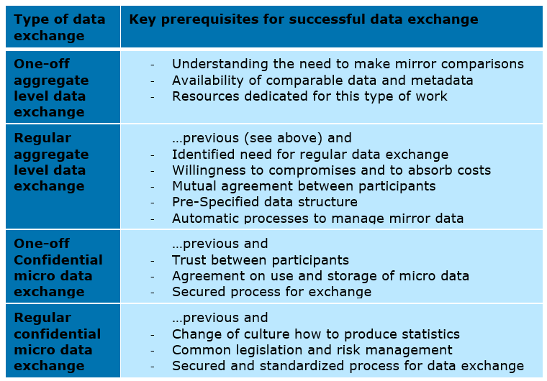
Review of data exchange examples
Task Team A – lead Finland
STATISTICS
Collects and reviews real data exchange cases
Analyzes the benefits and challenges experienced

Slide 7
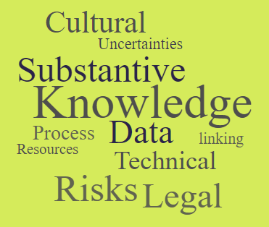
Obstacles and enablers of data sharing
Task Team B – lead Canada
STATISTICS
Identified:
10 aspects influencing data exchange
30 obstacles of data exchange
30 enablers of data exchange
Will seek possible solutions and tools for dealing with obstacles and strengthening enablers
Collaborates with the UNECE Task Force on Common Elements of Statistical Legislation

Slide 8
Detecting MNEs and data to be exchanged
Task Team C1 – lead United States
STATISTICS
Identified critical areas for data exchange:
Complex ownership structures, especially special purpose entities
Firms with a large amount of activity (e.g. employment or sales)
Re-arrangements and relocations of MNEs
Global production arrangements
Ownership of intellectual property products
Will develop generalized examples of the focus MNEs
Will identify critical data items to be exchanged, such as:
Register-type information, including identifiers
Structures of MNEs
Key globalization variables
MNE data most prone to revision
Financial/operational data, e.g. sales/turnover, employment, income
Accounting standards information

Slide 9
Large and complex enterprises units
Task Team C2 – lead Ireland
STATISTICS
Countries have large and complex enterprises units (LCUs):
Organizational units focusing on MNEs
Concentrate resources, skills and knowledge to focus on MNEs
Help to improve consistency of data on MNEs
The Task Team will update the existing guidance on LCUs
The Task Force will review possibilities of establishing a network of experts on large and complex enterprises to:
Identify the critical MNEs for data exchange
Carry out data exchange and analysis
Exchange best practices in dealing with MNEs
Develop common ways for communicating with MNEs

Slide 10
Issues for discussion
Seeking advice from AEG
STATISTICS
The Task Force would like to ask AEG’s opinion on the following questions:
From the AEG’s perspective – where could the quality of the SNA be improved by enhanced data sharing?
Is the AEG aware of examples of best practices or success stories related to data sharing?
Moving forward – are there any issues in possible future SNA updates that will benefit from improved data sharing internationally and nationally?

Slide 11
Thank you!
Rami Peltola
UNECE
STATISTICS

