Slide 1
Handbook on Accounting for Global Value Chains - UPDATE Extended National Accounts and Integrated Business Statistics
Ronald Jansen, Michael Connolly, André Loranger
UNSD Expert Group on International Trade and Economic Globalizatiuon
AEG on National Accounts
December 2017

Slide 2
Statistical Community
WTO / Pascal Lamy
Made in the World initiative
Global Forum
Goods for Processing
Abroad
FOC group
2008 SNA
Impact on SNA
BPM6
OECD/WTO TiVA
ITEGS Expert Group
FSB Data Gap
2000
2008
2011
2013
2016
Global Value Chain research
WIOD
Financial Crisis
Making GVCs work for Development
World KLEMS
EU / LA KLEMS
GVC in Post-crisis World
G20: GVCs – OECD/ World Bank
Research Community
GVCs: Aid for Trade

Slide 3
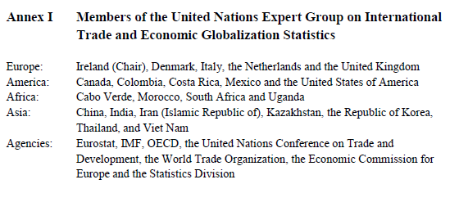
Expert Group on ITEGS
Mandate received from the Statistical Commission in March 2015 to prepare a Handbook on the measurement framework for international trade and economic globalization

Slide 4
Expert Group on ITEGS
Mandate received from the Statistical Commission in March 2015 to prepare a Handbook on the measurement framework for international trade and economic globalization
Editor – Steve Landefeld, former Director of US BEA
Additional Experts –
Dale Jorgenson (KLEMS), Gary Gereffi (GVCs), Tim Sturgeon (GVCs), Stacey Frederick (GVCs), World Bank (GVCs)
Meetings –
January 2016, New York
November 2016, New York
6-8 June 2017, Luxembourg

Slide 5
Handbook on ITEGS
High-level overview of how economic statistics can be made more accurate and relevant in measuring the effects of globalization in national accounts and business statistics
Better inform public policies and business decisions on
growth and productivity,
domestic and foreign share of value added in trade,
domestic and foreign labor and capital used in the trade
Provide a national perspective on globalization based on a GVC model
Specific GVC industries in a multi-country supply chain of goods, value adding services and institutional arrangements
Linking trade and business statistics

Slide 6
Five Parts of the Handbook
Policy, Business and Statistical Motivation
General Statistical Framework
Global Value Chain approach
Integrated Business, Trade and Investment Statistics
Application of the measurement framework

Slide 7
General Statistical Framework
Chapter 2: Overview of the Framework
Chapter 3: Extended Supply and Use Tables (TiVA)
Chapter 4: Extended Productivity (KLEMS) Accounts
Chapter 5: Extended Environmental-Economic Accounts
Chapter 6: Extended Capital and Financial Accounts
Chapter 7: Conceptual issues of Global Enterprise perspective
Chapter 8: Special Accounting Topics

Slide 8
Global Value Chain Approach
Chapter 9: Global Value Chain Satellite Account
GVC Template
Chapter 10: GVC Industry Modules and their Application
NA Automotive
Morocco Automotive
Costa Rica electronics and medical devices
Vietnam electronics and apparel

Slide 9
Integrated Business, Trade and Investment Statistics, and the applications
Part IV
Chapter 11: Firm heterogeneity related to globalisation
Micro-data linking
Business Functions
Chapter 12: Bilateral asymmetries, Global Groups Register and data sharing
Part V
Chapter 13: Public policy use of the Extended Accounts
Chapter 14: Research Agenda

Slide 10
Global Value Chains case studies
Central Framework for Handbook
Ch 9 Global Value Chain – Satellite Account
Example: Automotive GVC in North America

Slide 11
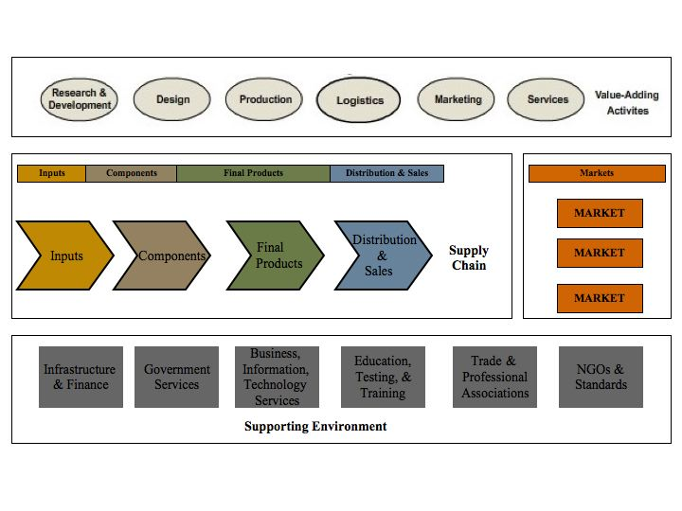
Global Value Chain (GVC) Model
The GVC framework describes the structure, dynamics and relationships among stakeholders in GVCs
Four dimensions
Business Functions
Geography
Governance
Institutional context
11

Slide 14
Articulating GVCs
A GVC SATELITE ACCOUNT
A set of tables that highlight particular elements of a GVC
Focusses on specific GVCs with a multi country perspective
Can go beyond production and primary distributions of income and capital
A bottom-up, micro data linking approach is proposed
Aggregate or top down will also be included later
Similarity and differences with Extended SUTs is discussed
Extended SUTs provide a national picture that provide insight on the impact of GVCs within an established framework

Slide 18
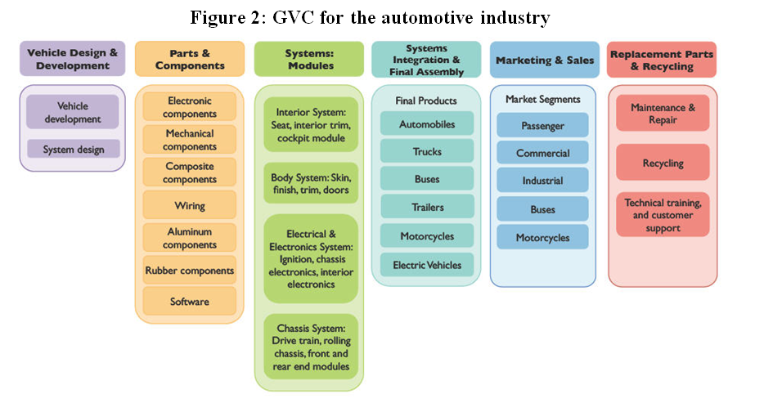
GVC for Automotive Industry
18

Slide 19
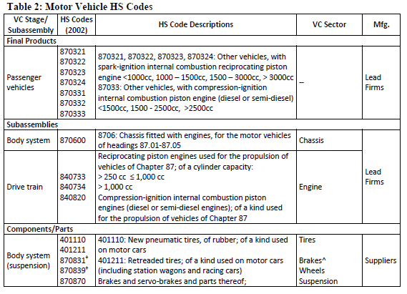

Slide 21
GVCs and the role of lead firms
The GVC includes all the forward and backward linkages of lead firms with other enterprises
Lead firms determine the specifications for the production of inputs parts and components
More information needed on these lead firms:
Domestic or foreign ownerships
Structure of its foreign affiliates
Trade intensity of domestic and foreign affiliates
Outsourcing of business functions
Proposal for a global business groups register
Proposal for international data-sharing agreements
21

Slide 22
How can we compare the various levels of measurement?
Global extended SUTs
Regional extended SUTs
Industry specific GVC extended SUTs
Large MNEs
Limited number of partners
National compiler ownership
Which indicators do we want to recommend from micro-level business statistics and various macro-level extended SUTs?

Slide 23
Summary of Progress to Date
Considerable progress with GVC Satellite Account
Overall Extended Accounts and Integrated Framework incl. policy uses – good progress
Global Enterprise - a lot done more to do
KLEMS - some progress
Regional Satellite Account – framework complete - being finalised
Related data linking and business functions - being finalised

Slide 24
Summary of Progress to Date
Fintech as a special case of GVC financing was discussed in detail.
A Sector Accounts/FDI based framework was articulated
Case studies – more needed beyond North American Auto GVC.

Slide 25
Thank you
25

