Slide 1
Table on household retirement resources
11th Meeting of the Advisory Expert Group on National Accounts
5-7 December 2017, New York
Presented by Jennifer Ribarsky (OECD)
Prepared by Jorrit Zwijnenburg (OECD)

Slide 2
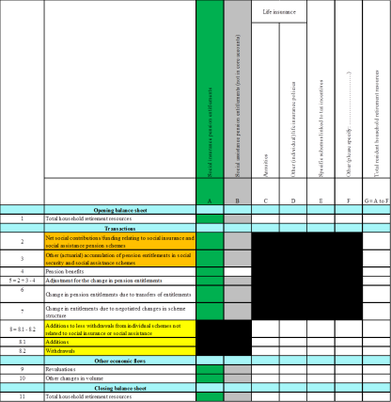
Table on household retirement resources
Important to have a more comprehensive overview of financial assets from the perspective of households, particularly of the resources they have set aside for retirement in times of an ageing society
Information on social insurance pension entitlement is already available from supplementary table as proposed by the OECD (column A)
This should be complemented with other retirement resources:
  Column B: Social assistance - not in central framework
  Column C: Life insurance – annuities
  Column D: Life insurance - other policies
  Column E: Private retirement savings schemes linked to tax incentives
  Column F: Country-specific individual schemes (e.g. dwellings)
  Column G: Total resident households’ retirement resources
All columns reflect viewpoint of resident households (in contrast to supplementary table which takes pension schemes as starting point)
Should the table distinguish (or exclude) more types of resources?

Slide 3
Table on household retirement resources
Set up of the table is in line with supplementary table:
Columns reflect the different types of schemes
Rows show the full reconciliation of changes in resources:
  Opening balance sheet
    Row 1: Opening stock
  Transactions
    Row 2: Net social contributions/funding relating to social insurance
    Row 3: Other (actuarial) accumulation of entitlements in social security
    Row 4: Social insurance pension benefits
    Row 5: Adjustment for the change in pension entitlements (= 2+3-4)
    Row 6: Change in pension entitlements due to transfers of entitlements
    Row 7: Change in entitlements due to negotiated changes in scheme structure
    Row 8: Additions to less withdrawals from individual schemes not related to social insurance or assistance
  Other economic flows
    Row 9: Revaluations
    Row 10: Other changes in volume
  Closing balance sheet
    Row 11: Closing stock
and social assistance pension schemes
and social assistance pension schemes
and social assistance
Change from supplementary table on pensions
+ all cells from viewpoint of household sector!

Slide 4
Table on household retirement resources

Slide 5
Question related to social assistance schemes
Entitlements should be derived on basis of actuarial estimates
In contrast to social security, no dedicated social contributions are collected for social assistance schemes
What does that mean for the accrual of the entitlements?
Two options:
  Show change in entitlements in ‘other (actuarial) changes’ (in row 3)
  Impute for implicit funding of these schemes (in row 2)
    Equal to the pension benefits, or
    Equal to the accrual of new entitlements
  The imputation equal to pension benefits seems most in line with pay-as-you-go set up of social assistance schemes
Which option is preferred to account for the accrual of social assistance pension entitlements?

Slide 6
Way forward
OECD is looking for feedback on desirability and feasibility of separate table on household retirement resources
Input is needed on how to deal with specific methodological issues
The consultation on pension data will also cover these issues
The results will be used to draft a final proposal

Slide 7
Specific questions to AEG
What is your opinion of the table on household retirement resources?
Do you agree with the current design of the table?
How should the accrual of social assistance benefits be accounted for?
  Show change in entitlements in ‘other (actuarial) changes’
  Impute for implicit funding of these schemes
    Equal to the pension benefits, or
    Equal to the accrual of new entitlements
Are there any other issues that should be taken into account?
Are there areas where further research/guidance is needed?

Slide 8
Thank you for your attention!

