Slide 1
Guide to Analyze Natural Resources in the National Accounts
Eleventh Meeting of the Advisory Expert Group on National Accounts New York
5-7 December 2017
Michael Stanger
Notes:
DM: 6329930

Slide 2
Introduction
STA has developed a Guide to Analyze Natural Resources in National Accounts with the generous support of the Managing Natural Resource Wealth Topical Trust Fund
The Guide complements the GFS Template to Collect Data on Government Revenues from Natural Resources
Eight template tables to guide analysis of macroeconomic impacts of natural resources and to aid in national accounts compilation for natural resource industries
Activities since last year’s AEG meeting (April 2016)
Pilot missions to Indonesia and Mongolia
Contribution to EITI and Ulaanbaatar City Group
Project to implement via regional workshops and country missions

Slide 3
What is the Guide’s Contribution?
Other manuals on statistics for natural resources are being developed by the Ulaanbaatar City Group, the Oslo City Group, and the OECD Task Force on SEEA Implementation
Our Guide is different
We do not cover environmental-economic accounts
We focus on issues of compilation and analysis of natural resource industries in core national accounts
Concepts are defined with the specificity needed by national accounts compilers
The Guide is fully consistent with the 2008 SNA
And many of the analytical measures of macro impacts of natural resources aren’t covered by existing guidance

Slide 4
Template Table 1: Proportion of Natural Resource Industries to GDP

Slide 5
Template Table 3: Labor in the Natural Resource Industries
Employment, hours, compensation and compensation per hour in the natural resource industries are compared to the economy as a whole
The average employee in Mongolia’s natural resources industries received 122 percent more than the average employee in non-natural resources industries in 2014
Australia (2012/13) is 24 percent more
MONGOLIA (2014) | Employment (employees) | Compensation of Employees (milllon togrog) | Compensation of Employees per employee (togrog)
Natural Resource Industries | 43,600 | 765,780 | 17,563,761
All other industries | 641,700 | 5,086,706 | 7,926,922
All Industries | 685,300 | 5,852,486 | 8,540,035

Slide 6
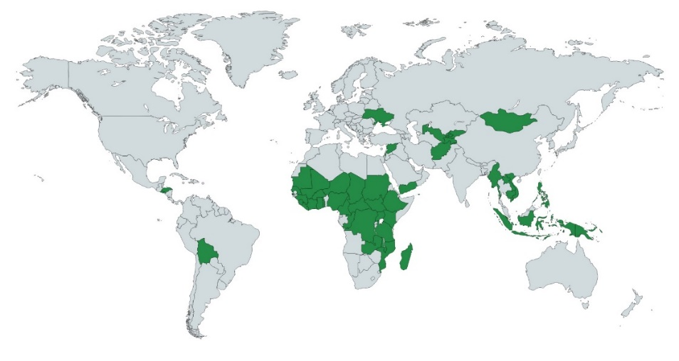
Future Work
Engagement with:
Ulaanbaatar City Group to finalize the Handbook for the next UNSC meeting
EITI to populate EITI reports using data the Guide.
Module of economic management online learning course
Conduct 6 regional workshops and 12 country specific missions to assist implementation in 49 countries

Slide 7
Comments!

