Slide 1
Carbon Pricing
www.statcan.gc.ca
Telling Canada’s story in numbers
James Tebrake
Statistics Canada
December 2017

Slide 2
Pan-Canadian Framework on Clean Growth and Climate Change.
Introduced by the Government of Canada in 2016, in an effort to combat climate.
Under the Framework, Canadian jurisdictions are required to price carbon emissions by 2018.
Pricing is to be applied to a broad set of emission sources, so that Canada can meet its target for reductions in emissions of greenhouse gasses (GHGs), and to support innovation and clean growth.
The price should start at a minimum of $10 per tonne in 2018, and rise by $10 per tonne each year, so that it reaches $50 per tonne by 2022.

Slide 3
Carbon Pricing
The purpose of carbon pricing is to reduce emissions by shifting consumption towards cleaner fuels.
It is expected that carbon pricing will also stimulate investment in cleaner energy sources and help Canada meet its carbon emission reduction target.
Provinces and territories can choose to price carbon by either implementing a carbon tax or adopting a cap-and-trade system.

Slide 4
Carbon Tax
A carbon tax is a fee applied to the purchase or use of fossil fuels. The chemical make-up of a particular fuel, particularly the amount of carbon in it, determines the amount of GHGs emitted when a unit of it is burned.
A flat tax rate charged on each tonne of carbon dioxide is translated to different tax rates for each type of fuel.
A carbon tax represents a tax on products and will increase government revenue in the form of taxes. Comparatively, it will result in a corresponding increase in the market price of fuels consumed in final household consumption expenditure.

Slide 5
Cap and Trade System
A cap-and-trade system is a flexible market mechanism, where annual limits are placed on emissions of carbon dioxide. Emission units in the form of permits can be auctioned off, sold, or distributed free of charge by the government. Industries or agents that exceed their quota for emissions can purchase unused portions of quotas from others.
An active market for tradeable permits means that they can be traded at market price. The total limits on emissions are lowered over time, to reduce overall levels of pollution.
Cap-and-trade systems provide greater certainty about the level of emissions that can be achieved, due to their set limits.

Slide 6
Cap and Trade System
Cap-and-trade emissions permits are considered as taxes on production that should be recorded at the time the emissions occur (i.e. they should be recorded on an accrual basis).
There is often a timing difference between the time the payments are received by the government and the time the emissions occur.

Slide 7
Cap and Trade System - Illustrated
The following example illustrates how the cap and trade program was implemented in the Canadian system of macroeconomic accounts.
Assume that the government auctions off 25,000 allowances for $10 per allowance. Assume that a large electricity producer purchases all 25,000 allowances.

Slide 8
Cap and Trade System - Illustrated
On the day of the auction there would be a financial transaction between the government and the corporation. The government would receive cash of $250,000 and set up an ‘other liability’ (prepaid permit). The firm would show a reduction in cash and an increase in ‘other assets’ (prepaid permit) of $250,000.

Slide 9
Cap and Trade System - Illustrated
As the firm emits carbon they would gradually reduce the prepaid receivable. At the same time, the government would record a tax revenue and reduce the other payable (emissions permit). Assume the corporation emitted 20,000 tonnes of carbon in the first year. We would record $200,000 in taxes on production payable by the corporation to the government and the prepaid asset and liability is reduced by the same amount.

Slide 10
Cap and Trade System - Illustrated
Assume that during the year there is a shortage of permits and the market price of the permit increases from $10 per allowance to $15. This increase in market price creates an unrealized gain, which will be shown as a non-produced non-financial asset on the balance sheet of the company that holds the permit. Continuing with the example, if the company only used 20,000 of their 25,000 allowances, they have 5,000 remaining at a value of $75,000 (5,000 × $15 per allowance) so a non-produced non-financial asset of $25,000 would appear on their balance sheet.

Slide 11
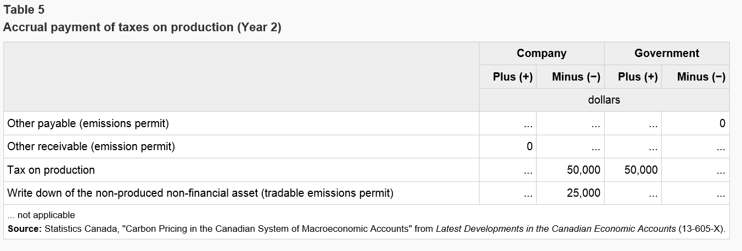
Cap and Trade System - Illustrated
The company can then do one of two things; either they will continue to pollute and use the permit or they can sell their permit. If they choose to keep the permit and continue to pollute, the company cannot surpass the emissions quota of 5,000 allowances. Once the emissions allowances have been reached, the company would need to write down the non-produced non-financial asset (tradable emissions permit) and remove it from the balance sheet.

Slide 12
Cap and Trade System - Illustrated
Alternatively, the company can decide to sell the remaining permits to another company. The sale of the remaining emissions allowances will trigger a cash transaction between company 1 and company 2 (current market value: 5,000 allowances × $15 per allowance = $75,000), followed by the sale of an existing asset. The purchasing company would record an other receivable (emissions permit) as well as a non-produced non-financial asset.

Slide 13
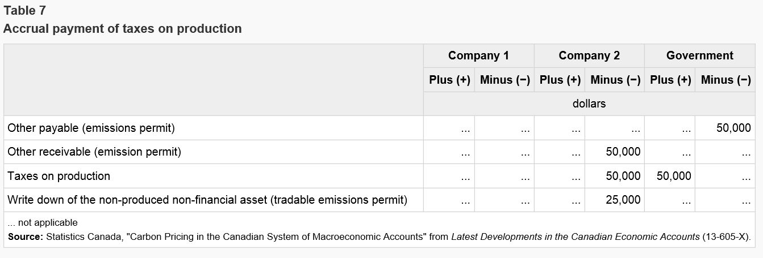
Cap and Trade System - Illustrated
Assuming purchasing company uses the remaining allowances, they will need to record taxes on production equal to the issue price of the permit ($50,000). In addition, the company would record an additional capital loss equivalent to the value of the non-produced non-financial asset ($25,000). They would then remove the non-produced non-financial asset from their balance sheet.

Slide 14
Questions for the AEG
Is it this the correct treatment and if it is - is it reasonable that we can obtain the necessary data to properly record the transactions.
Should cap and trade programs be treated as taxes on production or more like spectrum where a non-produced non-financial assets is recorded at the date of the auction. The cost of the auction is still reflected in the price of the good since corporations need to recover the cost of the permit but it is not shown as a tax on production.
How should non-resident purchases of emissions permits be recorded – should notional units / branches in the issuing country be established.

