Slide 1
11th Advisory Expert Group on National Accounts
5-7 December, 2017
New York
Economic Loss from Disasters

Slide 2
Background
Asia-Pacific Expert Group on Disaster-related Statistics (est. 2014)
  Develop “basic range of disaster-related statistics”
  Deliverable: Disaster-related Statistics Framework (DRSF) and guidance for implementation
Composition
  Disaster Management Agencies, National Statistics Offices, International Organizations and other experts
Strategy:
  Case studies, continuous consultation, partnership with related groups and organizations

Slide 3
SDG & Sendai Framework Indicator
Direct Economic Loss
  SDG1.5.2: “Direct economic loss attributed to disasters in relation to global gross domestic product (GDP)”
  Valuation of physical damages to Assets; costs of reconstruction
“the monetary value of total or partial destruction of physical assets existing in the affected area.” (UNGA, 2016)

Slide 4
“The increase in damages [from disasters] is widely considered to outpace national investments in disaster risk reduction, but this claim is more intuitive than supported by evidence. Indeed, there is hardly any comparable data available on national expenditure for disaster risk management and data on disaster losses is generally incomplete and thought to be underestimated...
Policy makers, at present, possess usually scattered and incomplete data resources, which are not comparable across countries. To design policies to reduce losses from disasters we need to know how such economic losses are counted.”
-Improving the Evidence Base on the Costs of Disasters:
Key Findings from an OECD Survey (OECD, 2016)

Slide 5
What’s the current practice?
“Direct economic losses usually happen during the event or within the first few hours after the event and are often assessed soon after the event to estimate recovery cost and claim insurance payments. These are tangible and relatively easy to measure. “ (UNGA, 2016)

Slide 6
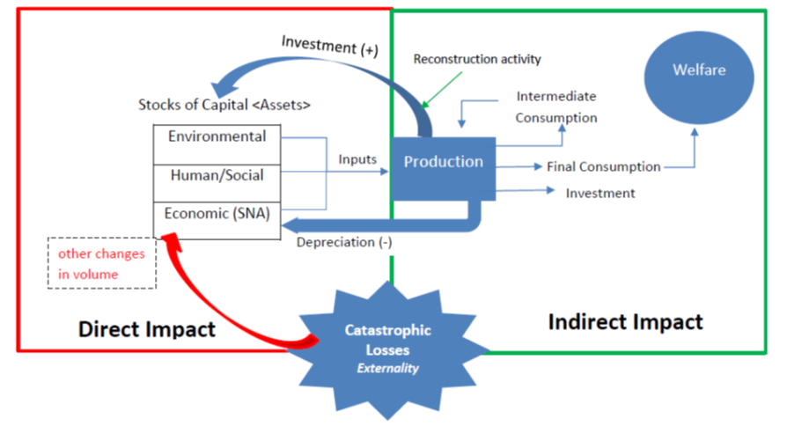
Direct & Indirect Impacts in the SNA

Slide 7





Direct Economic Loss
Impacts to Livelihoods
Indirect Impacts
Damages

Slide 8





Slide 9

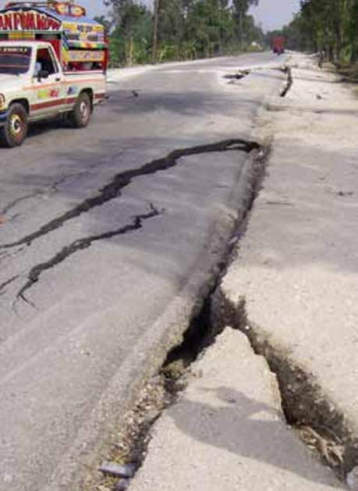

Slide 10
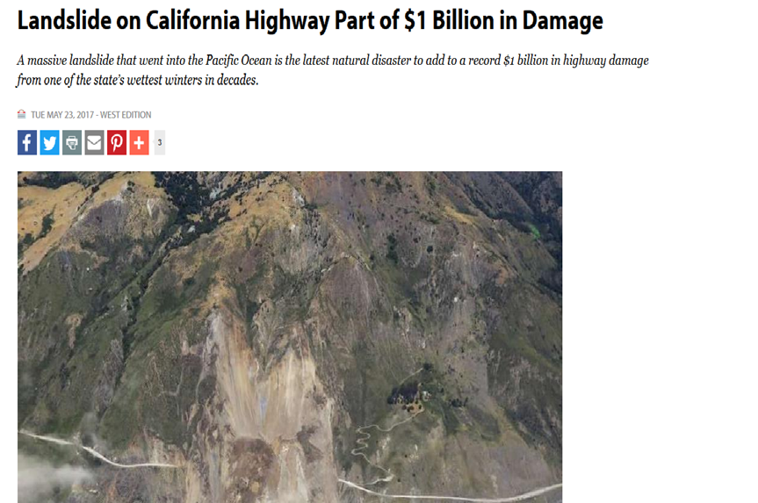

Slide 11
Direct Impacts to Agriculture

Slide 12
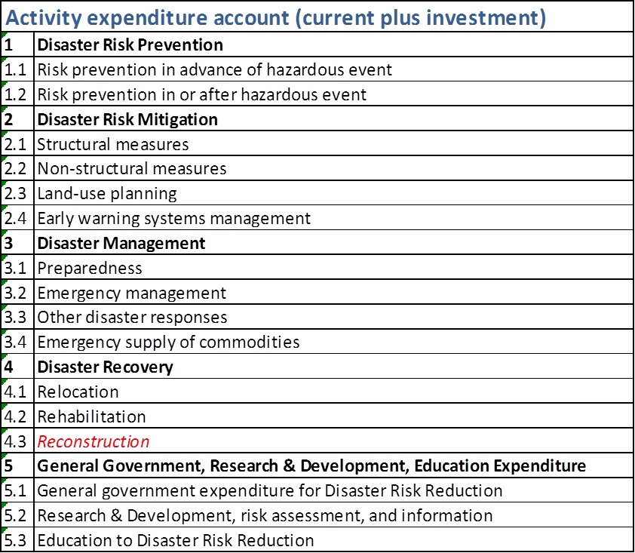
Future work? Satellite Account for Disaster risk reduction expenditure and transfers accounting
  Intl’ demand for monitoring for investment, especially for ODA, for disasters
  Cost and benefit analysis between prevention and mitigation versus post-disaster recovery

Slide 13
Questions for paper
Clarified relationships between concept of direct economic loss from disasters with the SNA?
Useful to consider measurement possibilities from multiple analytical perspectives (owners of assets and impacts to livelihood)?
What should be the main 1 or 2 recommendations or principles from the SNA experience for valuing direct economic loss in light of the new recommendations from UNGA and SDGs?

Slide 14
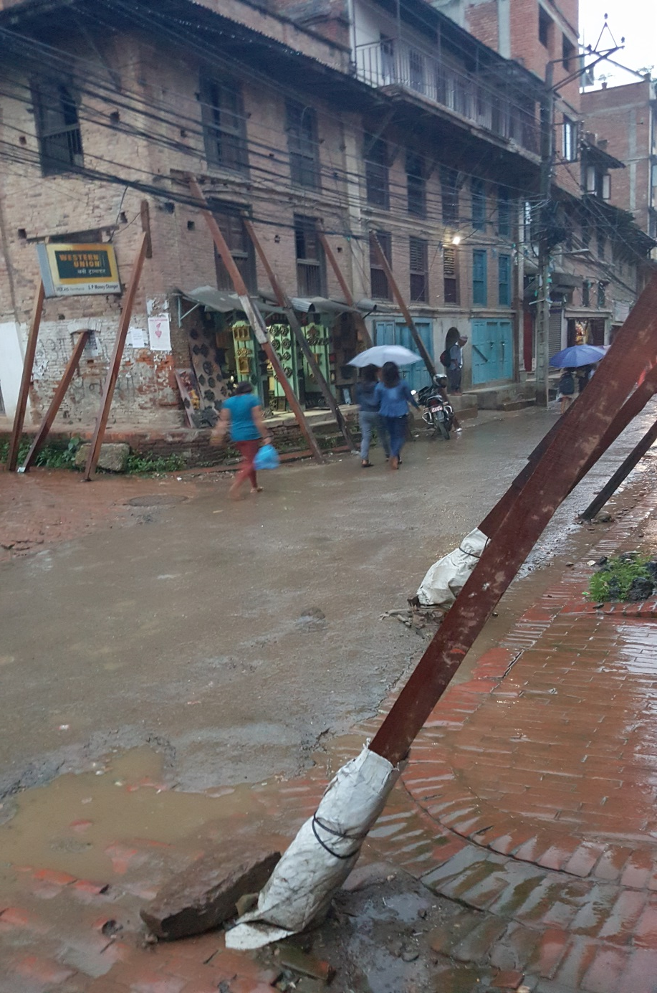
communities.unescap.org/asia-pacific-expert-group-disaster-related-Statistics/
Thank You

