Slide 1
Islamic Financial Instruments
10th Meeting of the Advisory Expert Group on National Accounts
April 13-15, 2016
Paris, France
Thomas F. Alexander
IMF

Slide 2
Islamic Finance: What is it and Why Does it Matter
The provision of financial services in accordance with Islamic jurisprudence (Shari’ah).
  Shari’ah bans interest (Riba), products with excessive uncertainty(Gharar), gambling (Maysir), short sales, as well as financing of prohibited activities that it considers harmful to society. It also requires parties to honor principles of fair treatment and the sanctity of contracts.
  Transactions must be underpinned by real economic activities, and there must also be a sharing of risks in economic transactions.

Slide 3
Islamic Finance: What is it and Why Does it Matter
Islamic finance currently encompasses banking, leasing, Sukuk (Islamic bonds) and equity markets, investment funds, insurance (Takaful), and micro finance
  banking represents about 80 percent and Sukuk assets represent about 15 percent of total Islamic finance assets
Three broad categories of products:
    Debt-like financing structured as sales or purchases with deferred delivery of the products and lease (Ijārah) with different options to buy. Pure lending is allowed only when benevolent.
    Profit-and-loss-sharing (PLS)-like financing.
    Services, such as safe-keeping contracts (Wadi’ah) as for current deposits, or agency contracts (Wakalah), which are also increasingly used for money market transactions

Slide 4
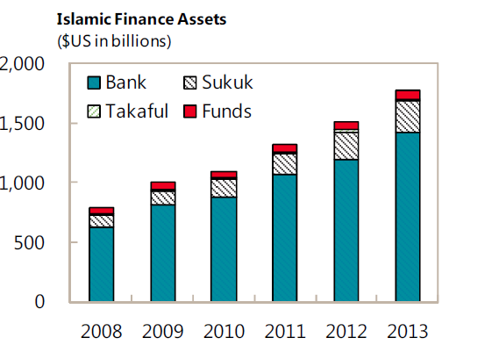
Islamic Finance Assets
Islamic Finance: Opportunities, Challenges, and Policy Options, IMF Staff Discussion Note No. 15/05

Slide 5
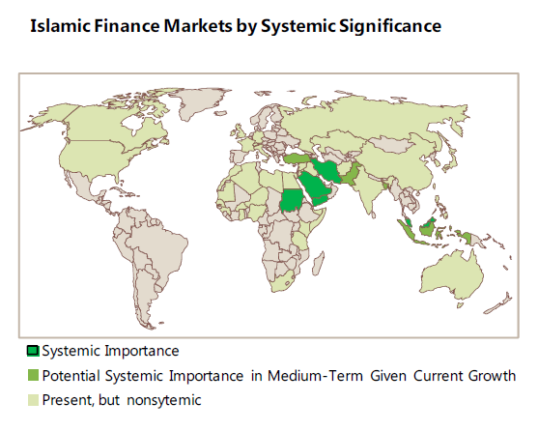
Geographic Distribution of Islamic Finance
Islamic Finance: Opportunities, Challenges, and Policy Options, IMF Staff Discussion Note No. 15/05

Slide 6
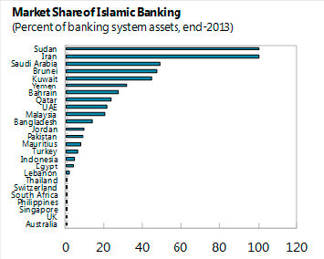
Market Share by Country
Islamic Finance: Opportunities, Challenges, and Policy Options, IMF Staff Discussion Note No. 15/05

Slide 7
Islamic Financial Institutions vs. Conventional Financial Institutions
IFIs differ from conventional FI in several ways.
  Conventional FI operate on the basis of borrowing and lending with pre-specified interest rates
  Islamic banks are funded by current accounts that do not attract interest or by profit-sharing investment accounts (PSIA) where the account holder receives a return that is determined ex-post by the profitability of the banks.

Slide 8
Islamic Financial Institutions vs. Conventional Financial Institutions
But to a large extent, IFIs also act like conventional FI by issuing deposit-like instruments ( such as PSIA) to the public in order to raise funds to finance commercial activity.
On the asset side, the activities of IFIs range from sale-based contracts to leasing and limited partnerships. The IFIs also make investments in equities, mutual funds, and medium- to long-term projects.

Slide 9
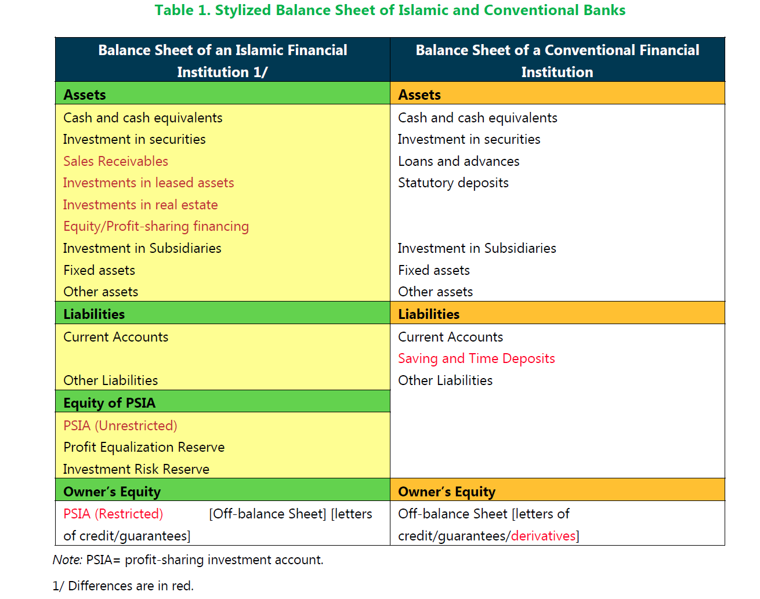
Islamic Financial Institutions vs. Conventional Financial Institutions
Islamic Finance: Opportunities, Challenges, and Policy Options, IMF Staff Discussion Note No. 15/05

Slide 10
Sources of Funds
As financial intermediaries, IFIs—like conventional FI—issue deposits (current, savings, and fixed-term deposits) or deposit-like instruments as their sources of funds.
  Qard, Wadiah, and Amanah deposits can be withdrawn on demand, at par, without penalty or restriction, and are generally usable for making payments by check, draft, giro order, or other direct payment facilities.
    classified as Transferable deposits if such deposits are directly usable for making payments by check, draft, giro order, direct debit, or direct payment facility. Otherwise, these deposits are classified as Other deposits.

Slide 11
Sources of Funds
Profit Sharing Investment Accounts(Mudaraba)
  A contract between investors and an IFI that, as a silent partner, invests the deposits in a commercial venture. Profit sharing of the venture is pre-determined on the basis of risk and return, and the IFI and investors share any profit generated from the venture.
  Could be:
    Restricted - the investor restricts the manner as to where, how, and for what purpose the funds are invested.
    Unrestricted - where the investor fully authorizes an IFI to invest the funds without restrictions as to where, how, and for what purpose the funds should be invested as long as it is deemed appropriate.
    Various types of unrestricted PSIAs – could be treated as other deposits or debt equities, depending on the type

Slide 12
Sources of Funds
Profit and loss sharing certificates and investment deposit certificates, such as Mudaraba certificates, are investors’ deposits that somewhat resemble shares in a company but do not provide a claim on the residual value of the IFI and participation in its governance. These instruments should be classified as Other deposits. If Mudaraba certificates are negotiable, they should be classified as Debt securities.

Slide 13
Sources of Funds - Islamic Bonds
Sukūk, also known as Islamic bonds and considered as alternative to conventional bonds, are investment certificates issued by IFIs as a way to obtain funding.
Key features:
  Should not involve elements of interest or excessive uncertainty
  Negotiable instruments
  Holders are entitled to share in the proceeds of the realization of the Sukūk assets—holders have beneficial claim on the underlying asset

Slide 14
Uses of Funds
IFIs invest money collected from investors in some commercial ventures by using either trading models or profit and loss sharing models.
Primary types of financing
  Murabaha contract - Similar to collateralized loans
    IFI purchases goods at the request of a client
    Client makes deferred payments that cover costs and an agreed profit margin for the IFI
    IFI handles payments to the supplier.
  (Qard-hasan) - return free financing made for social purposes.
    Debtor only required to repay principal.
    May pay a discretionary service fee that is not tied to the principal.

Slide 15
Takaful as a Form of Insurance
A Takaful is Islamic insurance that has emerged to complement IFIs, as an alternative form of conventional insurance.
Takaful was invented as an Islamic way of mutual assistance to deal with uncertainties (Al-Gharar). As in the case of conventional insurance, Takaful deals with both life and nonlife (general) insurance

Slide 16
Comments!

