Slide 1
Overview of the Implementation of National Accounts at Global Level
Herman Smith
UNSD
10th Meeting of the Advisory Expert Group on National Accounts
13-15 April 2016, Paris

Slide 2
Outline
Overview of the status of implementation of the 2008 SNA at global and regional level
Global implementation programme of the 2008 SNA
Ongoing discussion on the SNA research agenda

Slide 3
Status of implementation of the 2008 SNA
The implementation of the 2008 SNA is assessed in terms of:
Scope
Detail
Quality
Compliance

Slide 4
Implementation monitoring
For monitoring the implementation of the 1993 SNA the ISWGNA developed a set of six milestones to assess the scope of accounts that are compiled by countries.
These milestones were later supplemented by three data sets describing (a) minimum set of accounts that need to be compiled; (b) a recommended set of accounts; and (c) a desired set of accounts.
The quality of the national accounts dimension was assessed using the IMF quality assessment framework.
To assess the compliance with major 1993 SNA concepts the ISWGNA developed a set of questions.

Slide 5
Scope and Compliance Measures for the 2008 SNA
The elements of the scope and compliance measures used for the 1993 SNA were deemed to be adequate to also assess the scope and compliance for the 2008 SNA.
However, the need for more timely information to facilitate appropriate policy responses highlights the importance to include also the compilation of quarterly national accounts, which require some adjustments to the scope measure as reflected by the required data set measure.
The compliance questionnaire was adjusted to reflect the 2008 SNA concepts for determining the conceptual adherence to the 2008 SNA.

Slide 6
Global status of annual reporting
Almost all countries are reporting annual national accounts to UNSD, many countries with a time lag of more than one year.
Most countries currently compliant with the 1993 SNA and ISIC Rev. 3.1, with some countries using the 1968 SNA .
Many countries are not able to submit the minimum requirement data set (as defined by the UNSC) to the UNSD.

Slide 7
Number of countries reporting annually for the reporting period 2003 to 2014
7

Slide 8
Number of countries reporting annually and data availability
 | Total number of countries | Number of countries that replied to the UN-NAQ
 |  | At least once between 2010-2014 | NAQ 2013 | NAQ 2014 | 2014 data available
UN Member States | 193 | 183 (95%) | 165 | 166 | 119 (62%)
Developed region | 46 | 46 (100%) | 45 | 45 | 40 (87%)
Developing region | 147 | 137 (93%) | 120 | 121 | 79 (54%)

Slide 9
Reporting of Expenditure based GDP
Reporting of quarterly data | 2005 | 2015
Current prices and volume measures | 0 | 75
Reporting of annual data | 2005 | 2015
Current price | 109 | 164
Constant price | 93 | 145
Availability of annual data | 2004 | 2014
Current price | 46 | 105
Constant price | 40 | 96

Slide 10
Number of countries reporting annually and data availability
Notes:
10

Slide 11
Breakdown of base years

Slide 12
Number of countries compliant with the 1968, 1993 and 2008 SNA
 | Total number of countries | 1968 SNA compliant | 1993 SNA compliant | 2008 SNA compliant
UN Member States | 193 | 22 | 109 | 62
Developed region | 46 | - | 7 | 37
Developing region | 147 | 22 | 100 | 25
62 Member States have implemented the 2008 SNA
Some Member States have opted to introduce certain aspects of 2008 SNA in a gradual implementation of the 2008 SNA
12% of Member States still use 1968 SNA
83 Member States are implementing or partially implementing ISIC Rev. 4
Notes:
12

Slide 13
Scope of National Accounts
Milestone 1.GDP by Industry and Expenditure in current and volumes
Growth analysis
Milestone 2. GNI of Total Economy and Balance of Payments (current, capital and financial accounts) and GFS transaction accounts
Relations with the rest of the world (BoP) analysis
Milestone 3. For all institutional sectors: Production acc. For GG: Generation of income; allocation of primary income; secondary distribution of income, use of disposable income; capital and financial accounts
Productivity analysis and fiscal analysis
Milestone 4. For all institutional sectors: generation of income, allocation of primary income; secondary distribution of income, use of disposable income; capital and financial accounts
Income distribution analysis

Slide 14
Milestone 5. Production, income and use accounts, capital accounts and financial accounts for institutional sectors
Growth analysis, BOP analysis, productivity analysis, fiscal, income distribution analysis and investment-financing analysis
Milestone 6. All transaction and flows accounts plus balance sheets
Financing-debt analysis (Flow of funds) and vulnerability analysis (currency mismatches, maturity mismatches (roll-over of debt), capital structure (equity vs debt), solvency (assets over liabilities)

Slide 15
Milestones and MRDS
The detail of National Accounts is measured in term of Minimum Required Data Set (MRDS)
MRDS covers:
Milestone 1.GDP by Industry and Expenditure in current and constant prices
Milestone 2. GNI of Total Economy and Balance of Payments (current, capital and financial accounts) and GFS transaction accounts
Milestone 3. For all institutional sectors: Production acc. For GG: Generation of income; allocation of primary income; secondary distribution of income, use of disposable income; capital and financial accounts
Milestone 4. For all institutional sectors: generation of income, allocation of primary income; secondary distribution of income, use of disposable income; capital and financial accounts
Minimum required macroeconomic data set, annual institutional sector accounts up to net lending and also quarterly GDP and quarterly BoP

Slide 16
National Accounts Questionnaire
Tables | MRDS
Table 1.1 – 1.3 GDP by expenditure at current/constant prices Relations among product, income, savings and net lending aggregates at current prices | √
Table 2.1 – 2.3 Value added by industries at current/constant prices Output, GVA and fixed assets by industries at current prices | √ √
Table 3.1 – 3.2 GFCE by function at current prices Individual CE of HH, NPISHs, and GG at current prices
Table 4.1 – 4.9 Total Economy (S.1) at current prices Rest of the world (S.2) at current prices Non-financial Corporations (S.11) at current prices … | √ √
Table 5.1 Cross classification of Gross value added by industries and institutional sectors at current prices

Slide 17
Number of countries submitting the tables of the MRDS
 |  | GDPe C 1.1 | GDPe K 1.2 | GDPp C 2.1(2.4) | GDPp K 2.2(2.5) | GDPp detail 2.3(2.6) | IEA Total 1.3(4.1) | IEA RoW 4.2
UN Member States | 193 | 176 | 155 | 185 | 180 | 144 | 164 | 110
Developed region | 46 | 45 | 44 | 46 | 45 | 45 | 43 | 38
Developing region | 147 | 131 | 111 | 139 | 135 | 99 | 118 | 72
Notes:
17

Slide 18
Scope of National Accounts Statistics
 | Total number of countries | MRDS |  | Milestone Level
 |  | 6 or more tables | 7 tables | 1 or higher | 2
UN Member States | 193 | 131 (68%) | 101 (52%) | 176 (91%) | 157 (81%)
Developed region | 46 | 42 (91%) | 37 (80%) | 45 (98%) | 43 (93%)
Developing region | 147 | 89 (61%) | 64 (44%) | 131 (89%) | 114 (78%)

Slide 19
Percentage of countries submitting the MRDS
Notes:
19

Slide 20
Implementation Programme for the System of National Accounts 2008 and Supporting Statistics
Global initiative to assist countries in developing statistical and institutional capacity to:
make the conceptual changeover from the 1968 or 1993 SNA to the 2008 SNA and
improve the scope, detail and quality of national accounts and supporting economic statistics
Based on agreed principles of the implementation strategy:
Strategic planning
Coordination, monitoring and reporting
Improving statistical systems

Slide 21
This is operationalized through 4 elements:
A strategic planning framework - the use of priority-setting national strategies for the development of statistics or similar national plans
Information structure based on the integrated economic statistics approach (standards, statistical production process, institutional arrangements) and internationally agreed scope (MRDS) and compliance for the national accounts and supporting economic statistics
Modalities of statistical capacity-building: training and technical cooperation, publication of manuals and handbooks, research and advocacy
Stages of implementation leading to the changeover to the 2008 SNA: Review, Adaptation and Application

Slide 22
Strategic planning framework
Global Strategic plan
Global strategy
Plans are in line with global strategy
e.g. NSDS
Regional plan
National Plan

Slide 23
Information structure
Integrated statistical systems
Modernization of statistical systems
Internationally agreed scope (Milestones), detail (MRDS), quality (DQAF) and compliance of the National Accounts

Slide 24
Integrated statistics
Scope of the statistics programme goes beyond the production of national accounts to also cover the statistical production process of basic statistics and to aspects of the institutional environment
It is, thus, based on an integrated statistics approach which
Produces statistics that present a consistent and coherent picture of economic activities for policy, business and other analytical uses
Uses common concepts, definitions, estimation methods and data sources for statistical reconciliation
Moves away from a narrow stove-pipe statistical production model to cross-functional holistic model

Slide 25
Integrated statistics
Building blocks
Common conceptual framework provided by the SNA
Institutional arrangements (legislative, organizational, budgetary, managerial and customer relationship arrangements) further support the environment for integration
Statistical production process as an integrated production chain from the collection of basic data to the dissemination of statistics

Slide 26
Integrated statistics approach
Integrated statistics
Silo approach
Agency A
Policy A
Info A
Data A
Agency B
Policy B
Info B
Data B
Agency C
Policy C
Info C
Data C
Indicators
Accounts
SNA and SEEA
Basic data
Economy Environment Social
Accounts to integrate statistics:
Linking policy needs and statistics
Understanding the institutional arrangements
Integrated statistical production process/chain and services
Consistency between basic data, accounts and tables and indicators
Notes:
26

Slide 27
Integrated statistics approach
Statistical operations
Outputs / Dissemination
Macroeconomic
accounts
Household and demographic statistics
Economic & environmental statistics
Inputs
Data integration
Data processing
Data collection
Registers and frames
Surveys
Statistical infrastructure
Standards and methods
Institutional setting
Information, Communication Technology (ICT)
Management and internal policy
Institutional arrangements

Slide 28
Modalities of statistical capacity-building
Training and technical cooperation
Publication of manuals and handbooks
Research
Advocacy

Slide 29
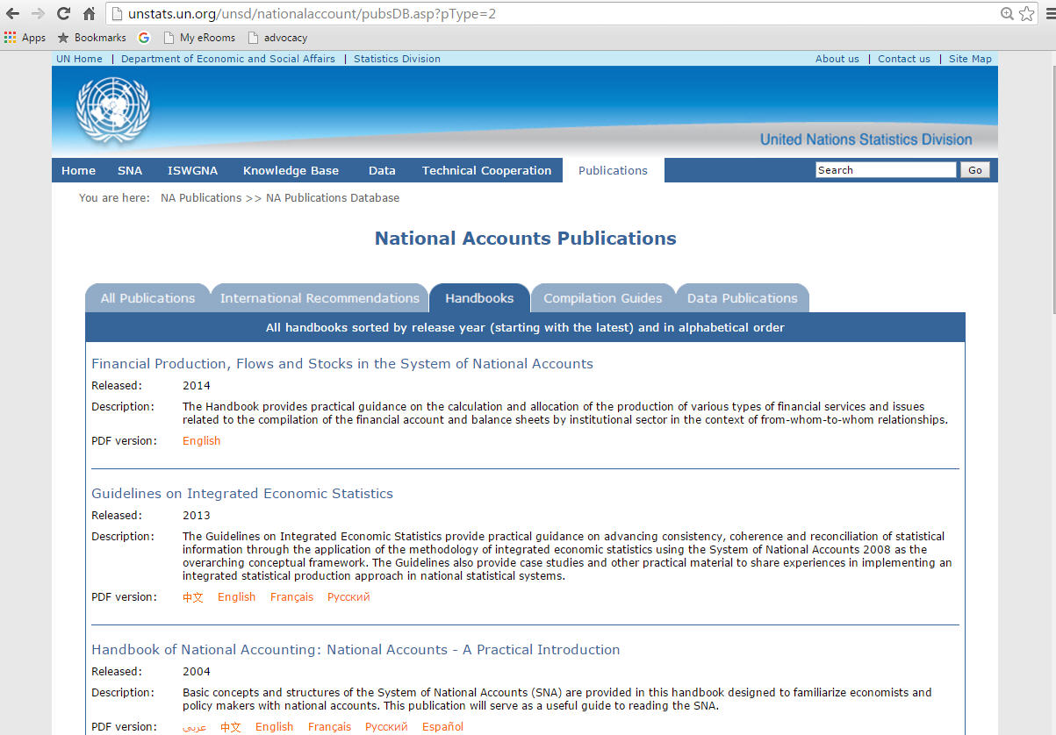
Publication of manuals and handbooks
Information on completed publications is available online at:
http://unstats.un.org/unsd/nationalaccount/pubsDB.asp?pType=2

Slide 30
Research
Advance the research agenda to provide further guidance on
Practical issues encountered in the implementation of the 2008 SNA
Methodological improvements to better measure existing and emerging economic realities
ISWGNA revise and update the SNA and develop supporting normative international statistical standards and other methodological documents on national accounts and supporting statistics
Advisory Expert Group (AEG) on National Accounts to resolve issues on the research agenda of the SNA and to review documents and tools for the SNA implementation.

Slide 31
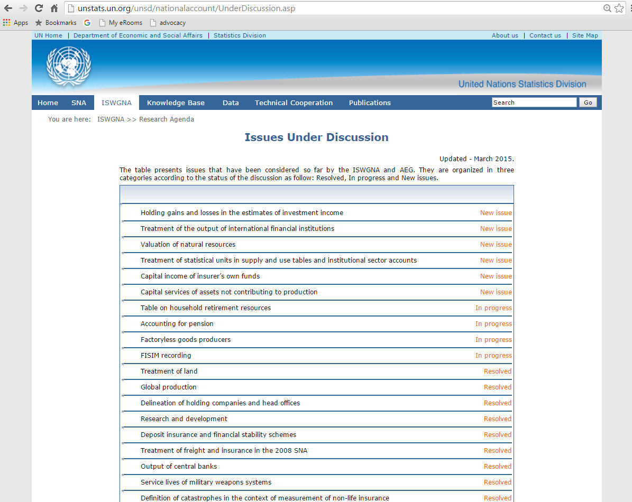
Research Agenda
Issues Under Discussion are available at: http://unstats.un.org/unsd/nationalaccount/UnderDiscussion.asp

Slide 32
Advocacy
To support an ongoing dialogue among statistical producers, the various levels of government, business sector, the academic community, and the general public about
user needs for official statistics and the progress in meeting those needs
the role of official statistics in evidenced based decision and policy making

Slide 33
Stages of implementation leading to the changeover to the 2008 SNA
Stage 1
Review of strategic framework and detailing of national and regional implementation programmes
Stage 2
Adaptation of classification, bus. registers and frames, surveys, admin. data sources and information technology infrastructure
Stage 3
Application of adapted frameworks and source data, backcasting and changeover to 2008 SNA
Country ownership

Slide 34
Conclusions
Importance of strengthening basic economic statistics
Importance of improving the national accounts in terms of scope, detail and quality
Importance of an integrated approach in the statistical system
Importance of coordinated efforts to implement the 2008 SNA at global, regional and national levels

Slide 35
Thank you!

