Slide 1
Data to Action
Gender Statistics Workshop August 2014 Maha Muna, Gender Adviser UNFPA Pacific Sub-Regional Office

Slide 2
Overview
Global – Regional – Country
What does the national VAW Prevalence data tell us beyond Headline Statistics?
Using VAW data to drill down and inform policy and programming around key issues – early marriage and teen pregnancy and VAW
Have we considered all women in the Pacific?
Notes:
UN is simultaneously addressing longer term economic development, conflict prevention and recovery as well as humanitarian issues at the same time in a country experiencing conflict.
Increased pressure & expectations on the UN in post-transition / post 2014 era.
UN taking on ‘its natural role’ ?
UN can help mitigate unpredictable future – to some extent.
Humanitarian scenarios – (humanitarian crisis, widened humanitarian –development gap)
“Schizophrenic” country situation

Slide 3
Prevalence of lifetime and current physical and/or sexual partner violence around the world (studies that used WHO methodology)

Slide 4
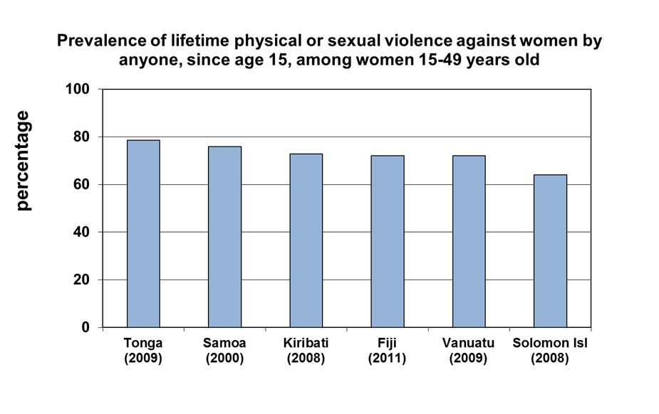
Gender-Based Violence

Slide 5
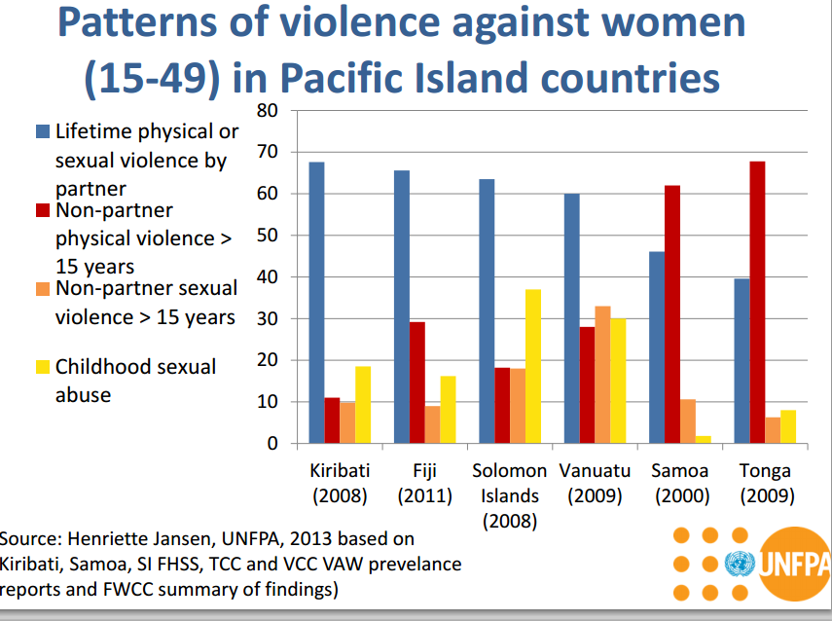

Slide 6
Health Seeking Behaviors
Majority (68%) of women repeatedly hit/hurt/sexually violated by partner. Of these:
26% ever injured reported injuries to eyes and ears
28% ever injured reported fractures or broken bones
15% ever injured reported loss of consciousness

Slide 7
Health Seeking and Referral - KIR
Of those who reported injuries as a result of partner violence, 46% reported being injured in last 12 months.
11% reported they had been hurt badly enough to need health care
Almost half (45%) of women who received healthcare had to spend at least one night in hospital due to injuries
Of women who received healthcare, most (74%) told the health worker the real cause of injuries

Slide 8
Reproductive Health & VAW
Of ever-pregnant women, 23% beaten during pregnancy. Of these:
17% severely abused, kicked punched in abdomen
Most had experienced abuse before pregnancy, but 37% reported first beatings started during pregnancy
Women who experienced violence were 1.6times more likely to report miscarriage.
Odds of having a child who died were 1.5 times greater among women who experience partner violence.
Integration of VAW during ANC Clinics

Slide 9
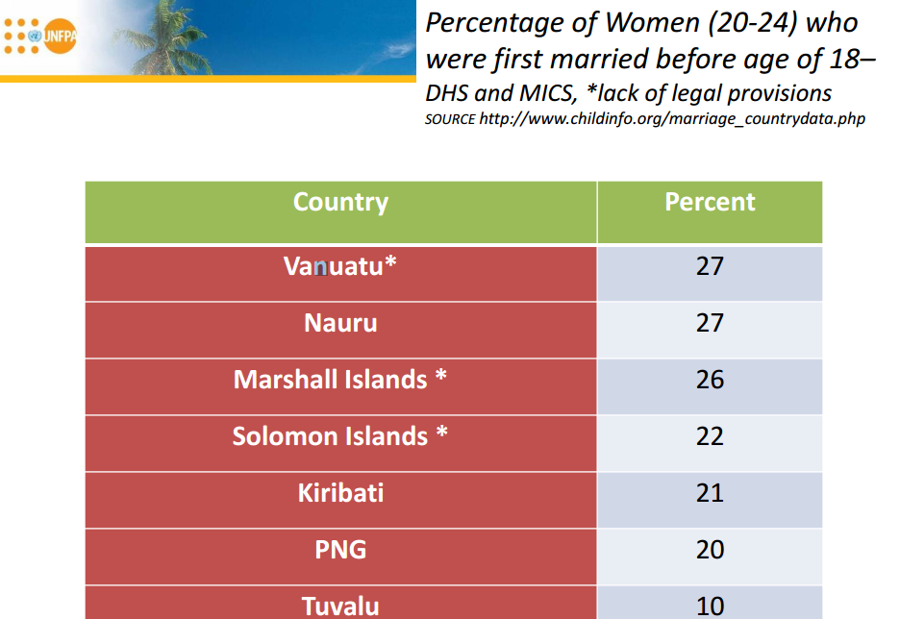

Slide 10
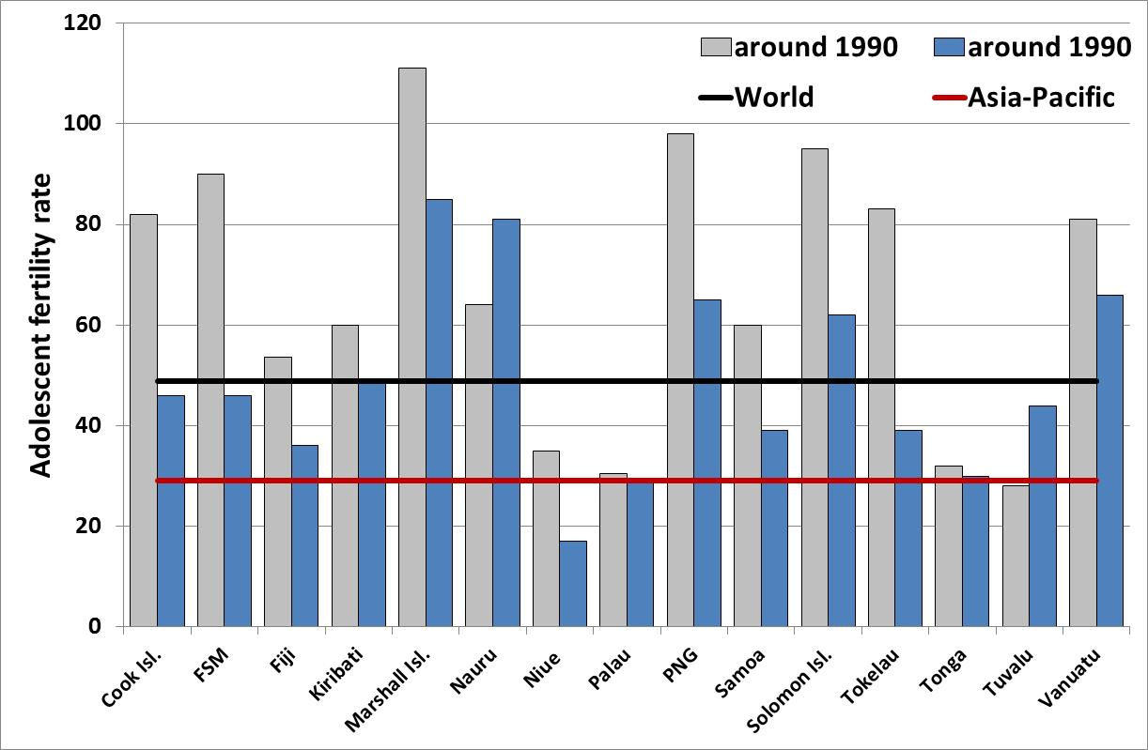
Teen Pregnancy in the Pacific
Notes:
Facts & Figures:
80% Afghans live in rural areas
GDP – 37% Agriculture-based economy; 26.3%, 42.1 (2008)
War-based economy
GNI per capita (USD) 370
4.6million voluntary returnees in 2002- end2010 period (25% of population) (UNHCR)
Worst place in the world to be a woman – according to several independent studies
14,000 / 100,000 Maternal Mortality Ratio
111/100,000 Infant Mortality Ratio
26% of >15 yrs olds literate - 12% women and 39% men; 82% female illiteracy
48% population has access to clean drinking water
37% population has access to safe sanitation
> 54% of Afghan children <5 yrs chronically malnourished; 34% under-weight
29% population consumes less than 2100 calories/day

Slide 11
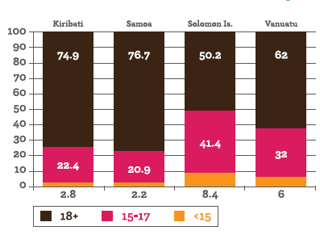
Percentage of women reporting their first sexual experience (by age at the time of the first sexual experience)

Slide 12
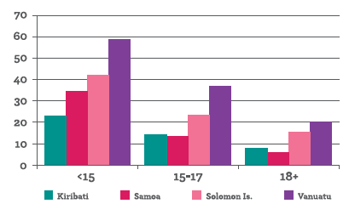
Frequency Distribution – First Sexual Experience was Forced (by age of first sexual intercourse)

Slide 13
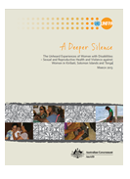
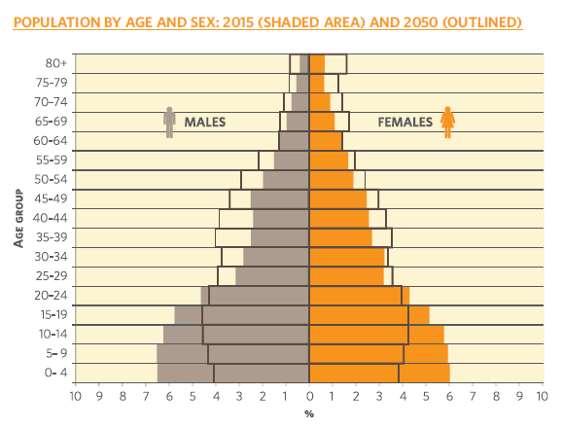
Women in their Diversity and Intersectionality

Slide 14
Thank you

