Slide 1
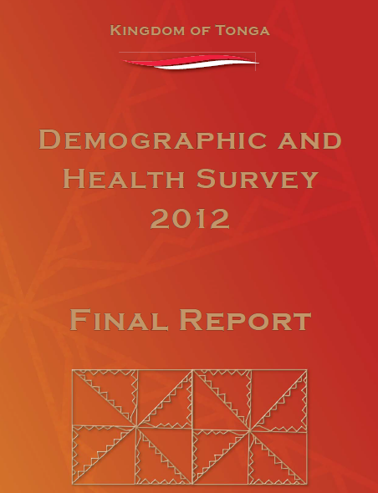
Gender Statistics & Human Rights Reporting
Regional Workshop 4-8, 2014
Tonga

Slide 2
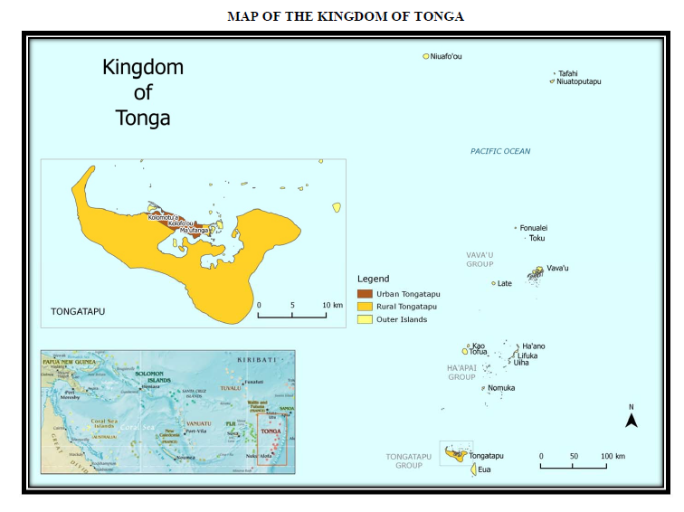

Slide 3
TONGA –DHS EXPERIENCE
Background to DHS
The survey was carried out by National Statistics and Ministry of Health
Financial assistance was provided by the ADB, UNFPA, Government of Australia and SPC for technical support
2,543 households was selected and 2,500 interviewed.

Slide 4
Cont’d
Only women aged 15 – 49 interviewed from every household (eligible 3,174 but 3,068 were interviewed)
Only men aged 15 years and over but only the second selected household (eligible1,855 but 1,742 were interviewed)
In 2012 DHS there are slightly more female than male in Tonga – sex ration 93 male per 100 females
Tonga’s population is characterised by youthful age structure, 39% of population aged < 15, 45% for 15 – 45, and only 16% for 50 and over

Slide 5
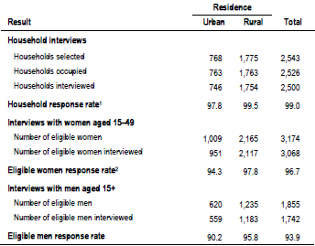

Slide 6
2. DHS Objectives
The primary objectives of this survey was to provide up to date information for decision makers, ………monitoring and evaluating population and health programs within the country.

Slide 7
3. Experience in carrying out Tonga DHS 2012
Planning
Questionnaire
Training
Fieldwork
Data processing
Report writing

Slide 8
4. Tonga DHS Result related to health
Fertility level and trend
Family planning and knowledge of contraceptives
Other proximate determinants of fertility
Fertility preference
Infant and child mortality
Productive health

Slide 9
Cont’d
7. Child health
8. Nutritional status of children and adults
9. HIV and Aids-related knowledge attitudes and behaviour
10. Women’s empowerment and demographic health outcomes….
11. Other (not in the report – disability, health expenditures, hardship for children & adults)

Slide 10
Conclusion
In 2012, Ministry of Internal Affairs launched Draft revised National policy on gender and Development.
The data outlined in Tonga – DHS is of relevance to key Gender and Development policy areas.
Some data outlined in the DHS is of relevance to Gender statistics.
The production of data disaggregated by sex to facilitate gender analysis
and development gender – based government policies and programmes.

