Slide 1
Asset Accounting
UNSD SEEA Training of Trainers Seminar
July 7-10, 2014, New York
Joe St. Lawrence
Statistics Canada

Slide 2
“Beyond GDP”
“Conventional economic aggregates generated through national accounting, such as GDP, do not reflect the extent to which production and consumption activities may be using up environmental assets and limiting the capacity for these assets to generate ecosystem services in the future.”
-TEEB Guidance Manual for Countries (2013)
OECD: indicators and reports: Green Growth and Material Flows and Resource Productivity
World Bank: Wealth Accounting and the Valuation of Ecosystem Services (WAVES)
Notes:
Metrics of performance: not necessarily flawed, but at a different scope. Economy in isolation vs bigger picture.

Slide 3
The Economy
-Natural Resources
-Ecosystem Services
-Residuals
and The Environment
Stocks
The
Economy
Flows
Expenditures

Slide 4
System of Environmental-Economic Accounts (SEEA) view
Industries
Final demand
Assets
Sectors
Financial and produced assets, opening balance
Natural resource assets, opening balance
Natural resource assets, opening balance
Industrial output of goods and services
Industrial intermediate demand
Final demand
Gross fixed capital formation
Environmental protection expenditures
Environmental protection expenditures
Capital expenditures for environmental protection
Commodities
Resource production by industries
Resource production by households/gov’t
Resource use by industries
Resource use by households/gov’t
Waste consumption by industries
Waste consumption by households/gov’t
Wastes
Waste output by industries
Waste output by households/gov’t
Other changes in volume & holding gains/losses on financial & produced assets
Changes in and holding gains/losses on natural resource assets
Changes in natural resource assets
Sectors
Financial and produced assets, closing balance
Natural resource assets, closing balance
Natural resource assets, closing balance

Slide 5
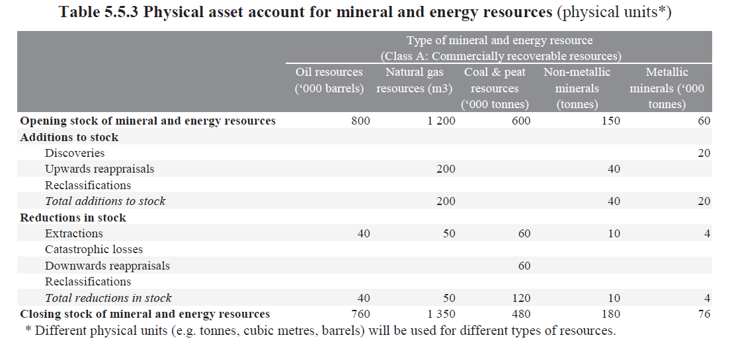
Accounting structure
Structure: conforms with a balance sheet structure - opening stocks, closing stocks and annual variations
United Nations, 2012, System of Environmental-Economic Accounting: Central Framework (white cover draft), New York. http://unstats.un.org/unsd/envaccounting/White_cover.pdf

Slide 6
Physical stock accounts: an example for crude bitumen

Slide 7
Monetary stock accounts: an example for crude bitumen

Slide 9
Calculation of resource rent
RR_{I} = TR - C - (r_{c}K + δ)
where: RR = resource rent (annual) TR = total annual revenue C = annual non-capital extraction cost (excluding taxes) δ = annual depreciation r_{c}K = return to produced capital

Slide 10
Valuation ― Numerical example
A | B | C | D | E | F | G | H | I | J | K | L | M | N | O | P
Crude Bitumen - 211114
 |  |  |  |  |  |  |  |  | Reserves under active development |  |  |  | 4.00% | = Discount rate
 |  |  |  |  |  |  |  |  | Physical accounts
 |  |  | GEOMETRIC
Year | Total revenues | Total production costs | Depreciation | Net capital stock | Rate of return | Return to capital | Total extraction costs | Resource rent | Opening Stock | Additions / Revisions | Depletion / Quantity of production | Closing Stock | Reserve life | Discount factor | Net Present Value
 | $ '000 | $ '000 | $ '000 | $ '000 |  | $ '000 | $ '000 | $ '000 | '000 m³ | '000 m³ | '000 m³ | '000 m³ | years | % | $'000 000
 | CAPP¹ | CAPP² | CANSIM 031-0002³ |  | Rate of return folder | (E*F) | (C+D+G) | (B-H) | (Mt-1) | (M-J+L) | AER ST98⁴ | AER ST98⁴ | (M/L) | (PV(N$2,N##,-1/N##)) | (I*N*O)/1000
1 | 10,000.00 | 4,000.00 | 100.00 | 10,000.00 | 0.02 | 200.00 | 4,300.00 | 5,700.00 | .. | 100,000 | 1,000 | 99,900 | 99.90 | 0.25 | 139.67
RR_{I} = TR - C - (r_{c}K + δ)
where: RR = resource rent (annual) TR = total annual revenue C = annual non-capital extraction cost (excluding taxes) δ = annual depreciation r_{c}K = return to produced capital

Slide 11
Valuation ― Net present value
Net present value (NPV) is the discounted value of future economic benefits from a given asset
Follows conventions adopted in the System of National Accounts to value capital assets
where: RR=resource rent T= reserve life, i.e. Closing stock ÷ extraction r_{i}= discount rate

Slide 12
Valuation ― Numerical example
A | B | C | D | E | F | G | H | I | J | K | L | M | N | O | P
Crude Bitumen - 211114
 |  |  |  |  |  |  |  |  | Reserves under active development |  |  |  | 4.00% | = Discount rate
 |  |  |  |  |  |  |  |  | Physical accounts
 |  |  | GEOMETRIC
Year | Total revenues | Total production costs | Depreciation | Net capital stock | Rate of return | Return to capital | Total extraction costs | Resource rent | Opening Stock | Additions / Revisions | Depletion / Quantity of production | Closing Stock | Reserve life | Discount factor | Net Present Value
 | $ '000 | $ '000 | $ '000 | $ '000 |  | $ '000 | $ '000 | $ '000 | '000 m³ | '000 m³ | '000 m³ | '000 m³ | years | % | $'000 000
 | CAPP¹ | CAPP² | CANSIM 031-0002³ |  | Rate of return folder | (E*F) | (C+D+G) | (B-H) | (Mt-1) | (M-J+L) | AER ST98⁴ | AER ST98⁴ | (M/L) | (PV(N$2,N##,-1/N##)) | (I*N*O)/1000
1 | 10,000.00 | 4,000.00 | 100.00 | 10,000.00 | 0.02 | 200.00 | 4,300.00 | 5,700.00 | .. | 100,000 | 1,000 | 99,900 | 99.90 | 0.25 | 139.67
t=1 | t=2 | t=3 | t=4 | … | t=100 | Total ($ '000)
5,481 | 5,270 | 5,067 | 4,872 | … | 113 | 139,678
=5700/(POWER(1.04,1)) |  |  |  |  | =5700/(POWER(1.04,100))

Slide 13
Questions?
Joe St. Lawrence
Environment Accounts and Statistics | Comptes et statistique de l'environnement
R.H. Coats Building | Immeuble R.-H.-Coats / Floor | Étage 25 M
Statistics Canada | 100 Tunney's Pasture Driveway, Ottawa ON K1A 0T6
Statistique Canada | 100, promenade Tunney's Pasture, Ottawa ON K1A 0T6
Joe.St.Lawrence@statcan.gc.ca
Telephone | Téléphone 613-951-7709
Facsimile | Télécopieur 613-951-0634
Government of Canada | Gouvernement du Canada

