Slide 1
Environmental Economic accounting in the Netherlands
Organisation, output and dissimination

Slide 2
Outline
Statistics Netherlands and environmental statistics
Organisation of the Dutch environmental accounts
Scope of the accounts
Main users
Dissimination and future projects

Slide 3
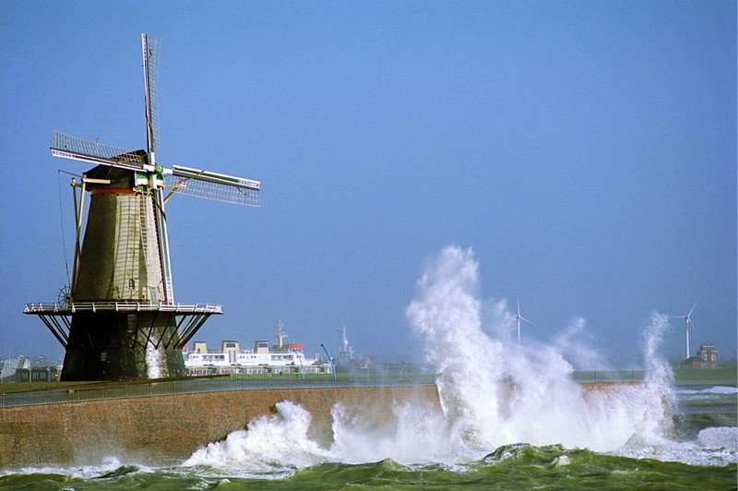
Statistics Netherlands
environmental statistics
and accounts

Slide 4
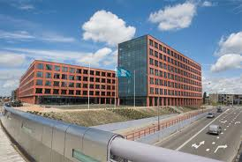
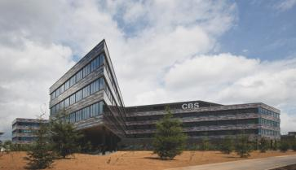
Statistics Netherlands
The Hague
Two offices
Heerlen
Ca. 1800 fte
Mission Statistics Netherlands:
‘To compile and publish undisputed, coherent, current statistical information that is relavant for the society, policy makers and science.

Slide 5
Environmental and energy statistics
Statistics Netherlands
Socio-economic
and spatial statistics
Economic and
business statistics
Data collection
Including
Environmental statistics
Biodiversity statistics
Land cover statistics
Energy statistics
Transport statistics
Agricultural statistics
including
National Accounts
Environmental accounts

Slide 6
Other national institutes involved
Ministry of the
environment
Ministry of
economic affairs
Statistics Netherlands
TNO
Water service
Environmental planning
agency (PBL)
ECN
RIVM

Slide 7
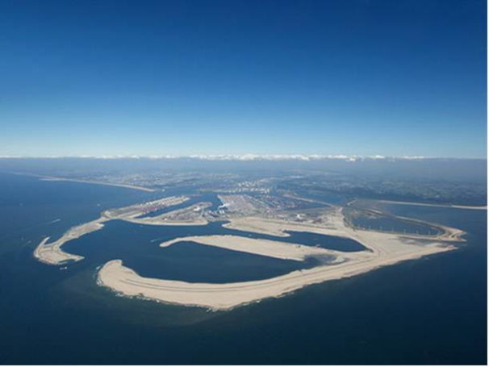
Organisation of the Dutch
environmental accounts

Slide 8
Short history…..
‘70s - ‘90s ⇒ Increasing interest in environmental issues ⇒ Development of NAMEA (National accounting matrix including environmental accounts)
⇒ Green accounting
2000-2011 ⇒ Development of several subaccounts: energy, water, environmental taxes etc.
2006: First publication on Dutch environmental accounts
2010: First publication in english

Slide 9
Organisation of the environmental accounts
Department of National accounts: ca. 90 fte
Environmental accounts: 7 fte (2014)
Activities: compilation, publication and development
No surveys: integration of existing statistics and accounts

Slide 10
Methodology
System of Environmental and Economic Accounts (SEEA-CF2012)
Eurostat compilation guides
Air emission accounts
Material flow accounts
Environmental expediture accounts
Environmental goods and service sector etc.
National reports on used methodologies

Slide 11
Most important data sources
National accounts (supply use tables, IO tables, labour accounts etc.)
Energy statistics (energy balances)
Emission inventory (emission to water, soil and air)
Government statistics
International trade statistics
Survey on environmental expenditure
Register data

Slide 12
Main users of the Dutch EA
Research institutes: Netherlands environmental assessment agency (PBL), National water institute, Energy research centre, etc.
Policy makers: ministries of economic affairs, environment and infrastructure
Business: Water producers, producers for environmental technology etc.
Eurostat
→ Legal base for environmental accounting

Slide 13
Focus in the Netherlands
Climate change
Greenhouse gas emissions → production and consumption based
Emission permits
Adaptation, mitigation expenditure
Water
Water quality : emissions to water, water quality
Water quantitiy: water flows and assets, valuation
Materials
Material consumption, recycling potentials, resource dependency
Green growth
Indicators for green growth
Environmentasl goods and service sector (EGSS)
Sustainable energy sector

Slide 14
Present status
Physical flow accounts and hybrid accounts
Energy flow accounts
Water flow accounts
Material flow accounts
Air emission accounts
Water emission accounts
Waste accounts
Asset accounts
Subsoil accounts for natural gas and crude oil
Monetary accounts
Environmental protection expenditure
Environmental taxes and subsidies
Environmental goods and service sector

Slide 15
2014 activities and projects
Implementation of SNA revision
Estimate physical supply - use tables for (critical) materials (Ministry economic affairs)
Expand water accounts with quality accounts; water balance; stocks; policy;
Improve Environmental protection expenditure accounts (Eurostat Grant)
Set up data import export EGSS (Eurostat Grant)
Pilot project for ecosystem accounts (develop land use accounts)
Update green growth data
Monitor Renewable Energy Sector

Slide 16
Dissimination and future plans

Slide 17
Dissimination
Statline (electronic database)
→ http://statline.cbs.nl/statweb/?LA=en
Website
→ http://www.cbs.nl/nl-NL/menu/themas/natuur-milieu/publicaties/milieurekeningen/default.htm
Data for Eurostat + reports
Several publications
→ annual publication on environmental accounts

Slide 18
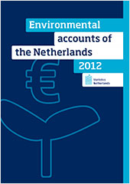
Publication Environmental acocunts in the Netherlands 2012
Energy
Water
Material flows
Waste
Air emissions
Water emissions
Oil and gas reserves
Environmental taxes
Environmnetal subsidies and transfers
Environmental expenditure
The environmental goods and service sector
Monitoring material flows
Emissions of carbon dioxide and sulphur dioxide between 1960 and 2012
Towards water quality accounts

Slide 19
Future work
Development of new accounts
1) Material flow accounts: RME
2) Ecosystem accounts
3) Renewable energy sector
Improvement of existing accounts (SEEA revision)
Environmental economic analyses

Slide 20
Conclusions: current challenges
Implementation of SEEA-CF
Improve quality of the accounts
Enhance the use of the accounts
Development of new accounts
Climate change and sustainability issues
Ecosystem accounting

Slide 21
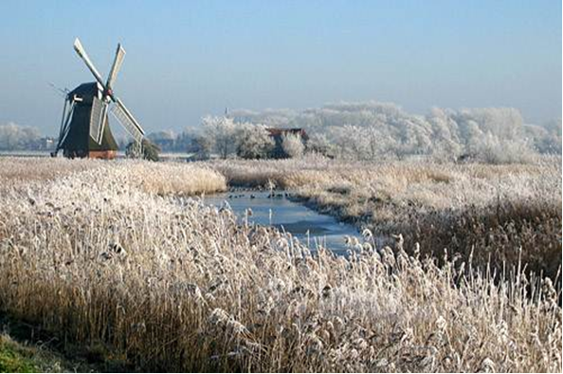
Questions ?

