Slide 1
Experimental Ecosystem Accounting (EEA): Introduction
Alessandra Alfieri
United Nations Statistics Division

Slide 2
Other water statistics
Energy balances
SEEA Central Framework
Systems frameworks
Output frameworks
SEEA-Water
SEEA-Energy
Intermediate frameworks
e.g. IRWS
e.g. IRES
Input frameworks
Compilation Material
Compilation Material
Cross functional frameworks
ISIC, CPC, Asset Classification, Class. of Environmental Activities, Class. of Physical Flows etc
Data
Data Quality Assessment Frameworks
Metadata and documentation (e.g. SDMX)
Notes:
2

Slide 3
SEEA-Experimental Ecosystem Accounting - Background
Complements SEEA Central Framework with focus on ecosystems perspective
Developed as part of broader process of revising SEEA 2003
Integrated system of information on distinct stocks and flows
Not a statistical standard but synthesizes current knowledge related to ecosystem services, ecosystem condition and related concepts
“Experimental” because significant methodological challenges remain and further testing of concepts needed

Slide 4
Relationship to SEEA Central Framework
Extends range of flows (production boundary) for accounting compared to SNA and SEEA in physical and monetary terms
Many flows from Central Framework also included in Experimental Ecosystem Accounting (e.g. flows of timber), but extension of EEA is to attribute flows to spatial areas
Some Central Framework natural input flows are excluded from Experimental Ecosystem Accounting (e.g. mineral and energy resources)

Slide 5
Interdisciplinary Approach
Conceptual model in ecosystem accounting draws from:
Ecology
Economics
National accounts
Statistical measurement

Slide 6
Why ecosystem accounts?
Information for tracking changes in ecosystems, such as degradation
Information for linking those changes to human activities and human well-being
Extends the scope of our information for analysis of impacts on the environment (and, thus, ultimately, on societies)
Information on ecosystem services and the trade-offs/co-benefits involved

Slide 7
What is an ecosystem?
dynamic complex of plant, animal and micro-organism communities and their non-living environment interacting as a functional unit
-UN Convention on Biological Diversity
Note:
Definition is independent of spatial scale
Ecosystems are inevitably interconnected or overlapping
Thus, the scale of analysis depends on the relationships we want to study , which, for ecosystem accounting, is primarily the relationships/flows between ecosystems and societies

Slide 8
Ecosystem Services as Flows From Ecosystem Assets
Individual & societal well-being
Benefits
SNA & non-SNA
Human inputs (e.g. labour, produced assets)
Ecosystem services
Ecosystem processes
Ecosystem characteristics
Intra-ecosystem flows
Inter-ecosystem flows
ECOSYSTEM ASSET
Notes:
8

Slide 9
Ecosystem Assets
9
Spatial area comprised of characteristics that are fundamental to analysis of ecosystems, such as:
Stocks and changes in stocks measured from 2 perspectives: ecosystem condition and ecosystem extent
“Operational” characteristics of an ecosystem asset
Structure (e.g. food web)
Composition (biotic and abiotic components)
Processes (e.g. photosynthesis)
Functions (e.g. resilience)
Contrast with “individual resources”

Slide 10
Spatial unit
10
Statistical units of ecosystem accounting are spatial areas
3 different types:
Basic spatial units (BSU)
Land cover/ecosystem functional units (LCEU)
Provisional classification provided in EEA
Ecosystem accounting units (EAU)
Based on purpose of analysis

Slide 11
Ecosystem Accounting Unit
LCEU type A
BSU
LCEU type C
LCEU type B
LCEU type A
11

Slide 12
Ecosystem Condition
Overall quality of an ecosystem asset, in terms of its characteristics
Land cover
Biodiversity
Spatial extent
Soil type
Freshwater
Altitude and slope
Climate
Condition (along with ecosystem extent) reflects changes to expected future flows of ecosystem services (capacity)
Many possibilities for suitable indicators of condition
Need to prioritize most relevant characteristics first
12

Slide 13
Example Accounting for Ecosystem Condition Characteristics
Note: key interest with these tables is particulary with evaluating the trends over time.
13

Slide 14
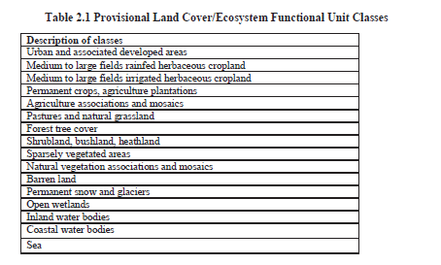
EEA, Chapter 2
14

Slide 15
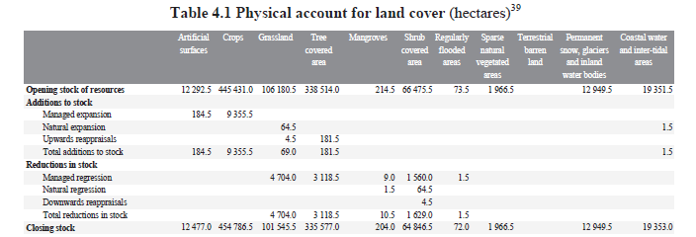
Land cover account
15
Equivalent to land cover account in SEEA Central Framework (Chapter 5)

Slide 16
Ecosystem Services
“are the contributions of ecosystems to benefits used in economic and other human activity”
“Contributions” because ecosystem services can be combined with other inputs (e.g. economic infrastructure) to provide benefits
In some cases the contributions may be equivalent to the benefit (where there are negligible other inputs)
Not all flows from the environment are ecosystem services
Excludes extracted minerals
Presence of human beneficiaries necessary

Slide 17
Ecosystem Service Types in SEEA- EEA
Provisioning
Material and energy contributions generated by or in an ecosystem (e.g., wood for fuel)
Regulating
Result from the capacity of ecosystems to regulate climate, hydrological and bio-chemical cycles, and other natural processes (e.g., flood control)
Cultural services
Generated from physical settings, locations or situations which give rise to intellectual and symbolic benefits that people obtain from ecosystems through recreation, relaxation, and spiritual reflection (does not require use)

Slide 18
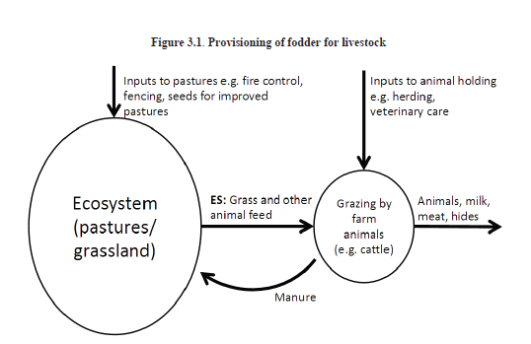
Provisioning Service Example

Slide 19
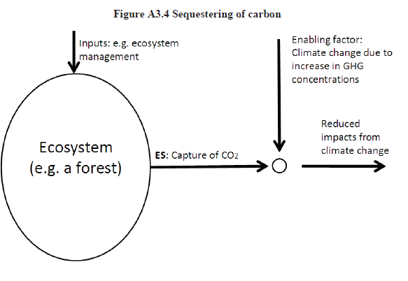
Regulating Service Example

Slide 20
Other Examples of Services and Their Benefits
Service example | Benefit example
Provisioning
Fodder (grass, herbs, leaves, etc.) | Livestock products
Freshwater | Crops
 | Drinking water
Fish | Fish
Regulating
Carbon sequestration | Climate regulation
Air filtration by vegetation | Cleaner air
Ecosystem regulation of water and soil erosion flows (e.g. landslide protection) | Protection of lives and property
Cultural
Ecosystems provide attractive spaces and landscape features | Recreation

Slide 21
Example Ecosystem Service (flow) Accounting

Slide 22
Areas for Development in EEA
Investigating spatial unit approach and “scaling up” and aggregation
Testing of models and tools for measuring ecosystem services and characteristics of ecosystem condition
Testing of classifications and measurement boundaries within the conceptual model (especially CICES and land classifications)

Slide 23
Total Economic Value Concept and Ecosystems
Total Economic Value
Use Values
Option Value
Non-use Values
Direct Use
Indirect Use
Existence Value
Bequest Value

Slide 24
Valuation of Ecosystem Services and Ecosystem Assets
Prices not directly observable in the market (no exact equivalent to SNA market prices)
Some prices and values embedded in market prices of marketed products (fish, timber, agricultural outputs) and marketed assets (land)
Non-market valuation techniques commonly used to place a value on the welfare impact of losing or gaining ecosystem services

Slide 25
Concept of Consumer and Producer Surplus
Supply
CS
P*
Price (P)
PS
Costs of Production
Demand
Q*
Quantity (Q)
CS = Consumer Surplus
PS = Producer Surplus

Slide 26
Valuation Consistent With National Accounts
Many non-market valuation methods estimate value of ecosystem service through ΔCS
Welfare-based concept of value
Welfare-based concept of value not equivalent to exchange concept of value of SNA
Exchange value considers all consumers paying price P* for quantity Q* of a good (so, P x Q equals producer surplus plus costs of production)
Under exchange value concept:
Total outlays by consumer = total revenue of producers

Slide 27
Valuation Approaches
Resource rent
Provisioning services (e.g. fish for harvest)
Markets established for regulating services (e.g. carbon)
Revealed preference methods (use values)
Production function approaches
Averting behavior
Replacement cost
Travel cost
Hedonic pricing
Stated preference methods (use and non-use values)
Contingent valuation
Choice experiments

Slide 28
SEEA-EEA Valuation Challenges
Which non-market methods can result in values consistent with national accounting?
How to aggregate values…
…within a single ecosystem?
…across ecosystems?
How to address uncertainty in valuation estimates?

Slide 29
Research agenda
Development of SEEA Experimental Ecosystem Accounting as a synthesis of developments across disciplines
Short development timeframe that did not aim to resolve all conceptual and methodological issues
Material presented to UNSC in February 2013
Draft SEEA Experimental Ecosystem Accounting
Draft Research agenda highlighting the need for continued testing and research
Current requirement to determine
Priority areas
Appropriate mechanisms, resources and links to related projects
Notes:
29

Slide 30
Key aspects of the research agenda
Must be multi-disciplinary
Not aiming at discipline specific measurement improvement (although these are important)
Must aim to cover multiple ecosystem types
Must incorporate both conceptual work and testing of definitions and methods
Must integrate effectively with existing projects and new initiatives
Should link with research agenda for the SEEA Central Framework and be associated with implementation of the SEEA Central Framework
Notes:
Many relevant initiatives might be cited here at the international and national levels. Ones that come to mind immediately are
CBD, TEEB, EU- MAES, IPBES, WAVES, etc
UK, Norway, Peru, Wentworth, Victorian Dept Environment, etc
30

Slide 31
Priority #1: Spatial units
Delineating appropriate spatial units and associated classification is central to effective progress
Units model generally accepted but is a blend of many perspectives and needs to be tested
Extensions to consider marine areas and the atmosphere are needed
Important to consider optimal links to geo-referencing of socio-economic data
Links to defining classifications for land use and land cover are important

Slide 32
Priority area #2: Methods for measuring ecosystem services and assets
Concepts and definitions described in SEEA Experimental Ecosystem Accounting
Less obvious exactly how to generate the data
Key considerations
How to determine the most important services and characteristics (don’t focus on only the measureable)
Linking physical flows of ES to beneficiaries
Advancing development of classifications
Determining reference/benchmark conditions
Incorporating measures of biodiversity
Variation in methods across ecosystem type

Slide 33
Priority area #3 : Presentation and structure
Concepts and methods need to be developed in the context of disseminating information
Accounting structures are only indicative in the SEEA Experimental Ecosystem Accounting text
Key considerations
Matching information requirements to concepts and methods
Approaches to linking ecosystem data to socio-economic data
Development of different dissemination techniques especially maps
Articulation of potential indicators

Slide 34
Priority #4: Linking to socio-economic data
SEEA’s objective is to bring environmental and economic information together
Challenge to ensure that the spatial scales used to compile ecosystem related data are aligned with those used for socio-economic data
Many developments on geo-referencing socio-economic data underway
Objective here is to examine ways to harness these developments and associated techniques around big data for use in accounting situations
Close links needed to delineation of spatial units

Slide 35
Priority area #5: Valuation of ecosystem services
This topic has much momentum in many places
Text of SEEA Experimental Ecosystem Accounting highlights some important considerations from an accounting perspective
Important to engage with economists to reach common understanding of potential methods and relevant assumptions
Important links also to developments at the corporate level in integrating values of ecosystem services in business accounting frameworks

Slide 36
Medium to longer term priorities
Accounting concepts
Degradation – valuation and allocation
Integration of ecosystem values into standard accounts and balance sheets (links to wealth a/c)
Treatment of expenditures on ecosystems (incl PES)
Connections between ecosystem services and ecosystem condition
Often seen as competing approaches
SEEA EEA sees clear links but they are complex and non-linear
Aggregation and ecosystem-wide indicators
Most challenging aspect: needs to build and combine all other research and testing work

Slide 37
Management and governance proposals
Recognise multi-agency requirements and harnessing existing knowledge
Technical committee under the auspices of the UNCEEA responsible for:
Coordinate and the advancement of the research agenda on the basis of lessons learnt from testing with the objective of developing best practices and in the longer term mainstreaming
Drafting practical guidance on how to
Organizing Forum of Experts (yearly)
Building connections and networks and putting SEEA Experimental Ecosystem Accounting on the agenda of other groups
Identification of research and testing opportunities
Future international conference (every 3 years)

Slide 38
Testing the SEEA Experimental Ecosystem Accounting
Initial stages, still experimental
High interest
On-going project UNSD, UNEP and CBD with testing in 7 countries
Bhutan, Chile, Mexico, Indonesia, Mauritius, Vietnam, South Africa

Slide 39
Thank You!
Alessandra Alfieri
alfieri@un.org
seea@un.org

