Slide 1

Implementation
of SEEA-Water
Regional Seminar on the System of Environmental-Economic Accounts in the Caribbean
6-7 February, Castries, Saint Lucia
UN Statistics Division
31 January 2014

Slide 2
Policy relevant information on water
Notes:
2

Slide 3
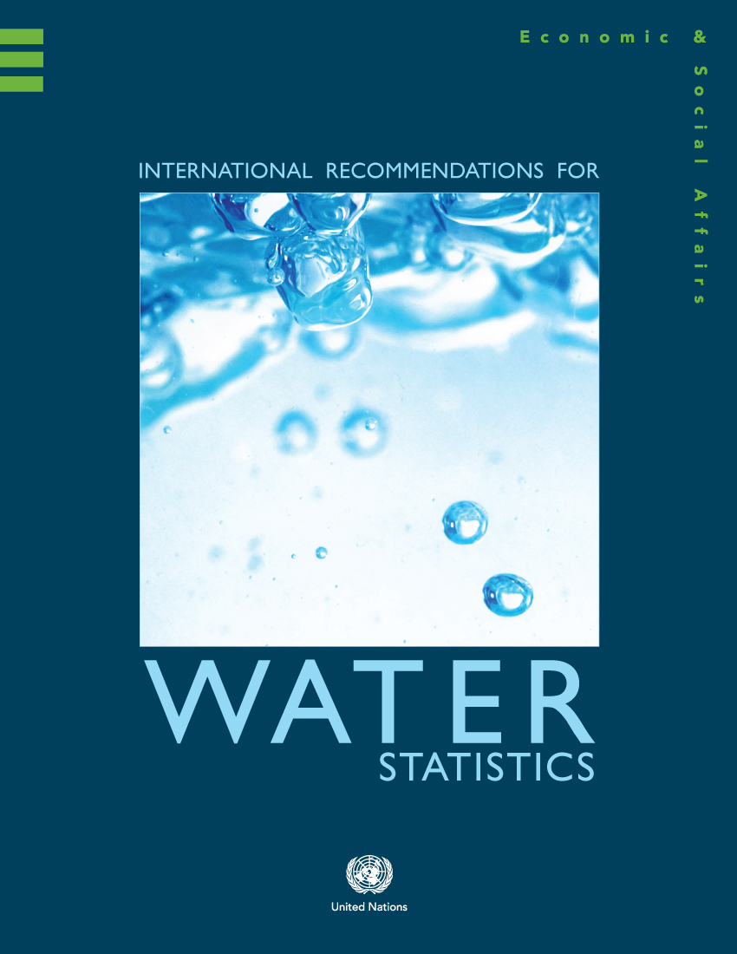
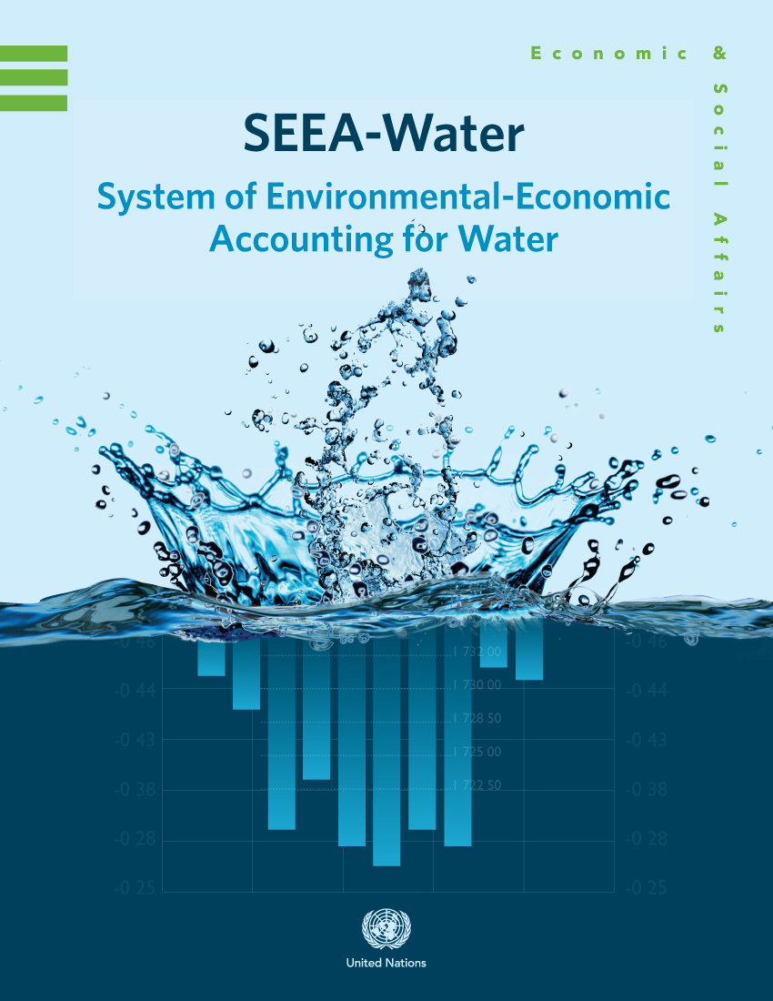
The SEEA-Water is a subsystem of the SEEA that covers the physical and economic stocks and flows associated with water. It also covers, to some extent, emissions of pollutants and water quality.
The International Recommendations for Water Statistics (IRWS) was designed to assist countries in the implementation of SEEA-Water. Guidelines are being developed to provide additional support.
The SEEA-Water and the IRWS provide the framework for developing information that is comprehensive, consistent, and comparable through time and space.
3
Notes:
SEEA-Water is divided into two main parts. Part I has been adopted as international standard, while part II remains still experimental, but could become a standard as more international agreement is built.
SEEA-Water is a statistical output framework since it provides the statistical framework to organize and integrate the information at the macro and sectoral level.
3

Slide 4
In general, water policy objectives can be grouped in the following four groups. Water security contributes to the attainment of higher level objectives.
I.
Improving drinking water and sanitation services
II.
Managing water supply and demand
Water Governance
III.
Mitigating water resources degradation/ Improving quality of water resources
IV.
Adapting to extreme hydro-meteorological events
SEEA-Water and IRWS respond to the need of measuring progress towards the attainment of the objectives in the four groups.
4
Notes:
4

Slide 5
The SEEA-Water is based on a model made of two subsystems: the economy and inland water resources. (Not all flows are shown in the figure).
Atmosphere
Rest of the World Economy
Rest of the World Economy
Economy
Precipitation
Imports
Exports
Evapo-transpiration
Outside territory of reference
Abstraction
Returns
Inland Water Resource System
Outside territory of reference
Abstraction
Inflows
Outflows
Sea
Sea
Notes:
SEEA-Water describes the hydrological system in terms of flows and stocks.
It includes the flows from the hydrological system to the economy and back from the economy to the hydrologic system.
The system can be applied to different geographical levels, which could be a river basin, a region or even a country. It is desirable to do it at the river basin level and integrate country accounts from basins.

Slide 6
The model in more detail. (Not all flows are shown).
Atmosphere
Rest of the World Economy
Evapo-transpiration
Households
Other industries (incl. Agriculture)
Precipitation
Rest of the World Economy
Imports
Water supply
Sewerage
Return
Exports
Economy
Abstraction
Return
Abstraction
Outside territory of reference
Soil water
Outside territory of reference
Surface water
Inflows
Groundwater
Outflows
Inland Water Resource System
Sea
Sea
6
Notes:
As seen in the detailed diagram, the hydrological system is modeled using three stocks: surface water, groundwater and soil water.
For the economy industries are classified according to the International System of Industry Classification (ISIC), where the water supply and sewarage industries are of special relevance.
Industries, like electricity, can be splitted into what has been called consumptive (water used for cooling of power stations) and non consumptive uses (hydroelectricity).

Slide 7

The SEEA provides a framework for transforming sectoral data into integrated policy-relevant information.
Sectoral Data
Integrated information
An integrated picture provides the basis for understanding the different ramifications in the decision-making process.
7
Notes:
7

Slide 8


The data required is usually incomplete, but provides elements for developing an integrated picture.
Sectoral Data
Integrated information
Integrating sectoral data for generating information starts a virtuous cycle for data improvement.
8
Notes:
8

Slide 9
SIDS example: Mauritius
Notes:
9

Slide 10
Statistics Mauritius, in partnership with the Water Resources Unit (WRU), the Central Water Authority (CWA) and the Wastewater Management Authority (WWMA) developed a draft first edition of water accounts.
The accounts integrate all the policy relevant information about water in one single document: water supply and sanitation, water resources management, waterborne pollution, floods and droughts…
The SEEA-Water and the IRWS provided the methodological basis for integrating a wide range of information from different sources.
10
Notes:
10

Slide 11
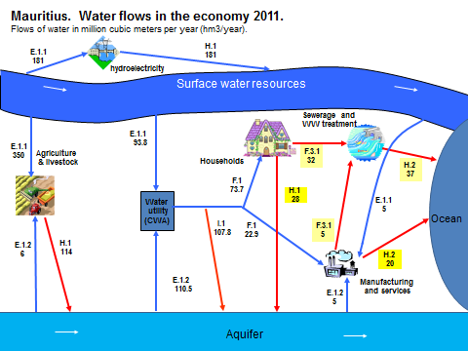
The accounts provide a bird’s eye view of the water flows in the economy of Mauritius.
The data available is organized in order to provide a coherent message .
All data available were integrated to create a complete picture. Gaps were identified, and more detail will be added as needed.
11
Notes:
11

Slide 12
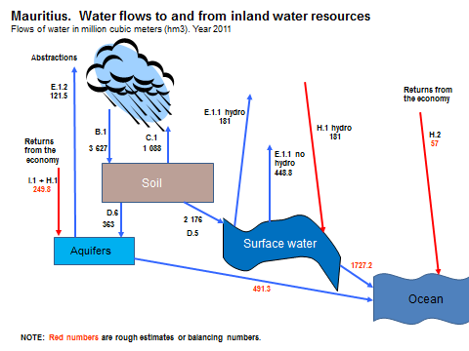
The accounts are also a useful tool for integrating information about the natural water cycle.
Simplified diagram of the natural water cycle of Mauritius.
Even a simplified version of the accounts using the scarce data available is useful for developing a comprehensive, comparable and consistent picture of the water cycle, useful for policy design and evaluation.
12
Notes:
12

Slide 13
From the accounts different time series can be produced and trends are identified using comparable information.
A wide variety of indicators can be developed based on standardized definitions.
13
Notes:
13

Slide 14
The SEEA-Water provides the basis for standardizing not only physical information, but also monetary data about water.
Monetary information is compatible with national accounts information.
14
Notes:
14

Slide 15
Monetary and physical data are seamlessly combined to understand interrelationships of economic decisions and environmental impact.
Indicators can be tailored for specific policy concerns having an impact in a whole variety of issues.
15
Notes:
15

Slide 16
A cycle of continuous improvement
Notes:
16

Slide 17
Countries implementing water accounts develop a self reinforcing loop in which better information creates the demand for better data, and in turn better data can generate better information.
Policy design
Implementation
Monitoring
(National Statistical System)
The virtuous cycle of continuous improvement is developed at sub-national, national and international levels.
17
Notes:
This archetype of continuous improvement provides the basis for a perfectible system.
17

Slide 18
Preliminary core tables and accounts for water

Slide 19
Reasons and mandate
Core tables provide concise, highly relevant information
Information is key to deriving indicators and aids in developing evidence based public policies
UNSC at its 44th session urged UNCEEA to develop a core set of tables and accounts
Water is a key resource; there is a high demand from many developed and developing countries for water accounts
Two core water tables are proposed

Slide 20
Building blocks to table 1
Core table 1 is composed of 3 major blocks
First block shown below—contains information on physical supply and use of water
Information is part of the physical supply and use table for water which contains more details
Codes correspond to data items from IRWS

Slide 21
Building blocks to table 1
Second block shown below—contains information on supply and use for water products in monetary terms
Information is part of the monetary supply and use table for water which contains more details
National accounts data can be used to populate table to the extent possible

Slide 22
Building blocks to table 1
Third block contains monetary information on water related assets
Information is relevant for a more complete understanding of the investment needs in the water sector

Slide 23
Core table 1-putting it all together

Slide 24
Core table 1
Countries can start by compiling information that is most policy relevant and focus on the any of building blocks to core table 1 if information on other building blocks is not readily available
Core tables are flexible in that if more detailed information is required, rows/columns can be further disaggregated as necessary.

Slide 25
Core table 2
Physical flows of water from/to environment
Part of the physical asset account for water
Focus on changes in stocks

Slide 26
Indicators
Core tables contain the necessary information for deriving numerous indicators on water
  Total renewable water resources
  Total abstractions by industry
  Intensity of use of water resources
  Water productivity/intensity indicators
  Investments in water infrastructure

Slide 27
Thank you!
Ivo Havinga (havinga@un.org)

