Slide 1
The London Group
Where do we go from here?
Joe St. Lawrence
November 12th, 2013

Slide 2
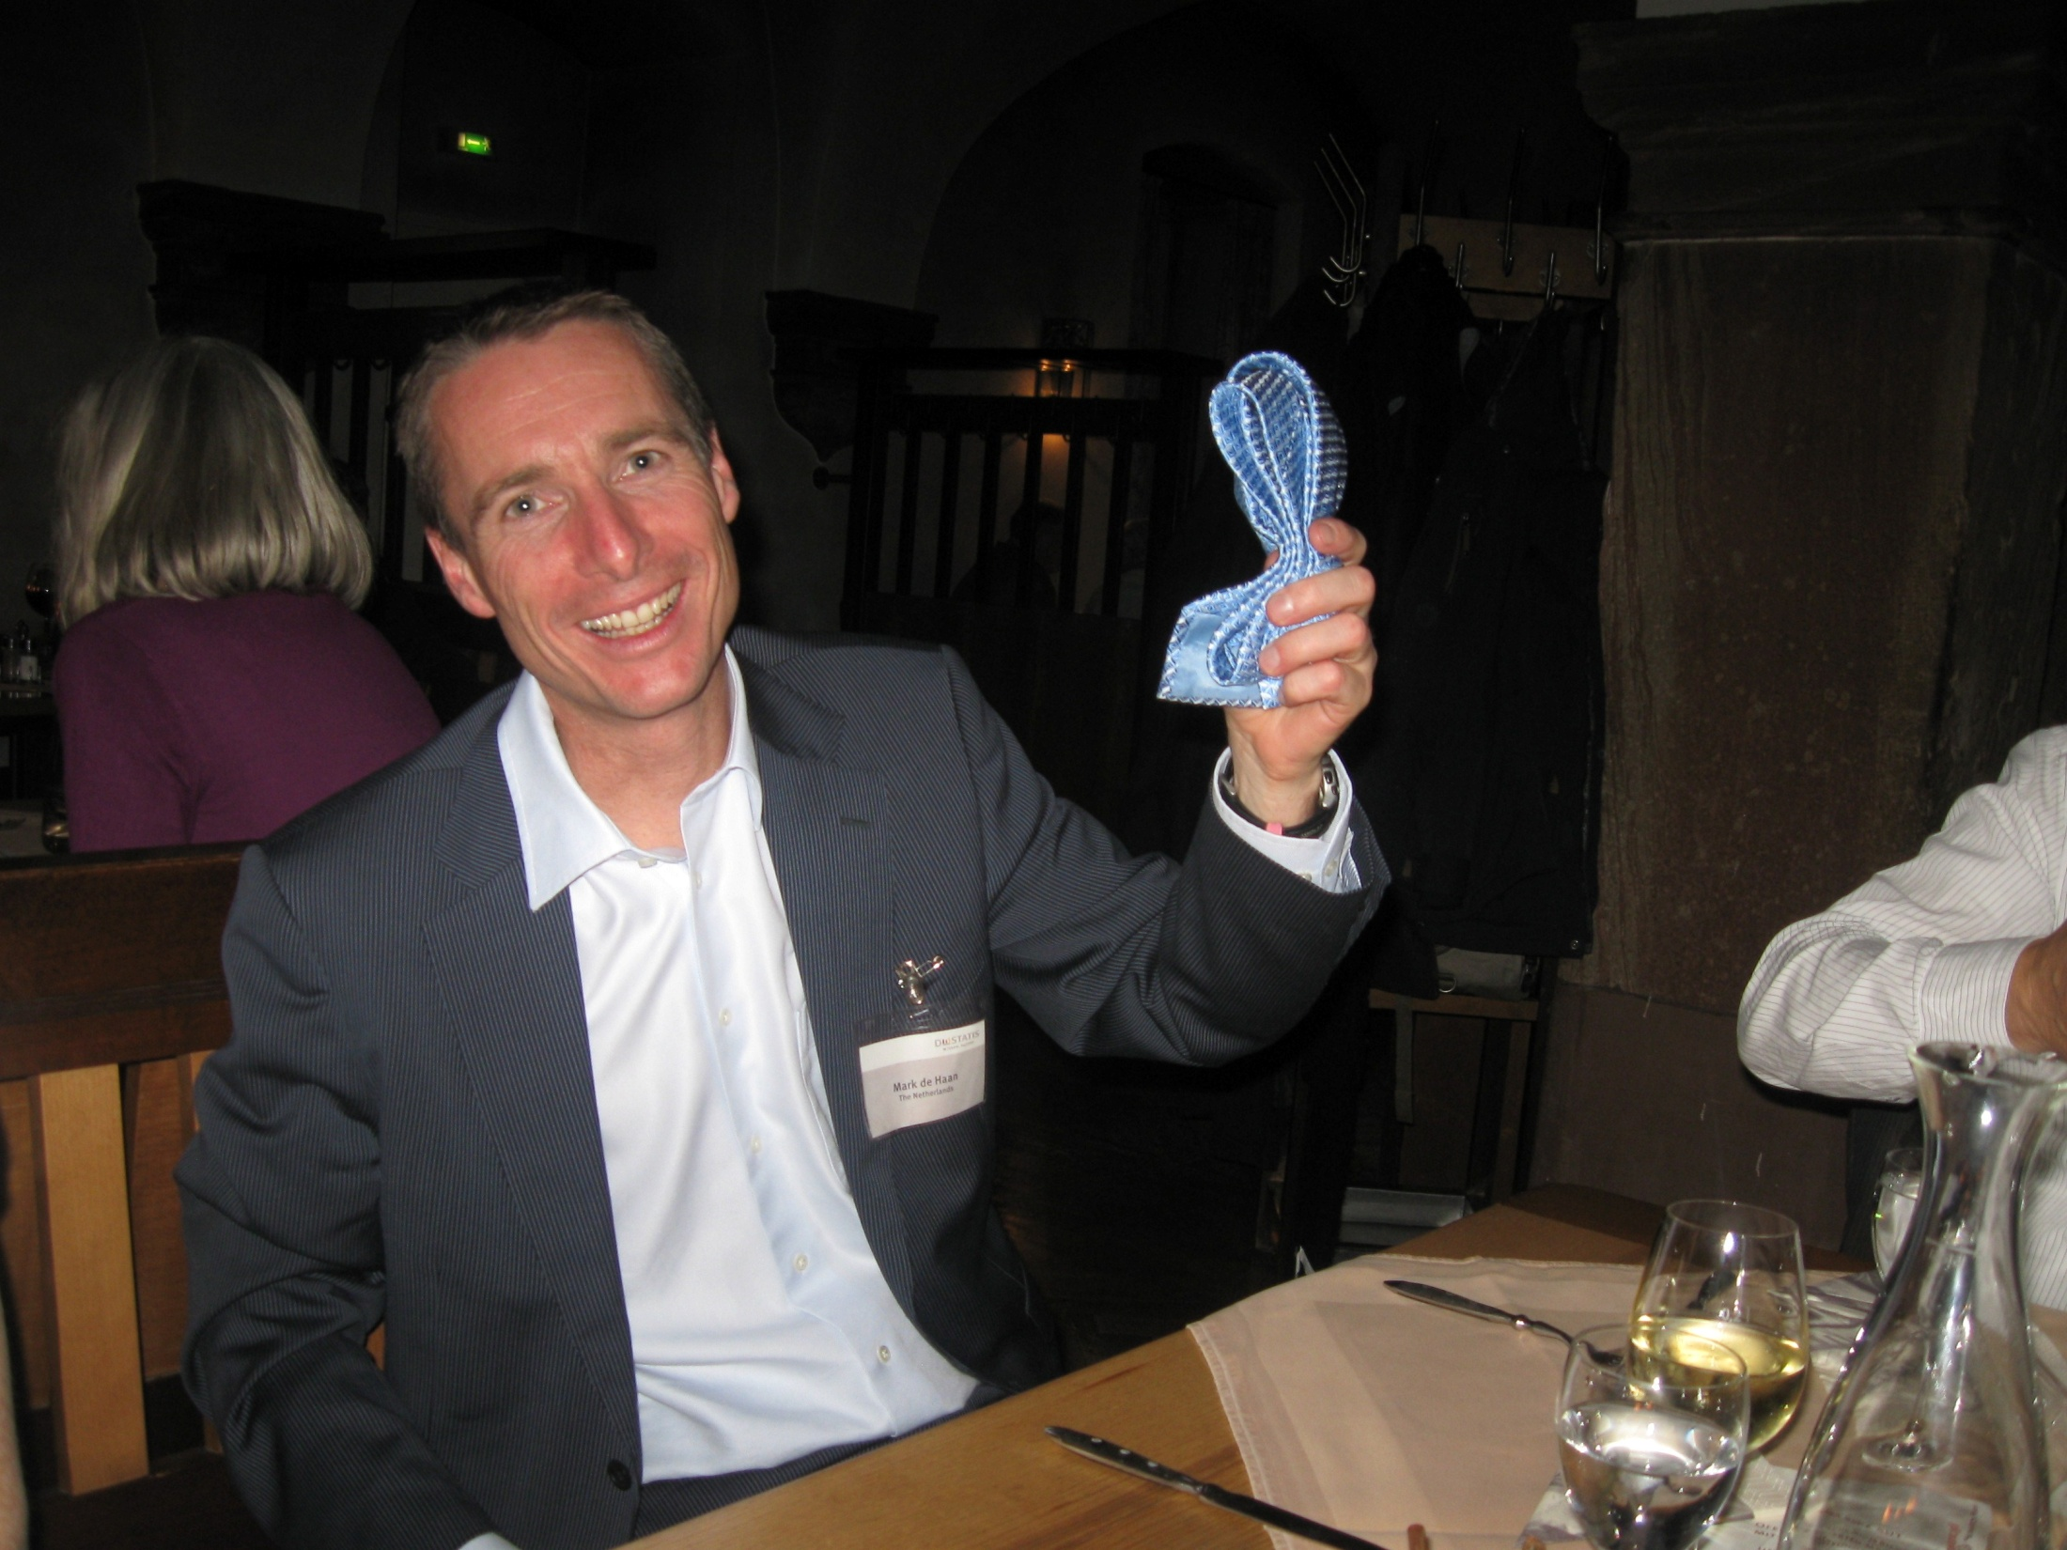

Slide 3
The London Group’s Objectives
(a) to play a leadership role in defining international best practices in the theory and practice of environmental accounting within the framework of the System of National Accounts;
(b) to provide a forum for the sharing of national and international expertise in this field; and
(c) to encourage the adoption of best practices in the field by promoting the results of the Group's efforts via proceedings volumes, concepts and methods manuals, operational manuals and other means.

Slide 4
The Chair’s Role
1. The Chair will develop the programme of work and related time schedule for the London Group, organize and develop the agenda for the meetings, facilitate the discussion during and in-between meetings, and ensure that the programme of work is implemented according to schedule.
2. The Chair in consultation with the London Group will evaluate requests made from the UNCEEA with regards to the participation of the London Group in working on UNCEEA work programme and research issues. For the areas accepted for further development by the London Group, specific project management plans to implement these areas will be developed.
3. The Chair, when formulating the programme of work of the Group, should seek a broad-based consensus with the members of the Group keeping in mind the past management style of the Group. The Chair should also consult the members of the LG on regular basis and develop an appropriate mechanism of reporting and consulting if necessary.
4. The Chair, in working out the programme of work of the LG and setting priorities for the Group, should strike a balance between the short-term research agenda of the London Group and the long-term perspective of the Group.
5. The Chair should seek input from leading developing countries to ensure appropriate developing countries’ participation in the activities of the Group. He/she will coordinate activities with the Chairs of other statistical entities to ensure consistency, coordination and cooperation.

Slide 5
The Chair’s Role
1. The Chair will develop the programme of work and related time schedule for the London Group, organize and develop the agenda for the meetings, facilitate the discussion during and in-between meetings, and ensure that the programme of work is implemented according to schedule.
2. The Chair in consultation with the London Group will evaluate requests made from the UNCEEA with regards to the participation of the London Group in working on UNCEEA work programme and research issues. For the areas accepted for further development by the London Group, specific project management plans to implement these areas will be developed.
3. The Chair, when formulating the programme of work of the Group, should seek a broad-based consensus with the members of the Group keeping in mind the past management style of the Group. The Chair should also consult the members of the LG on regular basis and develop an appropriate mechanism of reporting and consulting if necessary.
4. The Chair, in working out the programme of work of the LG and setting priorities for the Group, should strike a balance between the short-term research agenda of the London Group and the long-term perspective of the Group.
5. The Chair should seek input from leading developing countries to ensure appropriate developing countries’ participation in the activities of the Group. He/she will coordinate activities with the Chairs of other statistical entities to ensure consistency, coordination and cooperation.

Slide 6
UNCEEA’s Objectives
1. Mainstreaming environmental-economic accounting and related statistics;
2. Elevating the System of integrated Environmental and Economic Accounting (SEEA-2003) to an international statistical standard; and
3. Advancing the implementation of the SEEA at the global level.

Slide 7
SEEA-Central Framework Implementation
Technical notes, presentations, and training materials
Core tables
Research agenda
Outreach, promotion, technical assistance

Slide 8
SEEA-Experimental Ecosystem Accounting
Technical Expert Groups
Research agenda
Testing / pilot accounts
Coordination and linkages (Convention on Biodiversity, TEEB, Stiglitz, GDP and Beyond, etc…)

Slide 9
And…
SEEA – Agriculture
SEEA - ?
ESCM
Our own research and development questions
Our actual jobs
Managing workload is key
Coordination of international obligations is more key

Slide 10
The London Group
Lots of talent
Diverse practical experience
Devotion to subject matter
Willing to help
We see the connections and the big picture (importance of staying in the game on ecosystem accounts)
Open forum
(we’re all cows and pigs here)
History of success

Slide 11
So what’s next?
After this meeting, make recommendations to UNCEEA on:
Training materials
Technical notes
Core SEEA tables
Beyond this meeting:
Completing technical notes and work on core tables
Furthering the SEEA research agenda
LG role in Ecosystem Accounting
Etc...?

