Slide 1
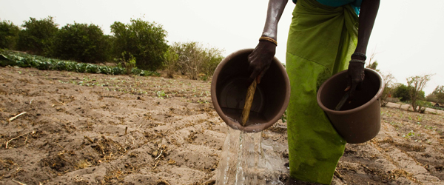
System of Environmental-Economic Accounting for Agriculture (SEEA-AGRI)
FAO
London Group meeting
12-15 November, 2013

Slide 2
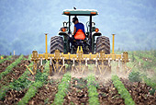
Background and context
Links within the broader SEEA implementation work program
FAO – Strategic Objective 2
“ Increase and improve the provision of goods and services from Agriculture, Forestry and Fisheries in a sustainable manner.”
Providing countries with a way of measuring the interactions between Agriculture and the Environment
Global Strategy on Improving Agricultural Statistics
Notes:
Key points
The update of the SEEA to become a statistical standard was a process that ran from 2007-2012
The outcome was the SEEA Central Framework that defined conceptual treatments and definitions for measuring the environment-economic relationships at national level.
The SEEA Central Framework describes accounts for various resources (eg. minerals, land, timber, fish, water) and types of physical flows (energy, water, emissions, waste)
SEEA Agri takes these standard accounts and adapts them such that the information they contain provides additional focus on agriculture, forestry and fishing activities
SEEA Agri is thus not a new standard but an application of the SEEA Central Framework

Slide 3
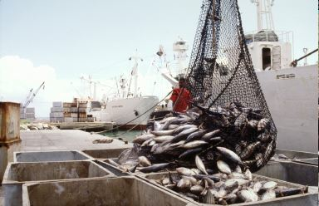
SEEA-Agri aims to link policy issues to data needs
• Enhancing the use of existing agricultural statistics and related common frameworks
• Providing a consistent, comprehensive, and coordinating framework to link data collected
• Providing a sound basis for the measurement of a set of economic, social, and environmental indicator
• Providing a framework to expand the analytical capabilities of the original FAO SEAFA (Economic Accounts for Agriculture)
•Providing a framework that links to other SEEA subsystems being articulated by other agencies.
Notes:
Key points
SEEA Agri doesn’t override the detail that will be present in source datasets
In that sense it provide an additional outlet for the use of data by combining data for individual themes with other data.
The use of common classifications and structures is important in building indicators since it ensures that the data feeding into the indicators are consistent and non-overlapping. For example in measuring the intensity of water use by dividing water use in agriculture with agricultural production it is important the scope of agriculture in both cases in the same.
SEEA is an accounting framework but not solely focused on monetary measures of value added, investment, etc. Accounting in the SEEA is applied to physical measures as well. Consequently the SEEA-Agri can be seen to extend the scope of the SEAFA by linking in physical measures related to environmental stocks and flow.
Ongoing work in a number of areas of the SEEA – particularly on water and energy and the SEEA –Agri because it takes an activity perspective is well placed to take advantage of these developments.

Slide 4
Coverage
Broad definition of agriculture: crops, livestock, forestry and fisheries with primary and intensive use of environmental goods and services
Different to the SEEA-CF focus, SEEA-AGRI focus on a group of activities
Linking production with
Full range of inputs: economic and environmental
Use and demand drivers (e.g. nutrition)
Notes:
Key points
The update of the SEEA to become a statistical standard was a process that ran from 2007-2012
The outcome was the SEEA Central Framework that defined conceptual treatments and definitions for measuring the environment-economic relationships at national level.
The SEEA Central Framework describes accounts for various resources (eg. minerals, land, timber, fish, water) and types of physical flows (energy, water, emissions, waste)
SEEA Agri takes these standard accounts and adapts them such that the information they contain provides additional focus on agriculture, forestry and fishing activities
SEEA Agri is thus not a new standard but an application of the SEEA Central Framework

Slide 5
SNA, SEEA-CF, SEEA-AGRI and FAO datasets
Notes:
The approach followed for the development of the FAOSTAT Agri-Environmental Indicators framework.
Key points
Although work is focused on FAO datasets this is, in fact, a proof of concept approach and the general idea of integrating information from existing datasets may be applied at national levels or in other situations.
There are many datasets. Not all data at all levels of details are required. For example for fisheries products there are over 1100 products in the full database but the aim for SEEA is to aggregate this to around 20 main groups.
As discussed earlier, the datasets in the right hand box on the slide are integrated using the concepts and frameworks of the SNA (System of National Accounts) and the SEEA-CF to generate the SEEA Agri based accounts
In total there look like being around 15 different base accounts to integrate information from the various FAO datasets.

Slide 6
Combined presentations and analytical possibilities
SEEA-Agri provides a combined presentation of information.
For example: analyse relationship between the production of wheat and
Inputs of water, fertilizer, pesticides, energy, etc;
Labour inputs;
Changes in land area and soil quality;
Generation of residuals – emissions, crop residues;
Use of assets – sowing and harvesting equipment;
Cost of production, value added and incomes
Notes:
Key points
The role of a combined presentation is to bring together the key pieces of information for a particular industry, product or process.
While it would be possible to go directly to the combined presentation – i.e. collecting only the information that are needed for the analysis, this approach does not ensure that the information is consistent with related information nor does it allow quick comparison of similar information for different products, industries or processes.
The example above is only for wheat but various groupings are possible in theory including for example,
groups of products – eg cereals, or crops for bioenergy
Types of farming practice – eg irrigation, aquaculture
Industry level – agriculture, forestry, fishing

Slide 7
Progress to date
Initial design of PSUT, asset accounts, land accounts and logic of combined presentations
Discussions on indicators and analysis
Commence proof of concept using FAO data
• Investigations of data availability within FAO datasets
Discussions on development of database
Notes:
Key points
The SEEA Agri base accounts are comprised of different types of accounts and listed in the slide
The key feature of the supply and use type of accounts (both physical and monetary) is that they apply the supply-use identity which means that what is supplied by one economic unit or the environment must also be received by another economic unit or returned to the environment. In this way all flows of natural inputs, products and residuals can be tracked.
The physical supply and use tables for crops and livestock are, in essence, a rearrangement of the information contained in food balance sheets of the FAO which balance production, imports, exports, human consumption and other uses for each type of crop and livestock product.
The environmental asset and land accounts follow the logic of measuring the opening stock at the beginning of a period, the closing stock at the end of a period and the changes over that time. These stock and change in stock entries must balance.
Ideally, the aim is to record the changes due to human / economic activity as distinct from natural changes but this can be challenging.
Overall, the role of the base accounts is to ensure that the data in each domain is structured in a consistent manner and that it is balanced and consistent with required accounting identities.

Slide 8
Next steps
Complete proof of concept project within FAO
Detailed review for data robustness, consistency with concepts, data gaps, etc
Developing analysis and indicators from the tables
Expert Group meeting
Seeking countries to also undertake “proof of concept”
Work with SEEA implementation, WAVES, Global Ag Strategy, UNCEEA, London Group
Notes:
Key points
Previous slides provide the broad model for SEEA Agri that is now being tested using FAO data
Good progress is being made but further work is required to check for consistency with accounting requirements, the extent to which data are available, and the types of analysis and consistent structuring of information that might be possible.
While a lot of information will be used in the SEEA Agri, in the initial phases there is no seeking of additional data – simply testing to see what is possible with currently available data – i.e. it doesn’t imply new surveys.
A report on data gaps and analytical potential will be develop early in 2014.
We are also looking for feedback on the general model, and suggestions for analytical directions and indicators that might be derived.
Hope also to pilot the SEEA Agri model in some countries – perhaps for specific parts of agriculture that are most relevant in a particular country – eg forestry, livestock production etc.

Slide 9
Contacts
robert.mayo@fao.org
carl.obst@me.com
seea-agri@fao.org
Notes:
Key points
We are interested to receive your feedback
THANK YOU

