Slide 1
The Integrated Business Statistics Program at Statistics Canada
Presentation to the UNCEEA
André Loranger
Assistant Chief Statistician – Economic Statistics
New York, June 2014

Slide 2
Outline
Harmonizing economic statistics that feed the System of National Accounts, Statistics Canada’s experience:
Corporate business architecture project
Early integration efforts
Project to Improve Provincial Economic Statistics (PIPES)
Unified Enterprise Survey Program(UESP)
Integrated Business Statistics Program (IBSP)
Facilitating further integration
Organizational alignment
Integrating environment surveys into IBSP

Slide 3
Corporate Business Architecture Project (CBA)
CBA Project
In 2008/09, Statistics Canada embarks on a large transformational project to renew its business and IT infrastructure
Objective
Generate efficiencies to be used for investment in priority projects
Outcomes
Consolidation of IT function
Organizational alignment with Generic Statistical Business Model (IT, Collection, Methodology, Analysis, Dissemination)
Several transformational projects to generate efficiencies

Slide 4
Early Integration Efforts...History
Business Survey Program
Multiple Frames
Inconsistent Methodology
Numerous Systems, Processes
Different Concepts
Program Specific Classifications
Limited Use of Admin. Data
Prior to mid 1990’s, the business statistics program is characterized by:

Slide 5
Early Integration Efforts PIPES
Fiscal Arrangements
Mid 1990’s: SNA data to be used in Fiscal Arrangements between Federal and Provincial Governments
Determine revenue generating equalization payments
Quality Improvements
Requirement for:
Expanded coverage of the economy...services
Establish PIPES
Project to Improve Provincial Economic Statistics
Unified Enterprise Survey Program
Allocate Harmonized Sales Tax revenue
Comparable quality of statistics by province
Expand GDP program to cover provinces (Provincial IO tables)

Slide 6
Early Integration Efforts UESP
UESP
Common Frame
Some Harmonization of Survey Content
Some common Processes and Classifications
Expanded Collection (#units)
Comparable Quality across Provinces and Industries
Extensive Use of Admin. Data
Characteristics of the UESP:

Slide 7
IBSP Current Drivers
UESP
Requirement for:
Operational efficiency
Reduced response burden
Improved quality and coherence
Modern and robust systems
IBSP

Slide 8
IBSP Scope of Project
Multi-year project, to develop new processing infrastructure and integrate existing surveys into the this infrastructure
Suite of approximately 150 existing business surveys covering manufacturing, services, retail, agriculture, capital expenditure, energy and R&D ; ad-hoc surveys as well
Will eventually encompass most business surveys conducted at Statistics Canada

Slide 9
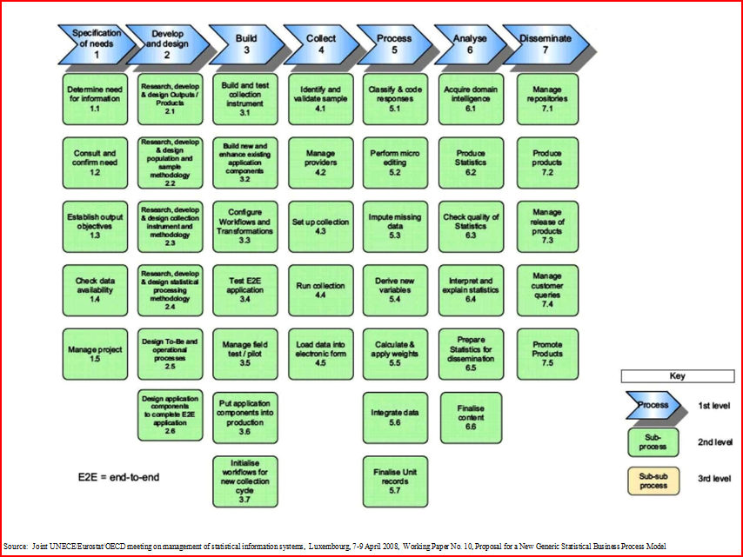
IBSP Generic Statistical Business Model
To successfully achieve integration across many programs and processes requires:
Continuous support from Senior leaders
Very strong governance over life of project
Extensive collaboration across the organization
Ability to negotiate and adapt: generic solutions have limitations

Slide 10
IBSP Horizontal integration
Mapping of Tax and Survey Variables
Common Frame
Common Classifications
Common Concepts
Transportation
R & D
Capital Exp.
Agriculture
Energy
Services
Environment
Dist. Trades
BOP
Other
Manufacturing

Slide 11
IBSP Vertical integration
Frame
Survey specific indicators (commodity/activity)
Sampling
Update directly on frame
Coordination
Collection
Common Editing Strategy
Edit & Imputation
Estimation
Target commodities with 2 phase sampling
Quality indicators
Analysis
Confidentiality
Harmonize output
Dissemination

Slide 12
IBSP Outcomes
Coherence
Output from different programs integrated into the System of National Accounts
Output from different programs comparable by users
Eliminates potential overlap in coverage and helps identify coverage gaps
Cost Effectiveness
Reduction in the number of systems and processes
Reduced Response Burden
Focus on administrative data, coordinated sampling, electronic collection

Slide 13
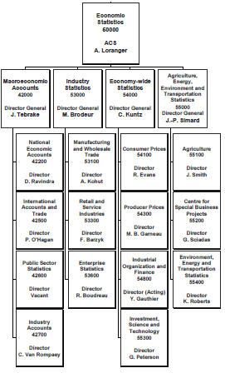
Facilitating further integration Organizational alignment

Slide 14
Facilitating Further Integration Surveys that feed Canada’s SEEA Accounts
Physical Flow Accounts:
Water use surveys for most major industrial sectors, agriculture, residences served by municipalities.
Energy surveys, Report on Energy and Supply and Demand
Transportation surveys
Solid waste survey (no account yet, but plan to develop pilot accounts within the next two years)

Slide 15
Facilitating Further Integration Integrating environmental surveys into IBSP
All environment surveys use Statistics Canada’s Business Register and adhere to NAICS/NAPCS.
Administrative data is used to generate statistics for household energy use – linked to the Household and Environment survey.
Currently developing a transition plan to move to electronic questionnaires and a suitable approach to integration in IBSP

Slide 16
Conclusion
CBA not just a project but new philosophy...a new way of doing business
IBSP is the single largest project for the economic statistics program with many links to other projects...good progress mid way through the transition, many positive outcomes including savings
Key ingredients to success:
Commitment, planning, oversight

Slide 17
Contacts
For more details on IBSP, please contact
Marie Brodeur, DG, Industry Statistics
Marie.brodeur@statcan.gc.ca
For more details on CBA, please contact
André Loranger, Assistant Chief Statistician, Economic Statistics
Andre.Loranger@statcan.gc.ca

