Slide 1
Data dissemination
Iain MacLeay – Head Energy Balances, Prices and Publications
Date 30 September 2011

Slide 2
Contents
IRES
UK practice
DECC energy statistics publications

Slide 3
IRES Chapter 10 - Dissemination
Official statistics should be made available to honour citizens’ entitlement to public information
Countries should have a clear dissemination policy covering:
  Scope of data
  Reference period and timetable
  Revisions policy
  Metadata
Policy to be user orientated reaching and serving all user groups

Slide 4
Confidentiality
Individual data collected should be kept confidential
Techniques should be employed to protect confidentiality
  Aggregation
  Suppression
  Controlled rounding or perturbation
Disclosure control

Slide 5
Confidentiality – cont.
But – rules to be implemented to promote access to data while ensuring confidentiality – so ensuring relevance of data.
  Confidential data to be reported in full at next higher level of aggregate
  Data which are publicly available are fully used
  Permission sought, with or without, time delay from concerned data reporters
  Passive confidentiality
  Publish confidentiality rules where data can be disseminated provided “excessive damage” not caused to concerned entity

Slide 6
Reference period and timetable
Countries should pre-announce and publicise dates for publication
Countries encouraged to release:
  Monthly data within 2 calendar months after end of reference period
  Quarterly data within 3 calendar months after end of quarter
  Annual data within 15 calendar months after end of year
Ideally though data released
  Monthly within 1 calendar month on specific flows and products
  Annual within 9 to 12 calendar months
Note: trade off between timeliness, reliability and accuracy

Slide 7
Revisions policy
Countries should develop a revisions policy
Provisional data should be revised when new and more accurate data become available
Two main types
  Routine revisions when new more accurate data become available
  Major / special revisions taking on changes in concepts, definitions, classifications and changes in data sources

Slide 8
Dissemination formats
Chosen to meet users’ needs
Electronic and/or paper formats
Metadata should be published
Sent to international organisations

Slide 9
Material Produced by the UK
Digest of UK Energy Statistics (DUKES)
Energy consumption in the UK
Energy sector indicators
UK Energy in brief
Energy Trends
Quarterly Energy Prices
Sub - regional energy data
Fuel Poverty report
UK greenhouse gas emissions
Local Authority carbon dioxide emissions
Plus regular briefings, input to PQs etc.

Slide 10
Statistics governance
DECC statement of compliance with the Pre-release Access to Official Statistics Order 2008
DECC energy statistics revisions policy
UK Greenhouse Gas Emissions Statistics: Revisions Policy
DECC’s timetable of statistical releases for twelve months ahead
Statement on quality strategy principles and processes
Customer service and engagement statement
Methodology notes detailing the surveys, data processes and data quality measures used in producing DECC's official statistics are published on the DECC Energy Sector Statistics web pages.

Slide 11
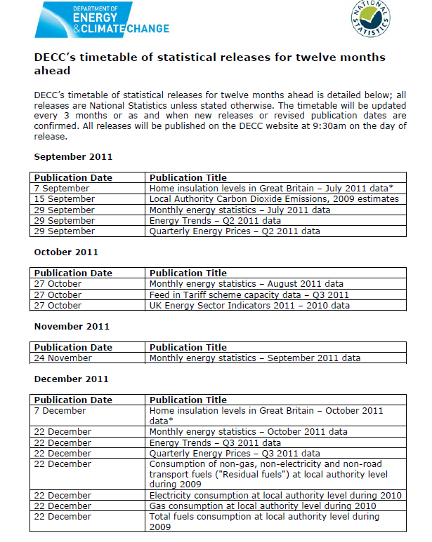

Slide 12
Digest of UK Energy Statistics (DUKES)

Slide 13
Energy Trends and QEP (Quarterly Energy Prices)

Slide 14
Energy in Brief and Energy Sector Indicators

Slide 15
Energy Flow Chart

Slide 16
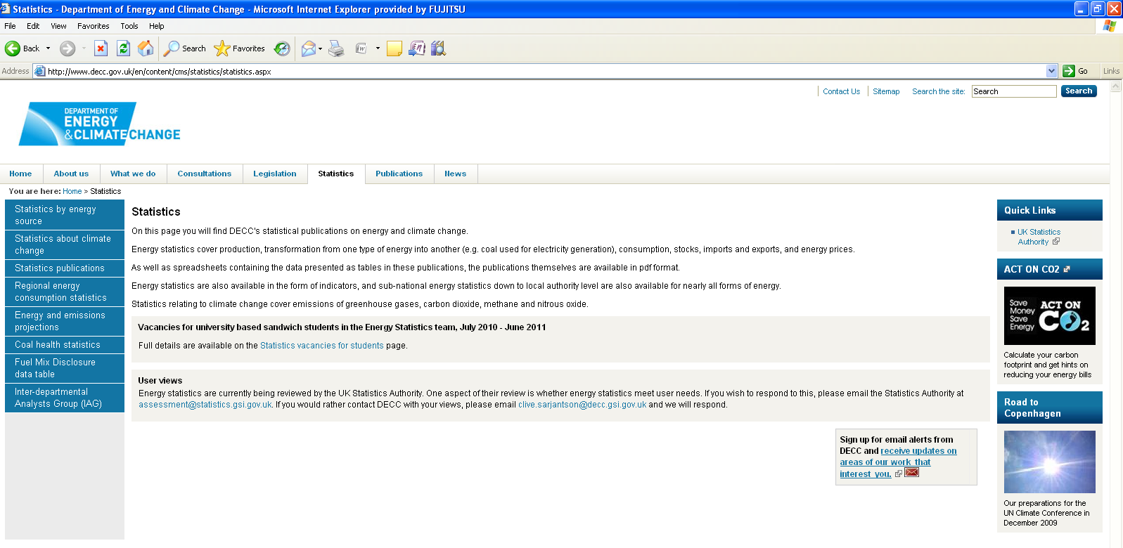
DECC website - http://decc.gov.uk/en/contents/cms/statistics.aspx

Slide 17
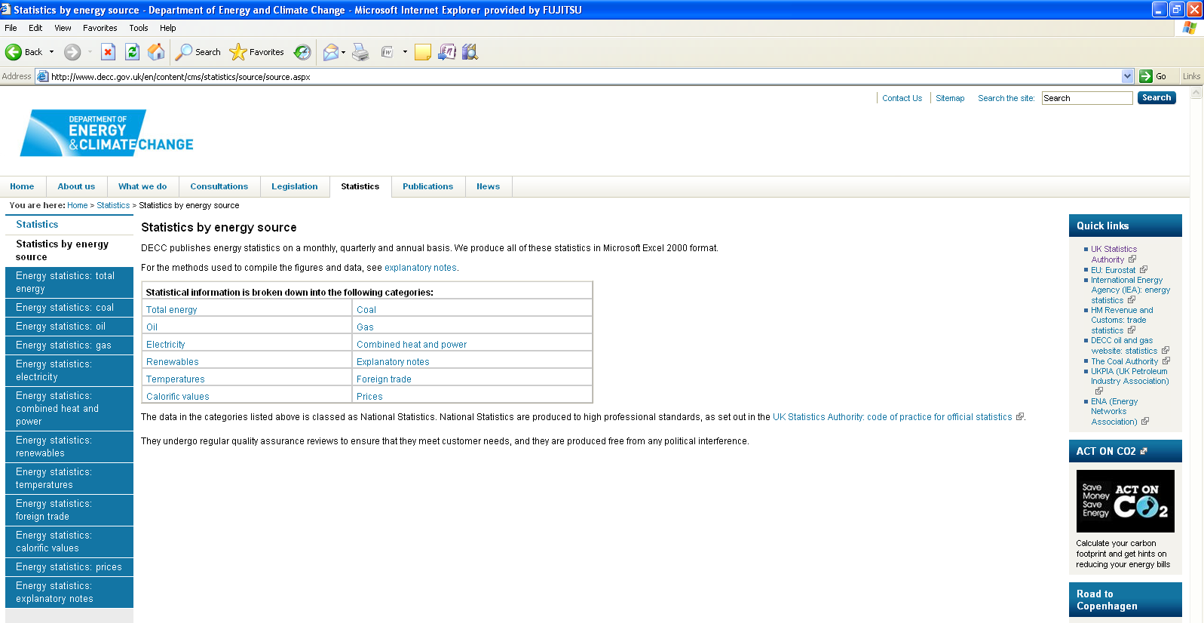
Publications - http://www.decc.gov.uk/en/content/cms/statistics/source/source.aspx

Slide 18
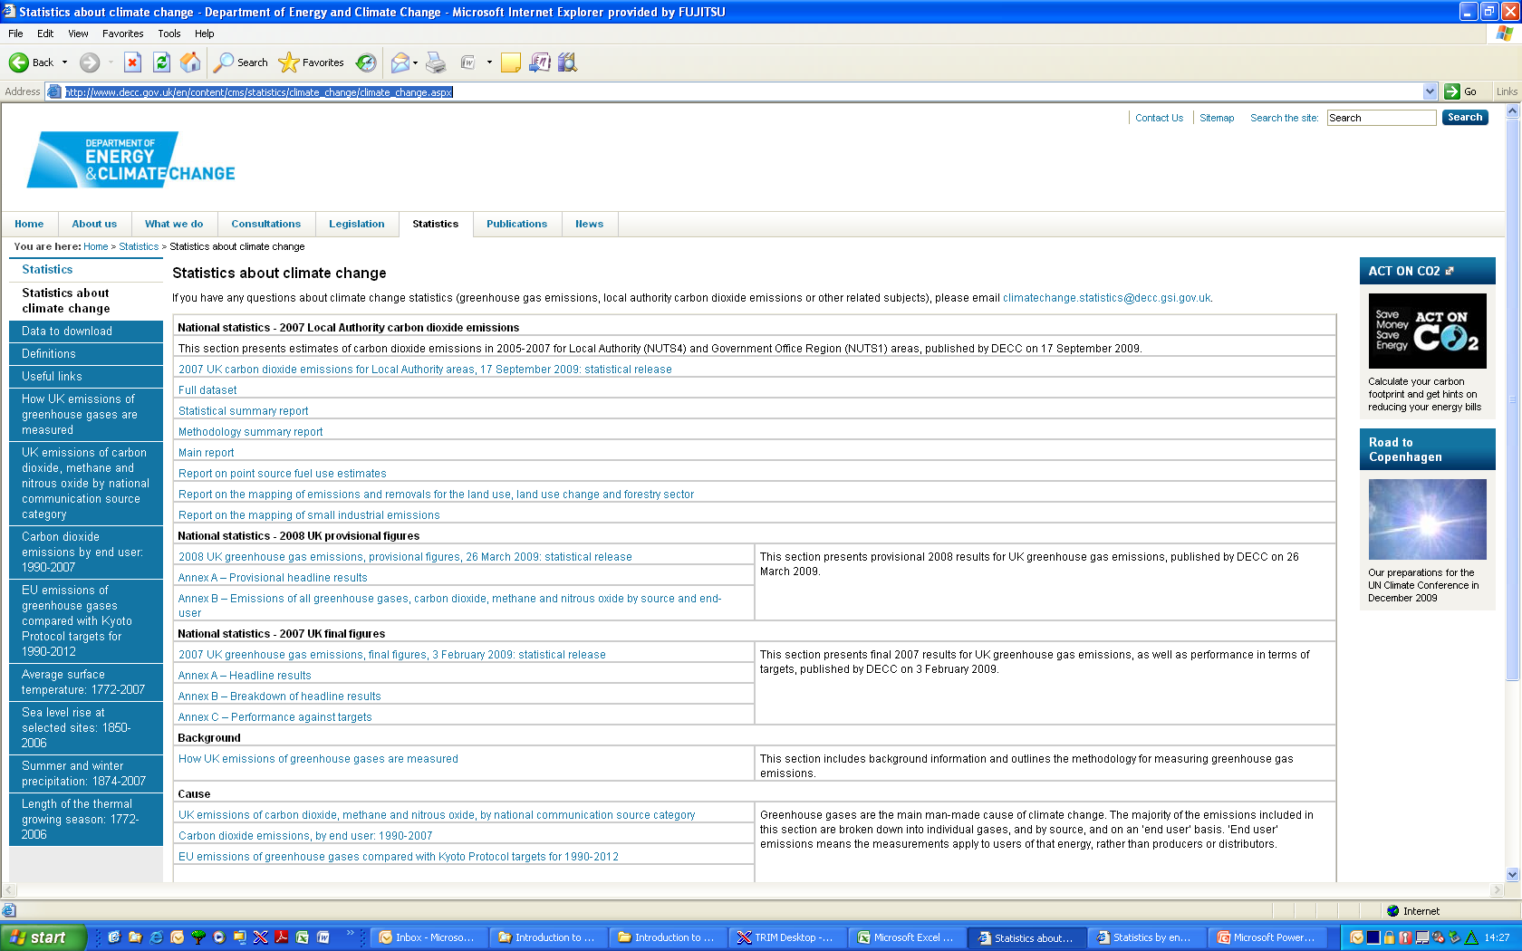
Statistics about Climate Change - http://www.decc.gov.uk/en/content/cms/statistics/climate_change/climate_change.aspx

