Slide 1
INTERNATIONAL WORKSHOP ON REGIONAL PRODUCTS & INCOME ACCOUNTS
13 – 17 MAC 2010
ESTIMATION OF GROSS DOMESTIC PRODUCT BY STATE IN MALAYSIA
DEPARTMENT OF STATISTICS, MALAYSIA

Slide 2
Contents
Background
Scope & coverage
Concepts
Compilation methods
Major findings
Issues & challenges

Slide 3
Background
Since 1970
End 2007
June 2008
July 2009
GDP by economic sectors has been produced for two states, Sabah & Sarawak since 1970
Evaluate potential data sources
Compilation begins for the years 2005 & 2006
Consultant, Dr Viet Vu Quang, review and evaluate the methodology
Review international best practice
Proposed methodology

Slide 4
Background (cont'd)
April 2010
Nov. 2009
Feb. 2010
First time released GDP by state for the years 2005 & 2006
Released data for the year 2007
Expected to release data for the year 2009
2011 Onwards
Plan to be compiled annually
Data released at constant 2000 price

Slide 5
Scope & Coverage
Compiled by kind of activity
Malaysia Industrial Classification 2000
Breakdown of industry only available to release at 9 industries
Industries

Slide 6
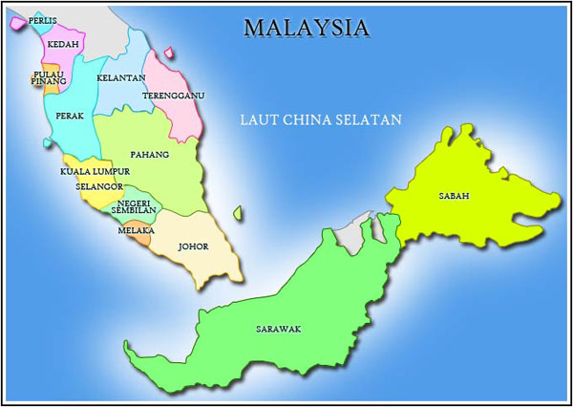
Scope & Coverage (cont’d)
States
SOUTH CHINA SEA
LABUAN

Slide 7
Concepts
Based on 1993 System of National Accounts
Adopted concepts used for the national estimates
Measured by using the production approach

Slide 8
Concepts (cont’d)
Resident
Allocates value added to the region where the production unit is resident
Economic territory
Any geographic area administered by States Government.
Supra State
Production activities that beyond centre of predominant economic interest for any states in Malaysia.
Allocates activity to the region where it takes place

Slide 9
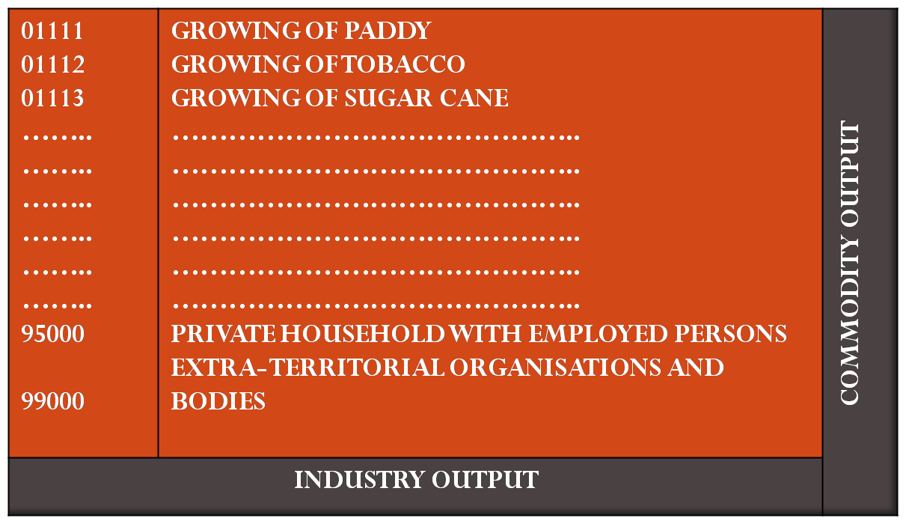
OUTPUT MATRIX: INDUSTRY BY COMMODITY BY STATES
Compilation Methods
COMMODITY
INDUSTRY

Slide 10
Compilation Methods (cont’d)
INPUT MATRIX: INDUSTRY BY COMMODITY BY STATES
COMMODITY
INDUSTRY

Slide 11
Compilation Methods (cont’d)
Bottom-up
Top-down
Censuses/surveys data and individual company accounts are used
Detailed data at establishment level is required
Allocates national level GDP estimates to states by using indicators
Applied to activities that operates across many states and the activities not reflected in the data by state available

Slide 12
Major findings GDP by State 2005-2007

Slide 13
GDP & PERCENTAGE SHARE BY STATE YEAR 2005, 2006 & 2007
RM Billion
2005
RM Billion
2006
RM Billion
2007

Slide 14
GDP GROWTH BY STATE YEAR 2006 & 2007
2006
2007

Slide 15
Issues & Challenges
Expertise
Needs to enhance the expertise.
Data limitation
Most surveys focused at national level
Limited of states indicators

Slide 16
THANK YOU

